Slide 1
Sense Me on the Ride:
Accurate Mobile Sensing over a LoRa Backscatter Channel
Haotian Jiang, Jiacheng Zhang, Xiuzhen Guo, and Yuan He
Tsinghua University
Notes:
Hello everyone. This is Haotian Jiang from Tsinghua University. Today I’m presenting Sense Me on the Ride: Accurate Mobile Sensing Over a LoRa Backscatter Channel.
My collaborators are Jiacheng Zhang, Xiuzhen Guo and my adviser, Yuan He.

Slide 2
Wireless Sensing
Wireless Sensing has become a key enabling technology for ubiquitous Internet of Things applications.
Acoustic
RFID
Wi-Fi
LoRa
mmWave
Notes:
Wireless sensing is a key enabling technology for ubiquitous Internet of Things applications.
In the past decade, we have witnessed a large body of studies on wireless sensing.
The wireless technologies for sensing range from acoustic, RFID and Wi-Fi to LoRa and millimeter-Wave.

Slide 3
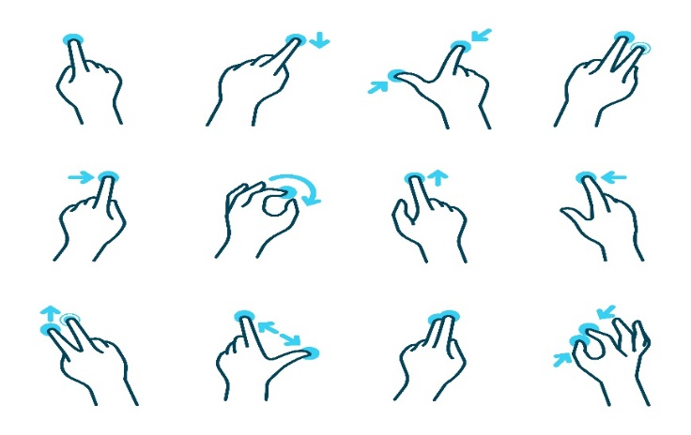
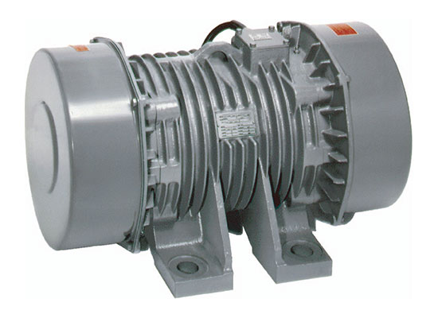
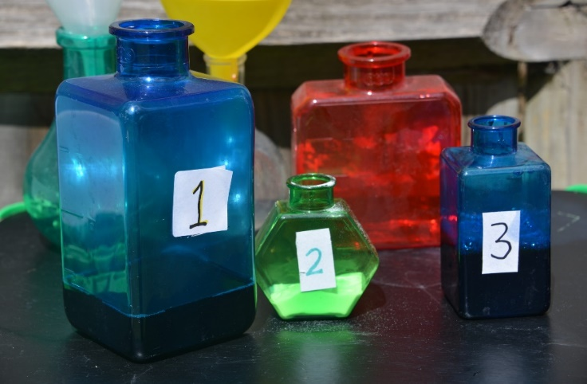
Wireless Sensing
motion and activity sensing
mobility measurement
environmental sensing
material sensing
Notes:
The sensing capabilities extensively cover motion and activity sensing, mobility measurement, environmental sensing, and material sensing.

Slide 4
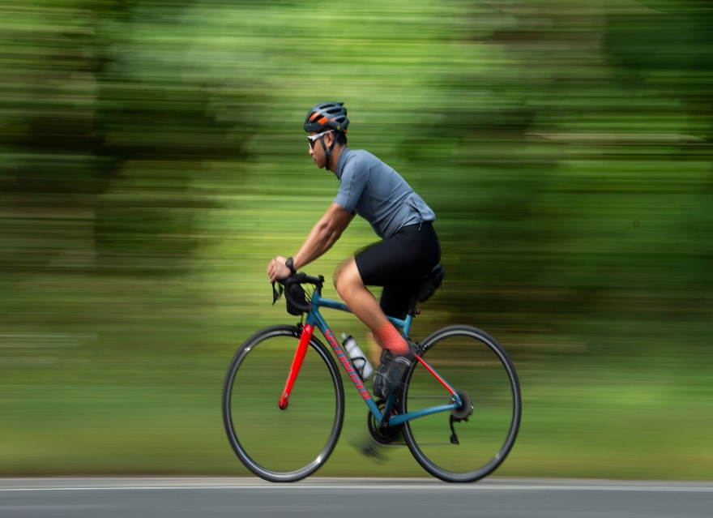
How to Sense a Long-Range Mobile Target?
Long-Range Mobile Target
Notes:
However, there is still a missing piece in the conception of ubiquitous wireless sensing, that is, how to sense the condition of a mobile target, especially at a long range.

Slide 5
How to Sense a Long-Range Mobile Target?
Notes:
Our work in this paper creates a new sensing technology for cyclists in the public bicycle sharing systems. Many of such bicycles are equipped with a long-range communication module, such as LoRa, so that their location data can be uploaded.
These communication modules can act as the signal sources for wireless sensing.

Slide 6
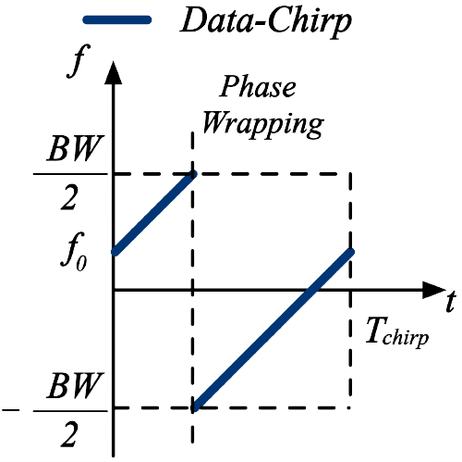
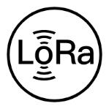
How to Sense a Long-Range Mobile Target?
LoRa node
LoRa Gateway
Communication range:
several kilometers
Sensing
Target
Sensing range:
tens of meters
CSS modulation of LoRa
* Fusang Zhang, Zhaoxin Chang, Kai Niu, Jie Xiong, Beihong Jin, Qin Lv, and Daqing Zhang. 2020. Exploring LoRa for Long-range Through-wall Sensing. Proc. ACM Interact. Mob. Wearable Ubiquitous Technol. 4, 2, Article 68 (June 2020), 27 pages
Notes:
As a key technology of low-power wide area network, LoRa extends the communication range to several kilometers via CSS modulation.
Previous studies have utilized LoRa signal to extend the range of wireless sensing to tens of meters.

Slide 7
How to Sense a Long-Range Mobile Target?
Sensing Target
Long Sensing Range
LoRa Gateway
Other Moving Target
More Moving Targets
Notes:
However, as the sensing range increases, 【Animation】 there are more moving targets that fall inside the sensing range and therefore submerge the signal reflection of the target of interest.
【Animation】 How to distinguish the target of interest from other moving targets in the environment has become an urgent challenge.

Slide 8
How to Sense a Long-Range Mobile Target?
LoRa Gateway
Sensing Target
Beamforming
Other Moving Target
LoRa Gateway
Stationary Target
Fail to sense mobile target
* Binbin Xie and Jie Xiong. 2020. Combating interference for long range LoRa sensing. In Proceedings of the 18th Conference on Embedded Networked Sensor Systems (SenSys '20).
Notes:
Some previous works leverage beamforming to mark the area where the target is located, but at the same time it limits the ability to sense moving targets.
【Animation】 Therefore, these existing works cannot perform sensing on mobile targets.

Slide 9
Palantir : LoRa Backscatter-Based Sensing
Notes:
The technology we invent, namely Palantir, utilizes the LoRa communication as the excitation carrier and 【Animation】 attaches a simple OOK-modulated backscatter tag for cyclist sensing.

Slide 10
Palantir : LoRa Backscatter-Based Sensing
Sensing with Side-Channel
100-Meter Sensing Range
Battery-Free Tag
Condition of Mobile Target
Notes:
Our proposal is attractive owing to multiple advantages.
【Animation】 First, Palantir does not occupy the communication channel of LoRa or backscatter, but senses the cyclists on the side channel, instead.
【Animation】 Palantir extends the sensing range to 100 m, 【Animation】 and performs long-range sensing with a battery-free tag.
【Animation】 Moreover, Palantir is extremely robust against the influence of mobility, and hence can sense the condition of mobile targets for the first time.

Slide 11
Palantir : Overview
OOK-modulation
Two states in the time domain
ON State
OFF State
OOK modulation of Backscatter
Notes:
At a high level, The basis of Palantir's sensing is that the OOK modulated signal can be divided into two states of ON and Off in the time domain.
【Animation】 These time domain signals can be stabilized by removing the modulation of CSS and then manifest two clusters in the IQ domain.
【Animation】 The signal in the OFF state is utilized as a reference in the sensing model to sense the movement of the target, and we will explain this model further.

Slide 12
Palantir : Overview
OOK-modulation
Two states in the time domain
ON State
Stabilization
Remove the modulation of CSS
OFF State
OOK modulation of Backscatter
Notes:
At a high level, The basis of Palantir's sensing is that the OOK modulated signal can be divided into two states of ON and Off in the time domain.
【Animation】 These time domain signals can be stabilized by removing the modulation of CSS and then manifest two clusters in the IQ domain.
【Animation】 The signal in the OFF state is utilized as a reference in the sensing model to sense the movement of the target, and we will explain this model further.

Slide 13
Palantir : Overview
OOK-modulation
Two states in the time domain
Stabilization
Remove the modulation of CSS
ON State
Condition
OFF State
Sensing
OFF State acts as a reference
Notes:
At a high level, The basis of Palantir's sensing is that the OOK modulated signal can be divided into two states of ON and Off in the time domain.
【Animation】 These time domain signals can be stabilized by removing the modulation of CSS and then manifest two clusters in the IQ domain.
【Animation】 The signal in the OFF state is utilized as a reference in the sensing model to sense the movement of the target, and we will explain this model further.

Slide 14
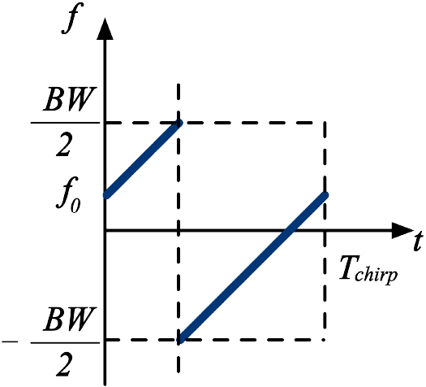
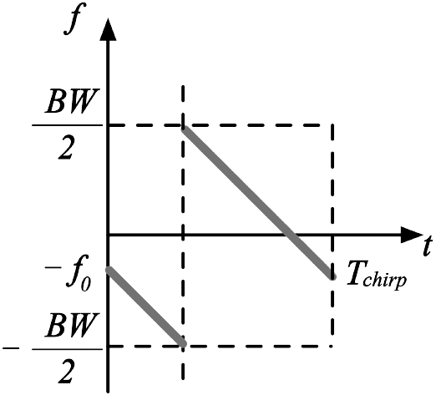
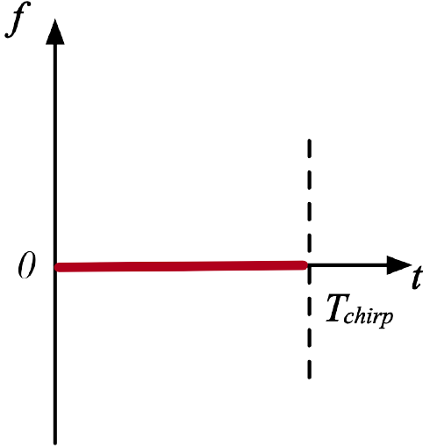
Palantir : Theoretical Sensing Model
Stabilization : Conjugate multiplication
Data Chirp
Conjugate Chirp
Stabilized Signal
Notes:
Theoretically, to perform sensing with LoRa backscatter, we firstly need to remove the css modulation of LoRa on the baseband.
【Animation】 A conjugate multiplication, as described in this figure, explains how to perform signal stabilization in theory.

Slide 15
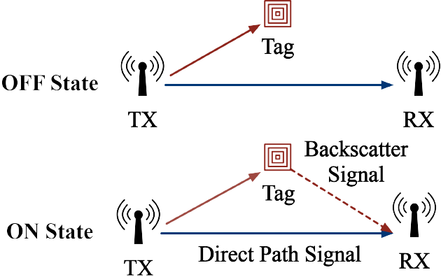
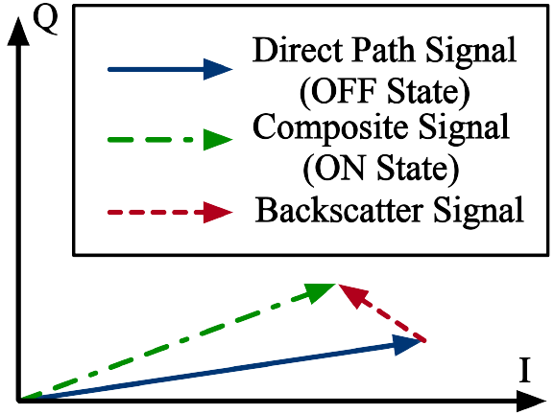
Palantir : Theoretical Sensing Model
Sensing : OFF State acts as a reference
Notes:
Then we can perform sensing with the stabilized signal.
【Animation】 The signal in the OFF state does not contain the backscatter signal, while the ON state is a composite of the LoRa signal and the backscatter signal.
【Animation】 The stabilized signal will manifest two clusters in the IQ domain, representing the ON and OFF states, respectively.
This means that the target of interest is uniquely marked via the switch of ON and OFF states in the time domain, and we can derive the backscatter signal by a subtraction of clusters in the IQ coordinate system.

Slide 16
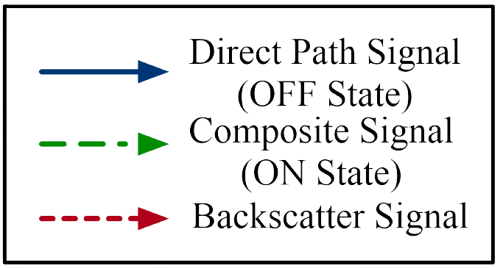
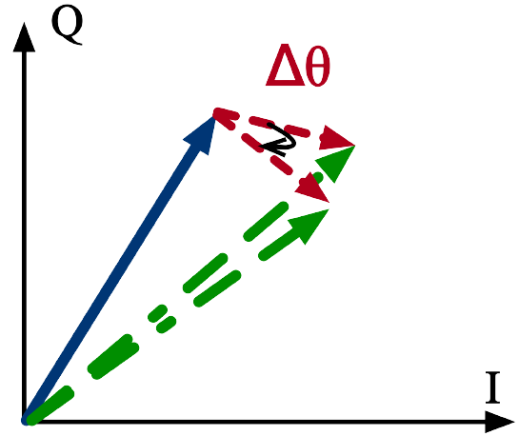
Palantir : Theoretical Sensing Model
Sensing : Movement of target
Rotation of backscatter signal $Δθ$
$$Δd=\frac{c}{2πf_{Carrier}}Δθ$$
Movement of target $Δd$
Notes:
Since the movement of backscatter tag changes the propagation distance of signal, the backscatter signal in IQ domain rotates with the move of the tag.
【Animation】 Hence we can sense the movement of the tag by calculating the rotation angle of the backscatter signal.

Slide 17
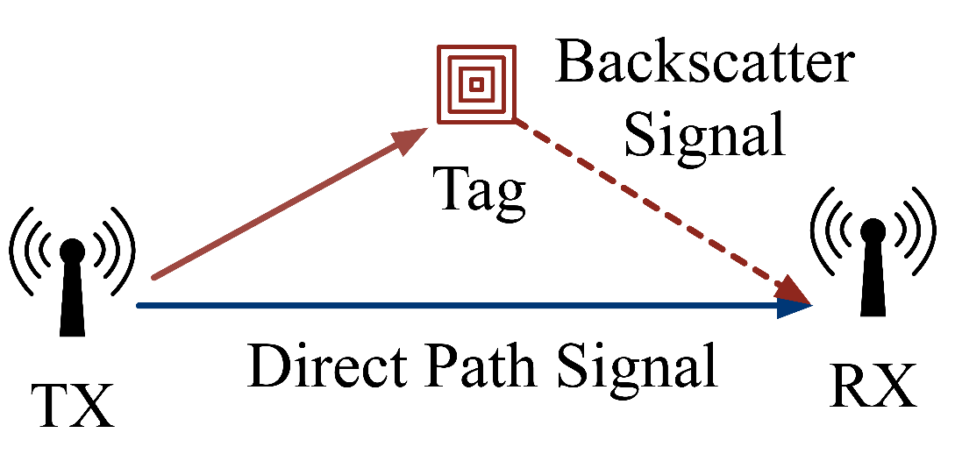
Palantir : Challenges
Communication
Sensing
Sensing sets higher requirements on channel quality than communication
Notes:
However, it is non-trivial to complete the sensing task in reality because sensing sets higher requirements on channel quality than communication.
Many redundancy introduced for the robustness of communication does not benefit sensing tasks.
Specifically, we separate four types of challenges that are coupled with each other, and they must be solved to perform accurate sensing.

Slide 18
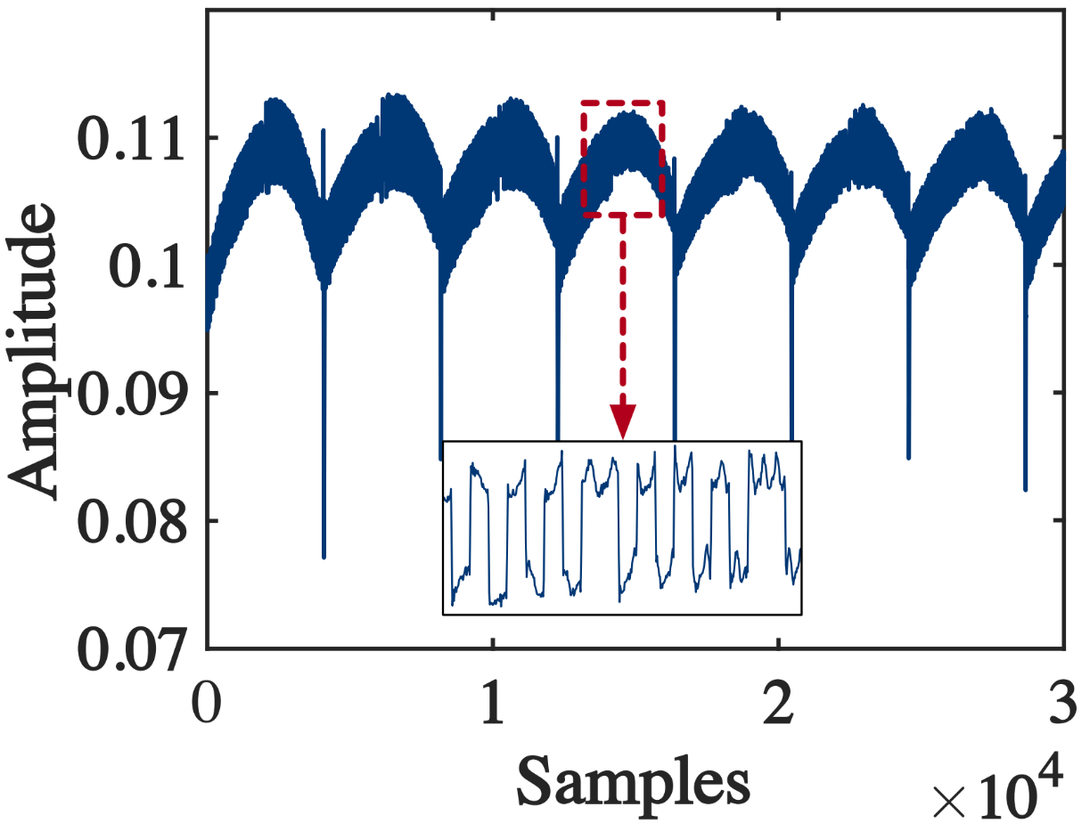
Palantir : Challenges
Amplitude Instability
Notes:
Firstly, although LoRa does not modulate the data in amplitude, the amplitude of the LoRa signal sent by the commercial device manifests a visible instability in the micro-benchmark experiment.

Slide 19
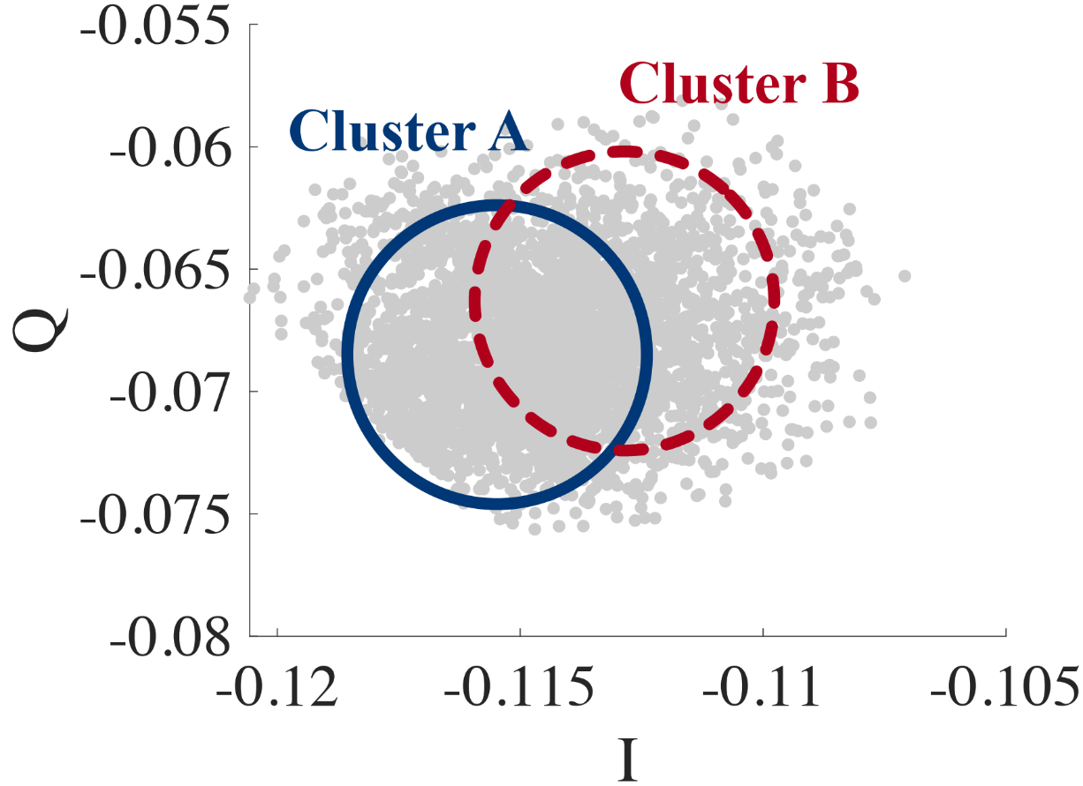
Palantir : Challenges
Amplitude Instability
State changes are submerged.
Notes:
These amplitude instabilities may submerge the state change of the backscatter signal and hence results in an inseparable cluster

Slide 20
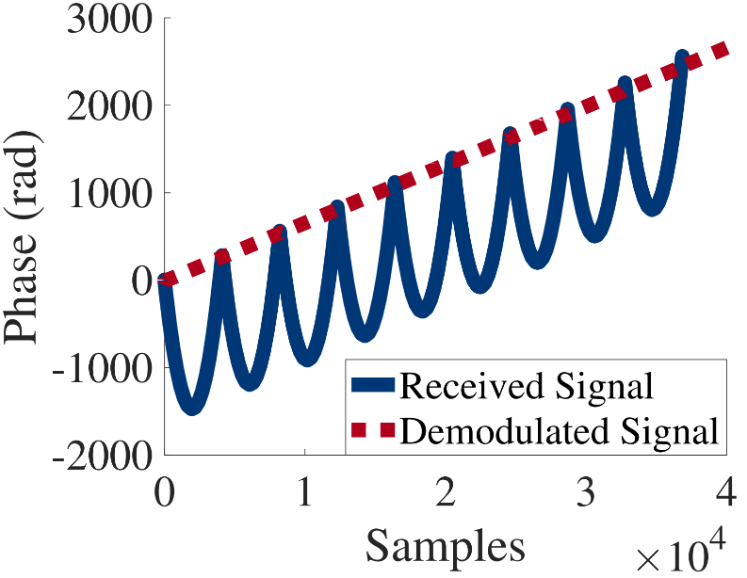
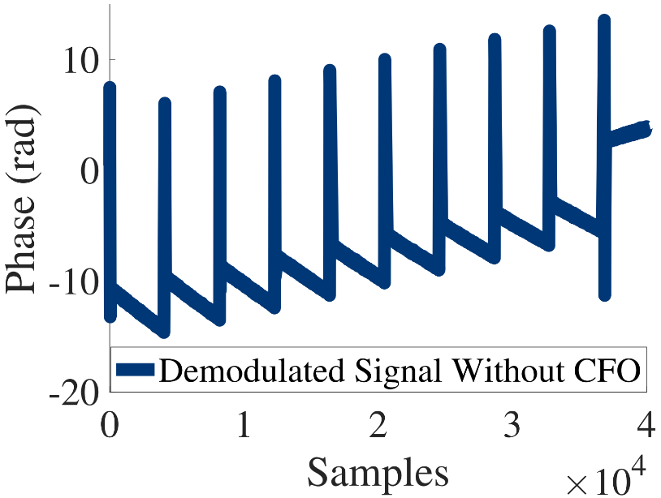
Palantir : Challenges
Amplitude Instability
State changes are submerged.
Offset and Drift
Carrier Frequency Offset
Sample Time Offset
Notes:
Secondly, carrier frequency offset, sample time offset, and clock drift are widely present in every transmitter-receiver pair.
These offset and drift distort the phase of the received signal, and the existing compensation methods designed for communication cannot be applied to sensing tasks.

Slide 21
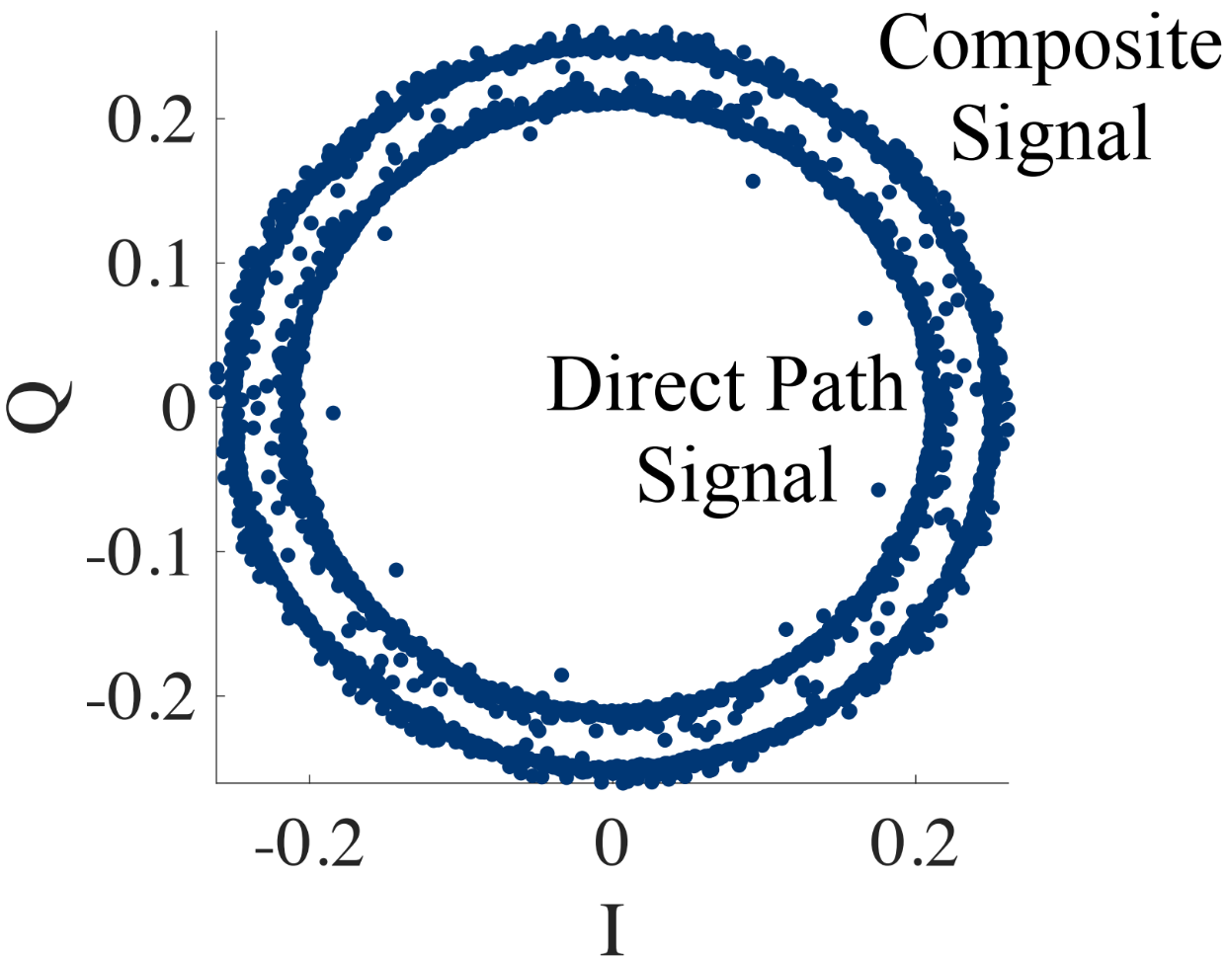
Palantir : Challenges
Amplitude Instability
State changes are submerged.
Offset and Drift
Phases are distorted.
Notes:
As a result, the ON and OFF state will manifest concentric circles instead of clusters, which significantly reduce the accuracy of sensing.

Slide 22
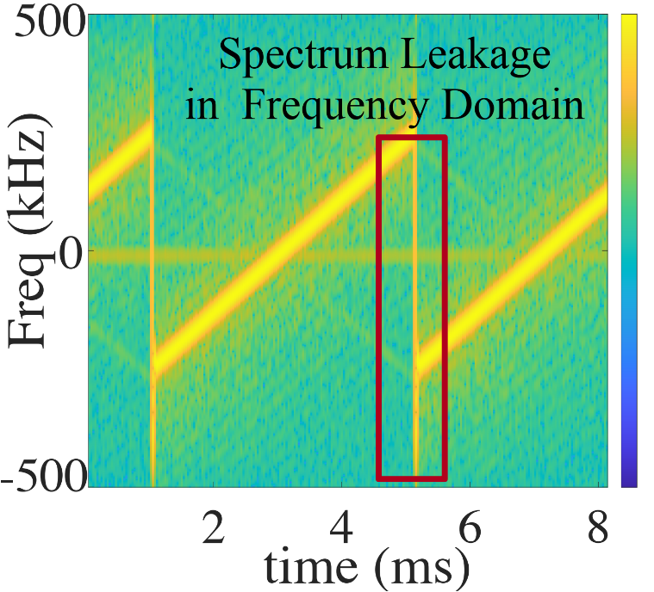
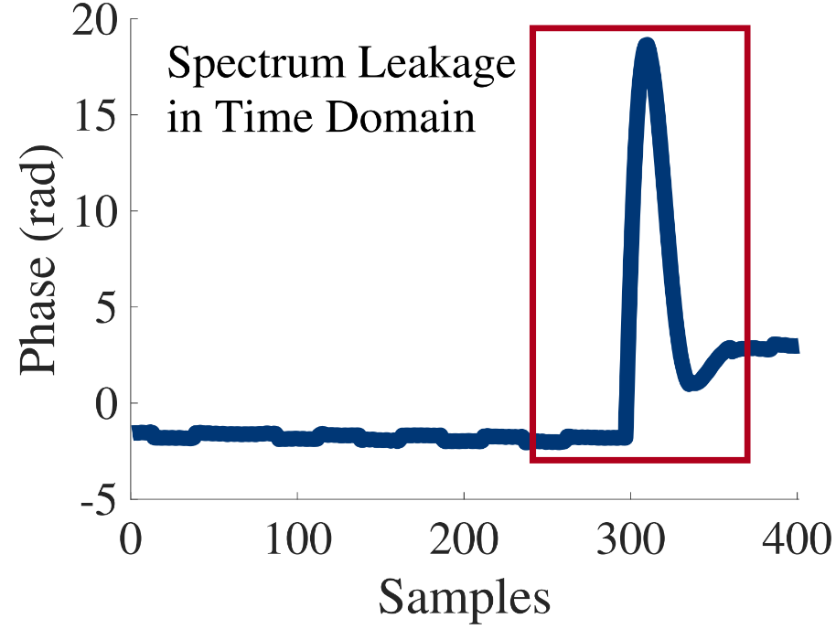
Palantir : Challenges
Amplitude Instability
State changes are submerged.
Offset and Drift
Phases are distorted.
Spectrum Leakage
Signal are broken into pieces.
Notes:
To make matters worse, due to the large number of frequency hopping in CSS modulation, spectrum leakage is very common in LoRa signals.
The spectrum leakage will couple with the aforementioned offsets and drifts, so that the original continuous signal is divided into discrete segments.

Slide 23
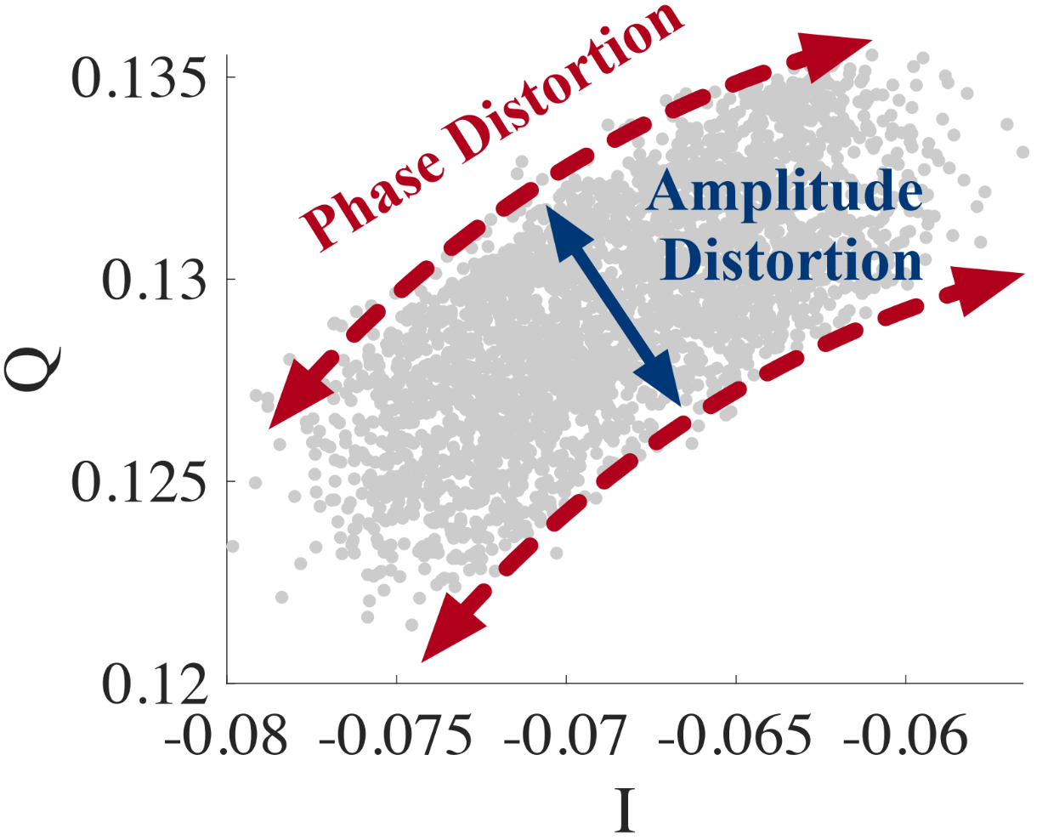
Palantir : Challenges
Amplitude Instability
State changes are submerged.
Offset and Drift
Phases are distorted.
Spectrum Leakage
Signal are broken into pieces.
Multiplicative Noise
Notes:
Finally, we find that the clusters of the received signal are arc-shaped, which means that the signal suffers from multiplicative noise.

Slide 24
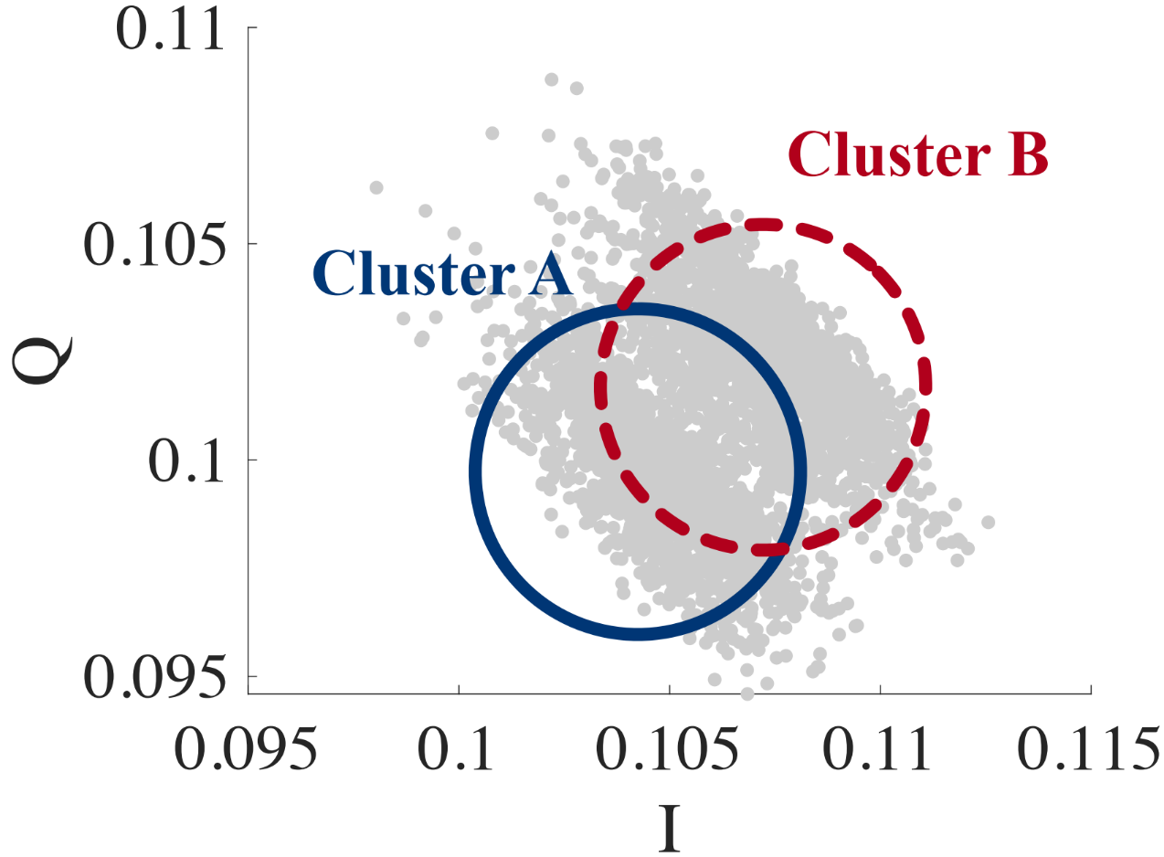
Palantir : Challenges
Amplitude Instability
State changes are submerged.
Offset and Drift
Phases are distorted.
Spectrum Leakage
Signal are broken into pieces.
Multiplicative Noise
Clustering algorithm is disturbed.
Notes:
And the result of multiplicative noise is the disturbance to the clustering algorithm in IQ domain.

Slide 25
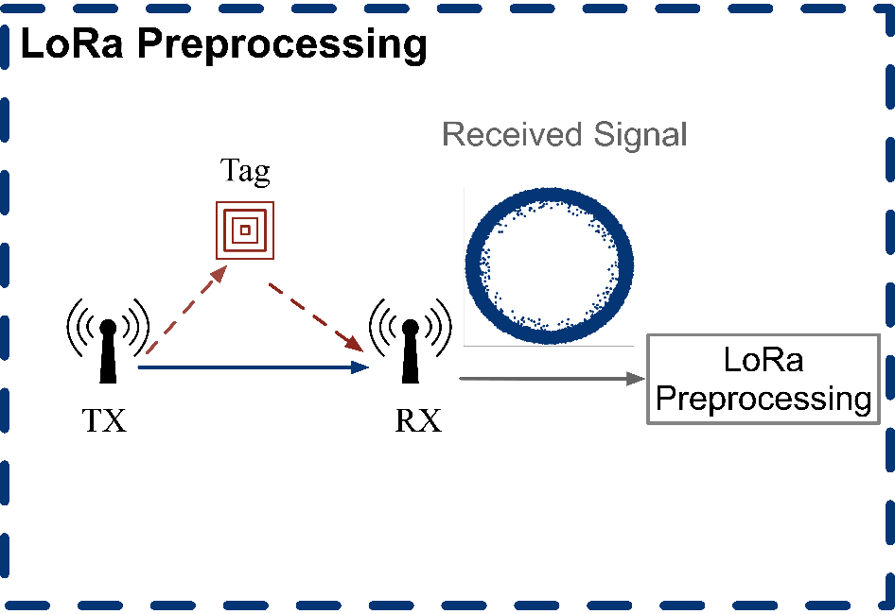
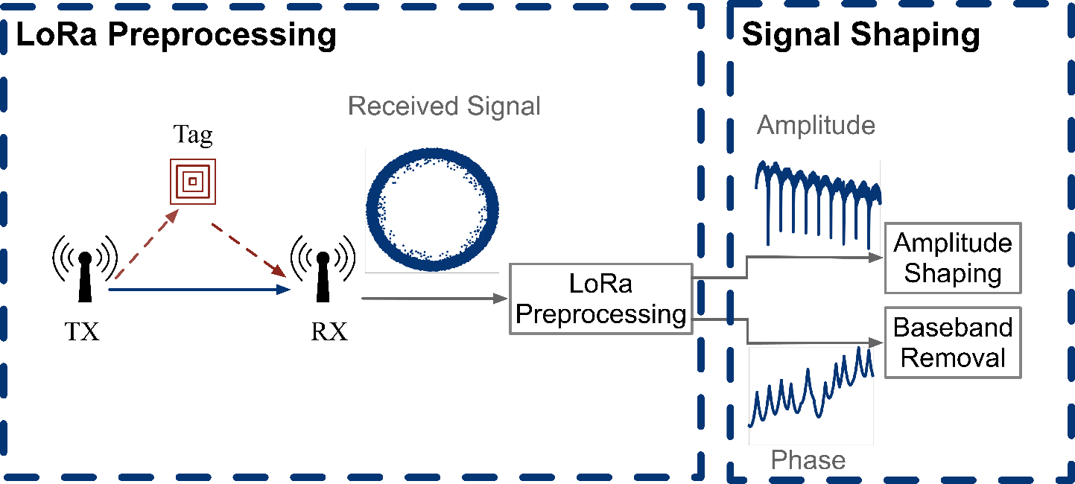
Palantir : System Design
Notes:
In order to solve these four types of challenges, we design the system of Palantir.
The overall design includes four modules, namely LoRa preprocessing, signal shaping ,clustering and sensing.
【Animation】 In the first module, Palantir calculates the starting time and frequency of each LoRa chirp.
【Animation】 Next, Palantir shapes the amplitude and phase of the received signal, respectively.

Slide 26
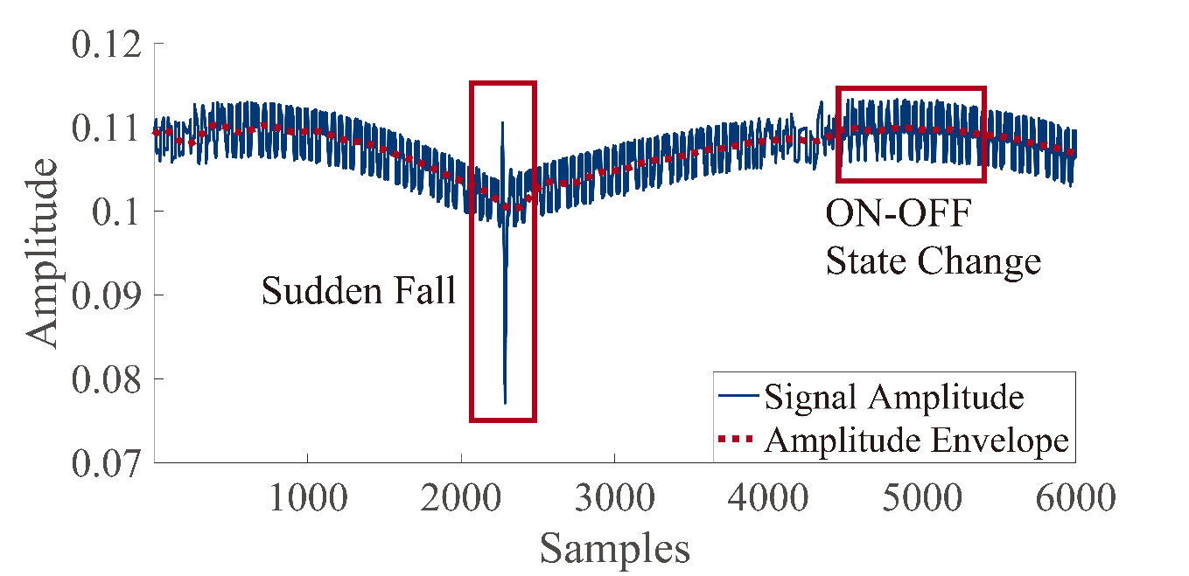
Palantir : System Design
Amplitude Envelope
Impact of Offset and Drift
$$Δφ_{baseband}\left(t\right)=2π\left(a_{0}t^{2}+a_{1}t+a_{2}\right)$$
$a_{0},a_{1}\text{and} a_{2}$ are determined by offsets and drifts.
Notes:
The amplitude shaping part is used to remove the low-frequency amplitude envelope through a filtering algorithm while retaining the ON-OFF state transition.
【Animation】 For the signal phase, the baseband waveform is removed by conjugate multiplication. The offset and drift are modeled mathematically, and then compensated by curve fitting.

Slide 27
Palantir : System Design
Notes:
The signal after shaping will be stable in the time domain, so that it can be clustered.

Slide 28
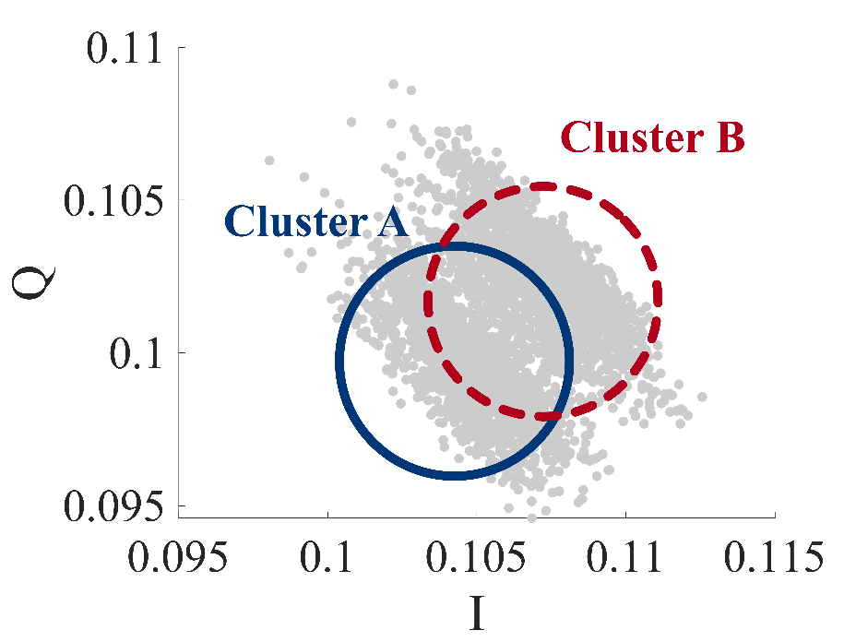
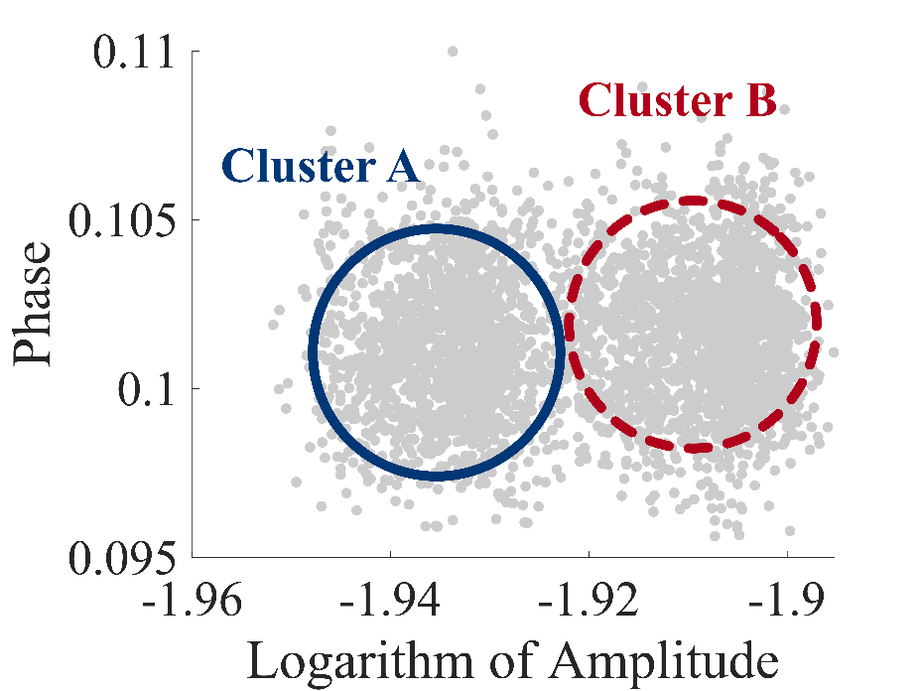
Palantir : System Design
Multiplicative Noise
$$Logarithm of Amplitude : logA+logA_{noise}$$
$$S_{sample}=AA_{noise}e^{j2π(θ+θ_{noise})}$$
$$phase : θ+θ_{noise}$$
I-Q
Logarithm of Amplitude-Phase
Notes:
In order to deal with multiplicative noise, Palantir performs clustering in the logarithm of the amplitude-phase coordinate system.
This is because the multiplicative noise in IQ domain 【Animation】 appears to be additive in the logarithm of the amplitude-phase domain.

Slide 29
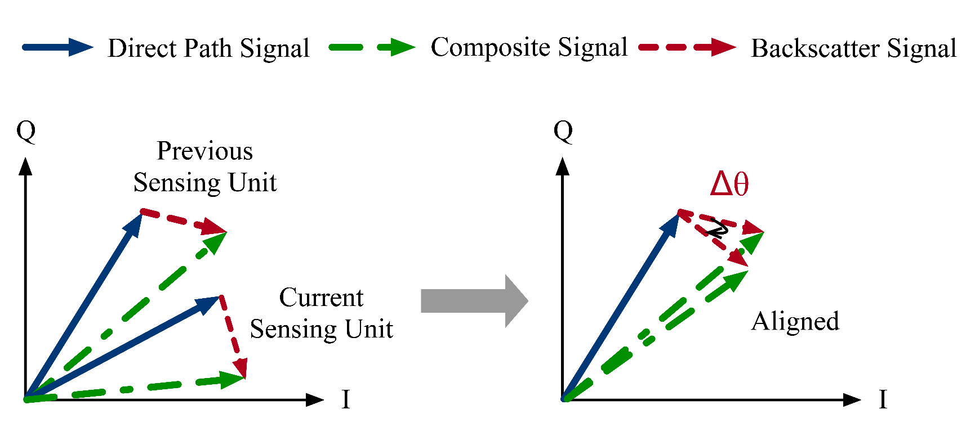
Palantir : System Design
Cluster Identification
The movement between the adjacent sensing units is small
Misaligned
Aligned
Notes:
Although the cluster of OFF state acts as a reference and is expected to be static, it manifests a phase difference between adjacent sensing windows due to the joint influence of sample time offset and spectrum leakage.
【Animation】 Fortunately, we can reasonably assume that the tag movement between the adjacent sensing units is small.
So Palantir can align the cluster centers and ensure the consistency of the judgment of cluster's ON-OFF state to avoid ambiguity.

Slide 30
Palantir : System Design
Notes:
Finally, Palantir gets the backscatter signal in IQ domain and senses the movement of the target by tracking the change of the signal.

Slide 31
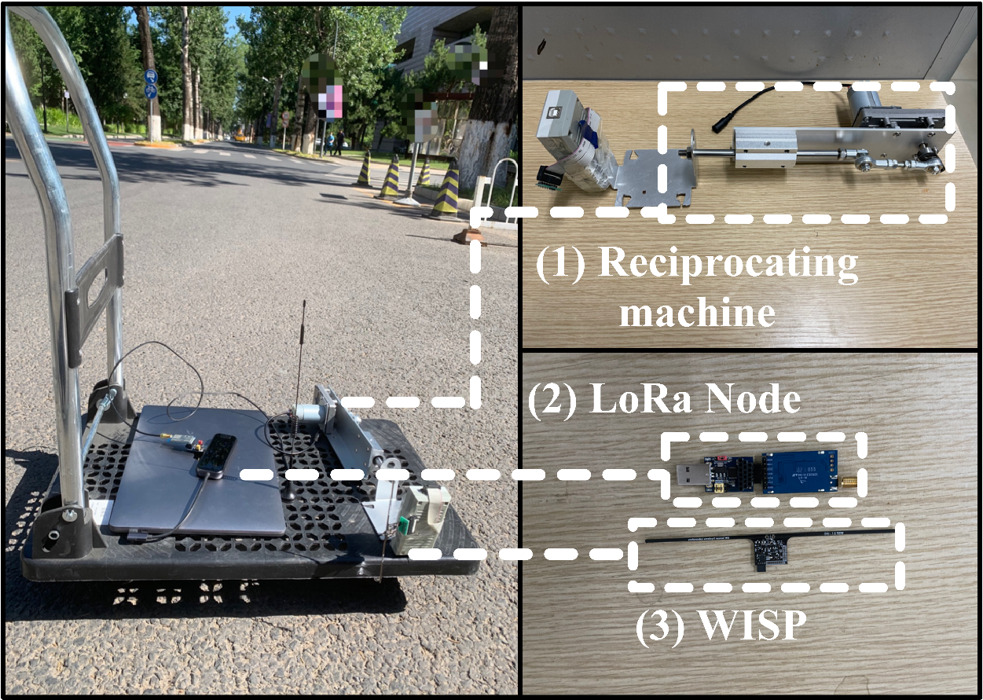
Palantir : Settings
Receiver
USRP N210
Transmitter
Semtech SX1276 chip
Carrier Frequency: 902MHz
Bandwidth: 500KHz
Backscatter
WISP 5.0
Notes:
With the complete system design, we build a prototype and conduct experiments to study the performance of Palantir in various situations.
We take a commercial LoRa node as our transmitter and a USRP as the receiver.
Both the transmitter and the receiver are equipped with an omni-directional antenna.
The LoRa node runs at 902 MHz with a spreading factor of 11 and a bandwidth of 500 KHz.
A WISP is used as the backscatter tag. And a reciprocating machine is used to generate a controllable periodic motion in the benchmark experiment, and it is fixed on a trolley.

Slide 32
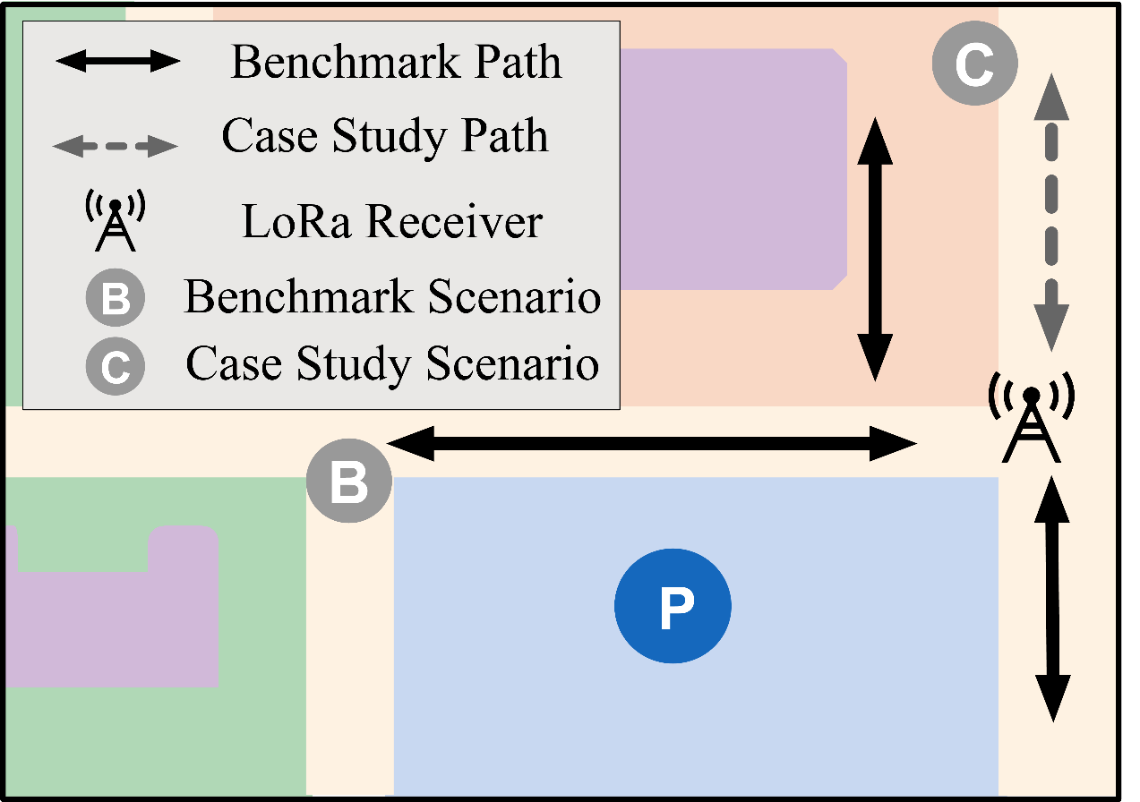
Palantir : Settings
Receiver
USRP N210
Transmitter
Semtech SX1276 chip
Carrier Frequency: 902MHz
Bandwidth: 500KHz
Backscatter
WISP 5.0
Notes:
The USRP is placed at a fixed position on a road and samples at 1 MHz.
We change the position of the Transmitter and Backscatter on the outdoor asphalt road, and move them with a trolley to simulate a mobile scenario.

Slide 33
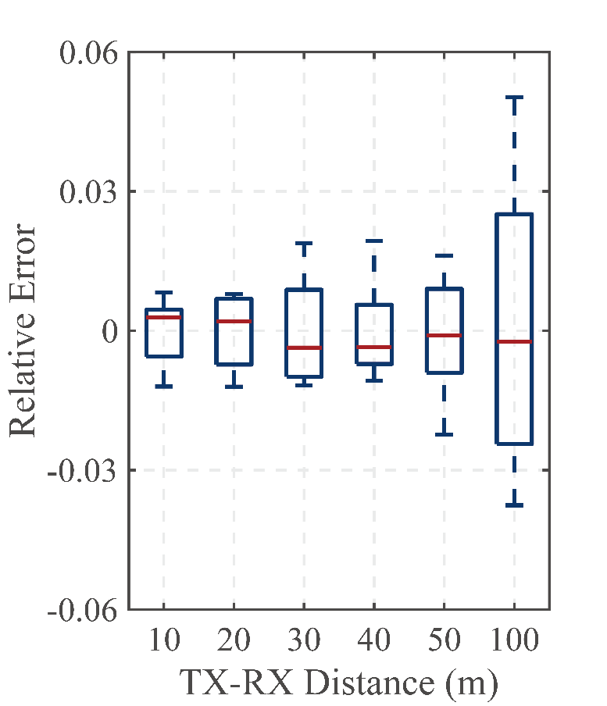
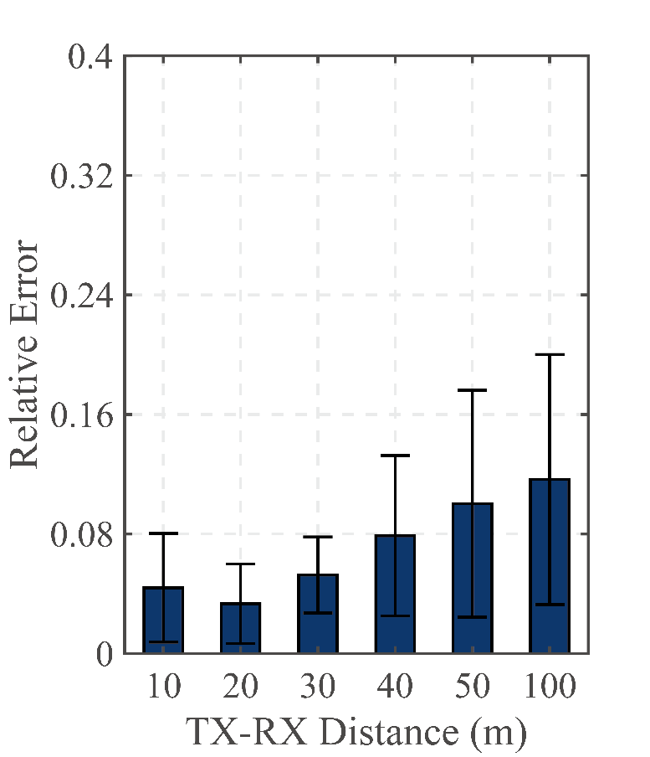
Palantir : Evaluation
What we sense?
Motion period
How fast a cyclist breaths?
Motion amplitude
How deep a cyclist breaths?
Metrics
Motion period deviation
Motion amplitude deviation
Motion period deviation
Motion amplitude deviation
Notes:
Palantir senses the motion period and the motion amplitude of the tag to determine how fast and how deep the breath is, respectively.
We rely on the deviation of the sensed period and amplitude to evaluate the performance of Palantir.
【Animation】 We first conduct benchmark experiments to study the performance of Palantir under different TX-RX distance.
The motion period deviation and motion amplitude deviation when the TX-RX distance is 10 m have medians of 0.3% and 4.39%, respectively.
As the distance between the TX and RX widens, the sensing accuracy decreases due to the decrease of signal noise ratio.
Nevertheless, the median deviation of motion period remains as small as −0.2%,

Slide 34
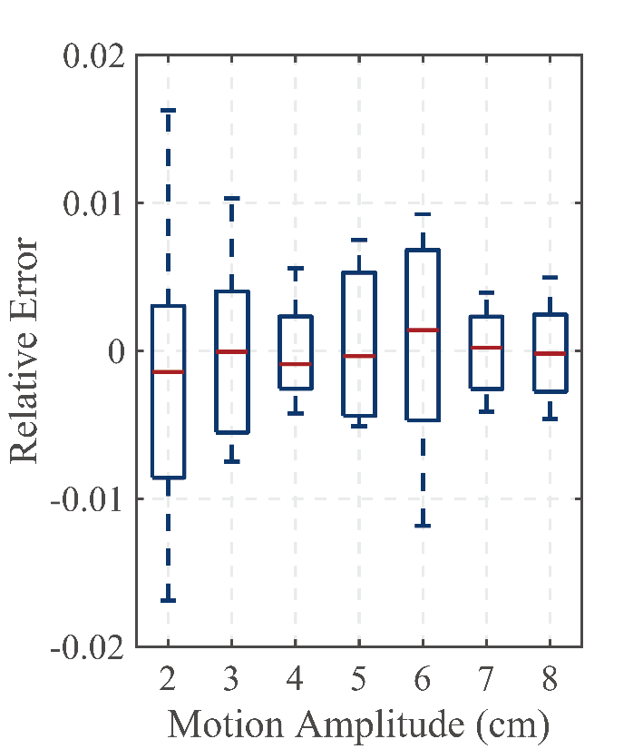
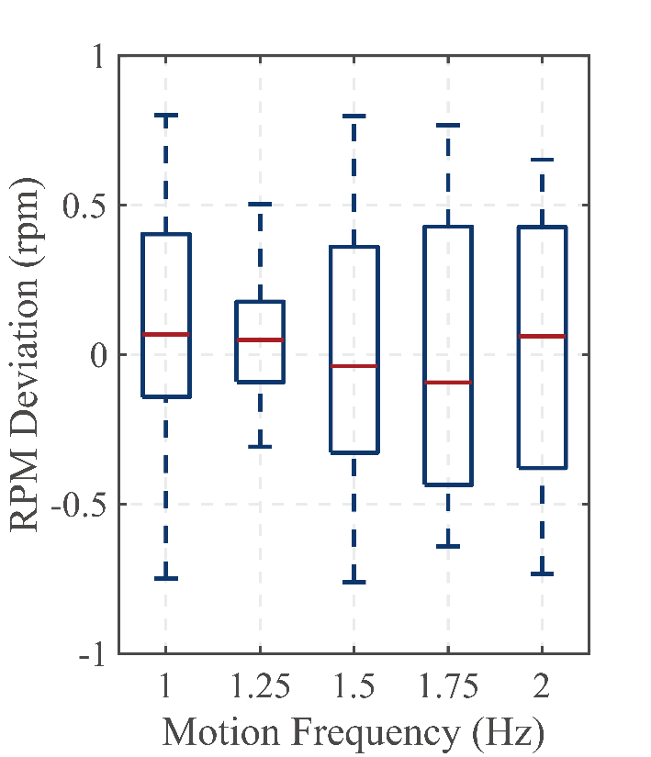
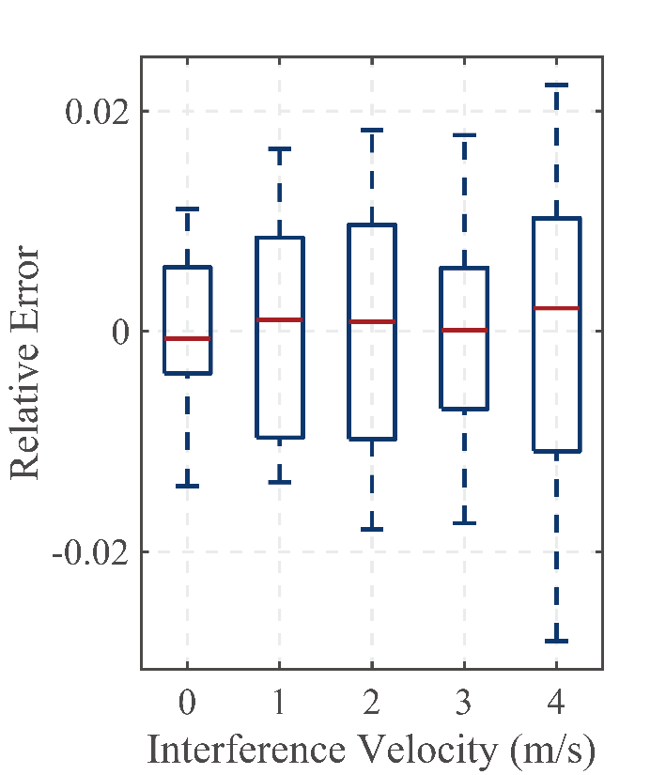
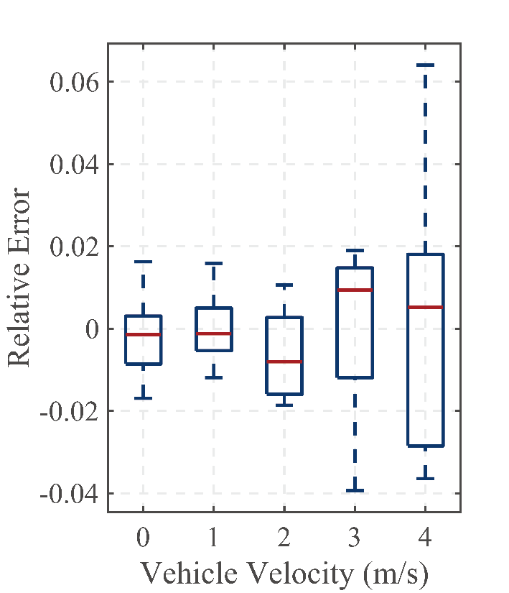
Palantir : Evaluation
Motion period deviation of Palantir in different …
Motion Amplitude
Motion Frequency
Interference
Mobile
Scenario
Notes:
We further evaluate Palantir under different motion amplitudes and motion frequencies. And the results show that Palantir works well in various settings.
【Animation】 To evaluate the robustness against the interference of other mobile target, a volunteer is instructed to move in different speed.
We also evaluate the performance of Palantir in mobile scenarios by moving the trolley at different speed.

Slide 35
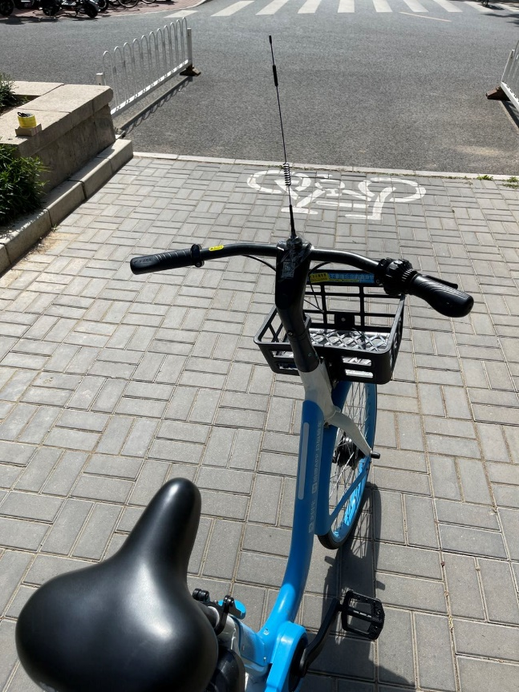
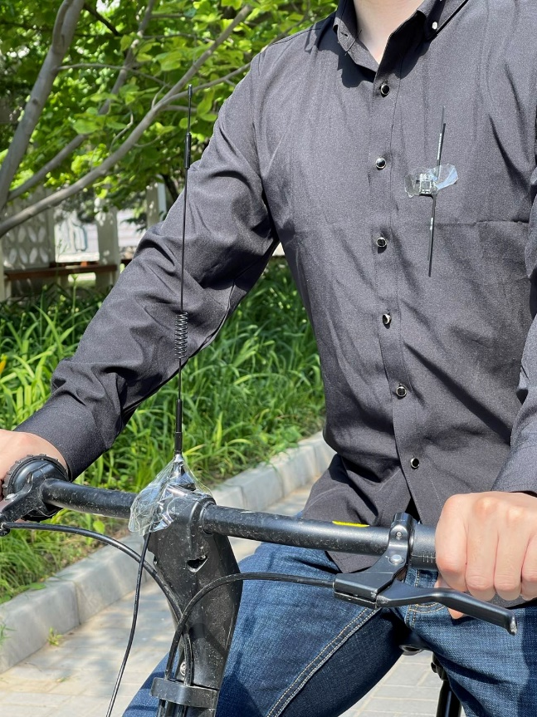
Palantir : Case Study
Receiver:
Stationary
Transmitter
Attached on a sharing bicycle
Backscatter
Attached to a volunteer
Notes:
Finally, we conduct a case study about respiration sensing while riding a bicycle. We attach the omni-directional antenna to the public bicycle. The Backscatter is attached onto the clothes on the chest.

Slide 36
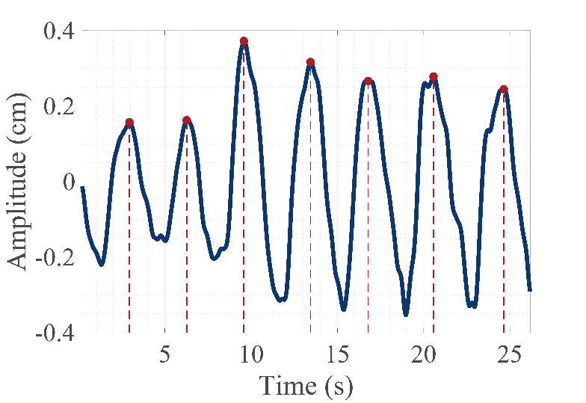
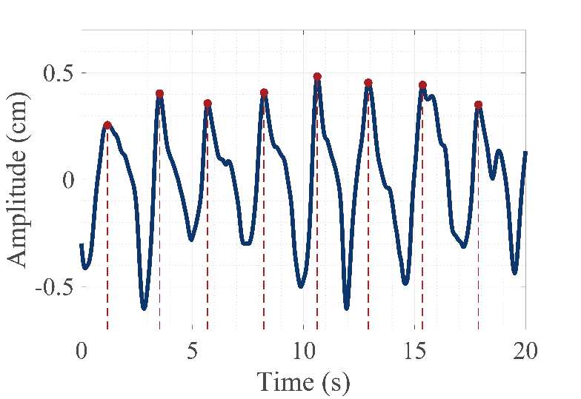
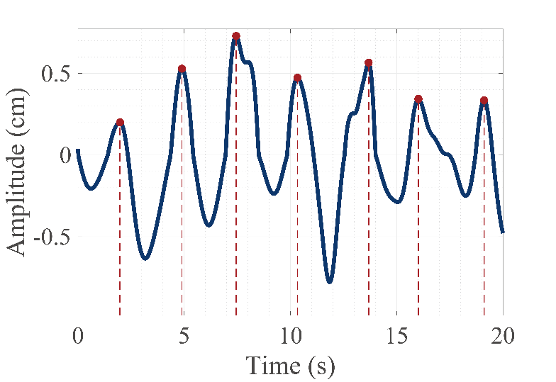
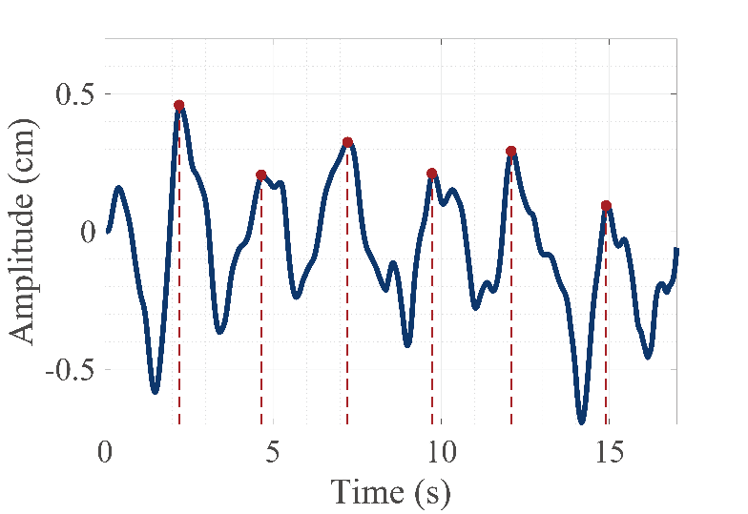
Palantir : Case Study
Stationary in 10 m
Stationary in 100 m
Riding at low speed
Riding at high speed
Notes:
The respiration of a volunteer is sensed at different distance.
Then, the volunteer is instructed to ride the bicycle at different speeds. Here we show some of our sensing results.
The red dotted lines mark the respiratory period detected by Palantir. It is shown that Palantir obtains stable respiratory period , which can be used as a clue for respiration monitoring

Slide 37
Palantir : Conclusion
Present a first-of-its-kind long-range sensing system based on the LoRa backscatter.
Extends the sensing range to 100 m.
Applied to both stationary and mobile targets.
Separate the coupled challenges and design a complete signal processing scheme.
Fill the gaps between sensing and communication.
Evaluate the performance of Palantir by performing comprehensive benchmark experiments.
Build a prototype and conduct a case study of respiration monitoring.
Notes:
To sum up, in this work, we present Palantir, a first-of-its-kind long-range sensing system based on the LoRa backscatter.
Palantir extends the sensing range to 100 m and can be applied to both stationary and mobile targets.
【Animation】 To achieve this , we Separate the coupled challenges and design a complete signal processing scheme.
Although we design Palantir based on the LoRa backscatter, our work fills the gaps between sensing and communication that commonly exist in all kinds of wireless signals.
【Animation】 We evaluate the performance of Palantir by performing comprehensive benchmark experiments, and we also build a prototype and conduct a case study of respiration monitoring in the real world.

Slide 38
Thanks for Listening
Notes:
These will conclude my talk. Thank you for your time.

Slide 39
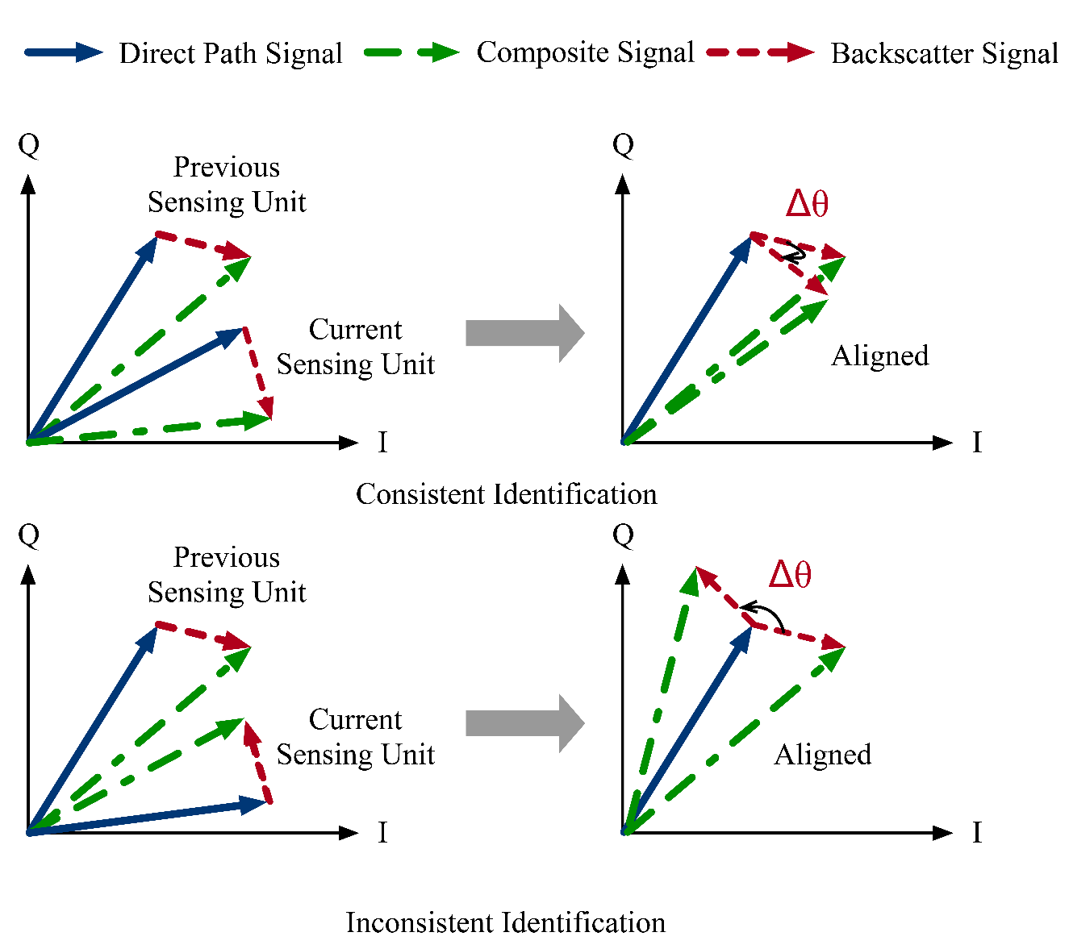
Backup
Cluster Identification
The movement between the adjacent sensing units is small

