Slide 1


FlipTracer: Practical Parallel Decoding for Backscatter Communication
Meng Jin¹, Yuan He², Xin Meng¹,
Yilun Zheng², Dingyi Fang¹, Xiaojiang Chen¹
¹Northwest University
²Tsinghua University
Notes:
Good afternoon everyone, I’m MengJin from northwest university in Xi’an China.
Today, I’m going to show with you our recent work, titled ”FlipTracer: Practical Parallel Decoding for Backscatter Communication”
This is a joint work between northwest university and Tsinghua university.

Slide 2


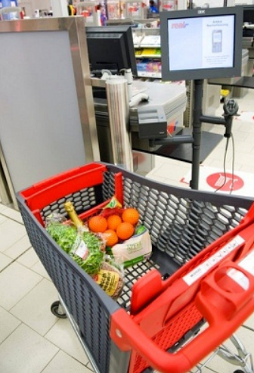
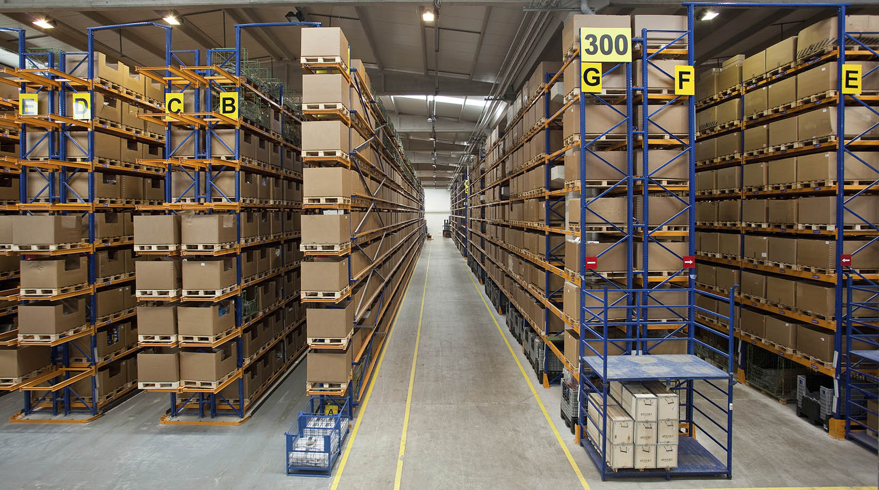
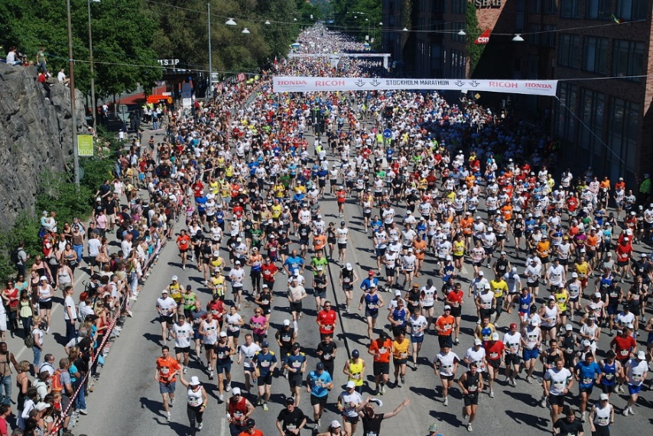
Large quantity of deployed tags
Large quantity of deployed tags
High throughput is required in large-scale
backscatter systems
1
/22
Notes:
Backscatter technology provide benefits of energy harvesting and low power communication, which make it attractive to many applications.
Most of these applications involve a large number of deployed tags to transmit large volumes of data.
Therefore, how to fully utilize the channels and enhance network throughput, turns to be a very important problem.

Slide 3

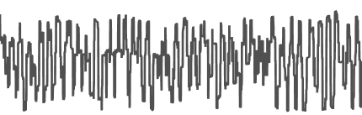
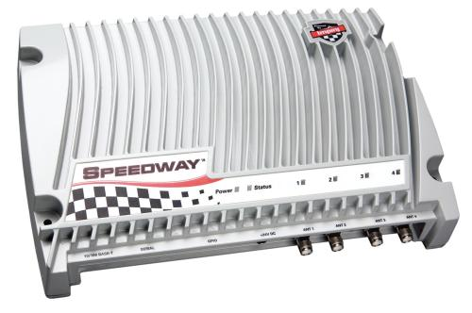
Parallelize multiple backscatter transmissions?
Large quantity of deployed tags
2
/22
Notes:
To solve this problem, parallel transmission is explored in many recent works.
They allow the tags to transmit in parallel,,,

Slide 4
Parallelize multiple backscatter transmissions?
Large quantity of deployed tags
……
2
/22
Notes:
And the collision will be decoded at the reader side.

Slide 5
Parallel decoding method is required
Notes:
To achieve this version, we need a parallel decoding method to decode the collided signal.

Slide 6
When one tag is transmitting
H
L
3
/22
Notes:
Before talking about the parallel decoding, let’s first look at the signal when only one tag is transmitting.
Since tags encodes its data by reflecting or absorbing the carrier waves, there are two magnitude in the time domain.
We can use a threshold to decode the signal.

Slide 7
When one tag is transmitting
H
H
L
L
3
/22
Notes:
If we look at the IQ plan, we see two symbol clusters, representing the two backscatter states.

Slide 8
When two tags are transmitting in parallel
LL, HL, LH, HH?
How can we identify the combined state of the signal?
4
/22
Notes:
Now we have two tags.
Since each tag have two states, thus we have four states in total
These states represents the combined state of the two tags.
Now the problem is: how can we identify the combined state of the signals.

Slide 9
Parallel decoding using IQ domain features
HH
HL
LH
LL
Identify the combined states of the clusters based on the clusters’ position in IQ domain?
5
/22
Notes:
Theoretically, channel coefficients of tags are stable and can be linearly combined when collision occurs.
That’s to say, the four clusters create a parallelogram in IQ plan.
So, if one of these clusters is identified, such as LL, it seems that all the other clusters can be further identified based on their location in the IQ domain.

Slide 10
Dynamics in the IQ domain
IQ domain signals are dynamic and irregular
Caused by dynamic environment
Movement of the tag
6
/22
Notes:
However, in practice, we observe both dynamic and irregular signals in the IQ domain.
For example, if the tags are moved,

Slide 11
Dynamics in the IQ domain
IQ domain signals are dynamic and irregular
Caused by dynamic environment
Movement of the tag
Near-field interference
Noise
Its challenging to identify the clusters based on their IQ domain features.
6
/22
Notes:
the position of the cluster will change with the dynamic environment.
And also, when two tags become to close, tags may backscatter the signals from nearby tags.
In this case, we can observe the non-linear dependency in the collided signals.
At last, in a low SNR scenario, noise from the environment will increase the radius of the clusters, which incurs overlap between clusters. So we cannot even separate different clusters in this case.
Clearly, its challenging to identify the clusters based on their locations on the IQ domain.

Slide 12
Using IQ + time domain features
Large quantity of deployed tags
Tag 2
Tag 1
4
HH
3
HL
2
4
3
2
1
LH
1
LL
An important assumption: stable bit duration.
Come and be served: Parallel decoding for cots rfid tags. In MobiCom, 2015.
Laissez-faire: Fully asymmetric backscatter communication. In SIGCOMM, 2015.
7
/22
Notes:
To solve this problem, some more recent works combine time and IQ domain signal to identify the clusters.
Specifically, by leveraging the reader’s capacity to sample at a much higher rate than the tag, we can extract each signal edge.
If all the tags have stable bit duration, we can map these edges to the flipping of the tags.
Then, using the IQ domain information, we can finally identify the combined state of the collided signal.
However, underlying this method is an assumption that: bit duration of all the tags are stable.
That’s to say, they require that the clock of the tags have low drifting rate, which is unrealistic in today’s backscatter systems.

Slide 13
Dynamics in the time domain
High drifting rate
Dynamic bit duration
Clock drift is required to be lower than 200ppm.
However, the built-in internal DCO in backscatter tags has a typical drift of about 50,000ppm.
70% of tags’ drifting rate fall between
40000ppm and 68000ppm
8
/22
Notes:
Due to the low cost design, the clock in backscatter tags typically have high drifting rates.
As we know, to separate the signals from different tags, the clock drifting rate should be lower than 200ppm.
However, based on our measurement, 70% of tags’ drifting rate fall between 40 thousand and 68000ppm.

Slide 14
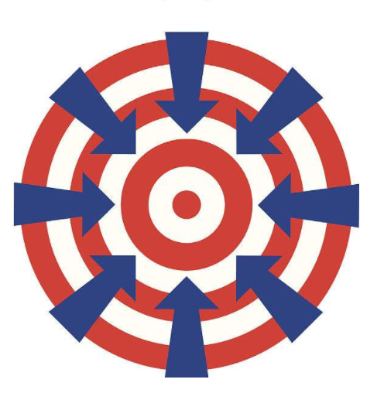
Our Goal
Identify the combined states of each cluster based on such dynamic and irregular signals
Notes:
The above experimental results motivate us to think about a question that: how to identify the combined states of each cluster based on such dynamic and irregular signals?

Slide 15
Using signals’ transition probability?
HL
HH
LL
Low Transition probability
LH
High Transition probability
Stable and regular
Dynamic
Non-linear
Although the IQ position is Dynamic and irregular
Transition pattern between signal clusters is stable
9
/22
Notes:
Our idea is to use signal’s transition probability between clusters.
We find that although the positions of the signals are dynamic and irregular,
signals’ transition probabilities between different clusters are highly stable.
【慢慢说】Indeed, a higher transition probability between two clusters implies the higher similarity between their corresponding combined states.
For example in this case

Slide 16
Using signals’ transition probability?
HL
HH
LL
Low Transition probability
LH
High Transition probability
Stable and regular
Dynamic
Non-linear
Although the IQ position is Dynamic and irregular
9
/22
Notes:
The transition probability between cluster LL and LH is much higher than that between LL and HH.

Slide 17
Using signals’ transition probability
Why the transition probabilities indicate the combined states of the clusters?
Signal’s transition between different clusters is caused by the flipping of the tags.
LH
Tag1
HH
Tag2
HL
Collided
signal
LL
10
/22
Notes:
Let’s look at the reason behind.
In practice, signal’s transition between different clusters is caused by the flipping of the tags.

Slide 18
Using signals’ transition probability
Why the transition probabilities indicate the combined states of the clusters?
Flipping of different tags are interleaved most of the time
LH
Tag1
HH
Tag2
HL
Collided
signal
LL
10
/22
Notes:
Since flipping of different tags are interleaved most of the time.
So, signal transitions are usually caused by flipping of only one tag.
That’s to say, signals usually transfer between clusters whose combined states have only one different states.

Slide 19
Using signals’ transition probability
Why the transition probabilities indicate the combined states of the clusters?
Flipping of different tags are interleaved most of the time
LH
Tag1
HH
Tag2
HL
Collided
signal
LL
10
/22
Notes:
Of course, in some rare cases, two tags may flip their state at exactly the same time.
This leads to the signal transition between two clusters whose combined states have two different states.
However, the probability for such signal alignment is very low.

Slide 20
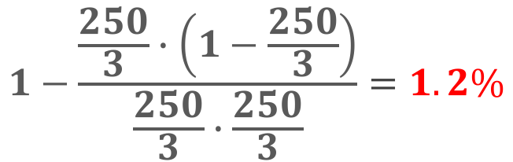
Using signals’ transition probability
Why the transition probabilities indicate the combined states of the clusters?
Flipping of different tags are interleaved most of the time
The reader’s sampling rate is 250 times higher than the tag’s bit rate.
LH
Tag1
HH
Flipping alignment:
Tag2
HL
Collided
signal
$$1−\frac{\frac{250}{3}∙\left(1−\frac{250}{3}\right)}{\frac{250}{3}∙\frac{250}{3}}=1.2\%$$
LL
10
/22
Notes:
Let’s look at a concrete example.
If the tag transmit at 100kbps
The reader’s sampling rate will be 250 times higher than the tag’s bit rate.
So in this case the probability that the two tags flip their state at exactly the same time is only 1.2 percent.

Slide 21
Using signals’ transition probability
Why the transition probabilities indicate the combined states of the clusters?
Flipping of different tags are interleaved most of the time
The reader’s sampling rate will be 250 times higher than the tag’s bit rate.
LH
Tag1
HH
Flipping alignment:
Tag2
Neighbor clusters
HL
Collided
signal
$$1−\frac{\frac{250}{3}∙\left(1−\frac{250}{3}\right)}{\frac{250}{3}∙\frac{250}{3}}=1.2\%$$
LL
We can use signals’ transition probability to identify the combined states of the clusters
10
/22
Notes:
That’s why the signal usually transfer between clusters whose combined state have only one different state.
We term such cluster pair as neighbor clusters.
So, if we can identify the combined state of one cluster, we can then identify the combined states of its neighbors, and then its neighbors’ neighbors.
And finally, we can identify the combined states of all the clusters, step by step.

Slide 22
How does FlipTracer work?
Notes:
Now, we take the 3 tag collision case as an example to explain how FlipTracer works.

Slide 23








Building the One-Flip-Graph
The One-Flip-Graph (OFG) is denoted as:
$$OFG=(C,E)$$
$$C=\left\{C_{1},…,C_{N_{c}}\right\}:$$
denotes the
$$N_{c}=2^{N}$$
symbol clusters, where $N$ is the number of tags
$$E:$$
if
$$C_{i}$$
and
$$C_{j}$$
are neighbor clusters, we have
$$<C_{i},C_{j}>∈E$$
Transition probability
11
/22
Notes:
Our first target is to construct a graph to connect all the neighbor clusters.
We term this graph as One Flip Graph.
The nodes in the One Flip Graph are the symbol clusters.
And, if two clusters are neighbor clusters, we build a connection between them.
To construct the One Flip Graph, we first cluster the received symbols, and calculate the transition probability between each two clusters.
Then, we use the transition probability to find the neighbors for each cluster.
And finally we get the One Flip Graph.

Slide 24
Correcting the false connections
Correcting false connections that connects two non-neighbor clusters
1
1
1
1
2
2
2
2
3
3
4
3
Correct Loop
2
3
Abnormal Loop
6
5
5
6
5
7
7
8
8
8
We can avoid forming false connections by detecting such abnormal loops.
12
/22
Notes:
However, one problem we face here is how to handle the false connections in the OFG, which may happen when the concurrent level is very high.
Indeed, we can identify the false connections based on the fact that: if all the connections in the OFG are correctly formed, there will be no loops with an odd number of nodes in the OFG.
For example, in a 3-tag collision case, we can see the loop with four, six, and eight nodes
However, a false connection always forms a loop with an odd number of nodes.
So we can avoid forming false connections by detecting such abnormal loops.

Slide 25
Identify the combined states of the nodes
Anchor
LLL
Root
1
Layer1
Layer by layer
Layer2
Layer3
13
/22
Notes:
Now we have the one flip graph, the next target is to identify the combined state of each node in the graph.
First, we need an anchor node whose combined state is known.
We consider the node LLL as the anchor node because we can always identify this node when all tags are being charged.
Then we layer the nodes based on the distance between the nodes and the achor node
Then identify the combined states of the nodes layer by layer, from the anchor node.

Slide 26
Identify the combined states of the nodes
Combined state of each node is identified based on its neighbors on the upper layer
LLL
1
HLL
LHL
LLH
2
3
4
14
/22
Notes:
Now we introduce how to identify the clusters.
Clearly, the nodes on the first layer have only one H state.
We can identify their combined states as HLL, LHL and LLH, without loss of generality.
Then, we identify the combined state of other node, based on theri neigbors on the upper layer, whose combined states are identified.
Like this

Slide 27
Identify the combined states of the nodes
Combined state of each node is identified based on its neighbors on the upper layer
LLL
1
HLL
LHL
LLH
2
3
4
HHL
HLH
LHH
5
6
7
15
/22
Notes:
Then, we identify the combined state of other node, based on theri neigbors on the upper layer, whose combined states are identified.
Like this

Slide 28
Identify the combined states of the nodes
Combined state of each node is identified based on its neighbors on the upper layer
LLL
1
HLL
LHL
LLH
2
3
4
HHL
HLH
LHH
5
6
7
8
HHH
15
/22
Notes:
Then, we identify the combined state of other node, based on theri neigbors on the upper layer, whose combined states are identified.
Like this

Slide 29
Identify the combined states of the nodes
Combined state of each node is identified based on its neighbors on the upper layer
LLL
1
HLL
LHL
LLH
2
3
4
HHL
HLH
LHH
5
6
7
8
HHH
15
/22
Notes:
Finally, we can identify the combined states of all the nodes.

Slide 30
Parallel decoding
Parallel decoding using the identified nodes
LHH
H
LLH
L
LLL
LHL
H
HLH
HHH
L
H
HLL
HHL
L
16
/22
Notes:
Then, by checking this combined states, FlipTracer outputs a sequence of “H“ and “L" states to represents the transmitted signal for each tag.
These binary sequence can be decode by the conventional single tag decoder.

Slide 31
Evaluation
Notes:
Now, let's look at the performance

Slide 32
Implementation
Reader implementation on USRP N210 SDR
5 Wisp programmable RFID tags
17
/22
Notes:
We implemented FlipTracer on USRP N210 software defined radio.
We use this reader to read the programmable tags

Slide 33
Compared schemes
FlipTracer
Cluster-based parallel decoding (CB)
BiGroup
18
/22
Notes:
We compare FlipTracer with two methods:
The first is CB, which identifies the clusters based on their locations on the IQ domain.
The second is BiGroup, which combines the time and IQ domain information to identify the clusters.

Slide 34
Throughput v.s. Number of tags
Upperbound
2.5X
15X
19
/22
Notes:
We first compares the throughput achieved by different schemes for different numbers of tags.
We can see that the throughput of FlipTracer is very close to the upperbound in all cases.
And the gain of FlipTracer is big: in the 5-tag collision case, FlipTracer is 2.5× better than BiGroup and 15× better than CB.

Slide 35
Throughput v.s. Bit rate
Empirical upper bound: concurrent transfer
from 5 tags at 500Kbps
20
/22
Notes:
To further investigate the maximum throughput of FlipTracer, Then we keep the number of tags as 5, and then increase the bitrate of the 5 tags from 100Kbps to 600Kbps.
The result shows that the maximum throughput that FlipTracer can support is concurrent transfer from 5 tags at 500Kbps
Since the maximum throughput that the programmable tags can support is 250Kbps, we conduct simulations to see the performance of FlipTracer when the tags transmit at 500 and 600 Kbps.
we conduct simulations to see the performance of FlipTracer when the tags transmit at a higher bit rate than the maximum bit rate than the programmable tags can support.
The result shows that the maximum throughput that FlipTracer can support is concurrent transfer from 5 tags at 500Kbps

Slide 36
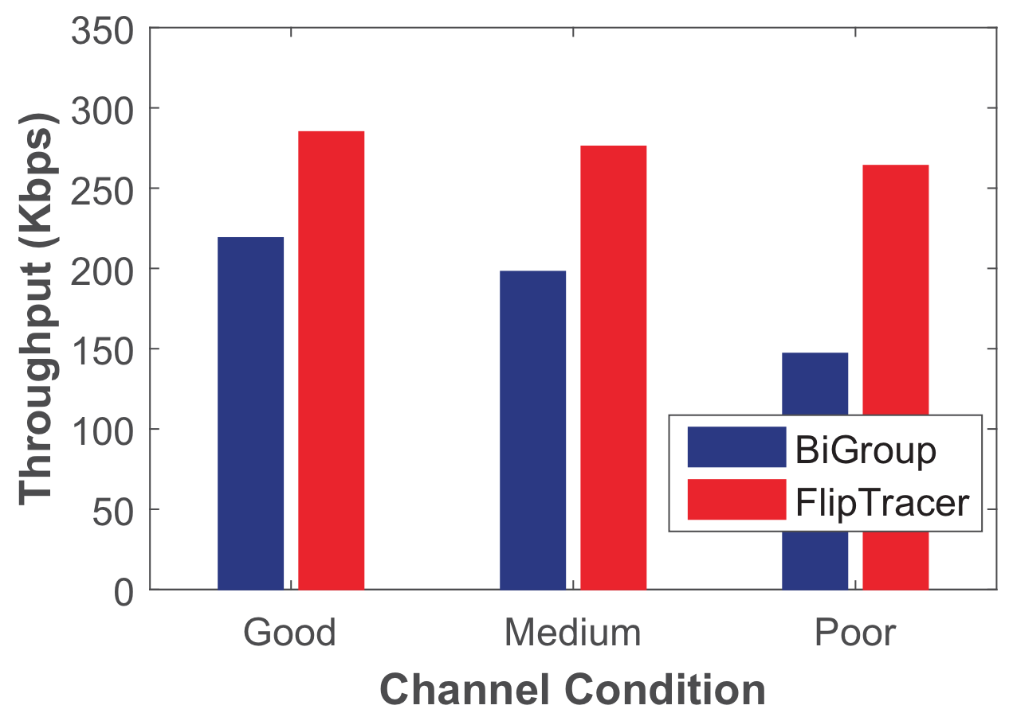
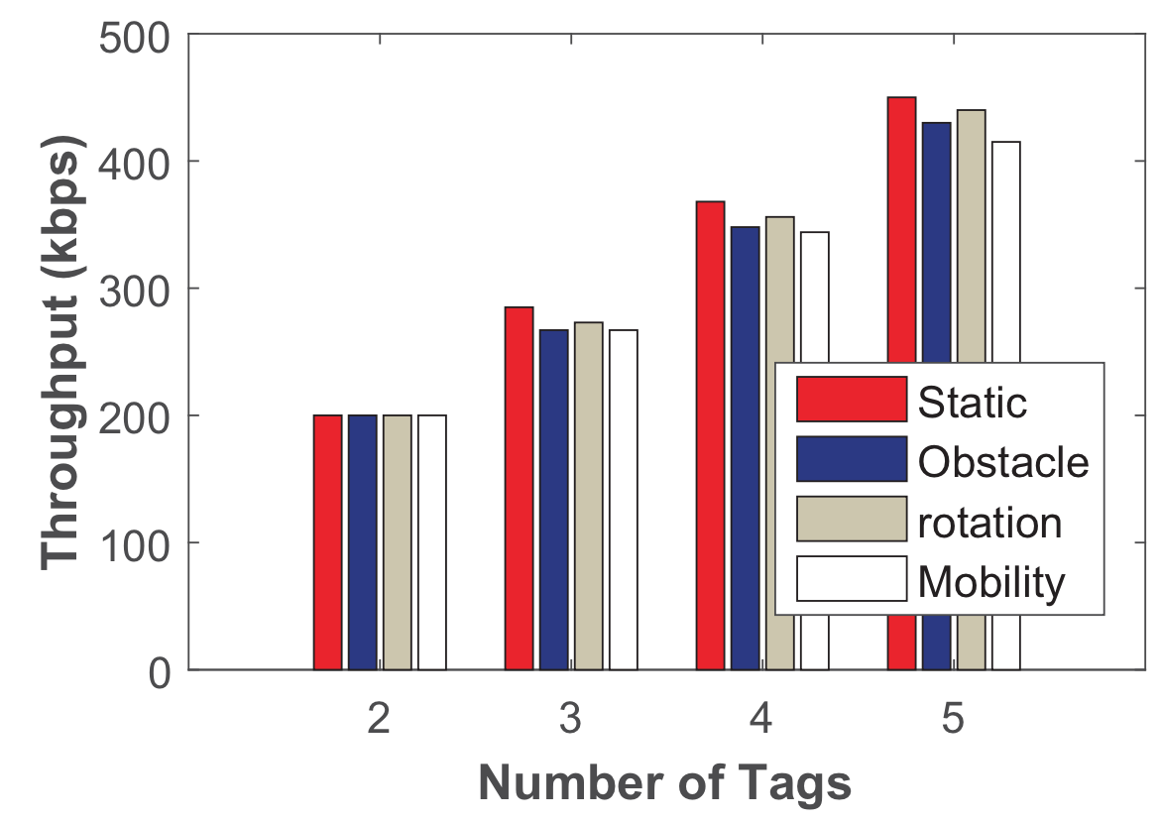
Impact of practical factors
Channel condition
Dynamic environment
20
/22
Notes:
We further conduct experiments under different environments to see the impact of practical factors.
We can see that, FlipTracer is robust to both poor channel condition and dynamic environment.

Slide 37
FlipTracer
First practical effort to achieve highly reliable parallel decoding even when the signal is highly dynamic and irregular.
Provides a new graphical model (OFG) that translates the transition probability between signal clusters to the similarity between their corresponding states.
Implemented on a USRP N210 based RFID reader and evaluated through experiments conducted in different environments
21
/22
Notes:
In conclusion,
FlipTracer is the first…..
To do so, it
It is

Slide 38

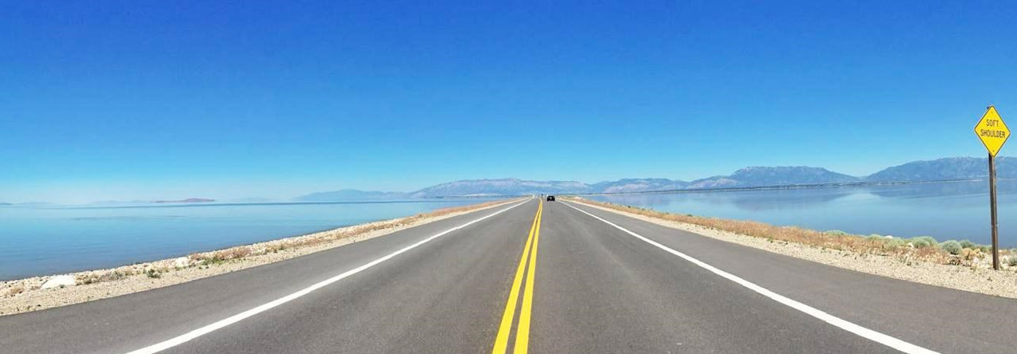
Meng Jin
mengj@stumail.nwu.edu.cn
Notes:
Thank you so much for your attention, I’m happy to take your question

Slide 39
Backups

Slide 40
Finding the “nodes” in the OFG
Belong to the same cluster
Confused symbol
Cluster center
Confused
symbols
Identified
Clustering by fast search and find of density peaks. Science, 344(6191):1492–1496, 2014.
Notes:
Now let me introduce how to clustering the signal symbols.
The challenge we meet here is how to separate the overlapping clusters, which are common in noisy environments.
Specifically, we can find the cluster centers, symbols belong to each cluster based on some existing clustering method.
However, what about the symbols located on the overlapped area?
We call these symbols as confused symbols.
In this paper, we separate the confused symbols based on a intuition that:
the signal will dwell on a certain cluster for a while between two transitions, thus successive symbols are likely to belong to the same cluster.
Therefore, we can identify these confused symbols based on the symbols before and after them.
Then the confused symbols can be separated.
===========
To do this, we first find the cluster centers based on the local densities of the symbols.
And then, we estimate the probability that each symbol I belongs to each cluster ck.
Here, the probability is calculated using a clustering method which has been published in Since at 2014.
The symbols located the have similar Pdi for more than one cluster, we denote symbol I as confused symbol.
We further use time domain information to clustering these confused symbols.
In practice, the signal will dwell on a certain cluster for a while between two transitions, thus successive symbols are likely to belong to the same cluster.

Slide 41
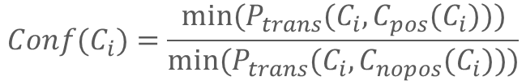
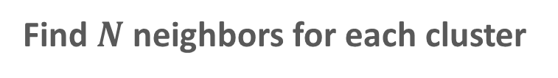
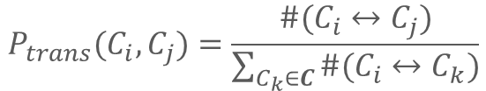
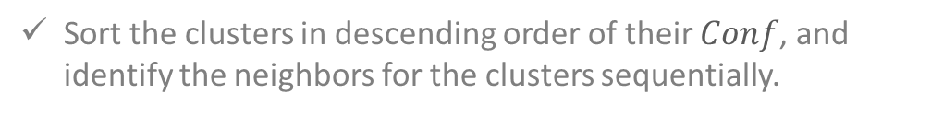
Building the “clusters” in the OFG
Building “connections” in the OFG
Calculate the transition probabilities between clusters
$$P_{trans}(C_{i},C_{j})=\frac{\#(C_{i}↔C_{j})}{\sum_{C_{k}∈C}{\#(C_{i}↔C_{k})}}$$
Find $N$ neighbors for each cluster
Calculate $Conf(C_{i})$ for each cluster $C_{i}$
$$Conf(C_{i})=\frac{min⁡(P_{trans}(C_{i},C_{pos}(C_{i})))}{min⁡(P_{trans}(C_{i},C_{nopos}(C_{i})))}$$
Sort the clusters in descending order of their $Conf$, and identify the neighbors for the clusters sequentially.

Slide 42
Identify the clusters in the first layer
LLL
LLL
1
1
HLL
LHL
LLH
LHL
LLH
HLL
2
3
4
2
3
4
HHL
HLH
LHH
LHH
HHL
HLH
5
6
7
5
6
7
8
8
HHH
HHH
Notes:
In fact, the assignments of the first layer clusters only determines the ID of the tags.
This ID is not the ID that embedded in the packet.
It just used in the parallel decoding process to distinguish or to denote different tags.
For example, in this case, if we denote the tag, which leads to transition between cluster 1 and 2 as Tag no.1.
Then we can denote the combined state of cluster 2 as HLL.
Of course there some other assignments, like this.
And of course the combined state of the clusters have also changed.
But such difference only affects the ID of the tags.

Slide 43
Identify the clusters in the first layer
LLL
LLL
1
1
HLL
LHL
LLH
LHL
LLH
HLL
2
3
4
2
3
4
HHL
HLH
LHH
LHH
HHL
HLH
5
6
7
5
6
7
8
8
HHH
HHH
Notes:
For example, if the reader receives a sequence of signals in the order of cluster 1 2 5 and 8.

Slide 44
Identify the clusters in the first layer
LLL
LLL
1
1
HLL
LHL
2
Tag1: LHHH
Tag2: LLHH
Tag3: LLLH
2
Tag1: LLLH
Tag2: LHHH
Tag3: LLHH
HHL
LHH
5
5
8
8
HHH
HHH
Notes:
Then the sequences transmitted by the three tags are like this.
We can see that,

Slide 45
Identify the clusters in the first layer
LLL
LLL
1
1
HLL
LHL
2
Tag1: LHHH
Tag2: LLHH
Tag3: LLLH
2
Tag1: LLLH
Tag2: LHHH
Tag3: LLHH
HHL
LHH
5
5
There are three tags, the transmitting:
LHHH, LLHH, and LLLH
8
8
HHH
HHH
Notes:
The only difference is the ID of the tags.
It doesn’t matter because what we really care about is:
There are three tags, the transmitting:
LHHH, LLHH, and LLLH
This is enough

Slide 46



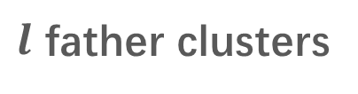


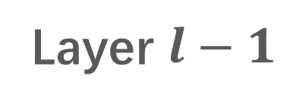
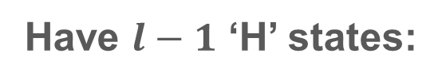
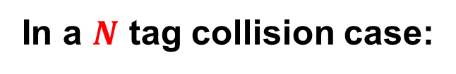

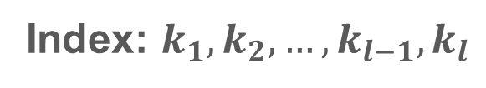
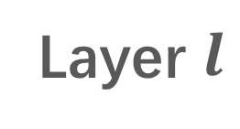
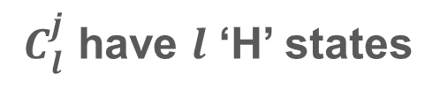

Identify clusters layer by layer
In a $N$ tag collision case:
Have $l−1$ ‘H’ states:
Index:
$$k_{2},k_{3},…,k_{l−1},k_{l}$$
$$k_{1},k_{3},…,k_{l−1},k_{l}$$
$$l$$
Layer $l−1$
$$…$$
$$k_{1},k_{2},…,k_{l−2},k_{l−1}$$
$$……$$
$l$ father clusters
$${ C}_{l}^{j}$$
Layer $l$
${ C}_{l}^{j}$ have $l$ ‘H’ states
Index: $k_{1},k_{2}, …,k_{l−1},k_{l}$
Notes:
Suppose that in a N tag collision case, we what to identify the combined state of a cluster that located at layer L. we denote such cluster as CLJ.
And, of course, the combined state of CLJ has l “H” states. We denotes the index of the H states as k1, to Kl
We also know that, CLJ has L father clusters on Layer l-1.
These father clusters have l-1 H states.
Since the combined states of the father clusters and that of cluster CLJ have only one different state.
So, for these l father clusters, the index of ’H’ states are like this

Slide 47




Identify clusters layer by layer
In a $N$ tag collision case:
Have $l−1$ ‘H’ states:
Index:
$$k_{2},k_{3},…,k_{l−1},k_{l}$$
$$k_{1},k_{3},…,k_{l−1},k_{l}$$
$$l$$
Layer $l−1$
$$…$$
$$k_{1},k_{2},…,k_{l−2},k_{l−1}$$
$$……$$
$l$ father clusters
$${ C}_{l}^{j}$$
Layer $l$
${ C}_{l}^{j}$ have $l$ ‘H’ states
Index: $k_{1},k_{2}, …,k_{l−1},k_{l}$
Notes:
Since the combined states of these father clusters have been identified, the index k1 to kl are known.
So,,,

Slide 48
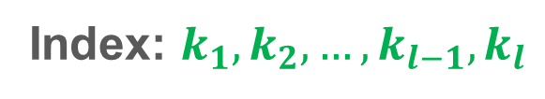
Identify clusters layer by layer
In a $N$ tag collision case:
Have $l−1$ ‘H’ states:
Index:
$$k_{2},k_{3},…,k_{l−1},k_{l}$$
$$k_{1},k_{3},…,k_{l−1},k_{l}$$
$$l$$
Layer $l−1$
$$…$$
$$k_{1},k_{2},…,k_{l−2},k_{l−1}$$
$$……$$
$l$ father clusters
$${ C}_{l}^{j}$$
Layer $l$
${ C}_{l}^{j}$ have $l$ ‘H’ states
Index: $k_{1},k_{2}, …,k_{l−1},k_{l}$
Notes:
Thus the combined state of cluster CLJ can be identified accordingly.

Slide 49
Parallel decoding
Using predictable state flipping pattern of the standardized FM0/Miller code.
It is a obvious error if two chips on the opposite sides of a bit boundary have the same state.
Abnormal bit boundary
We use a Conditional Random Field based decoder
to correct bit errors
Suspicious segment
Notes:
We just use the predictable state flipping pattern of the standardized code.
Here we use the fm0 code as a vehicle to describe our method.
FM0 code inevitably inverts the signal state at every bit boundary.
Thus it is a obvious error if two chips on the opposite sides of a bit boundary have the same state.
We term such a bit boundary as an abnormal bit boundary…
and the state sequence with a length of 6 chips centered at this abnormal boundary is considered as a suspicious segment.
Once we detect an abnormal bit boundary, we use a Conditional Random Field based decoder to correct the errors in the corresponding segment.

Slide 50
Identify the combined states of the clusters
How to identify the layer-1 clusters?
LLL
LLL
Root
1
1
Tag1
Tag3
Tag2
One H state
Layer1
HLL
LHL
LLH
2
3
4
Layer2
Layer3
Notes:
Clearly, the combined states of the first layer nodes have only one H state.
In fact, the index of the H state in the combined state only means the ID of the tags（我们指定的）.
If we denote the tag that cause transitions between node 1 and 2, node 1 and3, node 1 and 4 as tag no.1, no2, and no3, then we can identify node 2 as HLL, node 3 as LHL, and node 4 as LLH.
========
In the same way, if we identify the tag that cause the transition between cluster 1 and cluster 3 as tag no. 2, we identify the cluster 3 as LHL, and then cluster 4 LLH.

Slide 51
Identify the combined states of the clusters
How to identify a cluster based on its upper layer neighbors?
LLL
LLL
Root
1
1
Layer1
HLL
LHL
LLH
2
3
4
Layer2
5
Which states are the ‘H’ states?
Layer3
15
/22
Notes:
Then we show that we can identify a cluster based on its upper layer neighbor clusters.
Here we take node 5 as an example
Since node 5 is on second layer, thus we know its combined state must have two H states.
But how can we identify the H states of node 5.
Indeed, we can identify the H states use the neighbors of node 5 that in the upper layer, whose combined state have been identified.
Clearly, node 5 must have two neighbors on the first layer, whose combined states have only one H state.
They are node 2 and node 3.

Slide 52
Identify the combined states of the clusters
How to identify a cluster based on its upper layer neighbors?
LLL
LLL
Root
1
1
Layer1
HLL
LHL
LLH
2
3
4
Layer2
5
Layer3
Notes:
Since these two neighbors have been identified as HLL and LHL

Slide 53
Identify the combined states of the clusters
How to identify a cluster based on its upper layer neighbors?
LLL
LLL
Root
1
1
Layer1
HLL
LHL
LLH
2
3
4
HHL
HLH
LHH
Layer2
5
6
7
Layer3
15
/22
Notes:
So we can identify the combined state of node 5 as HHL,
And similarly, the combined state of node 6 must be HLH, and that of node 7 must be LHH.

Slide 54
Identify the combined states of the clusters
How to identify a cluster based on its upper layer neighbors?
LLL
LLL
Root
1
1
Layer1
HLL
LHL
LLH
2
3
4
HHL
HLH
LHH
Layer2
5
6
7
Layer3
8
HHH
Notes:
Then, we can also identify node 8 as HHH in the same way.

Slide 55
Identify the combined states of the clusters
How to identify a cluster based on its upper layer neighbors?
LLL
LLL
Root
1
1
Layer1
HLL
LHL
LLH
2
3
4
HHL
HLH
LHH
Layer2
5
6
7
Layer3
8
HHH
15
Notes:
Now, the combined states of all the nodes are identified.

