Slide 1


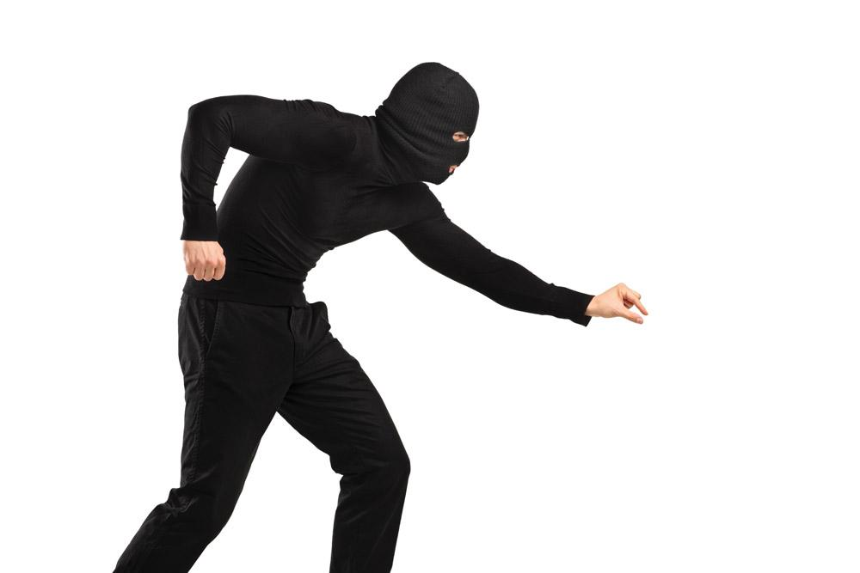
iGuard
A Real-Time Anti-Theft System for Smartphones
Meng Jin¹, Yuan He², Dingyi Fang¹,
Xiaojiang Chen¹, Xin Meng¹, Tianzhang Xing¹
¹Northwest University
²Tsinghua University
INFOCOM’17 Presentation

Slide 2
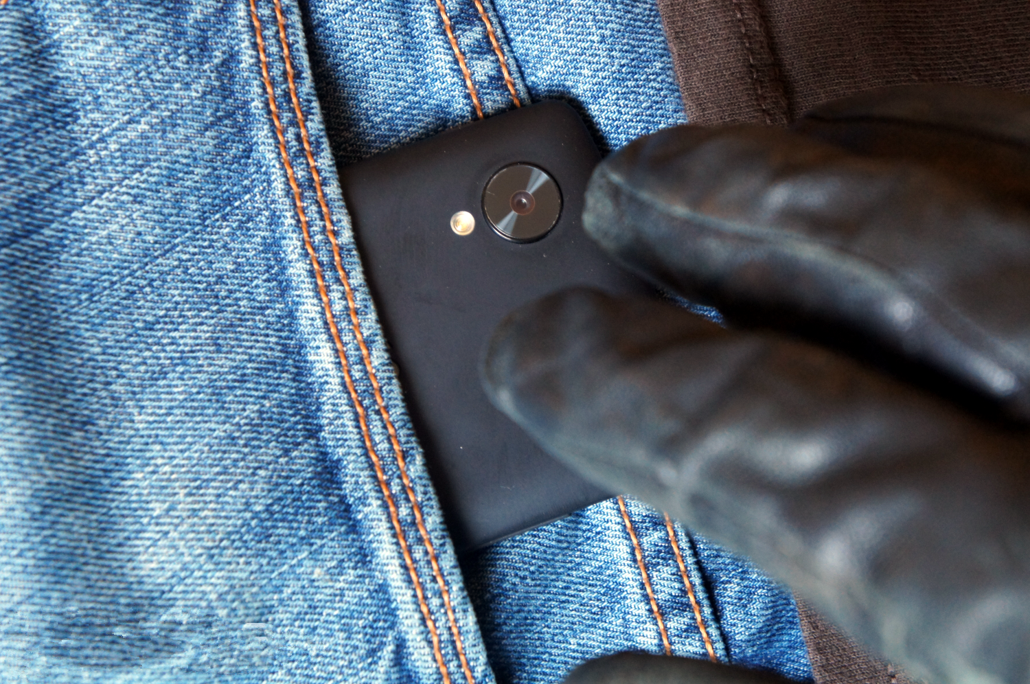
Smartphone thefts rose to 3.1 million in the U.S.

Slide 3

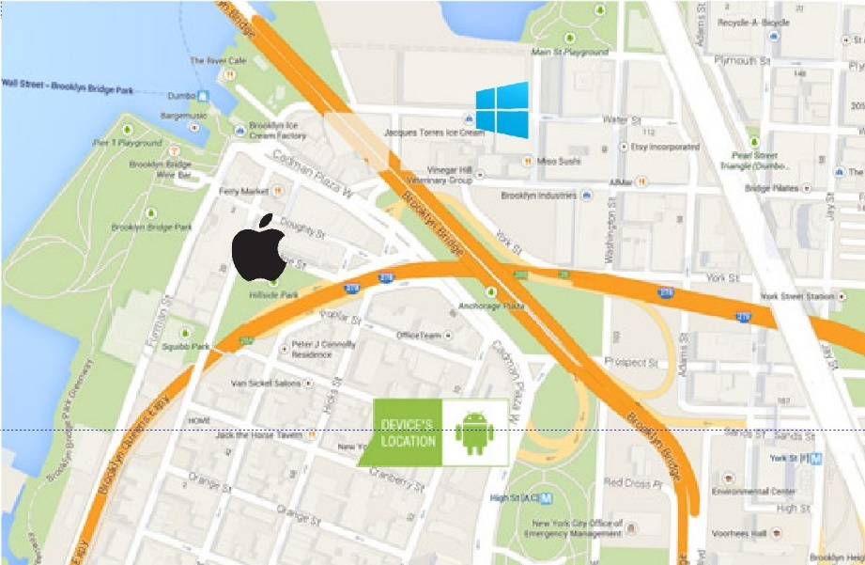
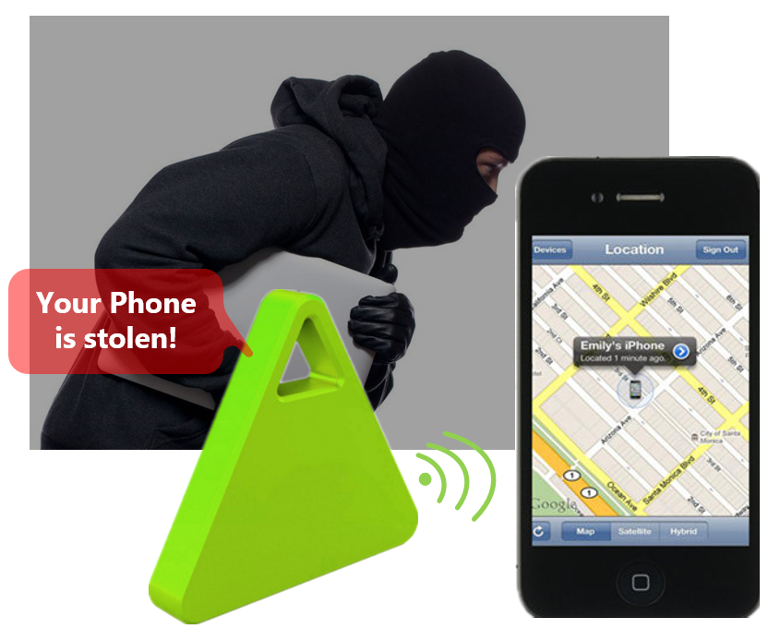
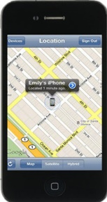
Smartphone Anti-theft
Track the Stolen Smartphone
Anti-theft device
Cannot protect the phone from being stolen
Require dedicated hardware

Slide 4
Smartphone Anti-theft
Our goals:
  Highly sensitive and accurate
  Easy to use under all kinds of scenarios
Utilize the built-in sensing capability
on the smartphones

Slide 5
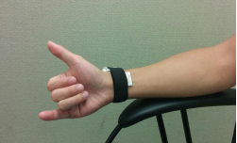



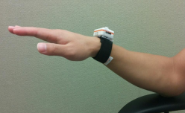

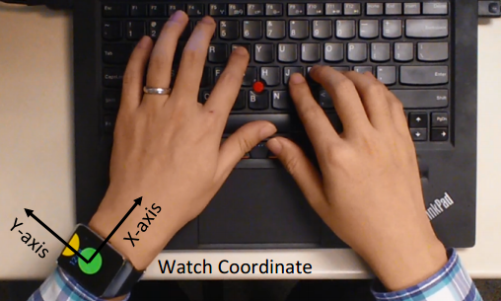
Real-time activity recognition
Identifying pre-defined or distinctive behaviors
Stealing behavior will be confused with the “take-out” motion performed by the owner!

Slide 6
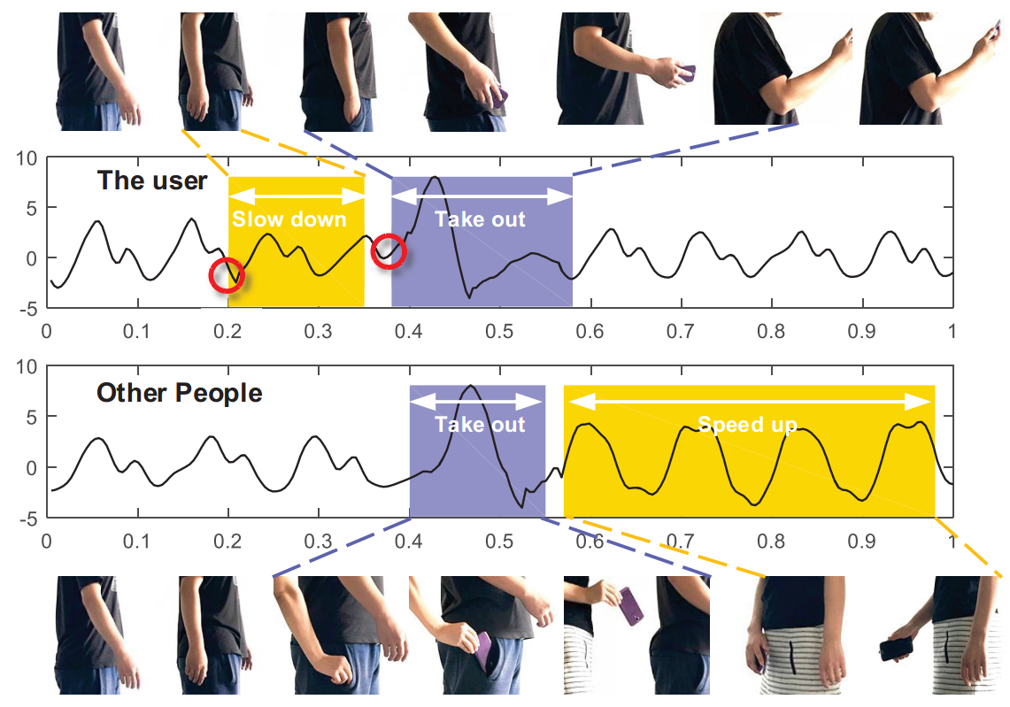
Our Approach: iGuard
Identifying steal behavior using a motion sequence.
Distinctive order of
motion
Owner
Thief
Distinctive features of independent motions
order of the motions +
pattern of each independent motion

Slide 7
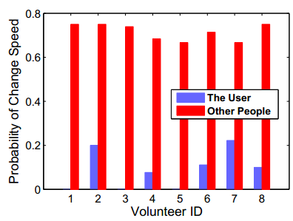
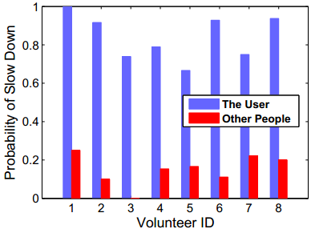
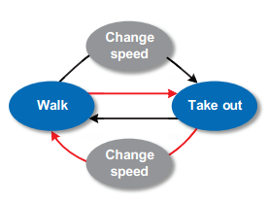
Motion Sequence
Slow Down
Take out
Owner
Accl
Thief
Accl
Speed-up
Normalized Time
Motion Sequence:
Owner: Walking, Speed change, Take Out, Walking
Thief: Walking, Take Out, Speed Change, Walking

Slide 8
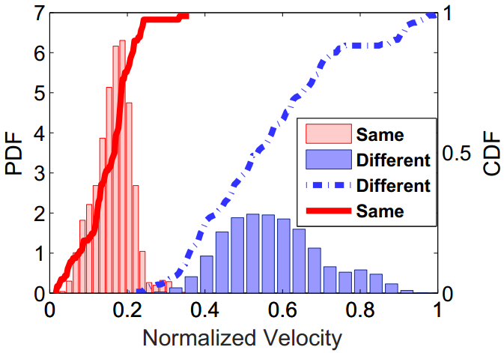
Independent Motion - Walking
The walking motion performed by the owner and the thief
Same Person
Accl
Normalized Time
Different Person
Accl
Normalized Time

Slide 9
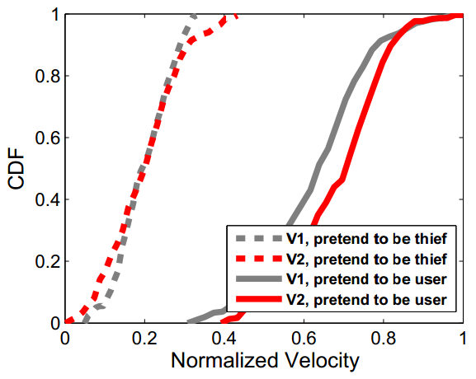
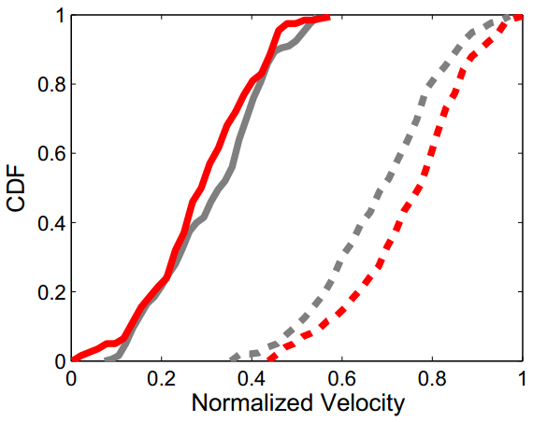
Independent Motion – Take-out
The take-out motion performed by the owner and the thief
Thief
User
Slow
Fast
Constant speed
Slow
Fast

Slide 10

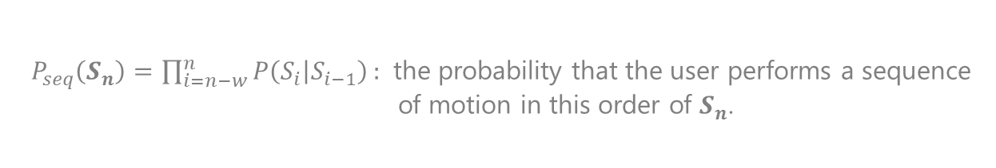
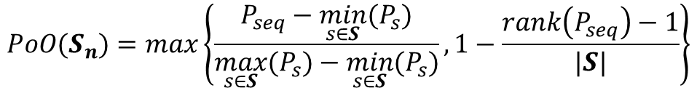
SAM: A Model for Theft Detection
Assuming the currently detected motion sequence is:
$$S_{n}=\{S_{n−1}, …,S_{n−w}\}$$
window for activity analysis
PoO: how likely the user performs a sequence of motion in the order
of $\{S_{n−1}, …,S_{n−w}\}$
$$PoO(S_{n})=max⁡\left\{\frac{P_{seq}−\min_{s∈S}{(P_{s})}}{\max_{s∈S}{(P_{s})}−\min_{s∈S}{(P_{s})}}, 1−\frac{rank\left(P_{seq}\right)−1}{|S|}\right\}$$
PoS: denote the probability that the motion $S_{i}$ is performed by the user himself/herself as $PoS(S_{i})$, we have
s$P_{seq}\left(S_{n}\right)=\prod_{i=n−w}^{n}{P\left(S_{i} | S_{i−1}\right)}:$ the probability that the user performs a sequence
of motion in this order of $S_{n}$.
$S :$ the set of all the possible motion sequences
$$PoS(S_{n})=\left\{PoS\left(S_{n−1}\right), …,PoS\left(S_{n−w}\right)\right\}$$
$rank\left(P_{seq}\right) :$ the ranking of $P_{seq}$ among all the $P_{s}$ ($s∈S$)
$P_{self} (S_{n})$: Joint consideration of both PoS and PoO
$P_{self} (S_{n})$ = $PoO(S_{n})⋅min\left\{PoS\left(S_{n−1}\right), …,PoS\left(S_{n−w}\right)\right\}$

Slide 11
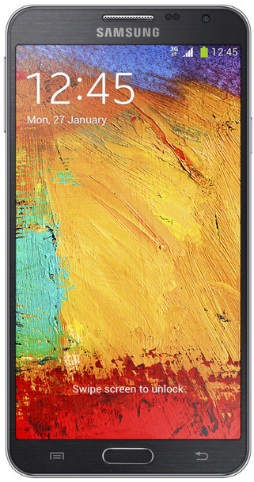
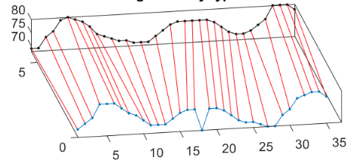
iGuard Design
Training
Motion Sequence
+ SAM Model
PoO
Estimation
P(S_{i+1}|S_{i})
LR Classifier
Sub-segmentation
+ LR Classifier
Motion Segment
Estimating PoS of the take-out motion
Walking
Take-out
Estimating PoS of the walking motion
SAM Model
Speed Change
DTW
algorithm
Alarm

Slide 12
iGuard Design: Motion Segment
Speed Change
Take out
Accl
Motion Segment
Accl
Walking
Speed Change
Normalized Time
Take-out
Target of motion segment:
Speed Change
Start and end points of the take-our motion
Point for speed change

Slide 13

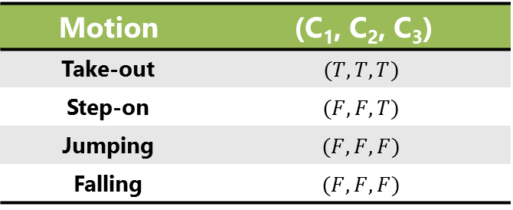

Motion Detection: Take-out
Extract the take-out motion
$$R_{i}^{(b)}=S_{i}−S_{i−τ}$$
$$R_{i}^{(f)}=S_{i}−S_{i+τ}$$
Take-out identification
Motion | (C₁, C₂, C₃)
Take-out | $$(T, T, T)$$
Step-on | $$(F, F, T)$$
Jumping | $$(F,F,F)$$
Falling | $$(F,F,F)$$
√
- C1: $VAR≤{VAR}_{max}^{take}$
- C2: $TD≤{TD}_{max}^{take}$
- C3: $AMP≤{AMP}_{max}^{take}$
End
Start
Accl Variance
Peak Accl
Motion Duration

Slide 14
Motion Detection: Speed Change
Change Point
ACC
CUSUM_{lo}
Change Point
Normalized Time
Normalized Time
Detect the speed change point
Detect small changes
Insensitive to data dynamic
Cumulative Sum (CUSUM) test
$${CUSUM}_{hi}(i)=max⁡(0,{CUSUM}_{hi}\left(i−1\right)+ave\left(i\right)−T−k)$$
$${CUSUM}_{lo}(i)=max⁡(0,{CUSUM}_{lo}\left(i−1\right)+T−ave\left(i\right)−k)$$

Slide 15
iGuard Design: PoS Estimation
Motion Sequence
+ SAM Model
PoO
Estimation
Sub-segmentation
+ LR Classifier
Motion Segment
Estimating PoS of the take-out motion
Walking
Take-out
Estimating PoS of the walking motion
Speed Change
DTW
algorithm

Slide 16
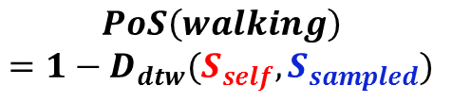
PoS Estimation: walking
PoS of walking motion = Similarity ($S_{self},S_{sampled}$)
Before take-out motion
After take-out motion
ACC
ACC
Time
Time
Dynamic time warping (DTW)
Accl
$$PoS\left(walking\right)$$
$$=1−D_{dtw}(S_{self},S_{sampled})$$
Time

Slide 17
PoS Estimation: take-out
The features extracted from sub-segments of a take-out motion exhibit higher differentiation degree.
Feature | Description | Category
Speed | Mean value of the ovement speed of the smartphone
distZ | Vertical displacement of the smartphone
distXY | Horizontal displacement of the smartphone
dist | Net displacement between the rest position and the peak position
Roll velocity | Median angular velocity around the Y axis
Roll | Net angular change around the Y axis
Pitch velocity | Median angular velocity around the X axis
Pitch | Net angular change around the X axis
Accl
Normalized Time
PoS is obtained using the logistic regression classifier
Its output ranges from 0 to 1
Computational simplicity

Slide 18

iGuard Design: theft detection
Training
PoO
Estimation
P(S_{i+1}|S_{i})
LR Classifier
Motion Sequence
Sub-segmentation
+ LR Classifier
Motion Segment
Estimating PoS of the take-out motion
Walking
Take-out
Estimating PoS of the walking motion
SAM Model
Speed Change
$$P_{Self}(S_{n})$$
DTW
algorithm
Alarm

Slide 19



iGuard Design: theft detection
$$S_{n}=\{S_{n−1}, …,S_{n−w}\}$$
$$PoO$$
Motion detection
$$P_{self}(S_{n})$$
$$PoS(S_{n}) =\{PoS(S_{n−1}), …,PoS(S_{n−w})\}$$
PoS estimation
Overlap
Threshold=0.39

Slide 20
Experimental Setup
Sumsung Galaxy S4/S5/Note3
  Sample accl and gyro at 200Hz
8 volunteers
  Ages range from 19 to 27.
  5 male, 3 female
2 scenarios
  a corridor in a university building
  a campus with a testing area of 365×535m²

Slide 21
Comparison
Comparison
  iGuard: the proposed system in this paper.
  PoS based method: theft-detection using only the PoS of the take-out motion.
  PoO based method: theft-detection using only the PoO of the motion sequence.
  Feature-based method: theft-detection based on the features extracted from the entire take-out

Slide 22
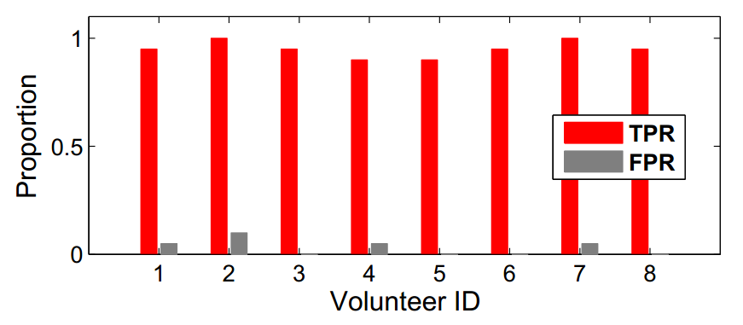
Corridor Experiment
Performance of iGuard in a relatively ideal condition (straight road without stair and curve) in the corridor.
0.9
0.1
 | iGuard | PoS | PoO | Feature based
TPR | 95 | 87 | 72 | 76
FPR | 0.04 | 0.09 | 0.22 | 0.15

Slide 23
An instant trace

Slide 24
An instant trace
Roundabout
Roundabout
TPR
FPR
Normalized Time

Slide 25
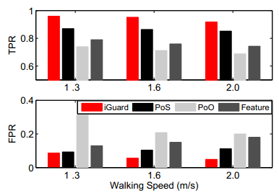
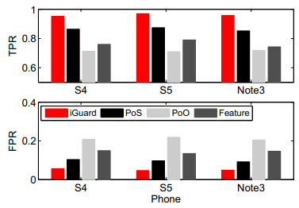
Robustness of iGuard
Different walking speed: 1.3m/s, 1.6m/s, 2.0m/s
Different smartphone: Sumsung S4, S5 and note3

Slide 26
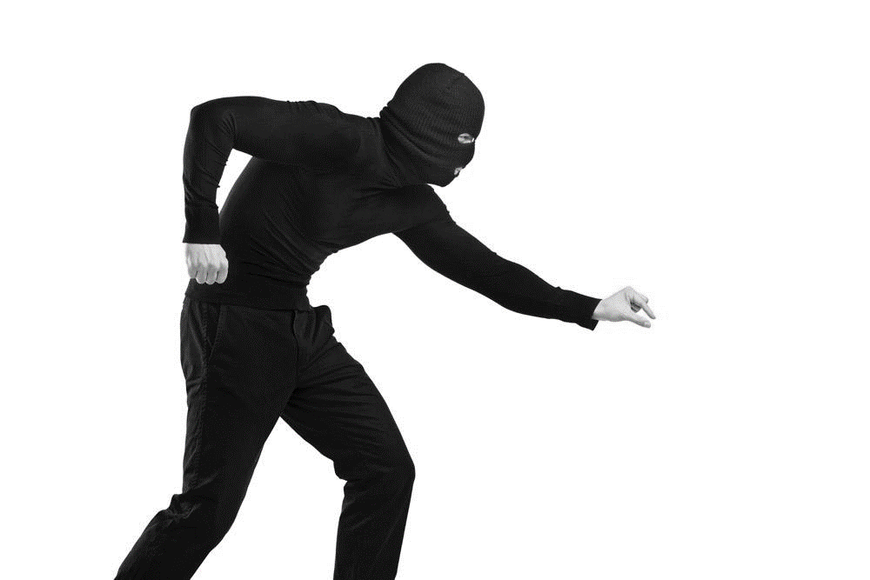
Conclusion
iGuard: Real-Time Theft Detection for Smartphones
SAM: A model to continuously track motions of the smartphone user and detects theft behavior with high sensitivity and accuracy.
Extensive experiments demonstrate the effectiveness of iGuard.

Slide 27


Meng Jin
mengj@stumail.nwu.edu.cn

