Slide 1

RF-Transformer:
A Unified Backscatter Radio Hardware Abstraction
Xiuzhen Guo¹, Yuan He¹, Zihao Yu¹, Jiacheng Zhang¹,
Yunhao Liu¹, Longfei Shangguan²
¹Tsinghua University
²University of Pittsburgh
Notes:
Hello everyone, I'm Xiuzhen from Tsinghua University.
Today,I’m going to share with you our recent work: /
“RF-Transformer: A Unified Backscatter Radio Hardware Abstraction”

Slide 2




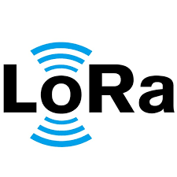


Internet of Things
Tag
Agricultural monitoring
Smart city
Health protection
Battery-free
Intelligent manufacturing
Building management
Smart home
Notes:
The Internet of Things aims to networking everything in our physical world, and allow them to be sensed or controlled remotely.
(点)
Backscatter promises to be an extremely low power, smaller and cheaper method to connect everything.

Slide 3
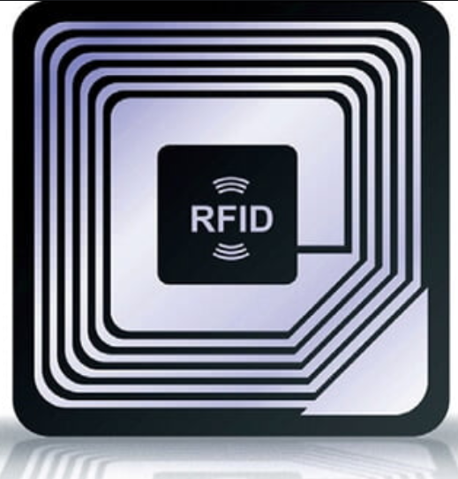
Internet of Things
Tag
标签
Agricultural monitoring
Smart city
Health protection
Battery-free
Backscatter Tag
Tag
Intelligent manufacturing
Building management
Smart home
Notes:
The Internet of Things aims to networking everything in our physical world, and allow them to be sensed or controlled remotely.
(点)
At the same time, backscatter promises to be an extremely low power, smaller and cheaper method to connect everything.

Slide 4

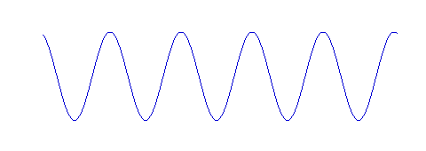
Backscatter Communication
The backscatter radio modulates data on top of an incident carrier signal
Tag
Carrier Signal
Backscatter Signal
Notes:
As you can see, backscatter radios does not generate the carrier. Instead, it takes the signals sent from the gateway as the carrier signals, and modulate its own data on top of the carrier signals. Compared with active radios, backscatter radios are more power efficient

Slide 5
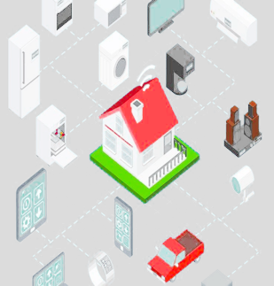


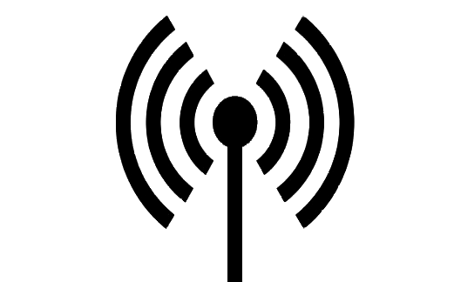


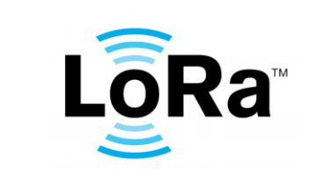
Wireless Heterogeneity
How to seamlessly integrate backscatter radios into heterogeneous wireless networks?
Backscatter
Tag
Notes:
Nowadays, the wireless Heterogeneity [ˌhɛtərədʒɪˈniəti] brings new challenges to the backscatter radios.
As we all know, the proliferation of IoT applications brings about the dense deployments of various devices, such as Wi-Fi, ZigBee, Bluetooth, LoRa.
The coexistence of heterogeneous wireless devices puts forward more stringent requirements for the adaptability and flexibility of the backscatter design.
(点)
In order to integrate seamlessly into heterogeneous wireless networks, the backscatter radio should be able to interplay directly with different technologies while maintaining ultra-low power consumption.

Slide 6
Existing Backscatter Designs
WiFi backscatter
LoRa backscatter
LoRa RX
Tailored Design
Limit Feasibility
Low Adaptability
6
Notes:
However, most of existing backscatter systems are tailored to a
specific wireless technology but lack flexibility.
For example, WiFi backscatter tag reflects WiFi signals, but can't generate LoRa signals. Because Wi-Fi and LoRa share different physical layer designs.
（点）
such a tailored backscatter design results in low adaptability,
obstructs [əbˈstrʌkts] its practical deployment in heterogeneous wireless networks.

Slide 7
Can we build a unified backscatter radio?
Notes:
So，we ask the following question: Is it possible to build a programmable backscatter radio that can generate different types of wireless signals while retaining ultra low power consumption?

Slide 8
A Unified Backscatter Hardware
Programmable
Feasible
Adaptable
Notes:
In this paper, we give an affirmative [əˈfɜːrmətɪv] answer.
（点）
We present RF-Transformer, a unified backscatter radio hardware abstraction that supports generating different wireless signals.
In other words, on top of the carrier signal, RF-Transformer can generate different amplitude-modulated, phase-modulated, and frequency-modulated signals.
（点）
So, RF-Transformer can realize the LoRa backscatter, ZigBee backscatter, Bluetooth backscatter, and WiFi backscatter links at the same time.

Slide 9
Design
Notes:
Next we introduce the design of RF-Transformer.

Slide 10
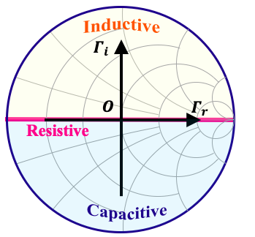
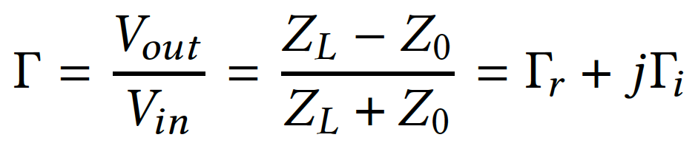





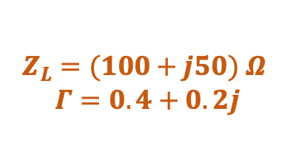










Load Impedance Modulation
Transmission-line theory
Smith chart
$$P$$
$$A$$
$$B$$
$$Γ=−1$$
$$Γ=1$$
Tag
$${(Z}_{L}=−∞)$$
$$Γ=0$$
$${(Z}_{L}=∞)$$
$${(Z}_{L}=50Ω)$$
ZL1
ZL2
ON
Absorbing
$$Z_{L}=Z_{0}$$
$$Γ=0$$
“O”
Reflection
coefficient
$$Z_{L}=+∞$$
$$Γ=1$$
“B”
OFF
Reflecting
$$Z_{L}=−∞$$
$$Γ=−1$$
“A”
Amplitude=0.45X
Phase = 26.6º
$Z_{L}=(100+j50)$ $Ω$
$$Γ=0.4+0.2j$$
Complex value
“P”
Notes:
The basic idea of RF-Transformer is load impedance modulation. This is inspired by ON-OFF Keying modulation in RFID systems.
We define Γ as the reflection coefficient, and it is determined by the degree of mismatch between the source impedance and the load impedance.
The RFID tag alternates between two states.
（点）For instance, when the source impedance perfectly matches the load impedance, the reflection coefficient Γ becomes zero, indicating the incident signal absorbed [əbˈzɔːrbd]. The center point ”O" in the Smith chart shows this case.
（点）In contrast, when the source impedance and the load impedance are totally mismatched, the reflection coefficient Γ becomes "1". In this case, the incident signal will be totally reflected by the radio antenna. The point ”A” or ”B” in the Smith chart shows this case.
However, In practice, （点）the reflection coefficient Γ is a complex value. （点）For example, as shown in the point ”P”in the simth chart.In this case, the amplitude and phase of the reflected signals will be changed.
From the above analysis, we can find that it is possible to generate different backscatter signals by changing the load Impedance. We call this method as load impedance modulation.

Slide 11


















How to Alter the Load Impedance?
Building a lookup table
Resistance & reactance → amplitude & phase
Smith chart
$$R$$
$$Q$$
$$P$$
$$S$$
$$B$$
$$A$$
$$A$$
$$O$$
$$Γ=−1$$
$$Γ=1$$
$$A$$
$$O$$
$$P$$
$$Q$$
$$R$$
$$S$$
$$T$$
$${(Z}_{L}=−∞)$$
$$Γ=0$$
$${(Z}_{L}=∞)$$
$$T$$
$${(Z}_{L}=50Ω)$$
Z1
Z2
Z3
Z4
Z51
Z52
Z53
Z1
Z2
$$U$$
$$V$$
Impossible to enumerate all load impedance through the combination of resistors, capacitors, and inductors
Notes:
While the idea of load impedance modulation is compelling [kəmˈpelɪŋ], practicing this idea is still challenging.
To generate any type of wireless signal,
（点）
an intuitive solution would be building a lookup table from impedance to reflected signal through the guidance of the Smith chart.
To make this solution work, we have to design a dynamic matching network that allows backscatter radio to change the impedance load using a switching circuit.
（点）
However, it is difficult, even impossible, to enumerate [ɪˈnuːməreɪt] all load impedance. In addition, such design based on a lookup table adds weight, cost, and form factor to backscatter radios.

Slide 12
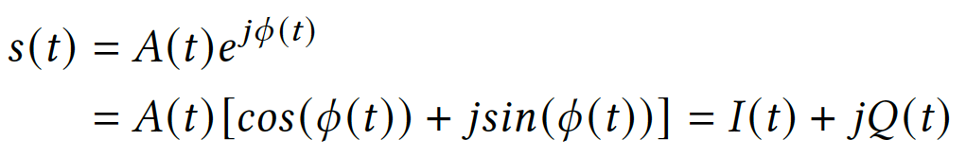
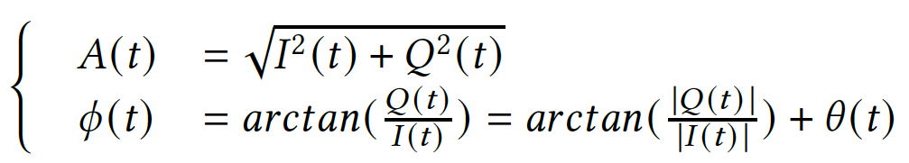









Insight from Euler’s Formula
Euler’s formula :Any RF signal can be represented as a complex value on a constellation diagram
$$Q(t)$$
$$S(t)$$
$$A$$
$$∅$$
$$I(t)$$
The signal amplitude and phase can be represented by:
$$S(t)$$
$$I(t)$$
Alter the amplitude
of I(t) and Q(t)
$$Amplitude$$
Alter load impedance
$$Q(t)$$
Notes:
In order to program the load impedance, we leverage the insight from Euler [ˈɔɪlər] formula [ˈfɔːrmjələ] .
（点）
If we define 𝐼 (𝑡 )and 𝑄(𝑡 ） are in-phase and quadrature components. Then the signal amplitude and phase can be represented.
（点）
This equation indicates that one can generate any backscatter waveforms by changing only the amplitude of their in-phase and quadrature components.
Accordingly, we transform the sophisticated impedance modulation into
the resistive-only load control.

Slide 13
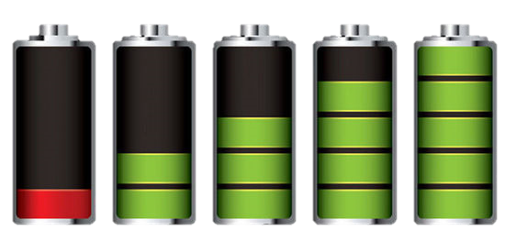
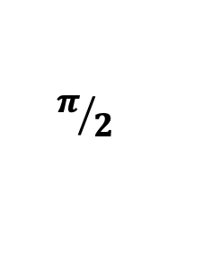
How to Build the Circuit?
Mixer
I(t)
x
DAC
Cos
Local
oscillator
S(t)
$$π/2$$
Sin
Tag
y
DAC
Q(t)
Traditional QAM transmitter
40 mW
< 1 mW
Notes:
Based on the above observation， the next question is how to build the circuit to control the amplitude of the i-path and the Q-path?
（点）
The traditional QAM transmitter uses the local oscillator, mixer, and DAC. However, these operations are power-intensive.
(点)
So the traditional QAM transmitter design is ill-suited [ɪl ˈsuːtɪd] for the backscatter tag.

Slide 14
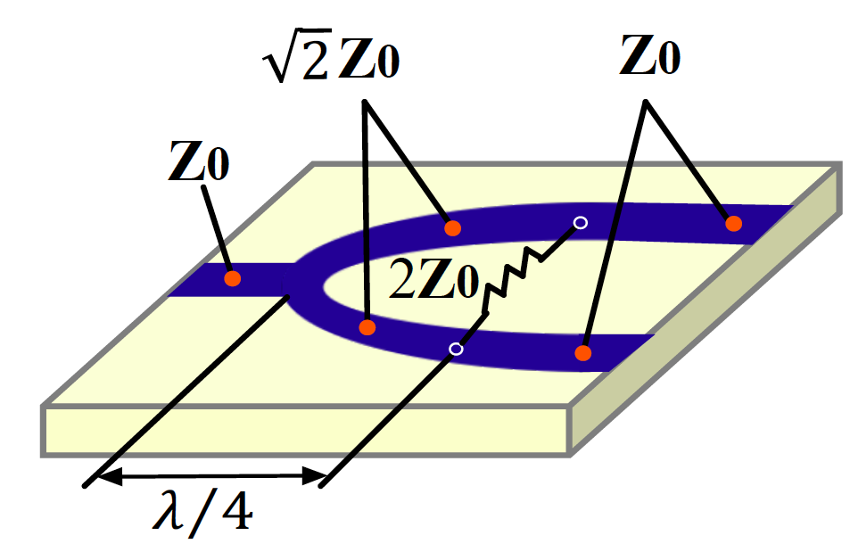
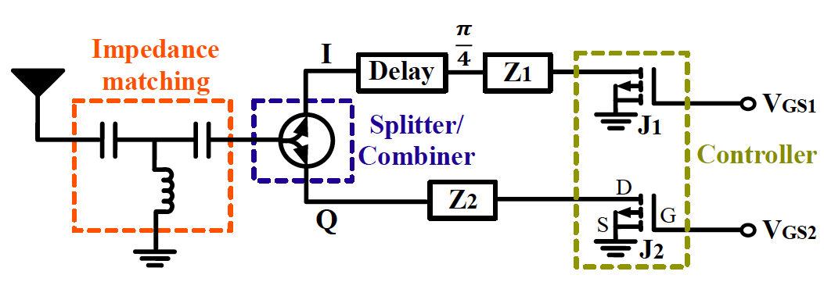
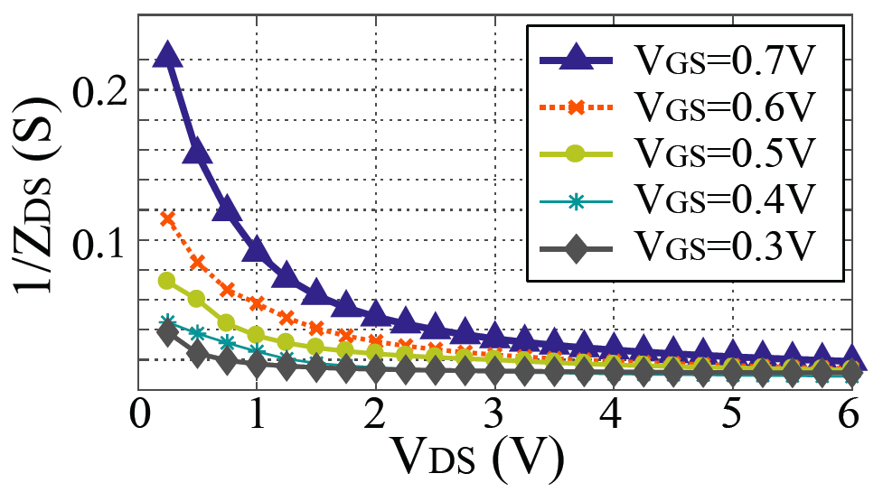
Ultra-low Power Circuit
Wilkinson power splitter/combiner
Split and combine I(t) and Q(t)
Control the amplitude of I(t) and Q(t)
Passive
Impedance-voltage relationship
MOSFET transistor
Notes:
How to modulate the amplitude of the I-path and Q-path while retaining the low-power nature of backscatter radio?
To answer this question, we leverage a passive RF splitter.
As you can see, （点）the carrier signal first goes through an impedance matching circuit to guarantee most of their energy absorbed by the antenna. （点）Next, we
get two copies of the carrier signal by passing t through a passive power splitter.
（点）
These two signal copies propagate along two separate paths. We add a delay line to one of the paths to shift the phase of the signal.
（点）
To modulate the signal power along these two paths, we connect
each path to a MOSFET transistor.
Evidently, as we increase the bias voltage [ˈvoʊltɪdʒ] , the load impedance of this transistor drops, which will change the reflected signal.
================
Specifically, this Figure shows the schematic of this circuit design.

Slide 15
Modulation Space
Q(t)
0.9V
Modulation space
0V
S
0V
0.9V
I(t)
Amplitude
modulation
Phase
modulation
Frequency
modulation
√
√
？
Notes:
To better understand the load impedance modulation, （点）we sweep the bias voltage and plot the impedance of the backscatter radio in the Smith chart.
As you can see in this figure, the dashed points in blue represent a set of reflection coefficients.
We term the coverage area of these dashed [dæʃt] points as the modulation space of this backscatter radio.
（点）
Each reflection coefficient represents the amplitude and phase of the backsatter signal.
So the load impedance modulation circuit allows RF-Transformer
to generate any type of amplitude-modulated and phase-modulated backscatter signals.
So We next will explain how to generate frequency-modulated signals by using this design.

Slide 16

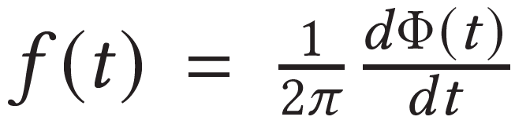
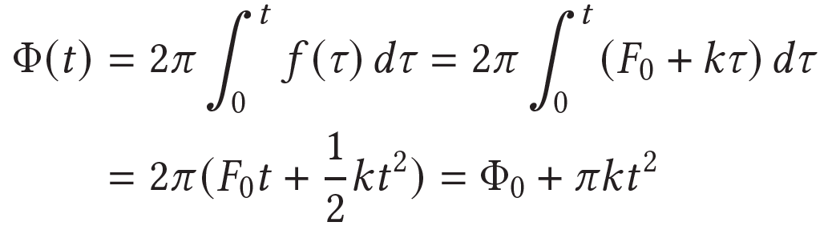
Extending to Frequency Modulation
Frequency-modulated signals, such as LoRa
Frequency
t
Frequency is the derivative of phase
Amplitude
Frequency-modulated signal → Phase-modulated signal
t
Phase
t
Notes:
We take LoRa as an example. （点）Each LoRa symbol is represented
by a chirp whose frequency changes linearly [ˈlɪniərli] over time.
It is understandable that the frequency of a LoRa symbol
can be derived [dɪˈraɪvd] by the phase changing rate.
（点）
Accordingly, The frequency modulated signal can be transformed into the phase modulated signal.

Slide 17
Optimizing the Modulation Space
The continuity of amplitude settings over the entire phase space $[0,2π]$,
the effective modulation space of this radio will shrink
Q(t)
Q(t)
0.9V
0.9V
Modulation space
Q(t)
Modulation space
0.9V
0V
0V
S
S
0V
0V
0V
S
0.9V
0.9V
0V
I(t)
0.9V
I(t)
I(t)
Adding series capacitance → Modulation space becomes larger
Notes:
Let’s review the modulation space we mentioned.
There are a set of reflection coefficients represented by the dashed points. （点）However, in order to guarantee the continuity [ˌkɑːntɪˈnuːəti] of the amplitude over the entire phase space,
the effective modulation space of this radio will shrink to a circular area, the area in orange in this figure.
This indicates that the backscattered signals tend to be weak and their communication range will suffer accordingly.
So We design a matching circuit to optimize the modulation space.
(点)Following the design principles, we add capacitors in series and (点) the modulation space will be rotated counterclockwise.
Compared to the initial modulation space, we can see the effective modulation space becomes significantly larger.
This allows RF-Transformer to generate different types of backscatter signals without sacrificing too much of communication range.

Slide 18
Implementation & Evaluation
Notes:
The above is the design of RF-Transformer.
Next, we introduce the implementation and evaluation.

Slide 19
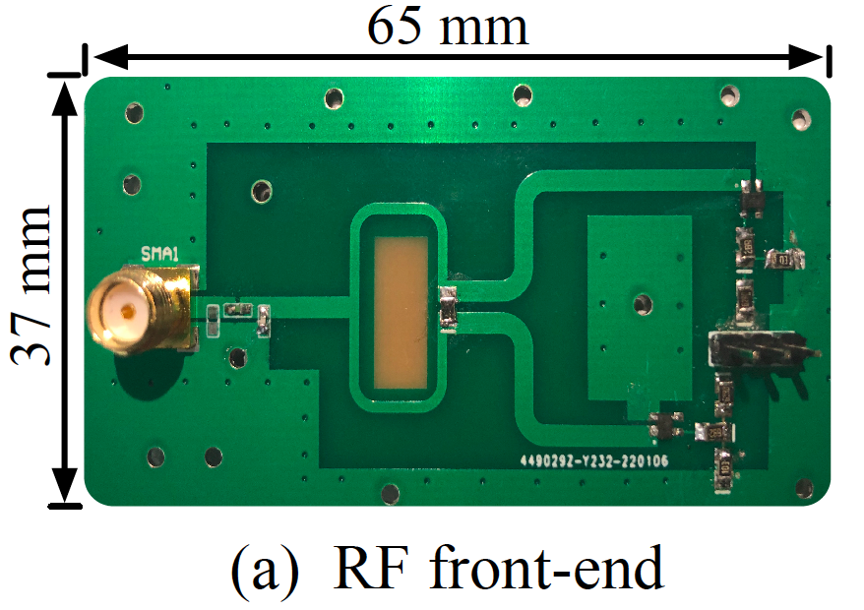
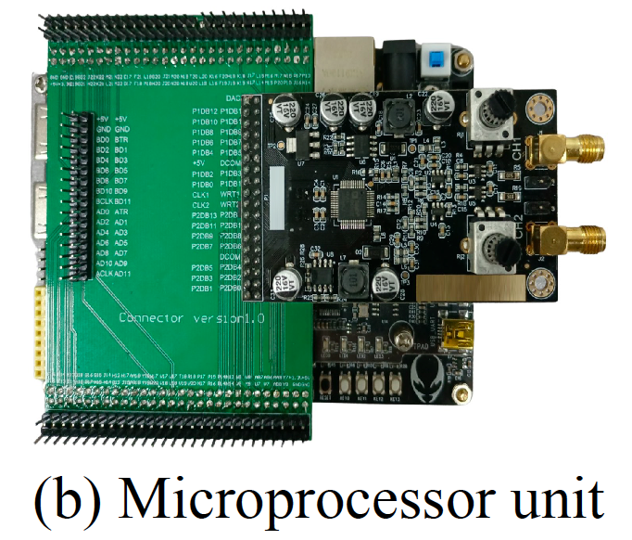
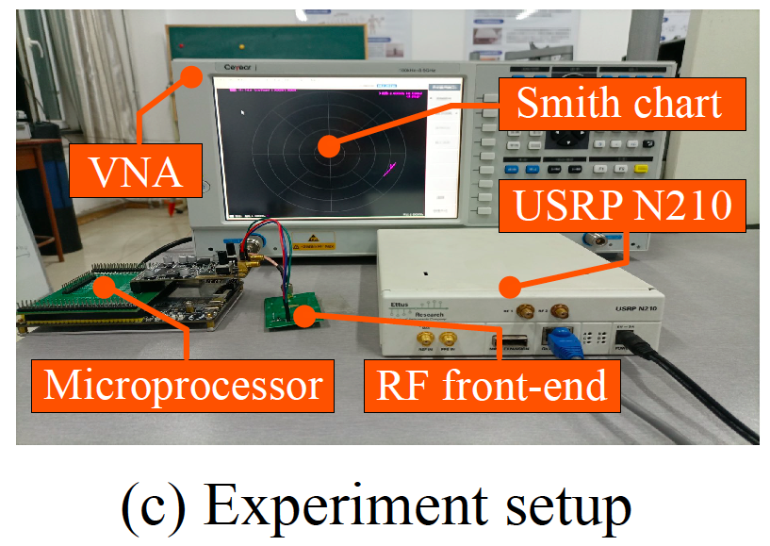
Implementation
RF front-end
  65mm * 37mm one-layer PCB
  Passive Microstrip line
  RF transistors ATF-54143
Microprocessor unit
  Low-power Xilinx Artix-7 FPGA
  14-bit DAC AD9767
Notes:
Our backscatter tag consists of a RF front-end and a micro-processor unit.
We conduct field studies to evaluate the performance of RF-Transformer on generating different types of backscatter signals.
We implement the RF front-end on a PCB board by using passive componenets.
The micro-processor unit is used to control the bias voltage of the RF transistors.

Slide 20
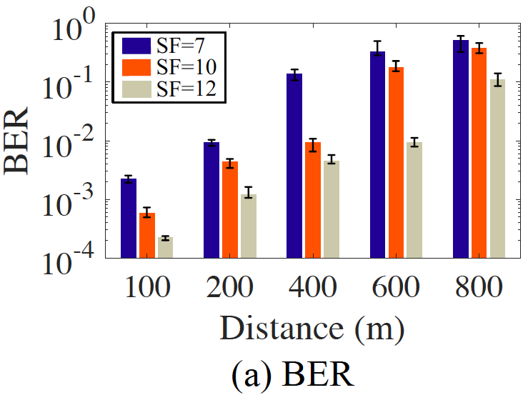
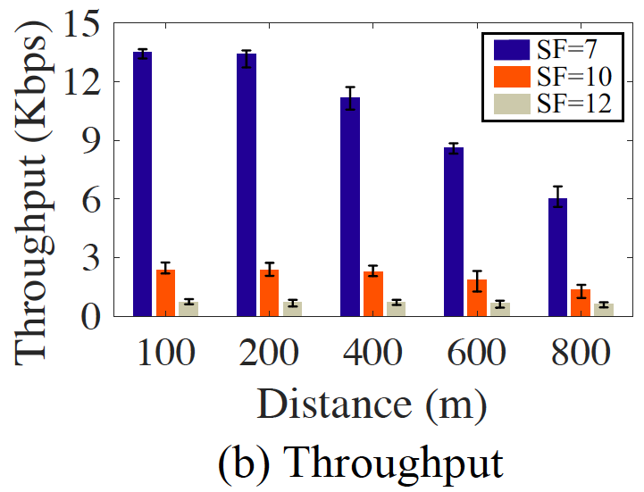
LoRa Backscatter Link
SF=7: 245.8m
SF=12 : 643.5m
SF=7: 13.5Kbps
SF=12 : 0.72Kbps
The BER and the throughput both decline with the increasing SF.
Notes:
For the LoRa backscatter link, we find that
The bit error rate declines with the increasing Spreading factor.
This expected since a higher Spreading factor improves the anti-noise ability of LoRa signals, and thus the backscatter distance
grows. On the other hand, it also results in lower throughput.
First, we control the RF-Transformer tag to generate LoRa backscatter signals.
We have the following observations.

Slide 21
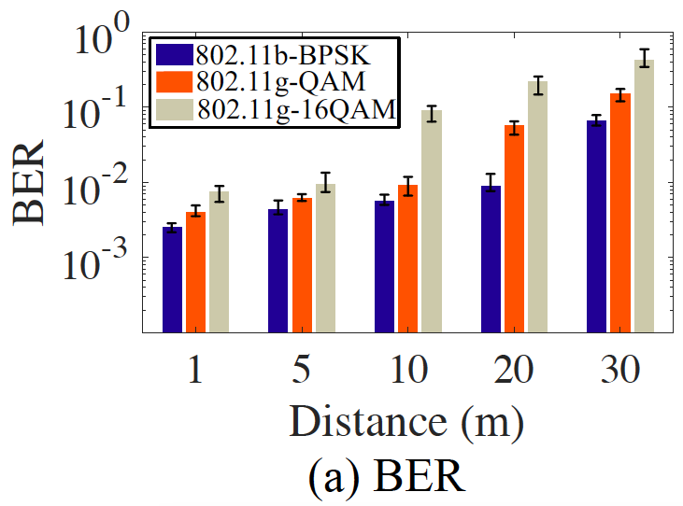
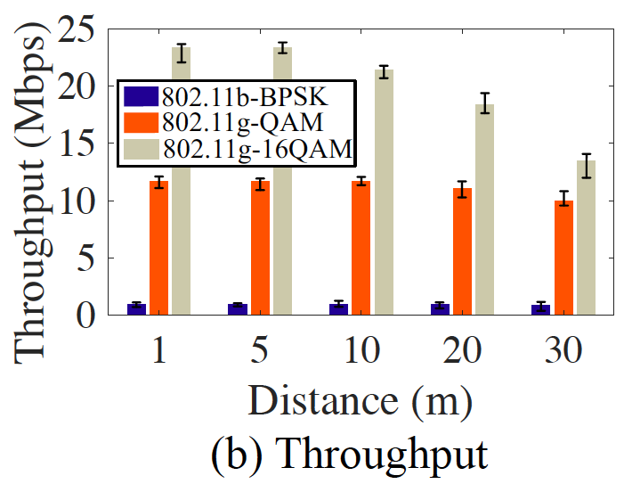
WiFi Backscatter Link
WiFi 802.11b-BPSK: 25.8m
WiFi 802.11g-QAM: 16.5m
WiFi 802.11g-16QAM: 8.4m
WiFi 802.11b-BPSK: 0.975 Mbps
WiFi 802.11g-QAM: 11.65Mbps
WiFi 802.11g-16QAM: 21.43Mbps
The BER and the throughput both grow with the increase of modulation complexity
Notes:
Next, for the Wi-Fi backscatter link with different modulation methods.
We observe that the bit error rate and the throughput both grow with the increase of modulation complexity [kəmˈpleksəti].
For example, for the WiFi with BPSK modulation, the achievable communication range is twenty-six meters and the throughput is about one megabits

Slide 22
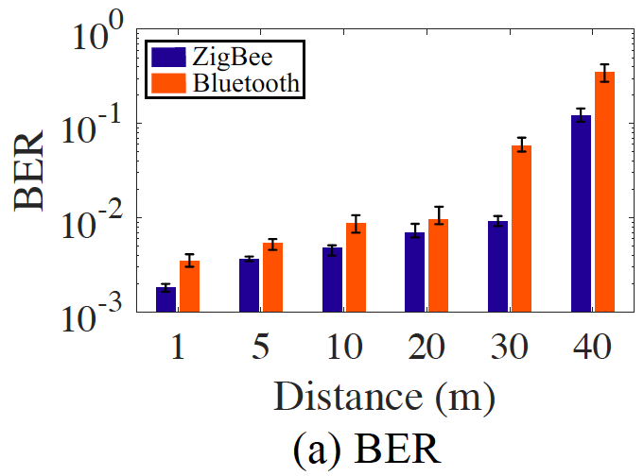
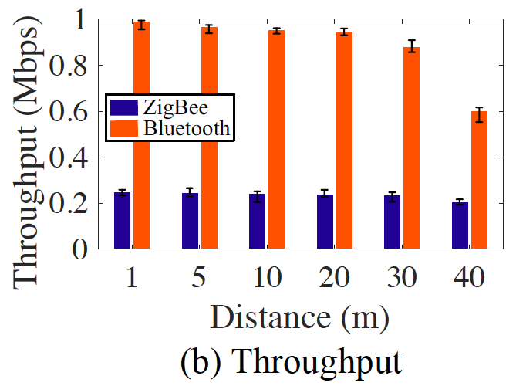
ZigBee and Bluetooth Backscatter Links
ZigBee: 33.5m
Bluetooth: 21.4m
ZigBee: 247.1Kbps
Bluetooth: 986.5Kbps
ZigBee adopts DSSS mechanism to resist the harmful impact caused by
the signal imperfection and attenuation.
Notes:
Furthermore[ˌfɜːrðərˈmɔːr], for the ZigBee and Bluetooth backscatter link.
the backscatter range of ZigBee is larger than Bluetooth due to the DSSS modulation of ZigBee.
===============
Because ZigBee adopts DSSS to resist the harmful impact caused by the signal attenuation.
On the other hand, the DSSS also leads to the decline of throughput.

Slide 23
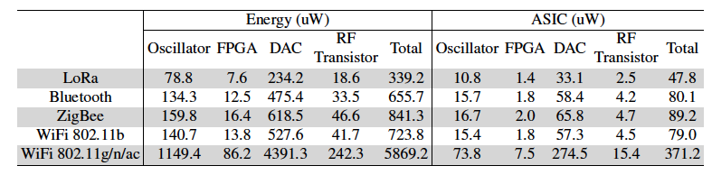
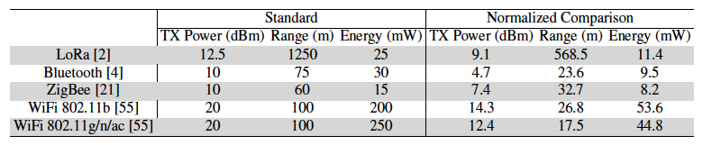
Power Consumption
RF-Transformer
7.6—74.2 X
Active radios
Notes:
We also evaluate the power consumption of RF-Transformer.
As summarized in this table, among these hardware components, the most power-hungry parts are oscillator and DAC.
Compared with the active radios，the power consumption of RF-Transformer is significantly reduced.

Slide 24
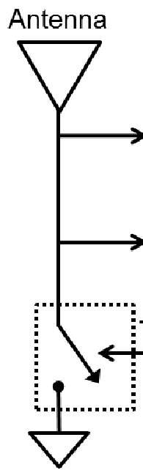
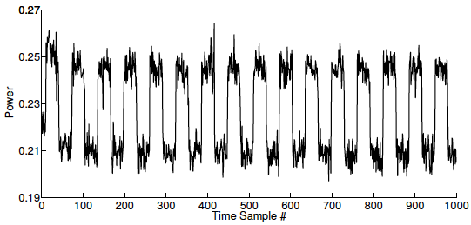
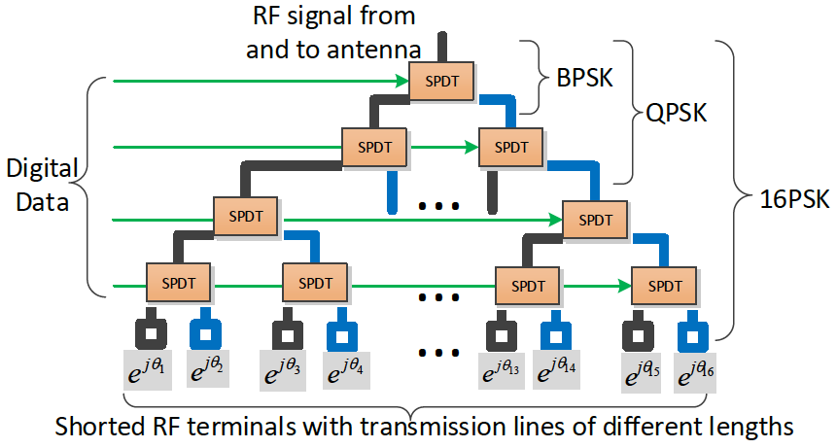
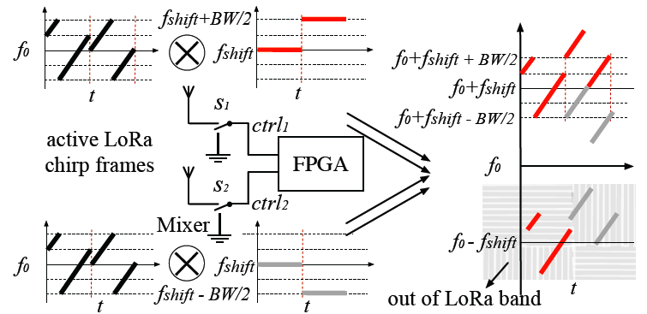
Related Works
Amplitude modulation by varying impedance
Phase shifting using delay lines
Frequency shifting & Frequency synthesis
Passive RFID [SIGCOMM’12]
Ambient backscatter [SIGCOMM’12]
Turbocharging [SIGCOMM’14]
WiFi Backscatter [SIGCOMM’14]
mmTag [SIGCOMM’21]
Passive WiFi [NSDI’18]
Interscatter [SIGCOMM’16]
HitchHike [SenSys’16]
BackFi [SIGCOMM’18]
FreeRider [CONEXT’16]
WiTag [SIGCOMM’20]
FS Backscatter [SIGCOMM’16]
FM Backscatter [NSDI’17]
BLE Backscatter [RFID’15]
PLoRa [SIGCOMM’18]
LoRa Backscatter [UbiComp’17]
For amplitude-modulated signals
(OOK)
For phase-modulated signals (BPSK\16PSK\OQPSK)
For frequency-modulated signals (FSK/CSS)
Notes:
Finally, we compare RF-Transformer with other works.
From the perspective of the modulation approach, existing works can be divided into three groups, by using ON-OFF Keying, phase shifting, or frequency shifting method.
Different with existing backscatter systems, Our tag is a flexible and programmable backscatter design. It can generate any type of backscatter signals.
The first group of works adopts ON-OFF Keying. Albeit [ˌɔːlˈbiːɪt] simple and power efficient, OOK achieves a very low link throughput.
The second group of works proposes phase shifting using delay lines to improve the thrpughput. But these works based on code-word translation and require extra hardware for backscatter decoding.
The third group of works proposes frequency shifting or frequency generation method to backscatter LoRa signals.

Slide 25
Take Away
Building a programmable radio design will scale out backscatter technologies to heterogeneous wireless networks.
Programing impedance load of In-phase part and Quadrature part in fine granularity can generate any type of backscatter signal.
Offloading the sophisticated load impedance modulation to the analog domain will significantly reduce the power consumption.
Notes:
We have presented the design, implementation, and evaluation of RF-Transformer. There is something to take away.
RF-Transformer provides the IoT sensor with a programmable interface to the micro-controller.
building a programmable radio will pave the way to the practical deployment of backscatter systems in heterogeneous wireless networks.
Based on an observation that the change of reflection coefficient will change
both the phase and amplitude of backscatter signals, we can program the impedance load of I-path and Q-path in fine granularity to generate any type of backscatter signal.
At the same time, in order to retain the low-power nature of backscatter radio, we offload the sophisticated modulation circuit to the analog domain, which will significantly reduce the power consumption.

Slide 26
Conclusion
Propose a low-power, unified backscatter radio hardware abstraction that can synthesize different types of backscatter signals.
Address both design and implementation challenges, prototyping RF-Transformer on PCB board for system evaluation.
Demonstrate RF-Transformer can support cross-technology backscatter, i.e., synthesizing LoRa packets on top of Wi-Fi transmissions.
Notes:
Overall, we briefly conclude our work.
We design a unified backscatter radio hardware abstraction and conduct extensive experiments to evaluate the performance of RF-Transformer.

Slide 27



Yuan He
Jiacheng Zhang
Longfei Shangguan
Xiuzhen Guo
Zihao Yu
Yunhao Liu
Code and hardware schematics can be found at: https://github.com/LeFsCC/RF-Transformer
Visit http://tns.thss.tsinghua.edu.cn/sun/ for details
Notes:
Finally, Thank you for my collaborators.
Thank you for watching and listening.
Code and hardware schematics are open-sourced.
Please visit our website for details.

Slide 28
Cross-Technology Backscatter
Notes:
The above analysis demonstrate RF-Transformer can generate any type of amplitude-modulated, phase-modulated, and frequency-modulated backscatter signals on the top of the sine carrier signals. In addition, we further demonstrate that RF-Transformer can also support cross technology backscatter.

Slide 29
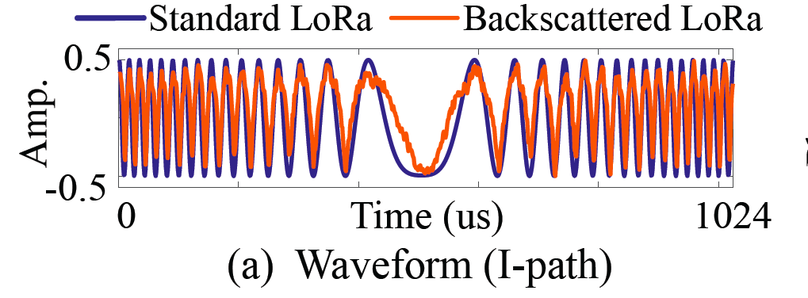
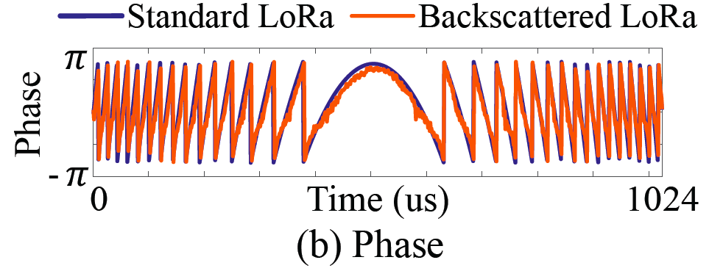
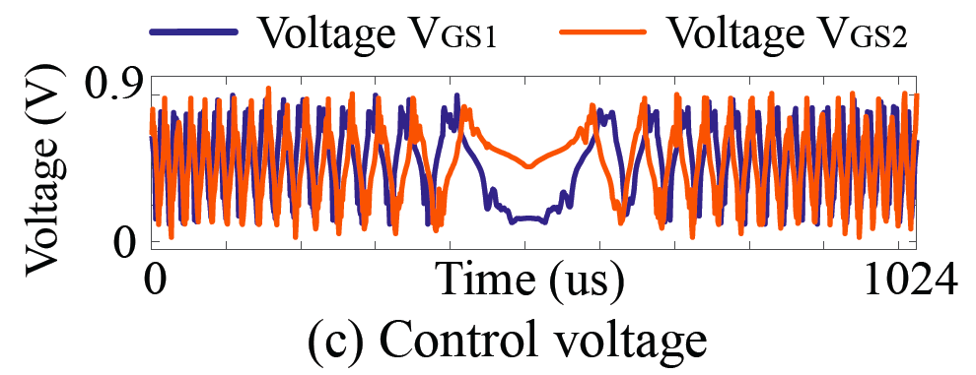
Extending to Frequency Modulation
Frequency-modulated signals, such as LoRa
Frequency is the derivative of phase
Frequency-modulated signal → Phase-modulated signal
Amplitude
modulation
Phase
modulation
Frequency
modulation
√
√
√
Notes:
We demonstrate the feasibility of RF-Transformer for such frequency modulation.
As you can see, the backscattered LoRa signals resemble the standard LoRa chirp in terms of waveform and phase pattern.
（点）The receiver can successfully demodulate this backscattered LoRa signal.

Slide 30
Cross-Technology Backscatter
How to modulate WiFi signals into LoRa packets?
QAM Signal
Chirp Signal
RF-Transformer
WiFi TX
?
LoRa RX
Carrier Signal
Backscatter signal
Notes:
As a proof of concept, we seek to modulate Wi-Fi signals into LoRa packets by changing the bias voltage of two MOSFETs on a RF-Transformer tag.
However, to put this idea into practice, there are many challenges.

Slide 31
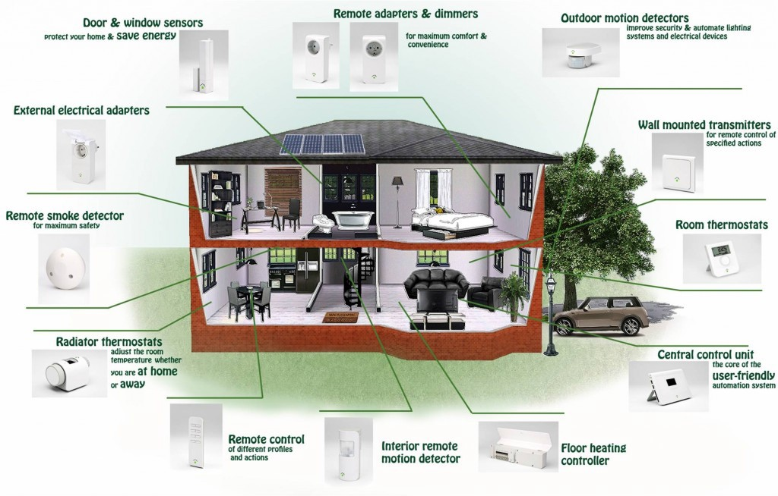
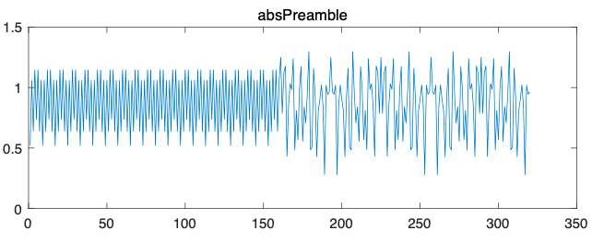


How to distinguish the Wi-Fi Carrier?
Perform cross-correlation with the pre-stored Short Training Field (STF) of the Wi-Fi packet
10 repeated short training sequences
(8us)
Notes:
First, unlike continuous sine signals, Wi-Fi traffic is inter mi ttent [ˌɪntərˈmɪtənt] . It coexists with other types of wireless traffic, such as Bluetooth, and ZigBee, on the same frequency band.
Consequently, the backscatter tag should be able to distinguish the Wi-Fi signal from the others, and then synchronize [ˈsɪŋkrənaɪz] with Wi-Fi symbols for fine-grained modulation.
To achieve this goal, we program the backscatter tag to sample the
incident signals and perform cross-correlation with the pre-stored
Short Training Field (STF) of the Wi-Fi packet.

Slide 32
How to Bridge the Gap of Frame Length?
Leverage WiFi frame aggregation technology (i.e., MAC Protocol Data Unit Aggregation, A-MPDU) to accommodate LoRa symbol modulation
Inter-frame spacing
Frame length gap
A-MPDU
Maximum length of WiFi = 72ms
Notes:
Second, the difference in frame length between Wi-Fi and
LoRa makes it impossible to generate a complete LoRa frame
on top of a single Wi-Fi frame.
Modulating multiple consecutive Wi-Fi frames into a LoRa frame may run into issues since the inter-frame spacing between Wi-Fi frames.
Hence, we are expected to see fragments in the modulated LoRa
symbols.
Our solution is to take advantage of the frame aggregation
feature on existing Wi-Fi systems to bridge the frame length gap of WiFi and LoRa.
By using this MAC protocol, the aggregated frame length of WiFi can reach up to seventy-two milliseconds. That is enough to modulate LoRa symbols.

Slide 33
How to Transform WiFi Carrier into Sine Signal？
Leverage the signal emulation techniques (like Interscatter [1]) to generate a single-tone by manipulating the payload of Wi-Fi frames
WiFi signal :
Abrupt changes in both amplitude and phase
Signal emulation technique^{[1]}
Sine signal :
Stable amplitude and phase variation
[1] Inter-technology backscatter: Towards internet connectivity for implanted Devices, SIGCOMM 2016.
Notes:
Third, both the amplitude and phase of Wi-Fi signals may change abruptly [əˈbrʌptli]. Accordingly, an abrupt change of Wi-Fi carrier’s phase will mess up the phase modulation of backscatter signals.
We leverage the signal emulation techniques to generate a sine signal
by controlling the payload of Wi-Fi frames. This ensures RF-Transformer modulates backscatter symbol with the same initial phase.

Slide 34
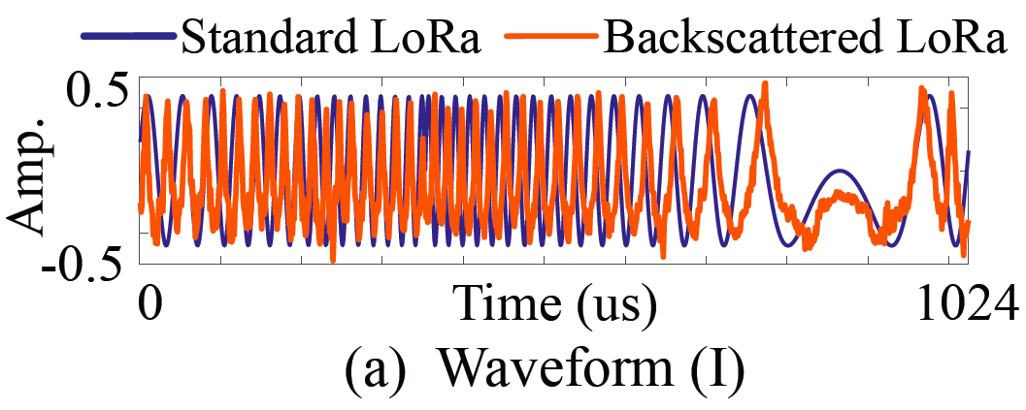
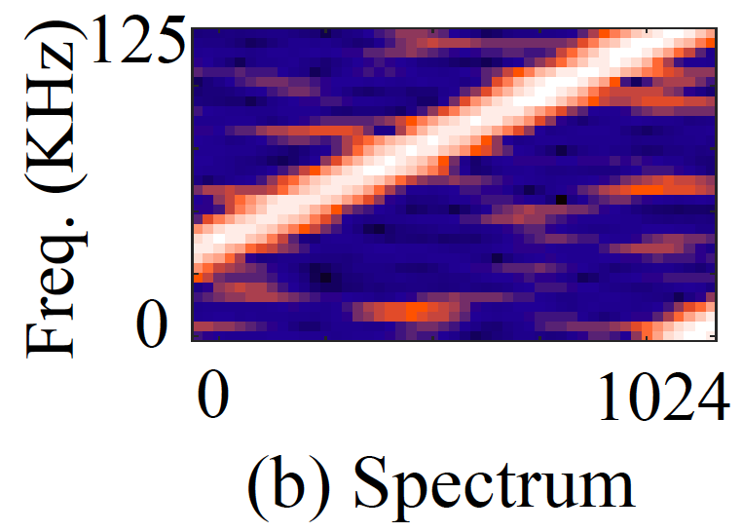
Supporting Cross-Technology Backscatter
Synthesizing LoRa symbol on top of Wi-Fi signals by changing the bias voltage of MOSFET transistors on the backscatter tag.
QAM Signal
Chirp Signal
WiFi TX
RF-Transformer
LoRa RX
Notes:
We compare the waveform of a standard LoRa chirp and our generated LoRa symbol on top of Wi-Fi signals.
Evidently, these two signals share very similar waveform pattern and frequency spectrum.

