Slide 1

ZigFi: Harnessing Channel State Information for
Cross-Technology Communication

Slide 2
CTC from ZigBee to WiFi
Physical Level Emulation
 | ZigBee | WiFi
Center Frequency | 2405+5(k-11) | 2412+5(k-1)
Modulation | DSSS | OFDM
Encoding | OQPSK | BPSK\QPSK\QAM
Rate | 250 Kbps | 54 Mbps
 | Simple | Complex
It is difficult to emulate WiFi for ZigBee

Slide 3
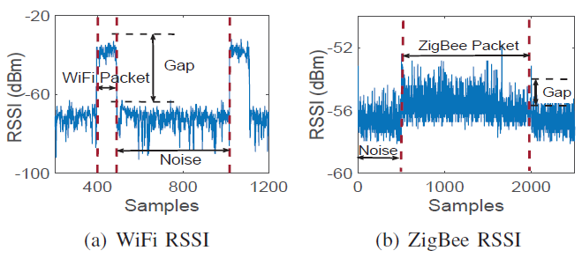
CTC from ZigBee to WiFi
Physical Level Emulation
Asymmetric transmission power of ZigBee vs. WiFi
Infeasibility of ZigBee to WiFi CTC using RSSI

Slide 4
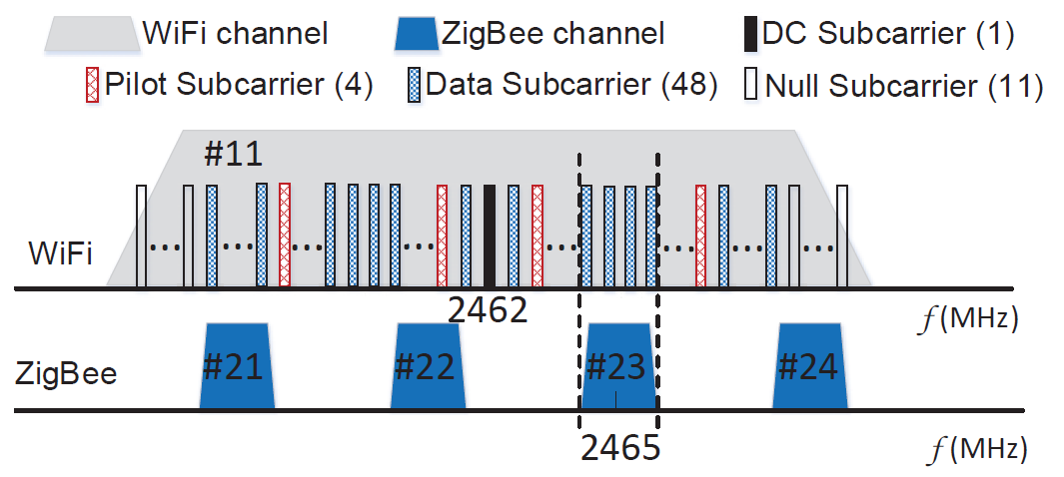
CTC from ZigBee to WiFi
Physical Level Emulation
Asymmetric bandwidth of ZigBee vs. WiFi
Feasibility of ZigBee to WiFi CTC using CSI

Slide 5
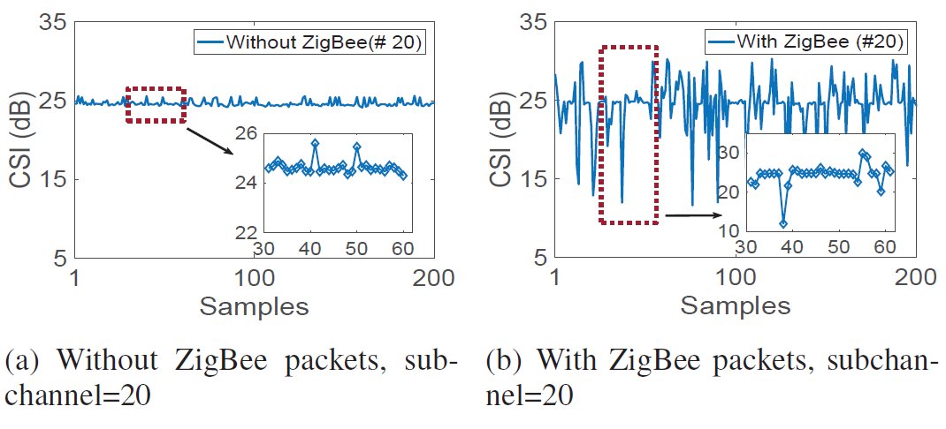
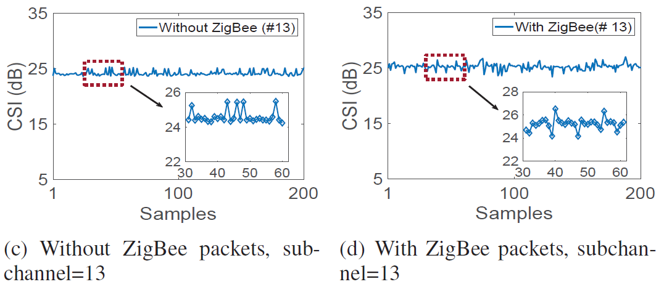
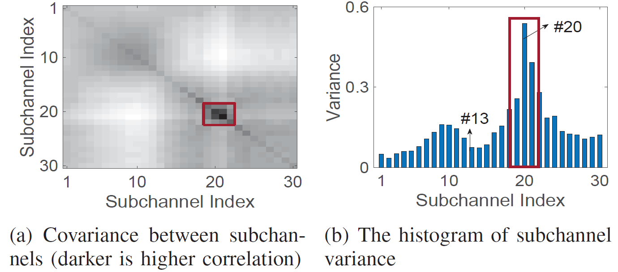
CSI sequence on different subchannels
The transmission of ZigBee packets affects the CSI sequence of the WiFi receiver
The variation of the CSI sequence at each subcarrier is different

Slide 6
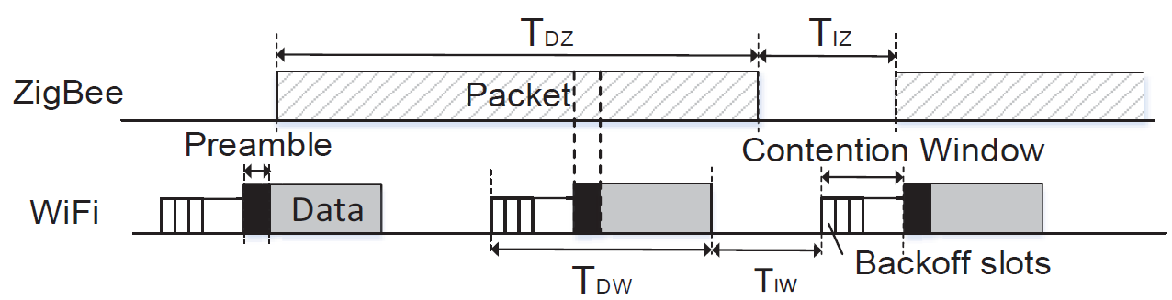
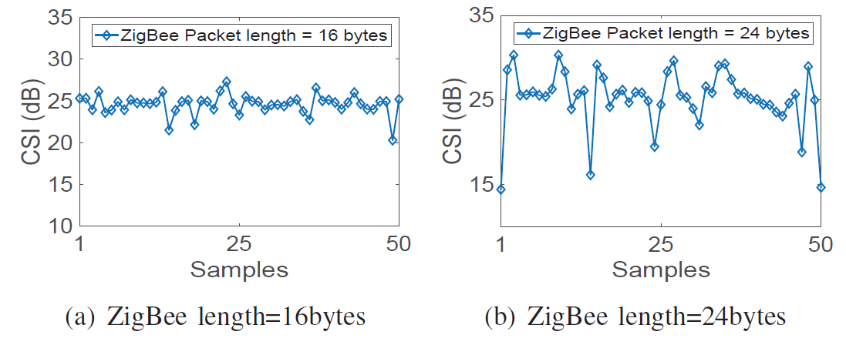

CSI sequences with different ZigBee packet lengths
One ZigBee packet overlaps with at least one WiFi packet
$$T_{DZ}≥2T_{DW}+T_{IW}$$

Slide 7
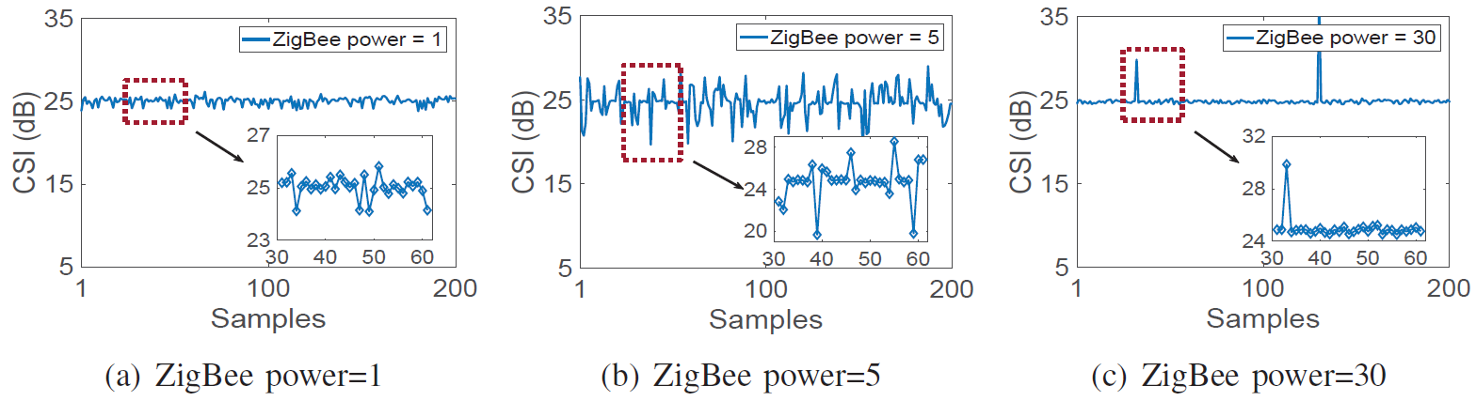
CSI sequences with different ZigBee transmit power
If the ZigBee power is low, the CSI variation will be too little to be detected at the WiFi receiver.
If the ZigBee power is too high, the WiFi preamble will be subjected to strong interference impacting regular WiFi traffic

Slide 8
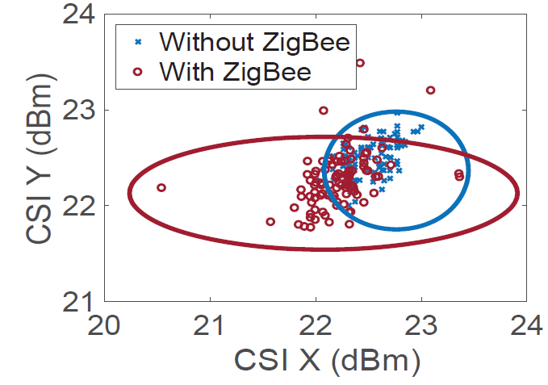
On classifying CSI sequences: SVM
There are no simple rules to describe the variation of CSI values
The two sets of CSI pair overlap with each other
Use a classifier and map the CSI features to higher dimensional space

Slide 9
ZigFi Design

Slide 10
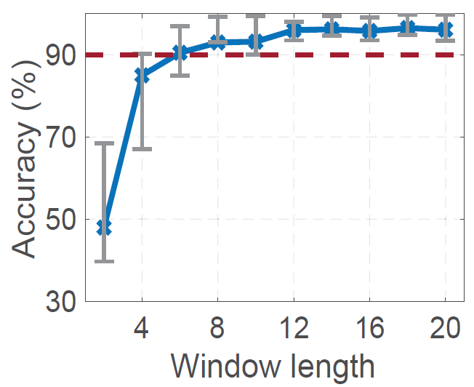
Decoding with a CSI classifier
the performance of SVM is related with the window length (CSI samples)
Choose the window length is 8

Slide 11
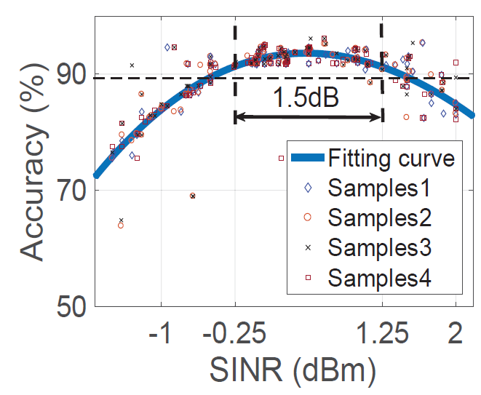

The relationship between the Accuracy and the SINR
A new metric SINR in ZigFi
$$SINR=10lg\frac{S_{Z}}{I_{W}+N}$$
SINR in range [-0.25,1.25], decoding accuracy > 0.9

Slide 12
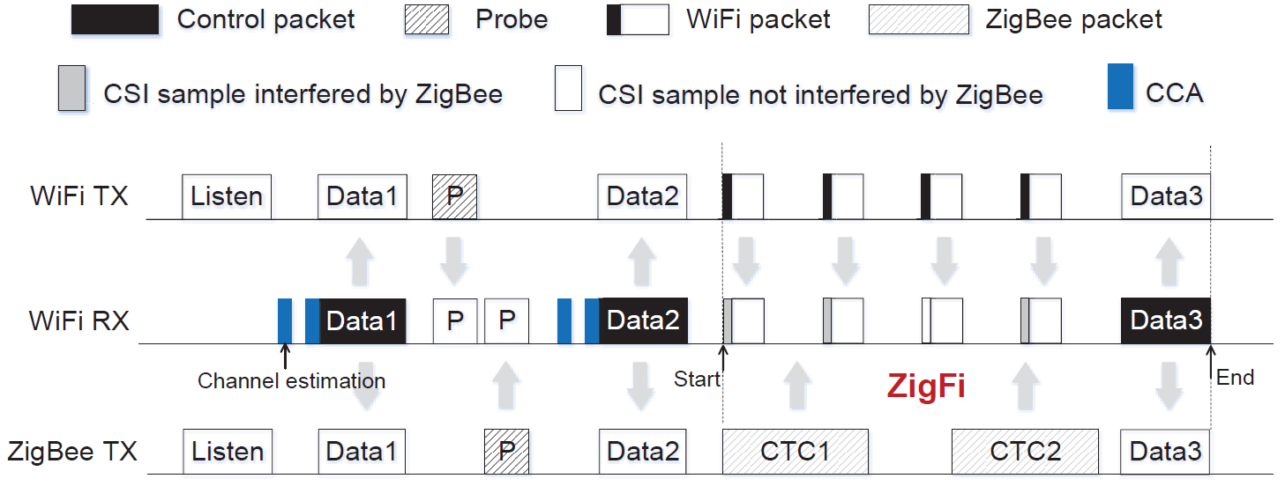
The Receiver-initiated mechanism
Establish a WiFi Link
Adaptively adjust ZigBee and WiFi power to obtain
an appropriate SINR

Slide 13
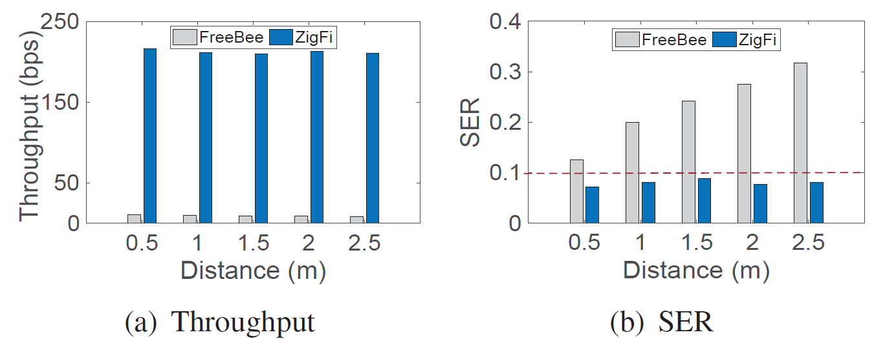
Evaluation
Implementation
Comparison ZigFi vs. FreeBee

Slide 14
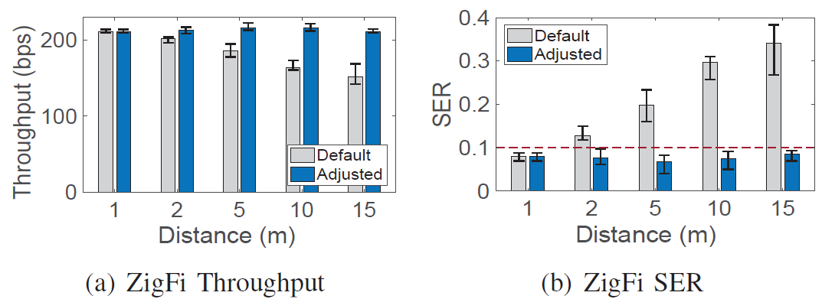
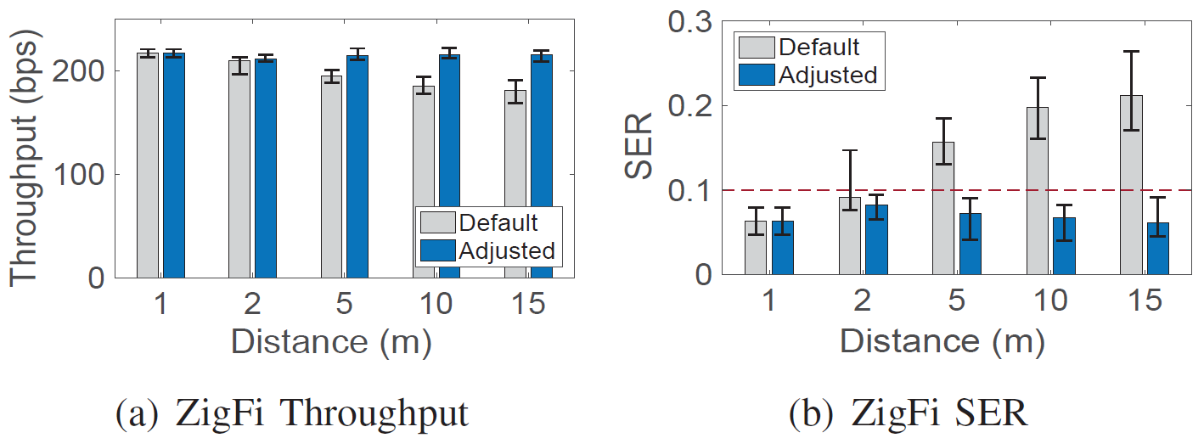
Evaluation
ZigFi under different distance between the ZigBee sender and the WiFi sender
ZigFi performance under different distance between the WiFi sender and the WiFi receiver

Slide 15
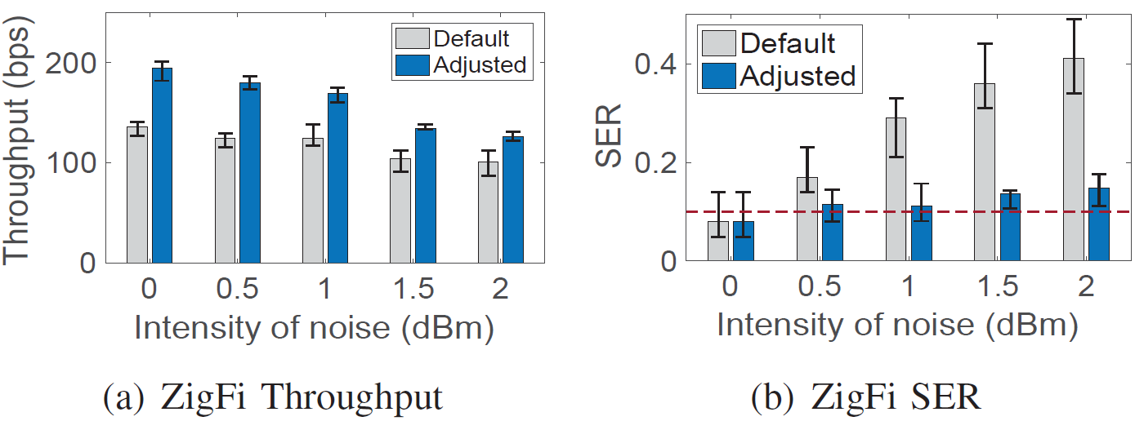
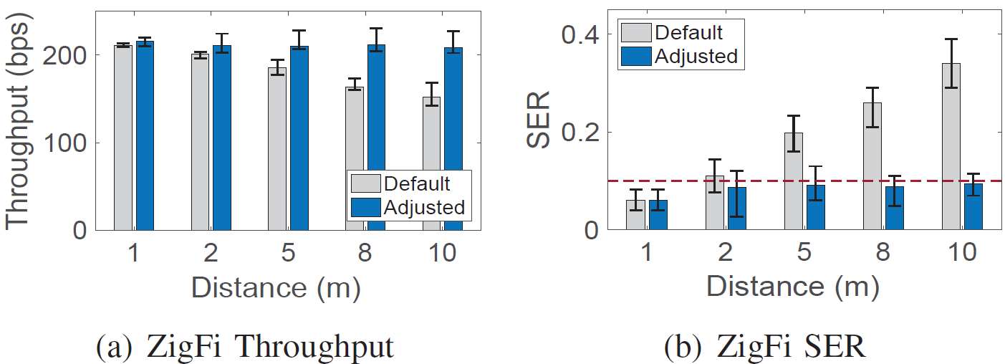
Evaluation
ZigFi performance under different intensity of noise
ZigFi performance under different distance between the ZigBee sender and the WiFi receiver in the NLOS scenario

Slide 16
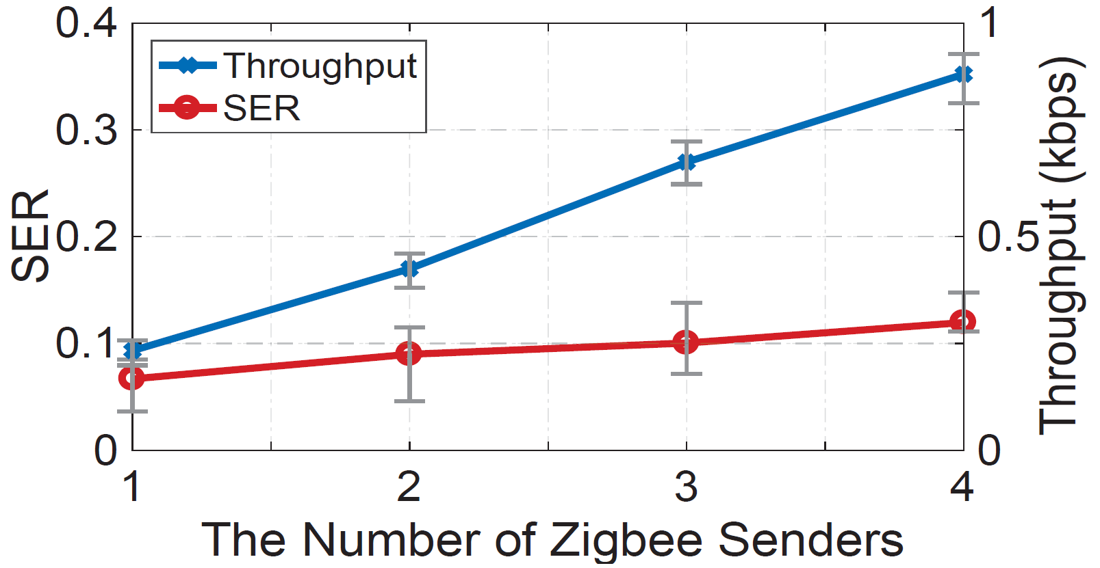
Evaluation
The SER and throughput of multiple-to-one concurrent transmissions

Slide 17
Thank
Q&A

