Slide 1
Aloba: Rethinking ON-OFF Keying Modulation for Ambient LoRa Backscatter
Xiuzhen Guo¹, Longfei Shangguan², Yuan He¹, Jia Zhang¹, Haotian Jiang¹, Awais Ahmad Siddiqi¹, Yunhao Liu^{1,3}
¹School of Software and BNRist, Tsinghua University
²Microsoft
³Department of Computer Science and Engineering, Michigan State University
Notes:
Hello everyone. My name is Xiuzhen Guo.
I come from Tsinghua university.
Today, I’m going to share with you our recent work: “Aloba: ! Rethinking ON-OFF Keying Modulation ! for Ambient LoRa Backscatter”

Slide 2
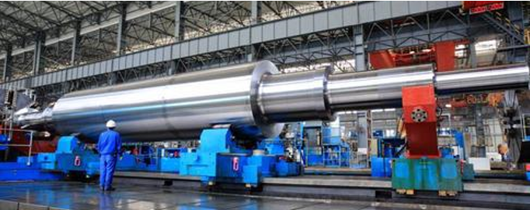
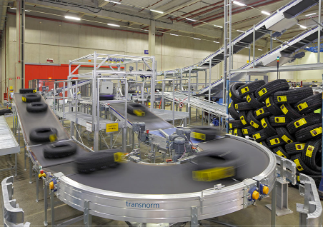
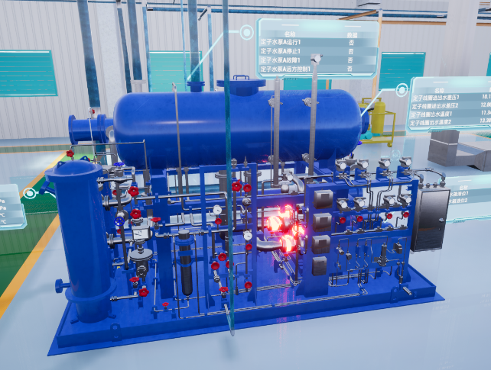
Automated
Factory
Logistics
HCI
Notes:
Nowadays, there are more and more industrial applications.
Different applications have different requirements ! on data exchanging and thus ! demand different communication technologies.

Slide 3
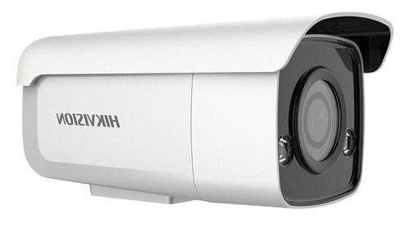
Keeping track of the status of machines:
Noise
Moderate-throughput (tens of Kbps)
Low-power and long-range
Vibration
Rotation
Notes:
For example, tracking the status [ˈsteɪtəs] of machines ！, such as the infomation of vibration [vaɪˈbreɪʃn],
noise and rotation [roʊˈteɪʃn] , demand [dɪˈmændz] moderate [ˈmɑːdərət , mɑːdəreɪt] throughput [ˈθruːpʊt] for sensing data forwarding.
However, some of machines ！may produce flash intense light, strong noise and harmful gases, these data forwarding should be also low-power and long-range. the sensors need to transmit data ！back to the gateway hundreds of meters away ！without extra [ˈekstrə] human intervention [ˌɪntərˈvenʃn] or frequent battery replacement.
industrial applications like tracking the status [ˈsteɪtəs] of machines ！demand [dɪˈmændz] moderate [ˈmɑːdərət , mɑːdəreɪt] throughput [ˈθruːpʊt].
However, some of machines ！may produce flash intense light, strong noise and harmful gases, the sensors need to transmit data ！back to the gateway hundreds of meters away ！without extra [ˈekstrə] human intervention [ˌɪntərˈvenʃn].
How can we achieve this system?

Slide 4
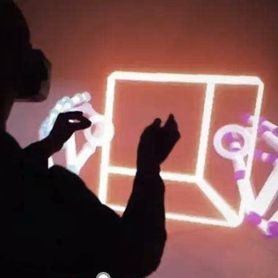
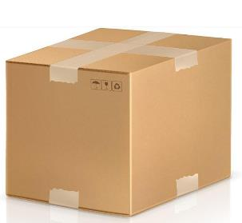
Backscatter Communication
Large quantity of deployed tags
Automated Factory
Logistics
HCI
Backscatter communication technology has been widely used in various sensing and tracking applications!
Notes:
Due to its low-power and simplicity [sɪmˈplɪsəti], backscatter communication becomes a promising [ˈprɑːmɪsɪŋ] technology ! to enrich the family of existing industrial applications.

Slide 5
State of the arts
Large quantity of deployed tags
Long range but low throughput
1000
500
LoRa
Backscatter
400
300
PLoRa
Range (m)
200
High throughput but short range
100
WiFi
Backscatter
HitchHike
Passive
WiFi
FS Backscatter
FreeRider
Turbo
charging
OFDMA Backscatter
FM
Backscatter
0
10³
10⁴
10⁵
10⁶
Throughput (bps)
Notes:
However, as we carefully examine ! [ɪɡˈzæmɪn] existing backscatter systems, we find that !
some of these works can achieve high throughput but the communication range is short.
other works can achieve high communication range but the throughput is low.
None of them ! is able to balance ! the throughput and communication range to ! satisfy the requirement of the ! machine monitoring in industrial practices.

Slide 6
State of the arts
Large quantity of deployed tags
Long range but low throughput
1000
500
LoRa
Backscatter
400
Industrial application
300
PLoRa
Range (m)
Aloba
200
High throughput but short range
100
WiFi
Backscatter
HitchHike
Passive
WiFi
FS Backscatter
FreeRider
Turbo
charging
OFDMA Backscatter
FM
Backscatter
0
10³
10⁴
10⁵
10⁶
Throughput (bps)
Notes:
None of them ! is able to balance ! the throughput and communication range to ! satisfy the requirement of the ! machine monitoring in industrial practices.

Slide 7
Rethinking OOK
Large quantity of deployed tags
OOK (ON-OFF keying) modulation enables the backsactter signal to work in the same frequency band with the carrier signal
(a)
ON
ON
ON
(b)
OFF
OFF
OFF
(c)
(a) Carrier signal; (b) OOF modulation; (c) Received signal
Compared with the amplitude, the receiving sensitivity of phase variation is higher
Notes:
In our work, we revisit the classic ON-OFF Keying (OOK) modulation.
OOK modulation enables the backsactter signal to work in the same frequency band
of the carrier signal.
We find that ook modulation will not only change the amplitude of the received signal, but also change the phase of the received signal.
Moreover, the receiving sensitivity of phase variation is much higher than the amplitude variation.
This inspires us to increase the communication range of backscatter signal with ook modulation.

Slide 8
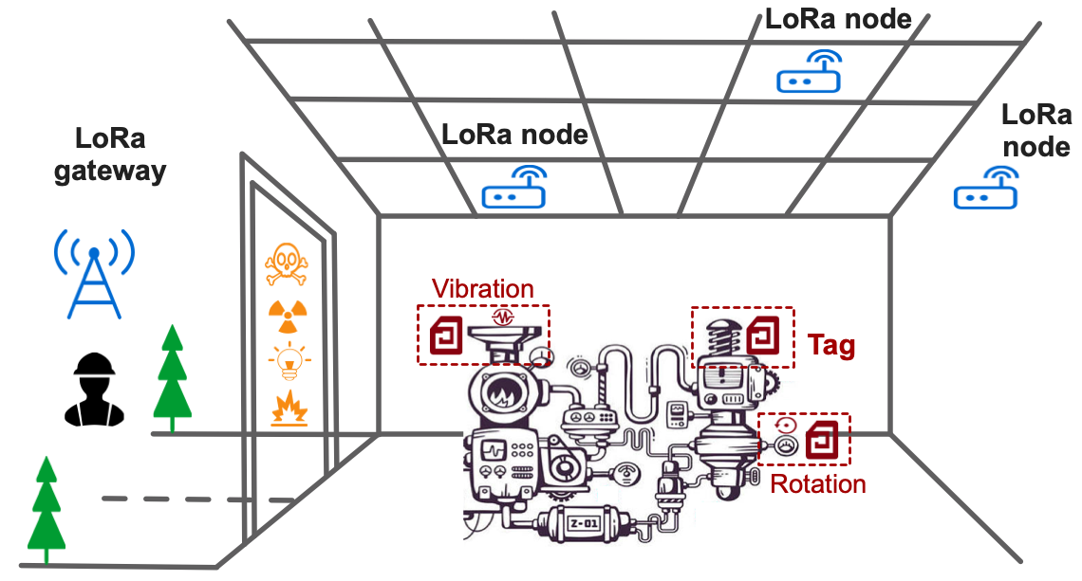
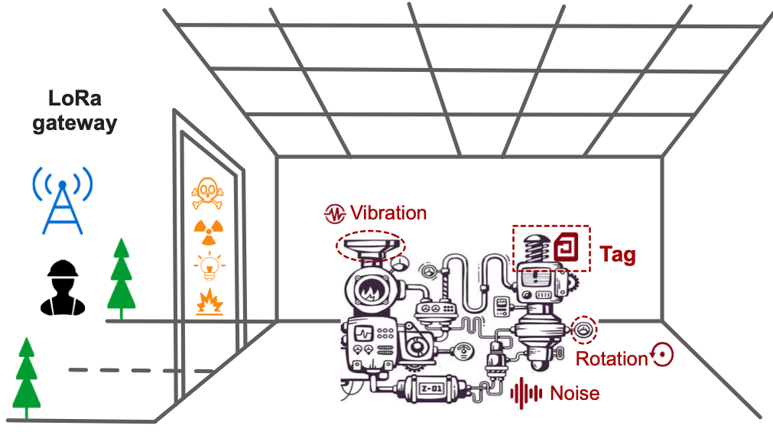
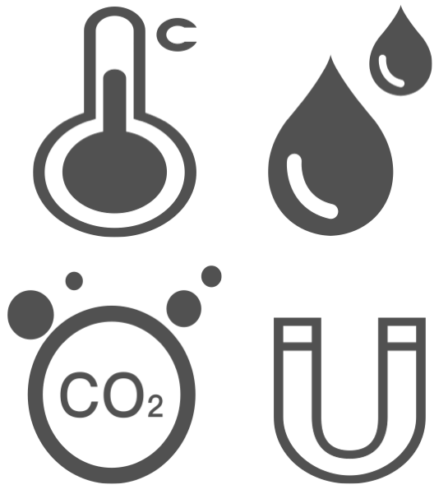
Aloba
Large quantity of deployed tags
LoRa node
Ambient
LoRa
node
LoRa node
Notes:
Therefore, we propose Aloba, an ambient backscatter design ! for machine status monitoring.
As shown in this figure, there are some active tags around the workshop are communicating with the gateway normally, such as the temperature [ˈtemprətʃər] and humidity [hjuːˈmɪdəti] Lora nodes.

Slide 9
Aloba
Large quantity of deployed tags
Ambient
Flexible link throughput:
OOK modulation
Long communication range:
Ambient LoRa signals as the carrier
Easy to deploy:
Without dedicated excitation sources
Notes:
These active LoRa nodes ! transmit LoRa signals, the Aloba tag takes the ambient LoRa signals ! as the carrier signal and ! modulates its sensing data ! using ON-OFF Keying modulation. Then the aloba tag ! reflects the modulated signal to the LoRa gateway.
In this way, such design has three ! desirable [dɪˈzaɪərəbl] properties [ˈprɑpərtiz]:
First, flexible link throughput. OOK modulation enables the Aloba tag ! to adapt its throughput to the link quality ! instead of the PHY-layer regulation of carrier signals.
Second, long communication range. By taking ambient LoRa signals ! as the carrier,
the Aloba tag could leverage the unique processing gain ! brought by the chirp signal design ! to enable backscatter communication at a range of hundreds of meters.
Third, easy to deploy. The Aloba tag modulates its data on the ambient LoRa signals. This can avoid the installation [ˌɪnstəˈleɪʃn] and maintenance [ˈmeɪntənəns] of the dedicated excitation sources.

Slide 10
Challenges
Large quantity of deployed tags
How to demodulate both the carrier signal and the
backscatter signal from their superposition?
How to pick up the ambient LoRa signals from other signals?
?
?
Notes:
However, harvesting these benefits ! faces fundamental challenges.
On one hand, the excitation signal in our design ! is an ambient, inter'mittent [ˌɪntərˈmɪtənt] LoRa signal ! that changes over time. The backscatter tag should be able to ! pick up the LoRa signal from
the others and further ! synchronize [ˈsɪŋkrənaɪz] with each LoRa symbol for fine-grained [faɪn ɡreɪnd] modulation.
On the other hand, the backscatter signal is ! orders of magnitude[ˈmæɡnɪtuːd] weaker ! than the excitation signal. The receiver should be able to demodulate this weak backscatter signal ! from the received signal.

Slide 11
Demodulation
Transforming Chirps into a Constant Sinusoidal Tone
Signal Reconstruction and Clustering-based Decoding
Notes:
In Aloba we propose a novel ! hardware and software solution to ! tackle the above challenges.
First, we introduce the demodulation algorithm at the LoRa gateway ! to decode the backscatter signal.

Slide 12
Signal Transformation
Large quantity of deployed tags
RFID system simplifies the backscatter signal decoding by adopting a sinusoidal tone as the carrier signal
Sinusoidal tone
Transform the standard LoRa carrier signal into a constant sinusoidal tone !
Notes:
The demodulation scheme of Aloba ! is motivated by the conventional [kənˈvenʃənl] RFID system.
RFID system adopts a sinusoidal [ˈsaɪnəˌsɔɪdəl] tone ! as the carrier signal.
In a similar way, if the LoRa receiver can transform the standard LoRa carrier signal ! into a constant sinusoidal [ˈsaɪnəˌsɔɪdəl] tone, the variation of received signal ! would be solely [ˈsoʊlli] determined by the backscatter signal.

Slide 13
LoRa Primer
Large quantity of deployed tags
$$f$$
$$f$$
$$\frac{BW}{2}$$
$$\frac{BW}{2}$$
Amplitude
$$0$$
$$0$$
$$t$$
$$t$$
$$−\frac{BW}{2}$$
$$−\frac{BW}{2}$$
Bin
$$f$$
(a) Symbol “00”
(b) Symbol “10”
(c) FFT output
The location of peaks on the FFT Bin is determined by the initial frequency
offset of LoRa chirps.
Notes:
LoRa adopts Chirp Spread Spectrum[spred ˈspektrəm] ! to modulate data.
Each LoRa symbol is represented by a chirp ! where the frequency changes linearly [ˈlɪniərli] ! over time.
To demodulate the LoRa symbol, the receiver ! multiplies [ˈmʌltɪplaɪz] an incoming LoRa symbol
! with a down-chirp. The multiplication [ˌmʌltɪplɪˈkeɪʃn] transformed to the frequency domain ! will yield [jiːld] a peak on an FFT bin.
The receiver tracks the location of this peak ! to demodulate the LoRa symbol accordingly[əˈkɔːrdɪŋli] .

Slide 14
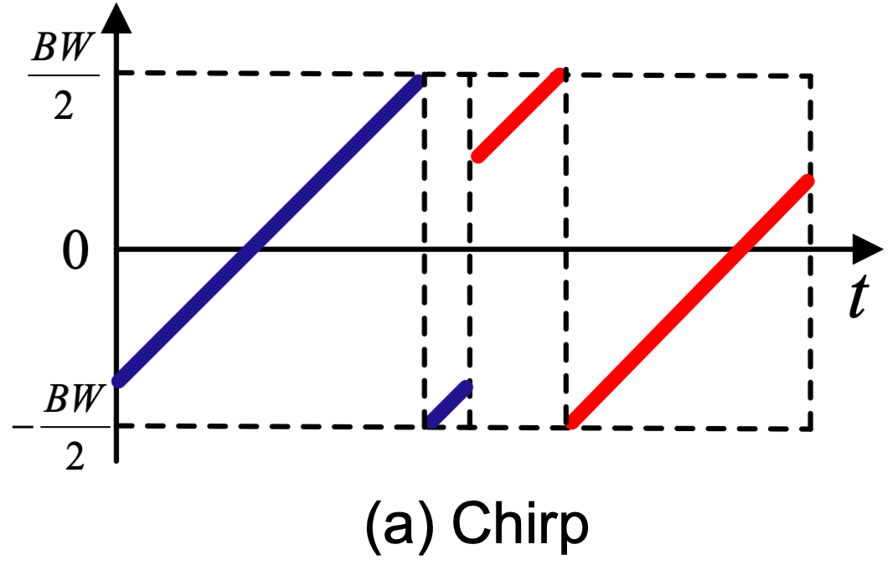
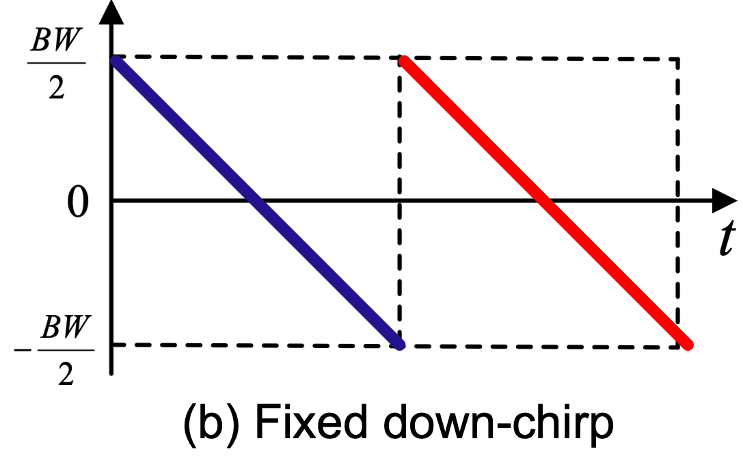
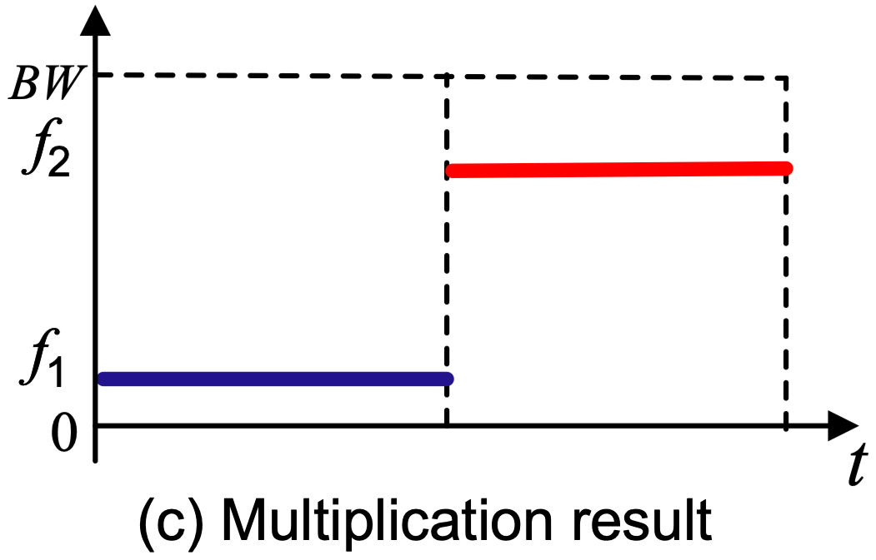
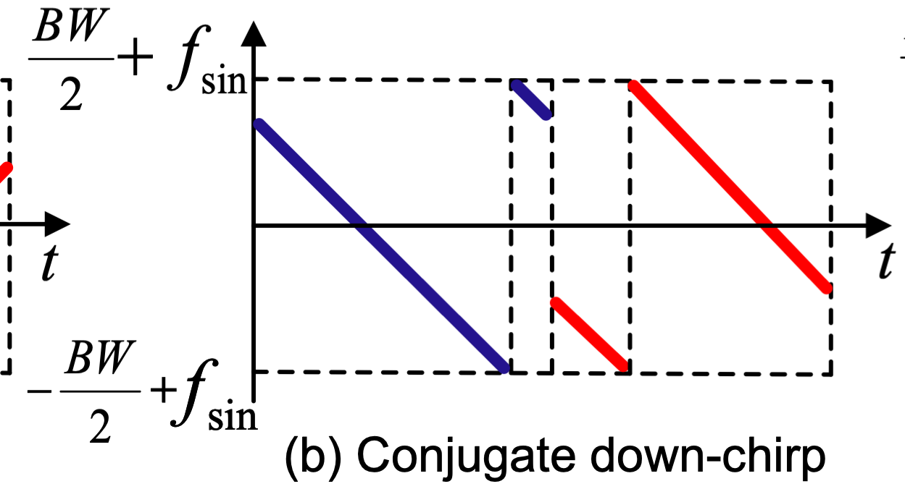
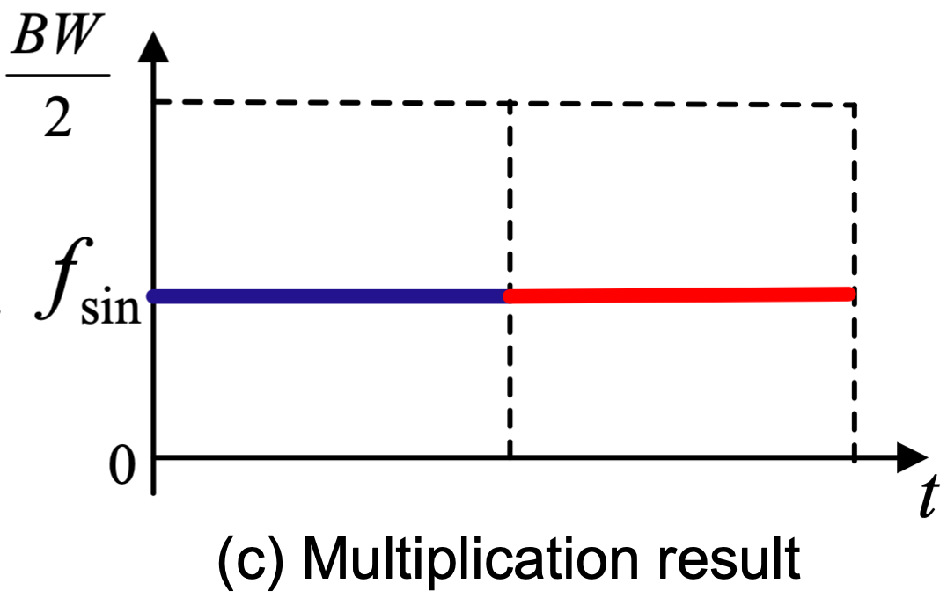
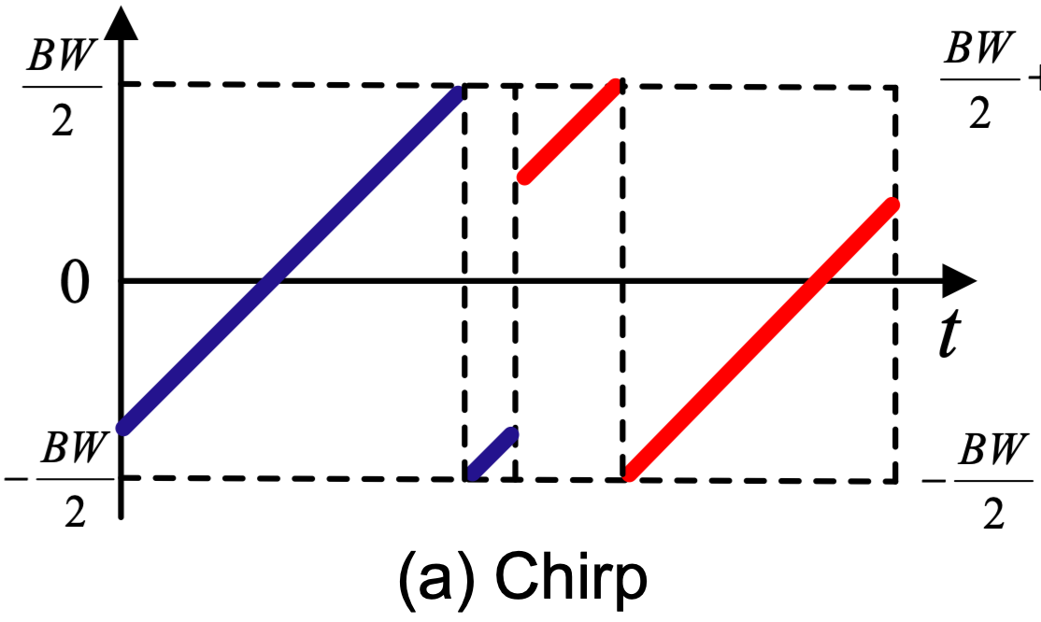
Signal Transformation
Large quantity of deployed tags
Generation of conjugate downchirp
The backscatter signal is orders of magnitude weaker than the carrier signal.
We can first leverage capture effect to demodulate the carrier LoRa chirps.
Symmetric to each other
Notes:
For example, two different chirps ! multiply the same fixed downchirp will yield ! two sinusoidal [ˈsaɪnəˌsɔɪdəl] tones [toʊnz] with different frequencies.
In aloba, we replace the standard down-chirp ! with the conjugate [ˈkɑːndʒəɡeɪt] of the incoming LoRa chirp. The LoRa chirp ! and its conjugate downchirp ! are symmetric [sɪ'metrɪk] to each other ! with respect to the reflection off the X-axis.[eks ˈæksɪs].
In our backscatter system, the backscatter signal is weaker than the carrier signal. So we can first leverage capture effect to demodulate the carrier LoRa chirps.
After that, different LoRa chirps ! multiply their corresponding conjugate downchirp ! will yield a sinusoidal tone at the same frequency.

Slide 15
Amplitude Vs. Phase
Large quantity of deployed tags
Received
Backscatter
Carrier
Constructive combination:
significant amplitude variation
Notes:
The received signal after signal transformation ! can be regarded as the superposition [ˌsupərpəˈzɪʃən] ! of the carrier signal and the backscatter signal.
When these two signals are strictly ! aligned, we expect to see a significant ! amplitude variation on the received signal.

Slide 16
Amplitude Vs. Phase
Large quantity of deployed tags
Received
Received
Carrier
Backscatter
Backscatter
Carrier
Constructive combination:
significant amplitude variation
Destructive combination:
significant amplitude variation
Notes:
When these two signals are strictly ! misaligned, the amplitude of received signal ! will also be significantly reduced.

Slide 17
Amplitude Vs. Phase
Large quantity of deployed tags
Received
Received
Received
Carrier
Backscatter
Carrier
Backscatter
Backscatter
Carrier
Constructive combination:
significant amplitude variation
Destructive combination:
significant amplitude variation
Phase variation
Notes:
However, most of the time, these two signals are neither [ˈnaɪðər] strictly ! aligned nor [nɔːr] misaligned.
Hence the amplitude of the received signal ! is similar with the carrier signal.
Therefore, in this case, we use the ! phase variation of the received signal to ! detect the presence [ˈprezns] of the backscatter signal.

Slide 18
Phase Jumping
Large quantity of deployed tags
Carrier
Carrier+Backscatter
Tag
t_{A}
t_{B}
t_{C}
false alarm
Phase jumping caused by ON-OFF switching could serve as a clue to detect the presence of the backscatter signal.
Before decoding, we need to eliminate false alarms.
Notes:
When Aloba tag is at the ! OFF state, the received signal ! is determined by the carrier signal. When Aloba tag ! switches to the ! ON state, the presence [ˈprezns] of backscatter
signal ! will alter [ˈɔːltər] the received signal and ! leads to a phase jumping on the sinusoidal tone.
This phase jumping ! caused by ON-OFF switching ! could serve as a clue [kluː] ! to detect the presence [ˈprezns] of the backscatter signal.
However, there are several false alarms [fɔːls əˈlɑːrmz] . We need to ! eliminate [ɪˈlɪmɪneɪt] false alarms before decoding.

Slide 19
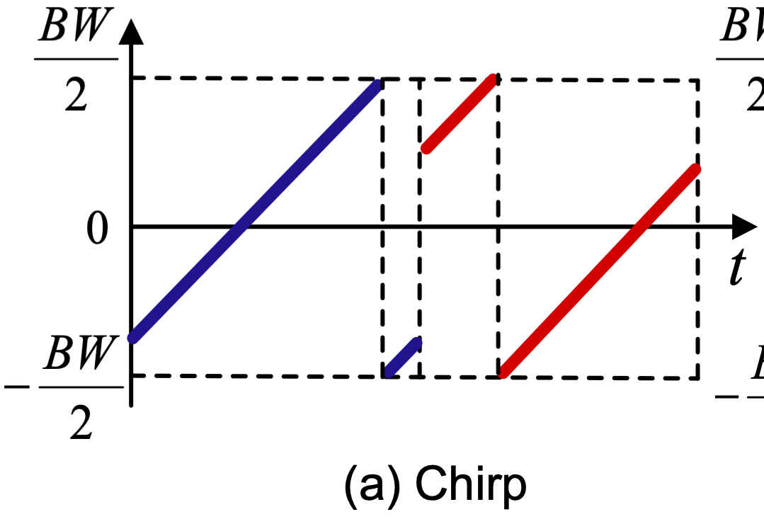
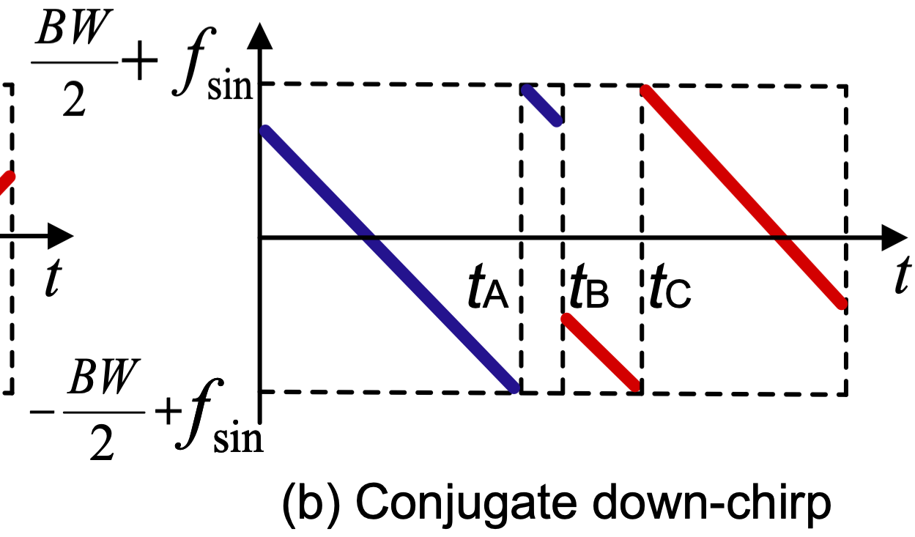
False Alarms Elimination
Large quantity of deployed tags
(1) Caused by signal transformation at the boundary of different LoRa chirps
(2) Caused by frequency wrapping within each LoRa chirp
Notes:
We explore the reason ! for the false alarms.
The first kind of false alarms occurs ! at the boundary of different LoRa chirps ! due to the signal transformation.
The second kind of false alarms occurs ! within each LoRa chirps ! due to the frequency wrapping [ˈræpɪŋ] .

Slide 20
Phase Alignment
Large quantity of deployed tags
Tag
t_{A}
t_{C}
t_{A}
t_{B}
t_{C}
Without false alarms !
false alarm
false alarm
(2) Eliminating flase alarms caused by the frequency wrapping within the LoRa chirp
(1) Eliminating flase alarms caused by signal transformation at the boundary
of each LoRa chirp
Notes:
In this way, we design a two-step ! phase alignment algorithm to ! eliminate false alarms. In the first step, the receiver ! checks the boundary of each LoRa symbol on the received signal, wrapping the phase ! of remaining signal samples ! for a proper [ˈprɑːpər] amount of degree ! such that they are all aligned with the phase samples ! of the LoRa symbol ahead. This process is repeated ! from the first LoRa symbol to the last one.
In the second step, the receiver ! locates those phase jumpings ! caused by frequency wrapping and repeats ! the phase alignment operation ! in the first step.
Finally, these leaving phase jumpings ! are only caused by the presence [ˈprezns] of backscatter signal.

Slide 21
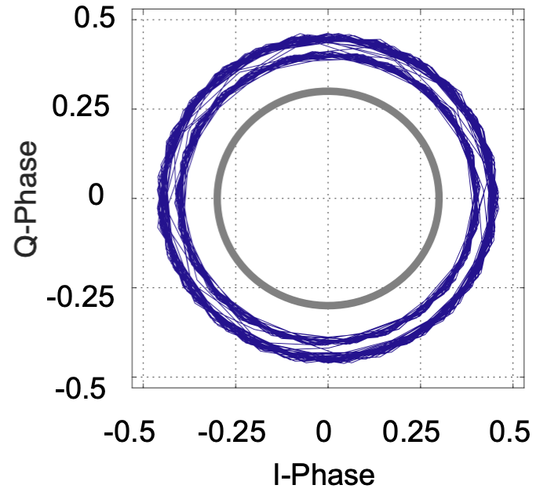
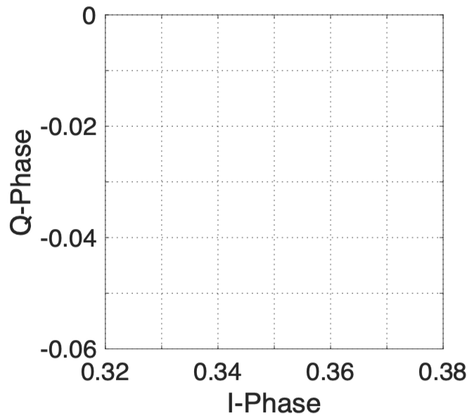
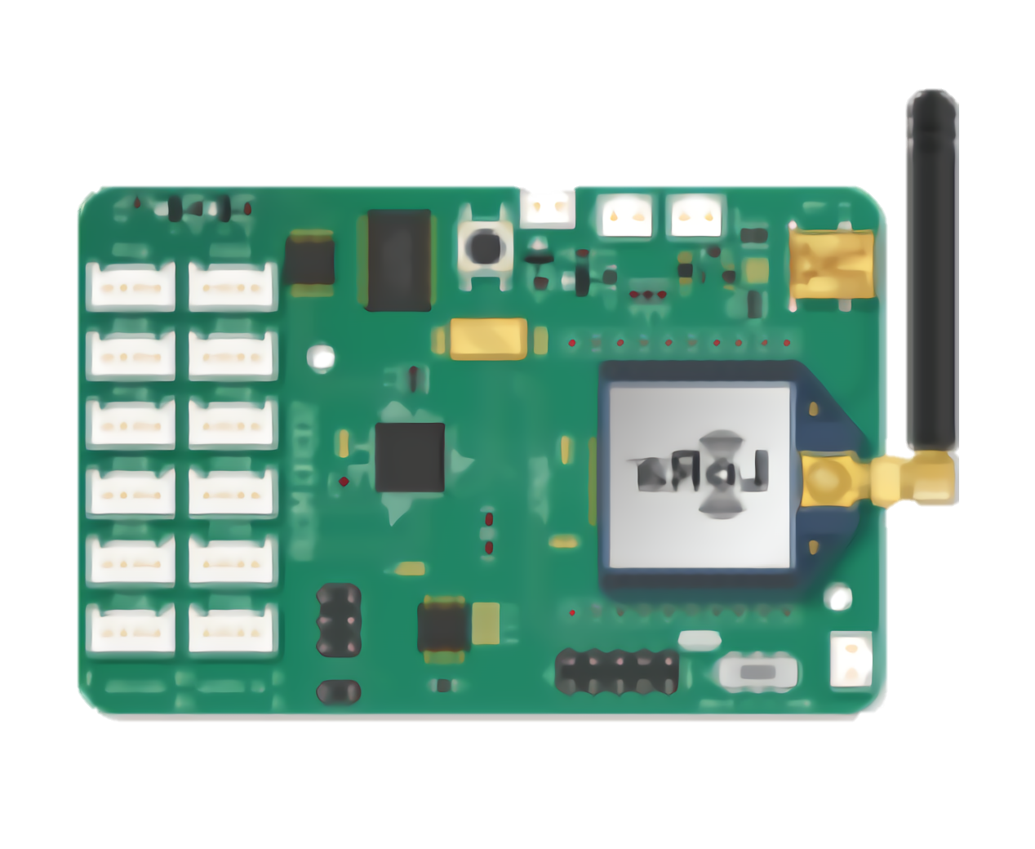
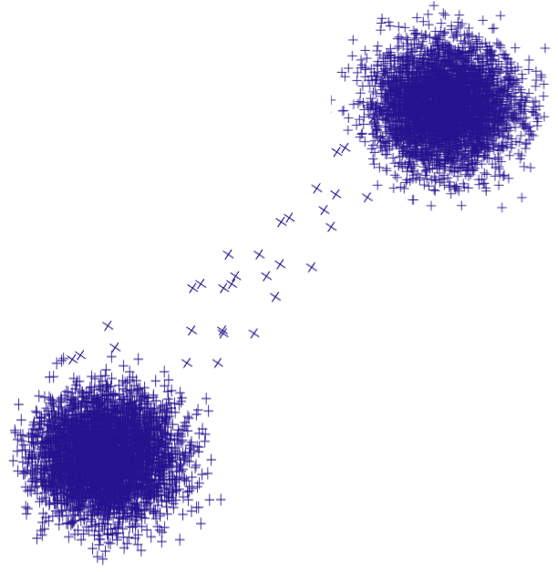
Signal Reconstrction & Decoding
Large quantity of deployed tags
The transformed sinusoidal tone can be reconstructed as: $S=A_{i}∅_{i}$
$A_{i}$is the $i^{th}$ amplitude sample on the transformed sinusoidal tone
$∅_{i}$ is the phase difference between the $i^{th}$ phase sample on this transformed sinusoidal tone and that on a reference sinusoidal tone
L
Tag
$$∅_{i}$$
H
H
H
H
H
H
L
L
L
L
Notes:
Then the receiver reconstructs ! the transformed sinusoidal tone as ! S equal to Ai multiplies Φi ,
where Ai is the amplitude sample ! on the transformed sinusoidal tone [ˈsaɪnəˌsɔɪdəl] [toʊn] . Φi is the phase difference ! between the phase sample ! on this transformed sinusoidal tone [ˈsaɪnəˌsɔɪdəl] [toʊn] and ! the corresponding phase sample ! on a reference sinusoidal tone [ˈsaɪnəˌsɔɪdəl] [toʊn].
To detect the backscatter signal, we propose a ! clustering [ˈklʌstərɪŋ] based detection algorithm.
Specifically, we plot ! all reconstructed signal samples ! on the constellation [ˌkɑːnstəˈleɪʃn] diagram [ˈdaɪəɡræm] .
These symbols are grouped ! into two clusters: one for the none-existence of backscatter signal, and another ! for the existence of backscatter signal.
We can then ! leverage the preamble of the backscatter signal ! which is a sixteen-bit Barker code, to distinguish these two clusters ! and decode the backscatter signal.

Slide 22
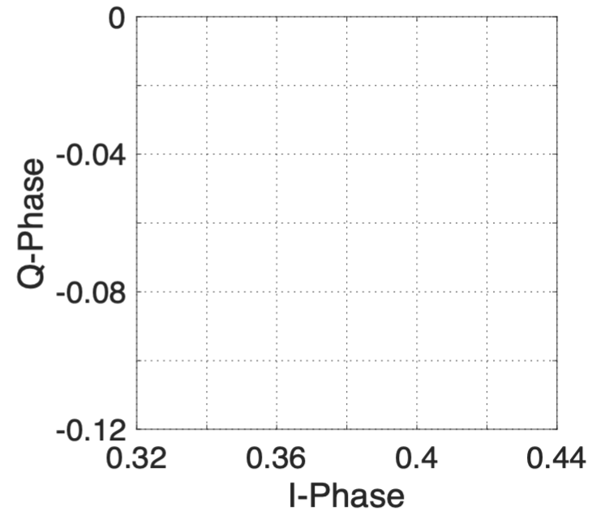
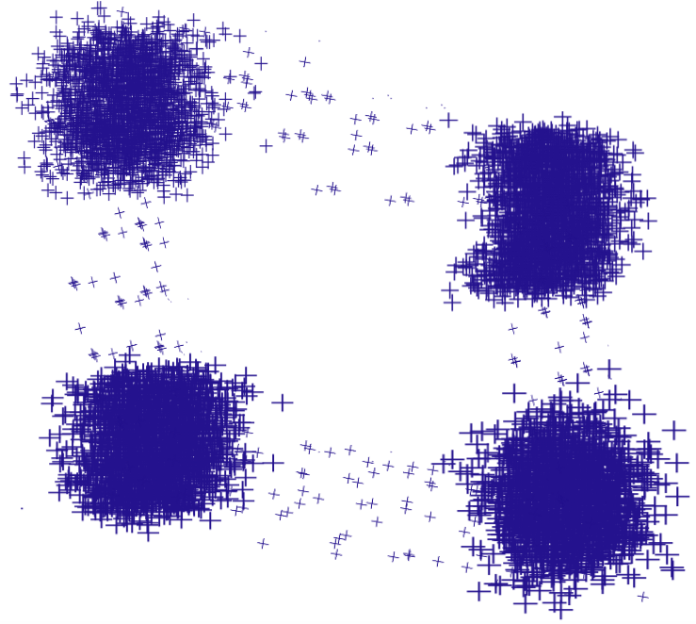
Multiple Tags
Large quantity of deployed tags
Multiple Aloba tags abide by the time-domain ALOHA protocol.
Our demodulation scheme can be used to decode collided multiple tags.
LL
HL
Tag
Tag
LH
HH
Notes:
When there are multiple aloba tags, these tags abide the time-domain aloha protocol.
Sometimes, when these tags collide, our method can be used to decode the collided signals.
for example, suppose there are two tags, we expect to see ! four clusters;

Slide 23
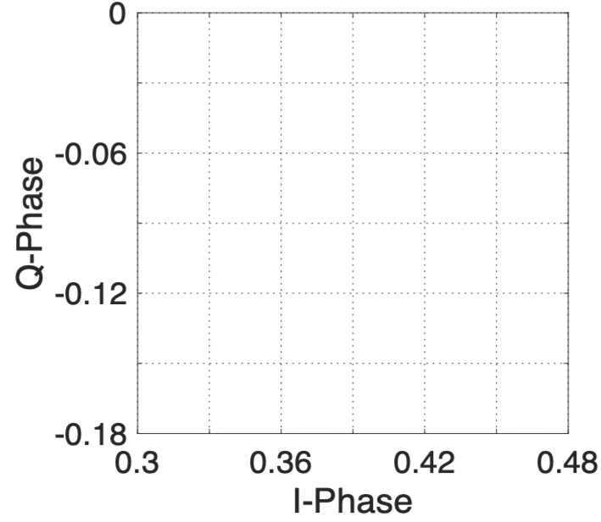
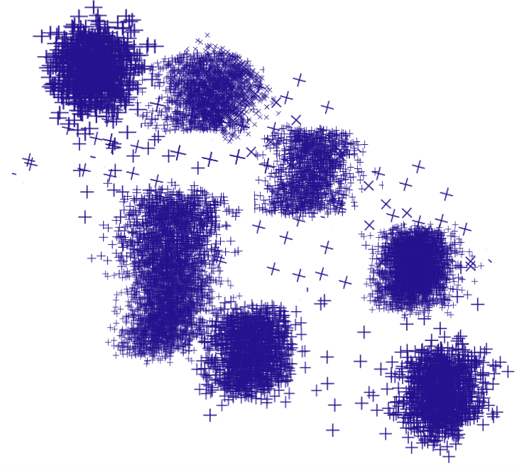
Multiple Tags
Large quantity of deployed tags
Multiple Aloba tags abide by the time-domain ALOHA protocol.
Our demodulation scheme can be used to decode collided multiple tags.
LLL
Tag
LLH
LHH
HLH
LHL
Tag
HLL
HHL
HHH
Tag
Notes:
when there are three tags, there will be ! eight clusters.

Slide 24
Aloba Tag Design
Low-power LoRa Packet Detection
Modulation
Notes:
Next we introduce the design of aloba tag.

Slide 25
LoRa Packet Detection
Large quantity of deployed tags
Unique pattern of LoRa symbols in the LoRa preamble: ten consecutive up-chirps with zero initial frequency offset.
Passing through a low pass filter, the ten consecutive up-chirps on a LoRa preamble will lead to ten equally spaced RSS pulses.
Freq (KHz)
Low-pass filter
moving average filter
window size=5
cutting-off frequency=30KHz
LoRa Tx
RSSI
Notes:
We design a packet detection circuit ! to pick up the LoRa signal from other signals.
We find that ! there are ten consecutive [kənˈsekjətɪv] up-chirps ! with zero initial frequency offset ! in the Lora preamble. When the incoming signal ! passes through a low pass filter, then the consecutive up-chirps on a LoRa preamble ! will lead to ten equally spaced RSS peaks.
Once the FPGA detect ! ten equally spaced RSS peaks, the aloba tag knows ! the arrival of lora packet and ! switches to the modulation mode.
In aloba, we implement a moving average filter on software as the low-pass filter. When we set the window size as 5, the cutoff frequency of low-pass filter is 30 KHz [ˈkɪləhɜːrts].

Slide 26
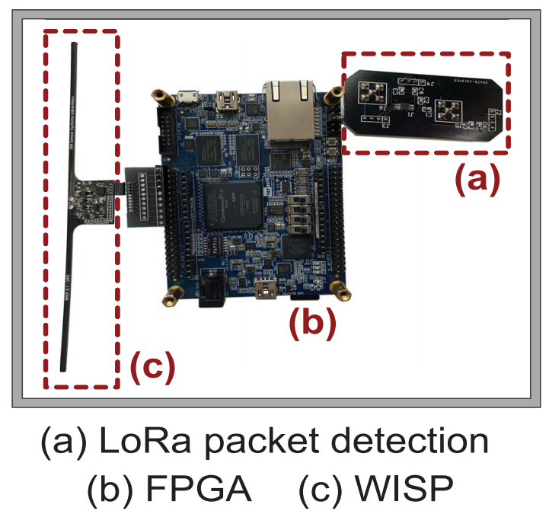
OOK Modulation
Large quantity of deployed tags
OOK Modulation: reflecting the signal when transmitting a bit one, and absorbing the signal when transmitting a bit zero.
Notes:
After detecting the LoRa preamble, Aloba ! modulates data on the payload part ! of this incoming LoRa packet ! using OOK: reflecting the signal ! when transmitting a bit one, and absorbing [əbˈzɔːrbɪŋ] the signal ! when transmitting a bit zero.

Slide 27
Evaluation
Notes:
Next, we introduce the evaluation of aloba.

Slide 28
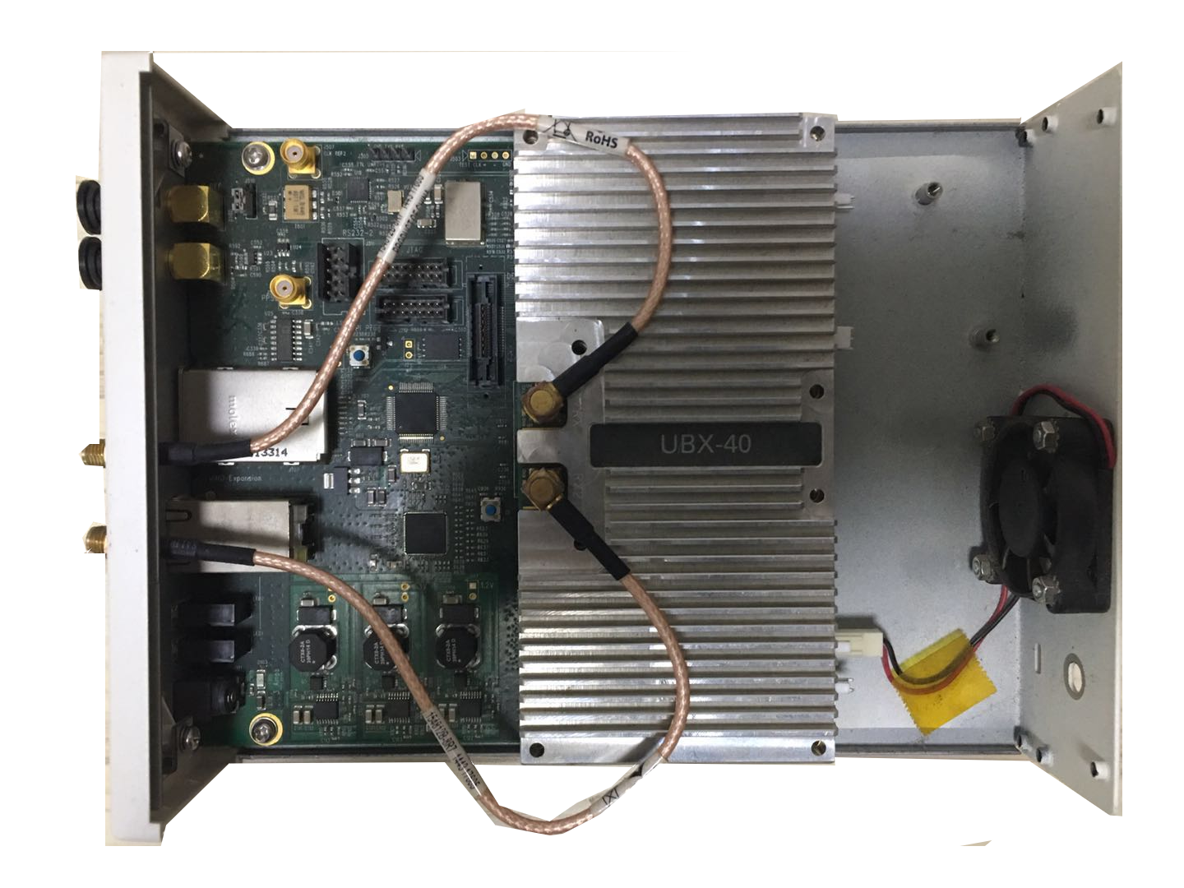
Implementation
Large quantity of deployed tags
LoRa transmitter: a STM32L083RZ board carrying a Semtech SX1276 chip, 3 dBi gain omni-directional antenna
LoRa gateway: an USRP N210 equipped with 3 dBi gain omni-directional antenna, 10 MHz sampling rate
Tag hardware: a single-layer PCB, the packet detection module uses one omni-directional antenna with 3 dBi gain, a DE0-Nano-SoC FPGA with an ultra low-power ADC, WISP 5.0 for OOK modulation
LoRa transmitter
LoRa gateway
Tag hardware
Notes:
We use a commercial LoRa node ! as the lora transmitter, an USRP platform as the lora gateway. aloba tag includes three modules, one lora packet detection module, one fpga controller [kənˈtroʊlər], and one ook modulation module.

Slide 29
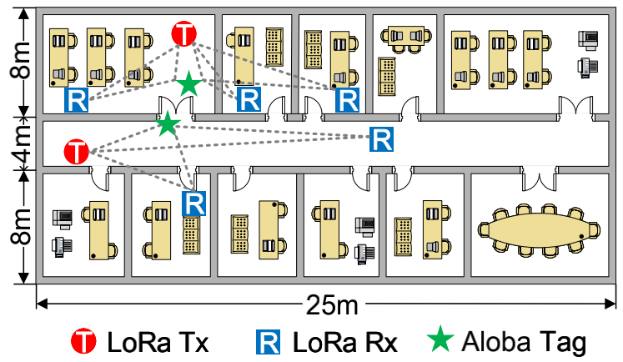
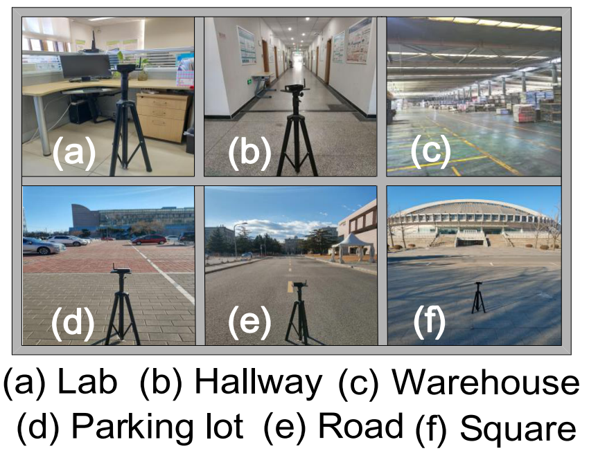
Setup
Large quantity of deployed tags
Channel: 902.5 MHZ; Payload length: 20 LoRa symbols
Default SF: 7; BW: 125 KHz; Coding rate: 1;
Scenario: indoors (classroom, hallway and warehouse) and outdoors (open road, square and parking lot)
Metric: throughput and maximum backscatter range
Notes:
the experimental setup is shown in this slide.
we evaluate aloba ! both indoors and outdoors. we take throughput and maximum [ˈmæksɪməm] backscatter range ! as the netric

Slide 30
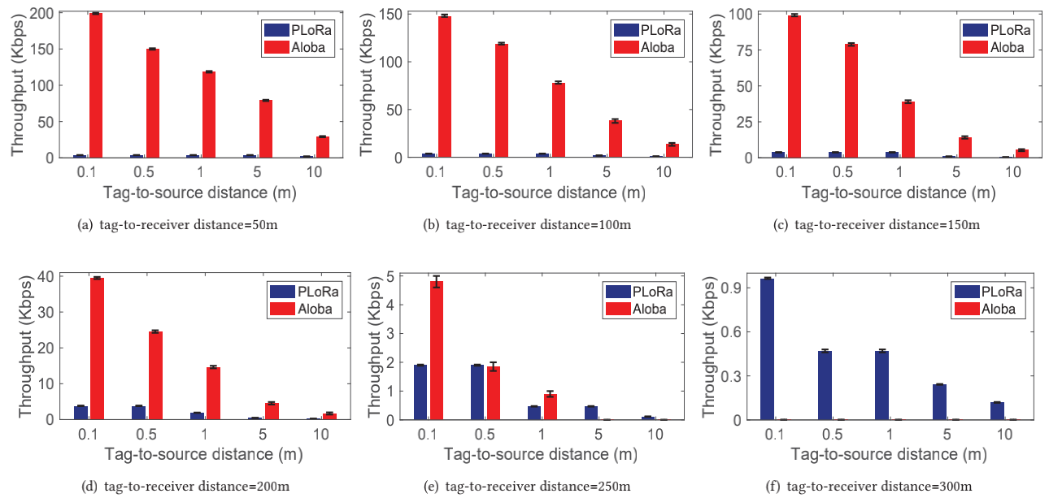
Link Throughput
Large quantity of deployed tags
PLoRa (SIGCOMM 2018) encodes only one bit per LoRa symbol;
The link throughput of Aloba is determined by the switch rate of OOK operation
The link throughput of Aloba is 10.4×–52.4× higher than that of PLoRa
The link throughput decreases with increasing tag-to-source distance
The performance gain of Aloba is mainly within short and medium range
Notes:
We compare Aloba with PLoRa in various settings. PLora encodes only one bit ! per lora symbol. The link throughput of Aloba ! is determined by the rate of ! ON-OFF keying operation.
First, we observe the throughput of Aloba ! is orders of magnitude [ˈmæɡnɪtuːd] higher than that of PLoRa.
Second, the link throughput achieved by Aloba and PLoRa ! both decreases with increasing tag-to-source distance. Aloba has to sacrifice the throughput to ensure a longer backscatter range.
Third, the performance gain of Aloba ! over PloRa ! is achieved mainly within short and medium communication range, because Aloba ! essentially [ɪˈsenʃəli] relies on energy to decode backscatter signals.

Slide 31
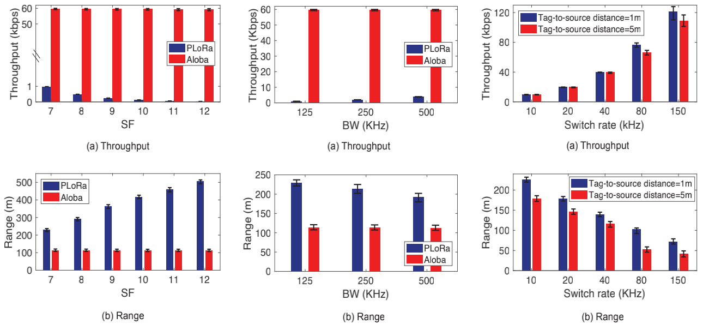
Different Settings
Large quantity of deployed tags
The performance of Aloba is reliable in different LoRa parameter settings
Aloba can achieve flexible throughput and backscatter range by adjusting
the tag's switch rate
Notes:
We further [ˈfɜːrðər] compare the performance of PLoRa and Aloba ! under different settings.
We find that ! the performance of PLoRa ! is more susceptible [səˈseptəbl] to the parameters of LoRa excitation signals, but the performance of Aloba ! is reliable in different LoRa parameter settings.
In practice, Aloba can achieves flexible throughput and backscatter range by adjusting the tag's switch rate.

Slide 32
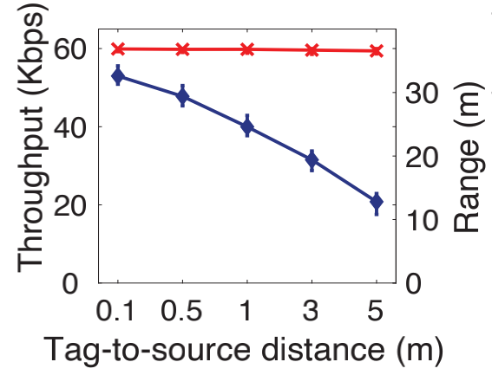
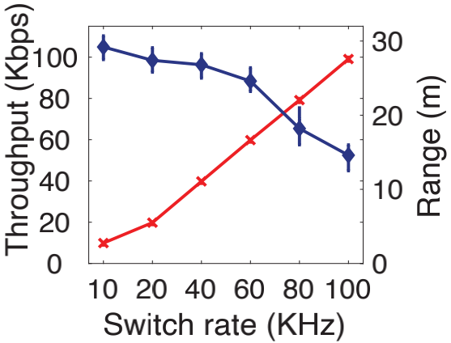
Indoor Experiments
Large quantity of deployed tags
Penetrating one concrete wall
Backscatter range decreases with the tag-to-source distance.
Adjust the switch rate to balance the data rate and backscatter range
Notes:
Then we evaluate the performance of Aloba in indoor environments when the backscatter tag penetrates [ˈpenətreɪt] one concrete wall.
In our experiments, the LoRa sender and the Aloba tag are in the classroom, and the LoRa receiver is in the office.
We vary the tag-to-source distance and the switch rate to study their impact on Aloba performance.
First, we find that the backscatter range decreases with the tag-to-source distance due to that the backscatter signal becomes weaker. In this case, the throughput of Aloba is stable at 60 KHz [ˈkɪləhɜːrts] when we vary the
tag-to-source distance.
Second, we adjust the switch rate from ten KHz [ˈkɪləhɜːrts] to one hundred KHz [ˈkɪləhɜːrts] to balance the data rate and backscatter range. the backscatter range of Aloba decreases with the increase of switch rate. but the throughput of Aloba increases,
These evaluation results demonstrate that Aloba also performs well in the indoor environments.

Slide 33
Conclusion
Notes:
Finally, we conclude our work

Slide 34
Conclusion
Large quantity of deployed tags
Aloba leverages ON-OFF Keying to provide flexible data rate and transmission range for different IoT applications and deployments.
Our design can pick up the ambient LoRa transmissions from other interfering signals and decode the backscatter signal from their superposition.
Evaluation results demonstrate that Aloba can achieve various data rates (39.5 – 199.4 Kbps) at various distances (50–200 m) in the wild.
Notes:
In conclusion, our work leverages ON-OFF Keying ! to provide flexible data rate and transmission range ! for different IoT applications and deployments.
aloba can pick up the ambient LoRa transmissions ! from other interfering signals ! and decode the backscatter signal from their superposition.
Evaluation results ! demonstrate the performance of ALoba.

Slide 35
Thanks
Q & A
guoxz@mail.tsinghua.edu.cn
Notes:
Thank you so much for your attention
I’m happy to take your question

