Slide 1

Saiyan: Design and Implementation of a Low-power Demodulator for LoRa Backscatter Systems
Xiuzhen Guo¹, Longfei Shangguan², Yuan He¹, Jing Nan³, Jiacheng Zhang¹,
Haotian Jiang¹, Yunhao Liu¹
¹Tsinghua University
²Microsoft & University of Pittsburgh
³YanshanUniversity
Notes:
Hello everyone, my name is Xiuzhen Guo.
I just got my PHD from Tsinghua University and I am now a Postdoc.
I’m going to share with you our recent work: /
“Saiyan: Design and Implementation of a Low-power Demodulator for LoRa Backscatter Systems.”
This a joint work among Tsinghua University, University of Pittsburgh[ˈpɪtsbərg], and Yanshan University.

Slide 2






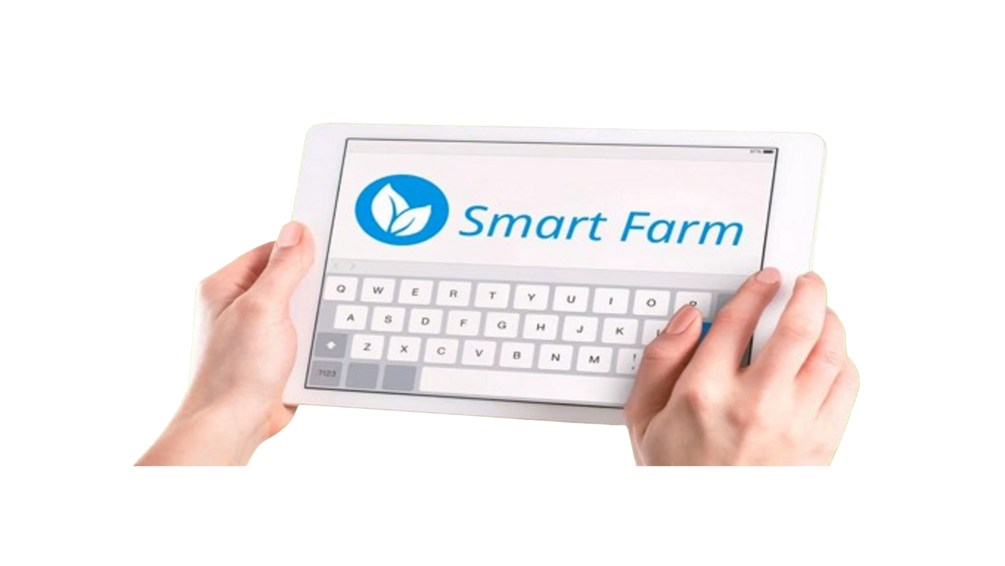
Backscatter Provides Ubiquitous Wireless Connectivity
Automated Factory
Logistics
Environment
Health
Battlefield
Smart City
Sensing Data
LoRa Backscatter Tag
1
Notes:
In recent years, backscatter communication has emerged as an ultra[ˈʌltrə]-low-power alternative [ɔːlˈtɜːrnətɪv] to active radios.
It provides ubiquitous wireless connectivity for lots of IoT applications.
For example, a farmer could remotely monitor the sensor data in a field.
From the conventional RFID technology to the latest LoRa backscatter radios,
（点）the communication range of the backscatter systems has been improved to several hundred meters.

Slide 3
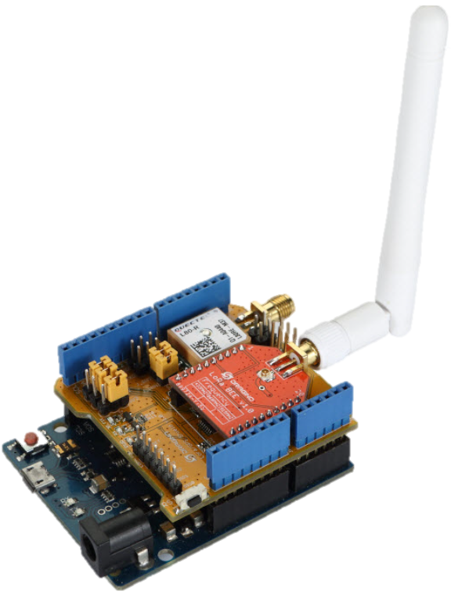
LoRa Backscatter Primer
Carrier Signal
Access Point
Tag
Backscatter Signal
[1] PLoRa: A passive long-range data network from ambient LoRa transmissions. SIGCOMM, 2018
[2] Aloba: Rethinking on-off keying modulation for ambient LoRa backscatter. SenSys, 2020.
2
Notes:
Existing LoRa backscatter tag takes the LoRa signals sent from the access [ˈækses] point as the carrier signals, and modulates its data on the top pf the carrier signals.
Due to the fact that the LoRa signals can be decoded at very low signal-to-noise ratio, LoRa backscatter systems allow the tag to communicate over the distance of hundreds of meters.

Slide 4
Challenge on Packet Delivery
Downlink:
on demand retransmission
Blind re-transmission
LoRa RX
Tag
20m
100m
PLoRa
Aloba
10⁰
0.1m
10⁻¹
10⁻²
BER
10⁻³
LoRa TX
10⁻⁴
10⁻⁵
0.1
0.2
0.5
1
5
10
20
Tag-to-TX distance (m)
[1] PLoRa: A passive long-range data network from ambient LoRa transmissions. SIGCOMM, 2018
[2] Aloba: Rethinking on-off keying modulation for ambient LoRa backscatter. SenSys, 2020.
3
Notes:
However, existing LoRa backscatter systems present [ˈpreznt] a new challenge on packet delivery[dɪˈlɪvəri].
(点)We conduct experiments on campus [ˈkæmpəs] to analyze this problem. The distance between the transmitter and receiver is one hundred meters.
When the tag is placed 10 centimeters [ˈsɛntəˌmitər] 'santermiter, the bit error rate is far less than one percent.
（点） As the tag is moved away from the transmitter, the bit error rate rises rapidly['ræpɪdli]。
We find that the receiver is almost unable to demodulate any backscatter signal once the tag is
placed twenty meters away from the transmitter.
（点）Considering that the tags are unaware of packet loss, each packet must be transmitted blindly for multiple [ˈmʌltɪpl] times. The blind re-transmission will waste precious [ˈpreʃəs] energy and cause interference to other radios that work on the same frequency band.
（点）To adress these issues, we expect a downlink from the access point to the backscatter tag.
Through the feedback signals, the re-transmission request can be transmitted to the tag on-demand.

Slide 5
Downlink Demodulation
Tag
Access Point
0100110
0011011
1101100
Making on-demand re-transmissions
Allocating commands and scheduling channels
Adapting data rate to link condition
4
Notes:
Therefore, we focus on the advancement of downlink, from access point to tag.
The tag can not only reflect the carrier signals, but also demodulate the carrier signals.
（点）For example, the backscatter tag demodulates feedback signals from an access point and makes a re-transmission, only if, it is asked to do so.
（点）Second, the backscatter tag can allocate commands and schedule channels. The access [ˈækses] point monitors the wireless spectrum and notifies the backscatter tag to switch channels in the presence[ˈprezns] of interference.
（点） Third, the backscatter tag can adapt data rate to link condition. The access point assesses the condition of backscatter link, each tag adapts its data rate based on the feedback messages to utilize the wireless link better.

Slide 6
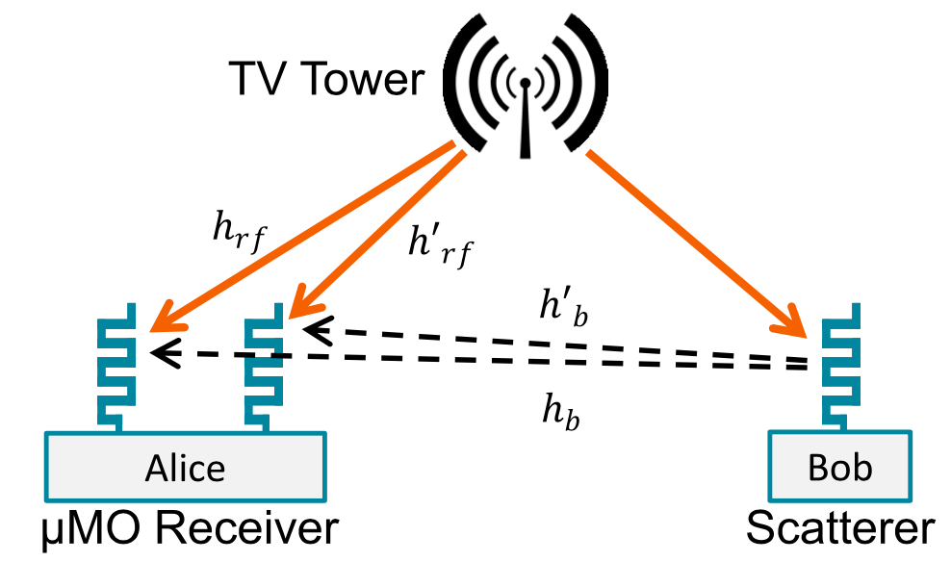
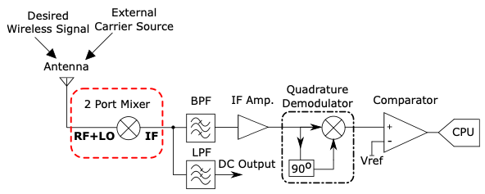
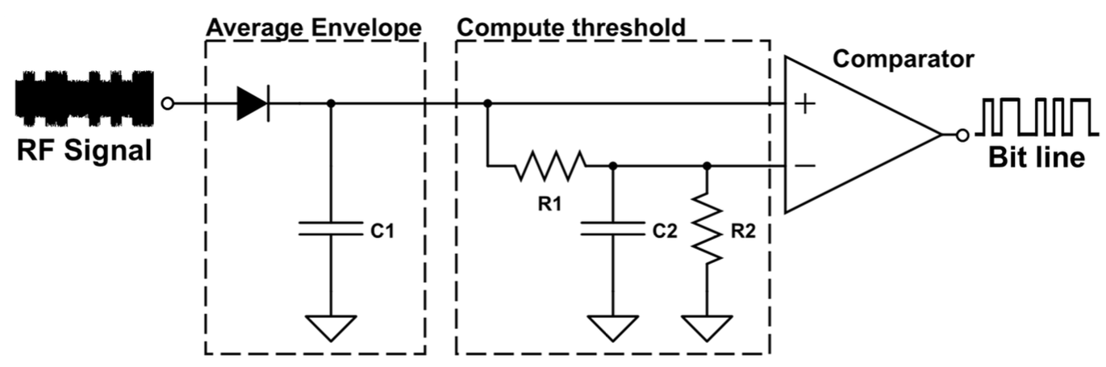
Existing Works for Downlink Demodulation
Leveraging the envelope detector
Leveraging a multi-antenna
cancellation circuit
Offloading power-intensive
functions to external devices
RFID systems
Ambient backscatter [SIGCOMM’12]
Passive WiFi [NSDI’18]
Netscatter [NSDI’16]
Turbocharging [SIGCOMM 2014]
Full-duplex LoRa backscatter
[NSDI 2021]
Low-power BLE receiver [RFID 2017]
Low-power ZigBee receiver
[IPSN 2018]
For amplitude-modulated signals
Power-intensive and complex
Limited demodulation range
5
Notes:
Prior[ˈpraɪər] works for downlink demodulation can be broadly divided into three groups.
The first group leverages the envelope [ˈenvəloʊp] detector to demodulate the downlink signal, such as RFID systems. But this method can only demodulate amplitude modulated signal.
(点)The second group leverages a multi-antenna [ˈmʌlti ænˈtenə] cancellation circuit to enable the signal demodulation on backscatter tags, but this method is power-intensive and complex.
(点)The third group offloads power-intensive functions to external devices, such as a low-power BLE receiver. However, the working range is limited to tens of centimeters.'santermiter
(点)Our work differs from these systems in two aspects[ˈæˌspɛkts]. First, our work is designed for demodulating frequency-modulated signals as opposed to amplitude modulated signals. Second, our work is designed for long-range LORa backscatter systems.

Slide 7
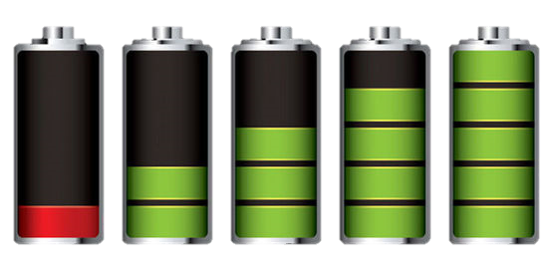
How to demodulate LoRa Symbols?
Down-conversion
LNA
ADC
FFT
Bits
LPF
Mixer
BPF
Clock
40mW
1mW
A commercial LoRa receiver
Tag
6
Notes:
bring demodulation ability to the LoRa backscatter tag is challenging, primarily [praɪˈmerəli] due to the tag’s stringent [ˈstrɪndʒənt] power budget[ˈbʌdʒɪt] .
(点)
To demodulate a LoRa symbol, the commercial LoRa receiver operates by down-conversion, ADC sampling, and FFT decoding.
These operations are power-intensive. They consume over forty milliwatt power altogether.
(点)
Considering a backscatter tag, it can only harvest less than 1 milliwatt power every ten seconds.
(点)
Therefore, the standard LoRa demodulation method is ill-suited [ɪl ˈsuːtɪd] for the backscatter tag.

Slide 8
Can we enable a low-power demodulator for long-range LoRa backscatter systems?
7
Notes:
So we ask a fundamental question: Can we enable a low-power demodulator for long-range LoRa backscatter systems?

Slide 9
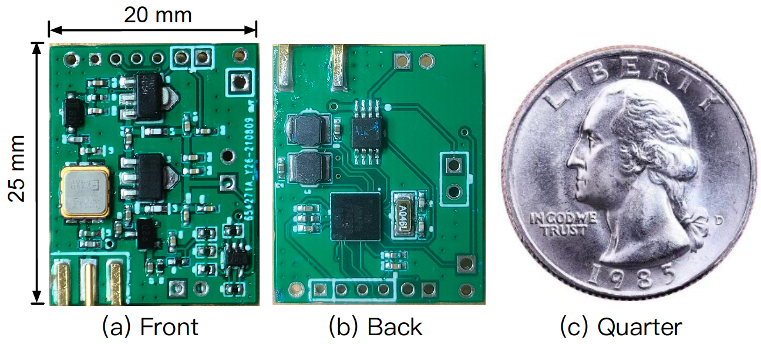
Saiyan: a Low-power Demodulator
The first-of-its-kind low-power LoRa demodulator
  Power consumption of 369.4uW
  Demodulation range of 180m
Code and hardware schematics can be found at: https://github.com/ZangJac/Saiyan
8
Notes:
Here we give an affirmative [əˈfɜːrmətɪv] answer with Saiyan, which is the first-of-its-kind low-power LoRa demodulator.
First, we simplify the standard LoRa demodulation from energy perspective and its power consumption is only about three hundred and seventy microwatts.
Second, we improve the demodulation sensitivity and the demodulation range can be up to one hundred and eighty meters.

Slide 10
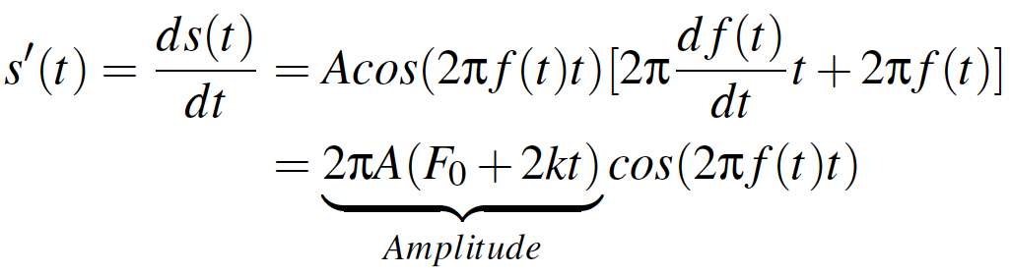
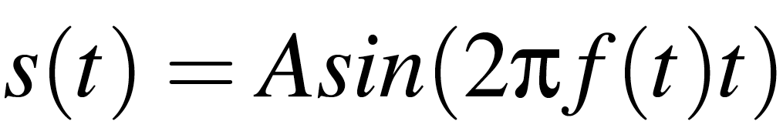
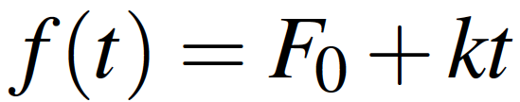
Key Observation
Frequency
Frequency
F
F
t
t
Differentiation
Operation
The frequency-modulated chirp signal can be transformed into the amplitude-modulated signal using a differential circuit.
Amplitude
Amplitude
A
A
t
t
9
Notes:
Saiyan is based on the following key observation.
First, a LoRa symbol is represented[ˌreprɪˈzentɪd] by a chirp whose frequency grows linearly over time.
(点)
Applying a differential [ˌdɪfəˈrenʃl] operation to a LoRa chirp, the amplitude of the transformed signal is proportional [prəˈpɔːrʃənl]to the frequency of the input LoRa chirp.
(点)
In other words, the frequency-modulated chirp signal can be transformed into the amplitude-modulated signal using a differential[ˌdɪfəˈrenʃl circuit.
an observation that a frequency-modulated chirp signal can
be transformed into an amplitude-modulated signal using a
differential circuit. The amplitude of this transformed signal
scales with the frequency of the incident chirp signal, thereby
allowing us to demodulate a LoRa chirp by tracking the peak
amplitude on its transformed counterpart without using powerintensive
hardware, such as a down-converter and an ADC.

Slide 11
Key Observation
Maximum Frequency
A
Maximum Amplitude
F
t
t
Symbol “00”
Demodulate the frequency-modulated LoRa signal by tracking the peak amplitude on its transformed counterpart.
Symbol “00”
Differential
Operation
F
Maximum Frequency
A
Maximum Amplitude
t
t
Symbol “10”
Symbol “10”
10
Notes:
For two LoRa symbols, they differ from each other in the initial frequency.
So these two chirps will reach the maximum frequency at different times.
(点)
After the differential operation, the amplitude of the transformed signal will reach the peak value at different time.
(点)
Therefore, this frequency-amplitude correlation inspires us to demodulate the frequency-modulated LoRa signal by tracking the peak amplitude on its transformed counterpart.

Slide 12
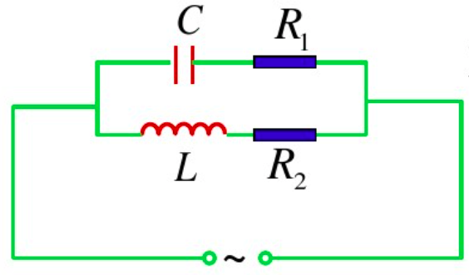
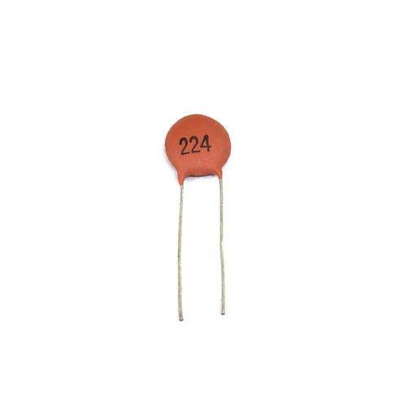
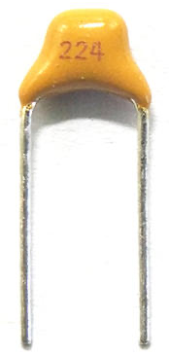
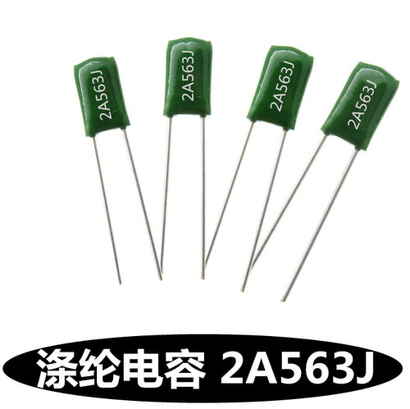
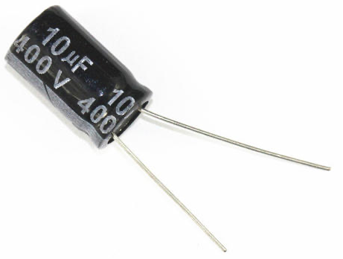

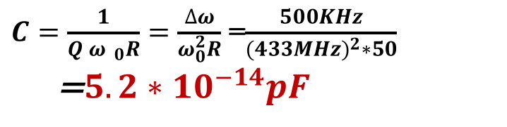

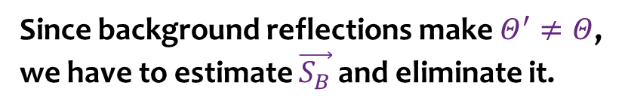



Frequency-amplitude Transformation
I_{max}
Upper bound capacitance
$$\frac{1}{\sqrt{2}}$$
a
b
I_{max}
$C=\frac{1}{Q{ ω}_{ 0}R}=\frac{∆ω}{ω_{0}^{2}R}$ =$\frac{500KHz}{{(433MHz)}^{2}∗50}$
=$5.2∗{10}^{−14}pF$
$$ω_{ 1}$$
$$ω_{ 2}$$
$$ω_{ }$$
$$ω_{0}$$
Building a narrow-bandwidth RLC differential circuit is impractical for LoRa signals!
Differential Circuit
Very difficult!
5pF
100pF
1000pF
0.1uF
11
Building a narrow-bandwidth RLC differential circuit is impractical for LoRa signals!
Notes:
To put this high-level idea into practice, an intuitive solution to realize the differential operation is using RLC resonant [ˈrezənənt] circuit.
Usually, the narrow bandwidth nature of LoRa
requires the capacitor [kəˈpæsɪtər] should be as small as/ Five times/ ten to the power of minus fourteen picofarad [picofanraid]
(点)
But existing commercial capacitors [kəˈpæsɪtər] are larger than this upper bound.
(点)
Therefore, building such a narrow-bandwidth RLC resonant [wɪdθ] circuit is impractical.

Slide 13
Surface Acoustic Wave (SAW) Filter
Passive SAW Filter
434MHz
433.5MHz
434MHz，-10dBm
Acoustic Waves → Electrical signals
Electrical signals → Acoustic Waves
434MHz
433.5MHz，-37dBm
Sharp
amplitude-frequency
response
434MHz
434MHz
433.5MHz
433.5MHz
433.5MHz
12
Notes:
In Saiyan, we instead [ɪnˈsted] adopt a Surface Acoustic Wave filter.
The SAW filter is a purely passive component with zero power consumption.
We leverage the sharp amplitude-frequency response of the saw filter to achieve signal transformation.
(点)For example, when a LoRa chirp is sent to the SAW filter, the input transducer [trænzˈduːsər] transforms the electrical[ɪˈlektrɪkl] signals into acoustic waves;
(点)The internal material has frequency selective characteristics [ˌkɛrəktəˈrɪstɪks] .
(点)As shown in the amplitude-frequency response of a SAW filter, we observe a twenty-five decibel [ˈdesɪbel] amplitude gap as the frequency grows from four hundred and thirty-three point five megahertz to four hundred and thirty-four megahertz [ˈmeɡəhɜːrts] .
Apparently, such amplitude gap is enough to differentiate the frequency variation within LoRa bandwidth.
(点)Finally, the output transducer [trænzˈduːsər] transforms acoustic waves back into electrical signals.
(点)We can find the frequency-modulated LoRa chirp can be transformed to the amplitude-modulated Lora chirp.

Slide 14
Vanilla Saiyan
Frequency
Sync
Payload
Preamble (10 upchirps)
Sync
Payload
Preamble (10 upchirps)
13
Notes:
A LoRa packet first contains the preamble using ten identical up-chirps, the synchronization[ˌsɪŋkrənaɪ'zeɪʃ(ə)n] world using downchirps, and the payload follows.
（点)
When this LoRa packet is sent to the SAW filter, （点)
The output of the SAW filter isfrequency and amplitude modulated signals.

Slide 15
Vanilla Saiyan
Frequency
Envelope
threshold
Vanilla Saiyan can demodulate LoRa signals with the minimum power consumption.
After the comparator
11
10
01
00
After the counter
Decodable!
=
+
ADC
Comparator
Counter
Output
Preamble (10 upchirps)
Sync
Payload
14
Notes:
The output of the SAW filter is frequency and amplitude modulated signals.
The amplitude of the transformed signal scales with the frequency of the input chirps.
(点)Then the transformed signals can be down-converted to the baseband through an envelope detector.
The following question is how to digitize[ˈdɪdʒɪtaɪz] these baseband signals and track the peak values?
A standard method is using an ADC, but the ADC is power intensive.
（点）To save power, we replace the ADC with a low-power voltage comparator [kəmˈpanrutər] and a counter.
（点）First, we set a voltage threshold, and the comparator [kəmˈpanrutər] output a ‘high’ voltage only when the signal’s amplitude is higher than the threshold.
（点）Second, the low-power counter is used to sample these logical values. Finally, Saiyan decodes each chirp by localizing [ˈloʊkəlaɪzɪŋ] the high logic.
（点）Therefore, Vanilla Saiyan can demodulate LoRa signals with the minimum power consumption.

Slide 16


Demodulation Sensitivity of Vanilla Saiyan
Signal attenuation
Passive Envelope Detector
$$x$$
$$y$$
Passive SAW Filter
Noise overlap-added
15
Notes:
However, the demodulation sensitivity [ˌsensəˈtɪvəti] of vanilla Saiyan is limited
due to the signal attenuation in the SAW filter
and the noise added by the envelope detector.

Slide 17
Super Saiyan
16
Notes:
Next, we introduce super Saiyan to improve the sensitivity.

Slide 18






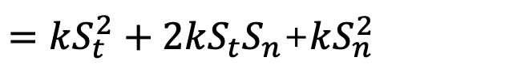
Improving the Demodulation Sensitivity
Non-linearity
$$y=kx^{2}$$
$$S_{out}=kS_{in}^{2}=k{(S_{t}+S_{n})}^{2}$$
Noise self-mixing
$$x$$
$$y$$
$=kS_{t}^{2}+2kS_{t}S_{n}$+$kS_{n}^{2}$
Signal self-mixing
Mixing between noise and signal
Envelope Detector
PSD
PSD
$$S_{t}$$
Signal self-mixing
SNR
Noise self-mixing
$$S_{n}$$
Mixing between noise and signal
f
f
0
Fc
0
17
Notes:
In order to improve the demodulation sensitivity, we first understand the principle[ˈprɪnsəpl] of envelope detector.
Due to the inherent [ɪnˈhɪrənt] non-linearity caused by the squaring operation, (点)
both the targeted signal and the RF noises will be down-converted to the baseband.
Consequently [ˈkɑːnsɪkwentli], the targeted signal becomes weaker after down-conversion. That results in the drop of the signal-to-noise ratio.

Slide 19
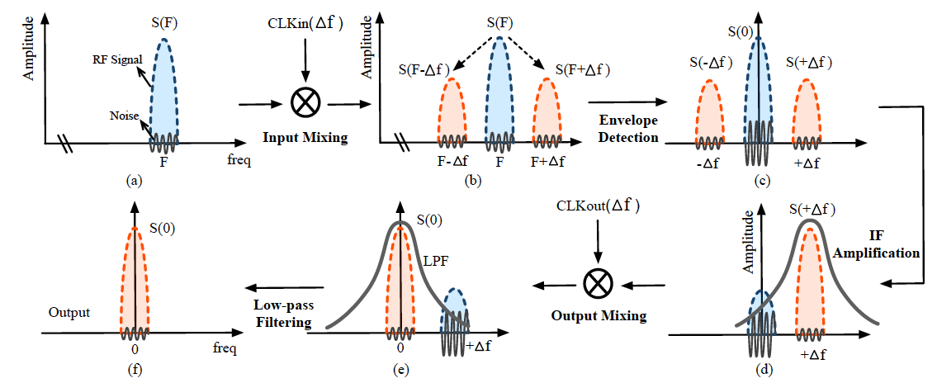
Cyclic-frequency Shifting
18
Notes:
To improve the demodulation sensitivity, we design a low-power cyclic [ˈsaɪklɪk]-frequency shifting method to remove the noise and amplify the desired signal.
（点）First, the input signal is mixed with the clock signal, resulting in two sideband signals.
（点）Second, the envelope detector extracts[ɪkˈstrækt] the envelope of those three signals and down-converts them to the baseband.
（点）Third, the amplifier boosts the power of desired signal and attenuates the power at other
frequency bands.
（点）Fourth, the desired signal is shifted back to the baseband.
（点）Finally, the desired signal is filtered by a low-pass filter.

Slide 20
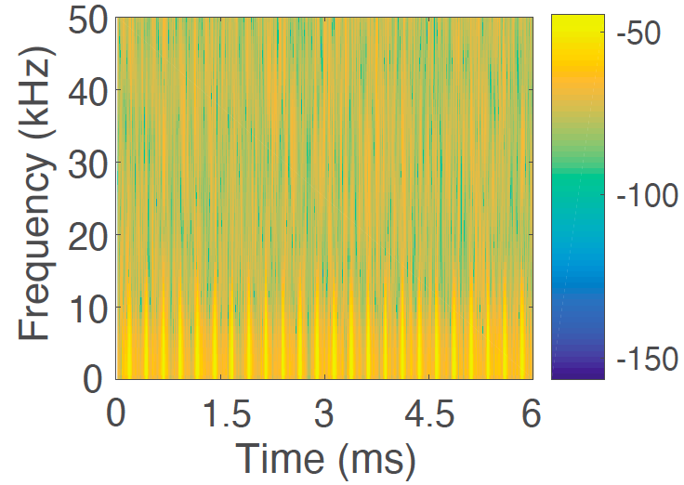
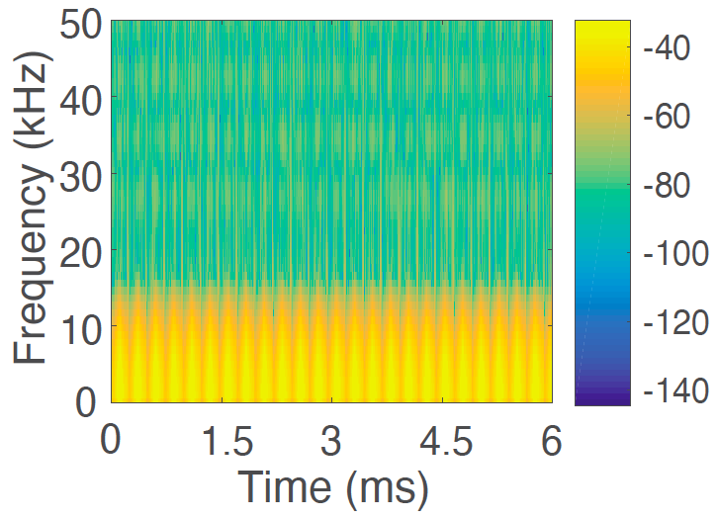
Cyclic-frequency Shifting
11dB SNR gain
19
Notes:
Evidently, Our measurement study shows this cyclic[ˈsaɪklɪk]-frequency shifting brings eleven [ˈdesɪbel] desibel gain to the signal-to-noise ratio.

Slide 21
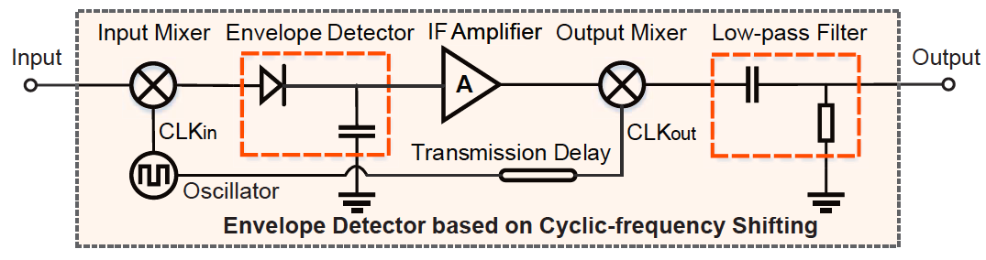
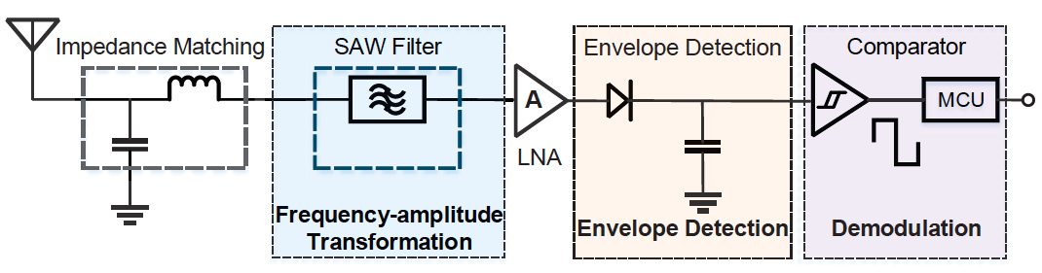
High-level Circuit Schematic
(Improve demodulation sensitivity)
Super Saiyan
Vanilla Saiyan
(Demodulate LoRa signals)
20
Notes:
Now, we present[preznt] the high-level circuit schematic [skiːˈmætɪk].
The circuit of vanilla Saiyan demodulate LoRa signals with the minimum power consumption.
(点)
The super Saiyan improves the demodulation sensitivity by integrating the cyclic-frequency shifting circuit into the envelope detector.

Slide 22
Implementation & Evaluation
21
Notes:
Next, we introduce the implementation and evaluation of Saiyan

Slide 23
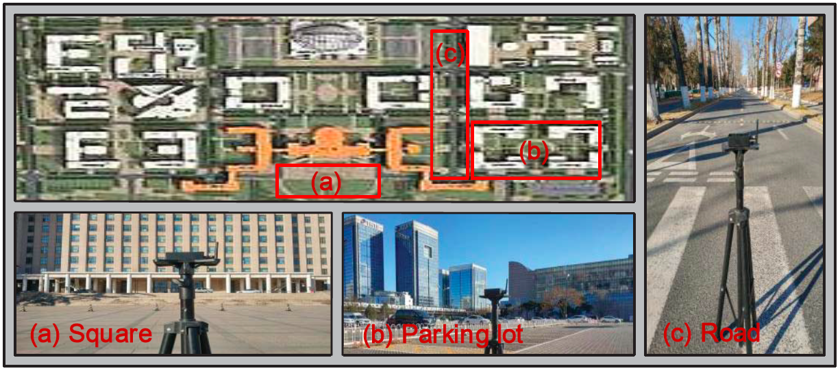
Implementation
Backscatter Tag
  25mm * 20mm two-layer PCB
  Passive SAW chip B39431B3790Z810
  Ultra-low power Apollo2 (10 μA/MHz) MCU
Plug-and-play
Power management: palm-sized photovoltaic panel + DC/DC converter LTC3105
SAW
Apollo2
22
Notes:
We implement Saiyan on a two-layer PCB board.
As a low-power demodulation peripheral[pəˈrɪfərəl], Saiyan can be integrated into the existing long-range LoRa backscatter systems.
We conduct field studies both indoors and outdoors to evaluate the performance of Saiyan.

Slide 24
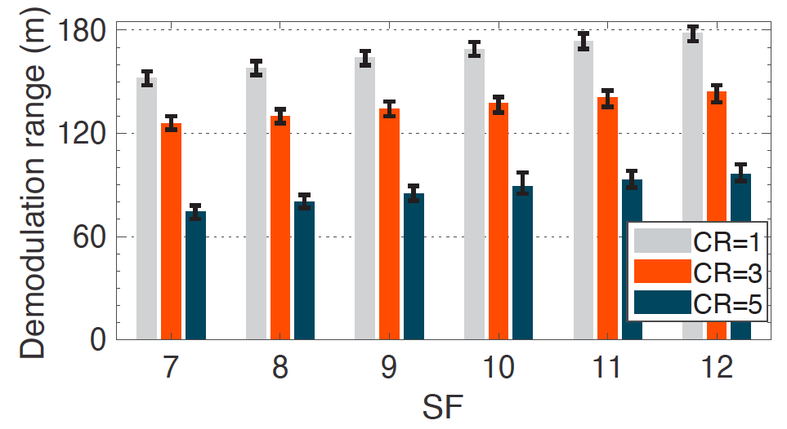
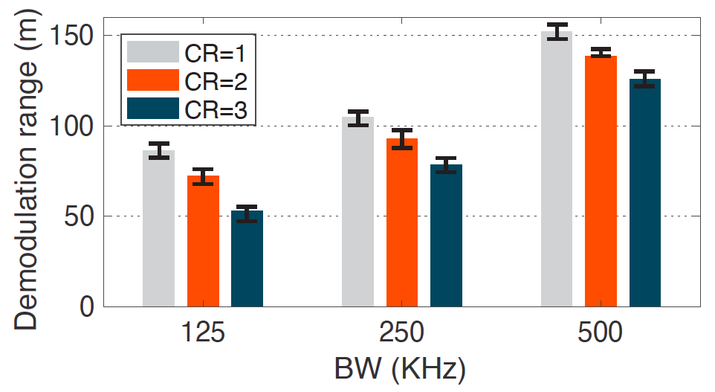
Demodulation Range
180m
Spreading Factor
Bandwidth
The demodulation range grows with the increasing SF and BW.
The maximum demodulation range can be up to 180m.
23
Notes:
First, we assess the demodulation range of Saiyan.
We have the following two observations.
（点）
First, the demodulation range grows with the increasing spreading factor and bandwidth of the LoRa signals.
This is expected since a higher spreading factor improves the anti-noise ability of LoRa signals; thus that the demodulation range grows.
（点）
Second, the maximum demodulation range can be up to one hundred and eighty meters.

Slide 25
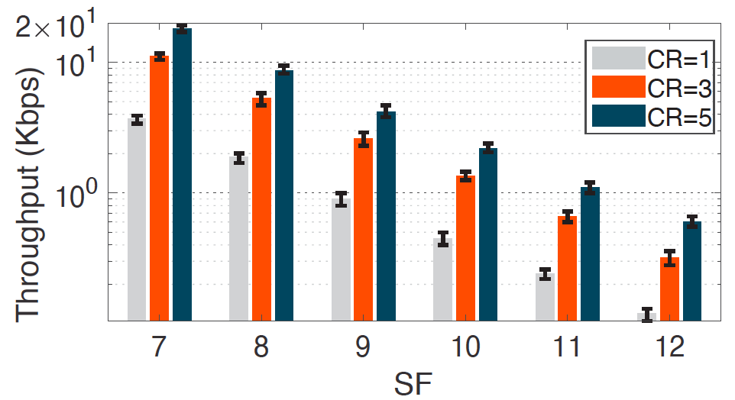
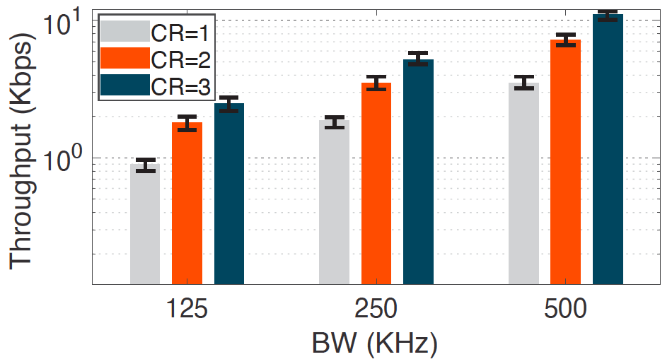
Throughput
18.12Kbps
Spreading Factor
Bandwidth
The throughput declines with SF and grows with BW.
The maximum throughput can be up to 18.12Kbps.
24
Notes:
In terms of the throughput, we find that the throughput declines with spreading factor but grows with bandwidth.
The maximum throughput can be up to eighteen Kbps.

Slide 26
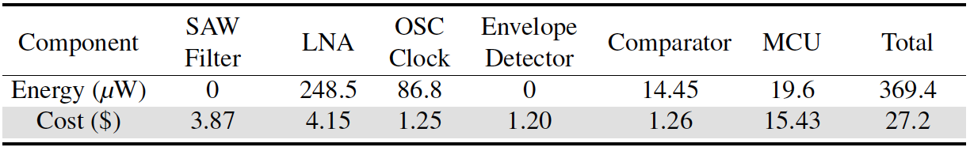
Power Consumption & System Cost
Passive
Low-power
The power and cost can be reduced sharply after ASIC fabrication
25
Notes:
We also carefully compute the power consumption and cost of each component in Saiyan.
As you can see, the SAW filter and envelop detector are passive. The overall power consumption is about three hundred and seventy microwatts.
The power and cost can be reduced sharply after ASIC fabrication.

Slide 27
Take Away
The advancement of downlink (TX→Tag), a fundamental but missing piece, will promote the development of the backscatter technology.
Replacing active components with their passive counterparts (e.g. SAW filter) can significantly reduce the power consumption.
Reducing the inherent non-linear distortion of the analog device is a key step to improve the SNR.
26
Notes:
We have presented the design, implementation, and evaluation of Saiyan. There is something to take away from Saiyan.
Conventional thinking usually treats the backscatter tag as a transmission-only device, so most of bakcscatter innovations try hard to push the uplink from the tag to the receiver, for example, improving the throughput, extending the backscatter range, or scaling to different mediums.
In Saiyan, we focus on the advancement of downlink, from the transmitter to the tag, a fundamental but missing piece.
However, bringing demodulation ability to LoRa backscatter tag is challenging due to the tag’s stringent [ˈstrɪndʒənt] 振 power budget.
So in Saiyan, we replace active components with their passive counterparts to reduce the power consumption.
For example, we leverage the passive SAW filter to achieve signal transformation.
Moreover, reducing the inherent non-linear distortion of the analog device is a key step to improve the signal to noise ratio, so we introduce a cyclic[ˈsaɪklɪk]-frequency shifting circuit to extend the communication range.

Slide 28
Conclusion
Simplify the standard LoRa demodulation from energy perspective and propose the first-of-its-kind low-power LoRa demodulator.
Design a set of simple but effective circuits and algorithms, prototyping them on PCB board for system evaluation.
Conduct extensive experiments and demonstrate Saiyan’s performance on power consumption, communication range, and throughput.
27
Notes:
Then we briefly conclude our work.
We design the first-of-its-kind low-power LoRa demodulator and conduct extensive experiments to evaluate the performance of Saiyan.

Slide 29



Longfei Shangguan
Nan Jing
Haotian Jiang
Xiuzhen Guo
Yuan He
Jiacheng Zhang
Yunhao Liu
Code and hardware schematics can be found at: https://github.com/ZangJac/Saiyan
Visit http://tns.thss.tsinghua.edu.cn/sun/ for details
Notes:
Finally, Thank you for my collaborators [kəˈlæbəˌreɪtərz].
Thank you for watching and listening.
Code and hardware schematics [skiːˈmætɪk] can be found on the github.
Please visit our website for details.

