Slide 1
Edge Assisted Real-time Instance Segmentation on Mobile Devices
Jialin Zhang∗, Xiang Huang∗, Jingao Xu, Yue Wu, Qiang Ma Xin Miao, Li Zhang, Pengpeng Chen, Zheng Yang
Tsinghua University
HeFei University of Technology
China University of Mining and Technology
IEEE ICDCS 2022

Slide 2
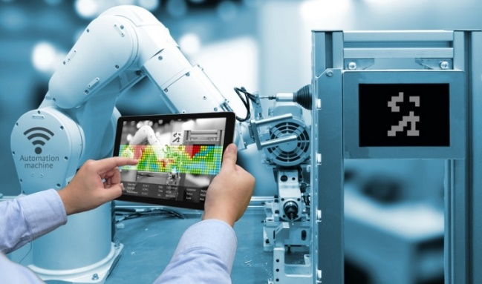
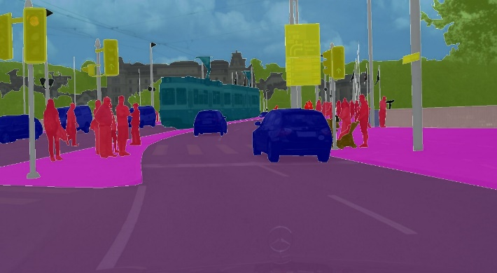
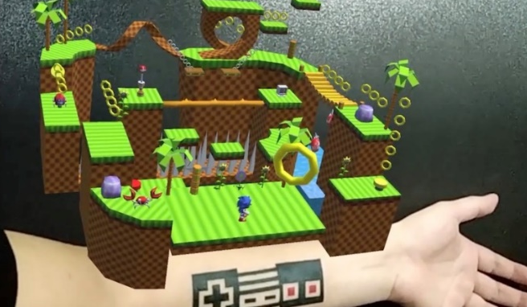

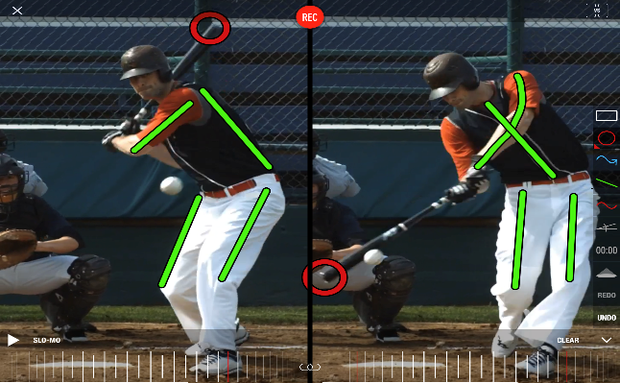
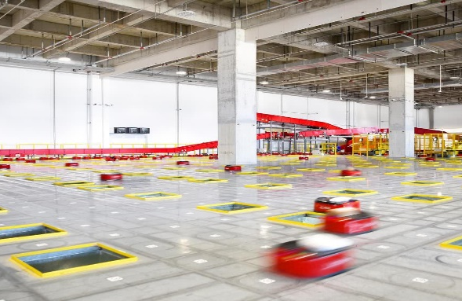
Background
Mobile Instance Segmentation
Industry Inspection
Autonomous Driving
AR Application
Edge Assisted Visual Tasks
Object Detection
Video Analysis
Drone Automation
Notes:
[START]
[CLICK]

Slide 3
Background
Typical Edge Assisted Architecture for Visual Tasks
Notes:
[START]

Slide 4
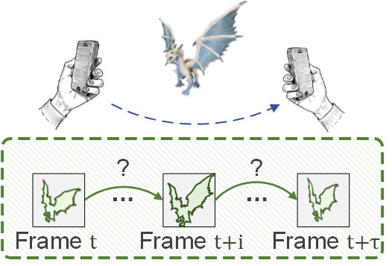

Challenge
Object Detection v.s. Instance Segmentation
Pixel-level information are hard to update.
Notes:
[START]
[CLICK]

Slide 5
Challenge
Object Detection v.s. Instance Segmentation
Segmentation models are considerably heavier than detection ones.
Notes:
[START]
[CLICK]

Slide 6
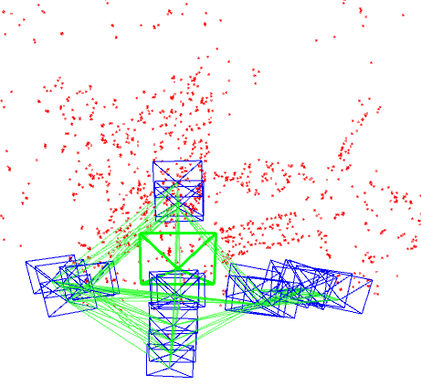

Key Insight
Introducing VO into the edge-assisted framework
Instruct
Accelerate
Leveraging VO’s ability of motion estimation and environment modeling.
Notes:
[START]
[CLICK]

Slide 7
Our Work
Leveraging VO’s sensing ability for mask transfering
Environment Modeling
Motion Analysis
Notes:
[START]
[CLICK]

Slide 8
Our Work
Integrating mobile side’s information into edge acceleration
Notes:
[START]
[CLICK]

Slide 9
Our Design
Motion Aware Mobile Mask Transfer
Notes:
[START]
[CLICK]

Slide 10
Our Design
Motion Aware Mobile Mask Transfer
Notes:
[START]

Slide 11



Our Design
Motion Aware Mobile Mask Transfer
$$T_{OW}^{i+1}$$
$$T_{CW}^{i+1}$$
$$T_{CO}^{i+1}$$
Notes:
[START]
[CLICK]

Slide 12
Our Design
Contour Instructed Edge Inference Acceleration
Dynamic anchor placement
RoI pruning
Notes:
[START]
[CLICK]

Slide 13
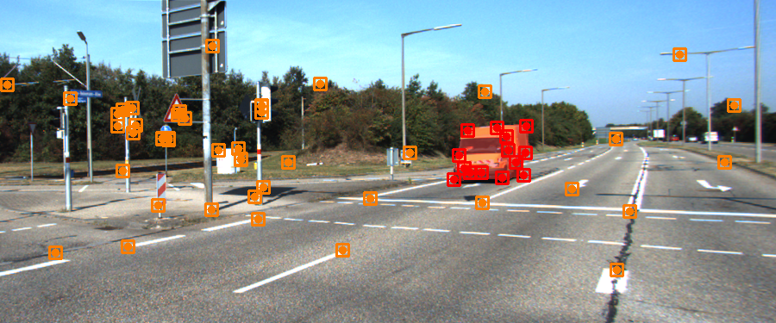
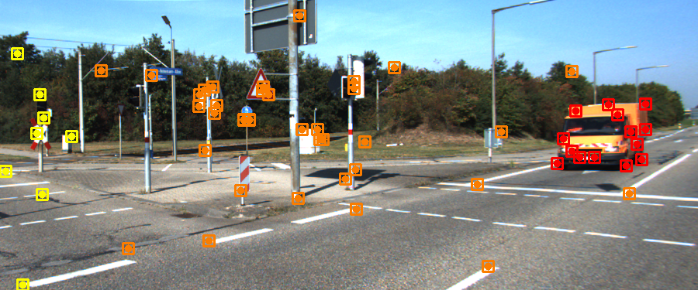
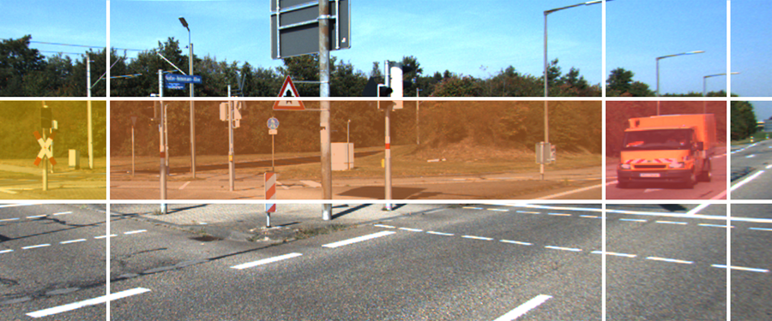
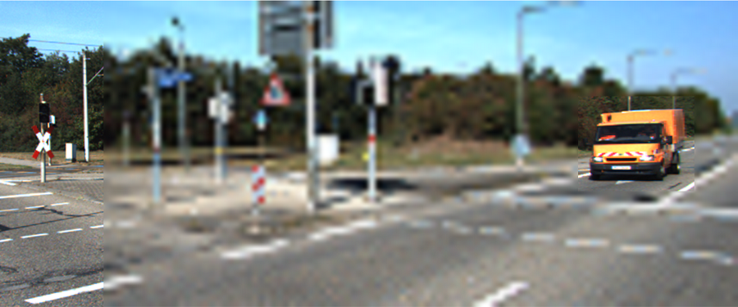
Our Design
Contour-based RoI Selection
Notes:
[START]
[CLICK]

Slide 14
Experiments
Datasets
  DAVIS, KITTI, Xiph
  A handmade dataset of 13k frames
Comparative methods
  EdgeDuet: Light-weight KCF tracker with prioritized transmission
  EAAR: Motion vector-based tracking with parallel inference
Devices
  Mobile: An iPhone 11 and a Samsung Galaxy 10
  Edge: Nvidia Jetson TX2 with Mask R-CNN
Notes:
[START]
[CLICK]

Slide 15
Experiment
Accuracy and latency
  Achieve an average IOU of 0.92, outperforming baselines by 10% and 20% while reducing the false rate to 3.9%
  The average latency of a single frame is 28ms, the only system that meets the demand of 30 fps input
Notes:
[START]
[CLICK]

Slide 16
Experiment
Ablation Study
  MAMT improves the accuracy by more than 19%
  The two parts of CIIA reduce the inference latency by at least 20% while maintaining the inference IOU accuracy of 0.92
  CFRS provides a more even performance under all network conditions.
Notes:
[START]
[CLICK]

Slide 17
Experiment
Robustness and resource overhead
  Achieve an average IOU of 0.83 and a 19.7% false rate with more than 5 dynamic objects in a scene
  Maintain a false rate less than 9.8% with a normal walking speed
  The CPU usage on iPhone is around 75% and the global memory usage is within 1GB.
Notes:
[START]
The false rate rises to 29% when the user is jogging, this is due to the inadequate input frame and thus less accurate object model

Slide 18
Conclusion
We propose edgeIS, enabling mobile devices to perform resource-intensive instance segmentation in real-time.
We integrate VO into the mobile-edge collaboration system and design a “transfer + infer” framework and a two-way facilitation.
  The mobile side can transfer segmentation results between adjacent frames with motion analysis and object modeling.
  The inference of the heavy DL model on the resource-constrained edge node is accelerated with mobile side’s prior information.
We conduct extensive evaluations and compare edgeIS with two related works to demonstrate its superior performance.
Notes:
[START]
[CLICK]

Slide 19
Thanks!
Q&A
Jialin Zhang
Tsinghua University
zhjialin16@gmail.com
Notes:
That's all. Thank you!

Slide 20
Our Design
Motion Aware Mobile Mask Transfer
Notes:
[START] SLAM which means Simultaneous Localization And Mapping, will calculate the pose of camera, at the meantime reconstruct the surrounding environment.
Among various approaches, visual SLAM based methods have hit the mainstream of location-based ubiquitous applications in recent years, and now has been widely applied in many scenarios, both in industrial applications and in our daily life.
[CLICK] With the size of the mapping area expanding rapidly, collaborative visual SLAM that involves multiple agents has been attracting growing interest from both academia and industry, which plays a key role in emerging mobile applications such as search-and-rescue, inventory automation, and multi-user AR gaming.

Slide 21
Our Design
Contour Instructed Edge Inference Acceleration
Notes:
[START] SLAM which means Simultaneous Localization And Mapping, will calculate the pose of camera, at the meantime reconstruct the surrounding environment.
Among various approaches, visual SLAM based methods have hit the mainstream of location-based ubiquitous applications in recent years, and now has been widely applied in many scenarios, both in industrial applications and in our daily life.
[CLICK] With the size of the mapping area expanding rapidly, collaborative visual SLAM that involves multiple agents has been attracting growing interest from both academia and industry, which plays a key role in emerging mobile applications such as search-and-rescue, inventory automation, and multi-user AR gaming.

Slide 22
Our Design
Motion Aware Mobile Mask Transfer
Notes:
[START] SLAM which means Simultaneous Localization And Mapping, will calculate the pose of camera, at the meantime reconstruct the surrounding environment.
Among various approaches, visual SLAM based methods have hit the mainstream of location-based ubiquitous applications in recent years, and now has been widely applied in many scenarios, both in industrial applications and in our daily life.
[CLICK] With the size of the mapping area expanding rapidly, collaborative visual SLAM that involves multiple agents has been attracting growing interest from both academia and industry, which plays a key role in emerging mobile applications such as search-and-rescue, inventory automation, and multi-user AR gaming.

