Slide 1

WiDance:
Inferring Motion Direction using Commodity Wi-Fi for Interactive Exergames
Kun Qian*, Chenshu Wu*, Zimu Zhou^,
Yue Zheng*, Zheng Yang*, Yunhao Liu*
*Tsinghua University, ^ETH Zurich
May 09, 2017@Denver, Colorado
Notes:
[Start] Thank you for the intro.
Today I’m going to talk about our work WiDance: Inferring Motion Direction using Commodity Wi-Fi for Interactive Exergames

Slide 2
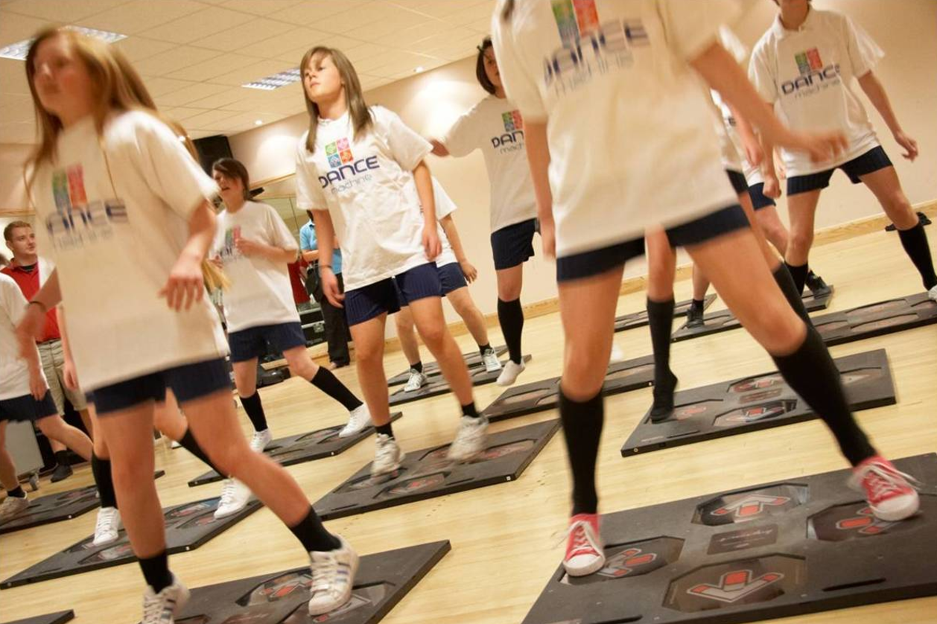
Exergames bring more than just fun
Exergames can improve the fitness, health and social involvement of players
Becoming increasingly popular!
Exergames anywhere, anytime!
Notes:
Exercise such as dance, kick-boxing, sports moves bring more than just fun. Researchers find that exergames can improve the fitness, health and social involvement of players.
[Click] Nowadays, exergames are becoming more popular. And especially people like to enjoy exergames not only at special places but want it to be available anywhere and anytime! For example, one would like simply taking a 5-min exergame in the office to refresh through the long-day working.

Slide 3
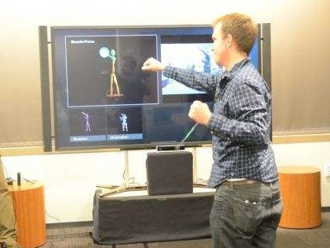
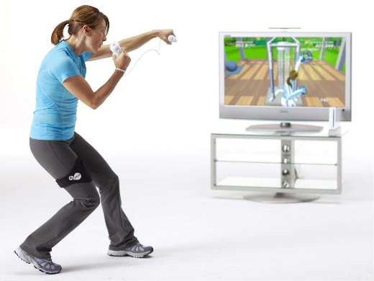
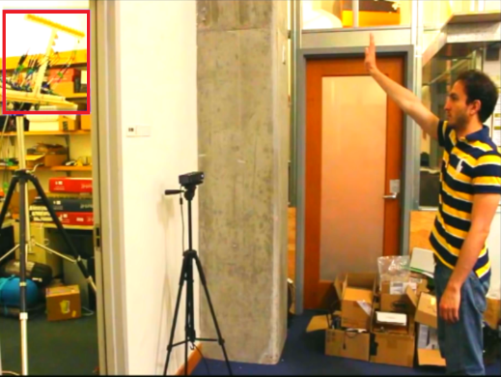
Various Exergame Interfaces
Various technologies for interactive exergames
Computer Vision
Sensors & Controllers
Ultrasound
Limitations
Limited field of view
Device attachment
Dedicated devices
High installation cost
Usually expensive
Not ubiquitous
Demand for a more ubiquitous solution to fit fragmented free time and space for modern life
Notes:
Various technologies have been used as exergame interfaces, including computer vision, sensors and controllers, and radar system.
[Click] Despite their high accuracy in tracking player motions, they suffer from limitations such as sensitivity to lighting condition and line-of-sight condition, requirement of device attachment and high-cost installation.
[Click] We argue that a more ubiquitous, lower-cost, and non-invasive exergame interface is demanded to fit the fragmented free time and space in modern life.

Slide 4


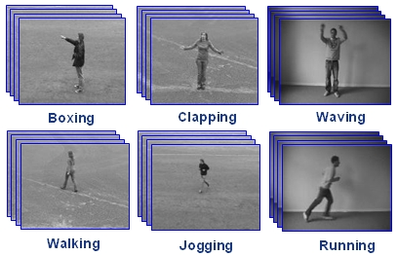
Leveraging Commodity WiFi
In contrast, the wireless approach is superior in
  Ubiquitous: Almost everywhere installed infrastructure
  Low-cost: off-the-shelf WiFi devices
  Non-invasive: not required to wear/carry any devices
  Omi-directional & no lighting requirement
WiFi-based sensing supports more than exergame
Navigation
Gait Analysis
Activity Recognition
Notes:
Such demand has triggered extensive research on in-air human sensing, especially using the almost-everywhere Wi-Fi infrastructure.
Comparing with other technologies, wireless method has its own advantages. In particular, WiFi devices like APs, and laptops are much cheaper and widely deployed.
[Click] And it enables contactless sensing which means users are not required to wear any devices.

Slide 5
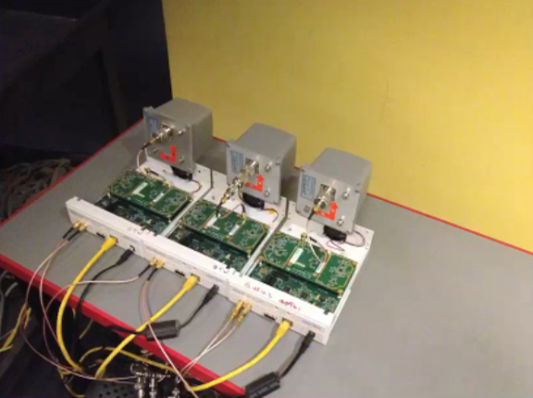
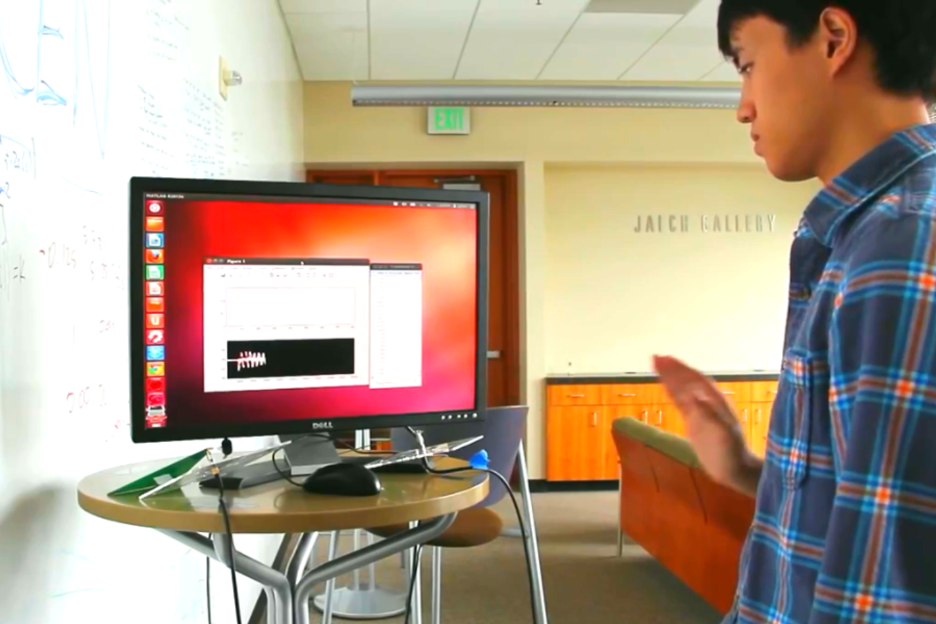
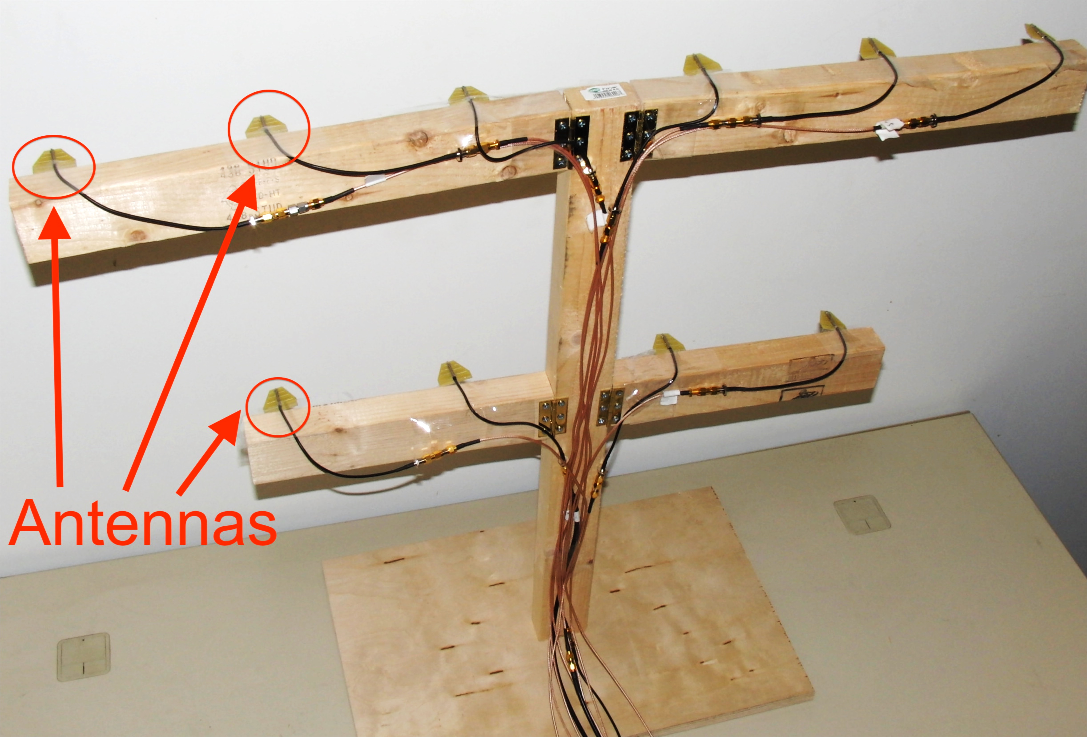
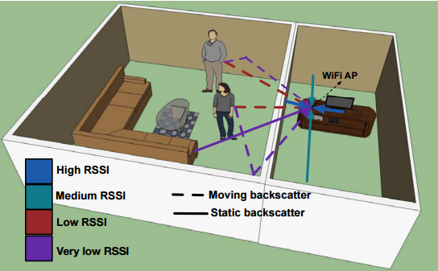
Existing Arts
WiVi, Sigcomm ’13
WiSee, Mobicom ’13
They estimate precise signal parameters, yet rely on specialized hardware!
WiTrack, NSDI ’15
WiDeo, NSDI ’15
Notes:
[Start] A number of works on wireless passive tracking and activity recognition have been published in recent years.
[Click] Some of them accurately estimate signal parameters such as time-of-flight and Doppler frequency shift. However, they rely on specialized hardware like FMCW radar and Full duplex devices.

Slide 6
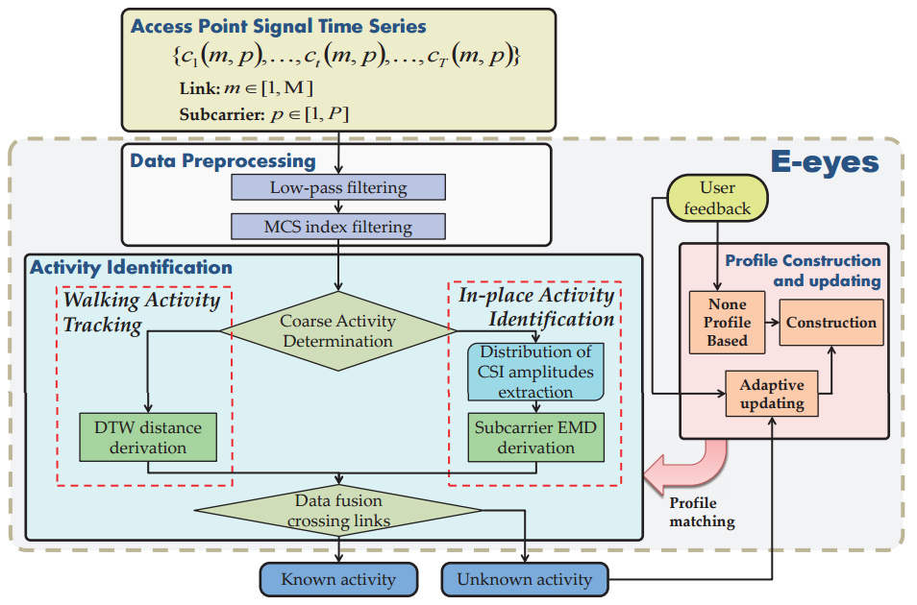
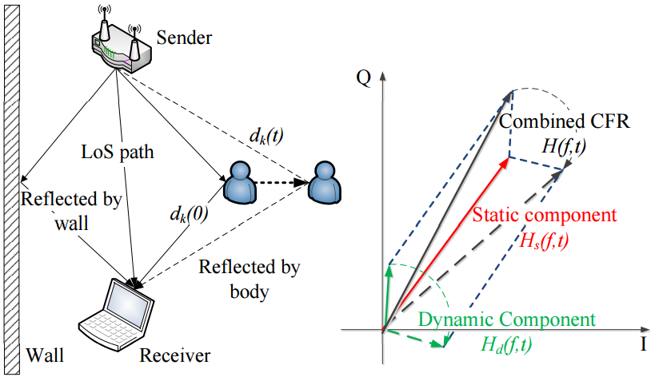
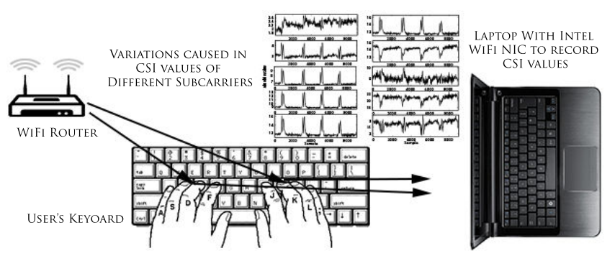
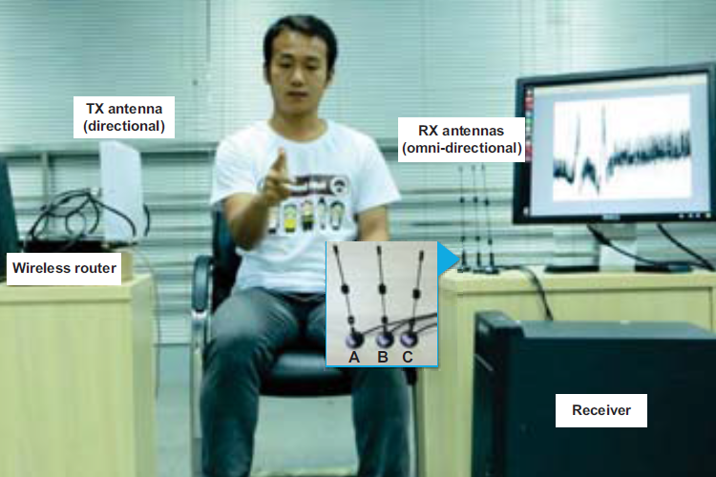
Existing Arts
E-eye, Mobicom ’14
CARM, Mobicom ’15
Though using COTS Wi-Fi, they require extensive training efforts.
WiKey, Mobicom ’15
WiFinger, Ubicomp ’16
Notes:
[Start] Other works use commodity Wi-Fi devices for wireless sensing.
[Click] However, most of these works rely on machine learning for recognition and thus need significant training efforts.

Slide 7
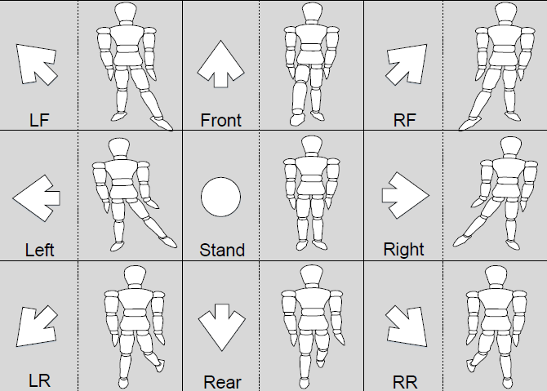
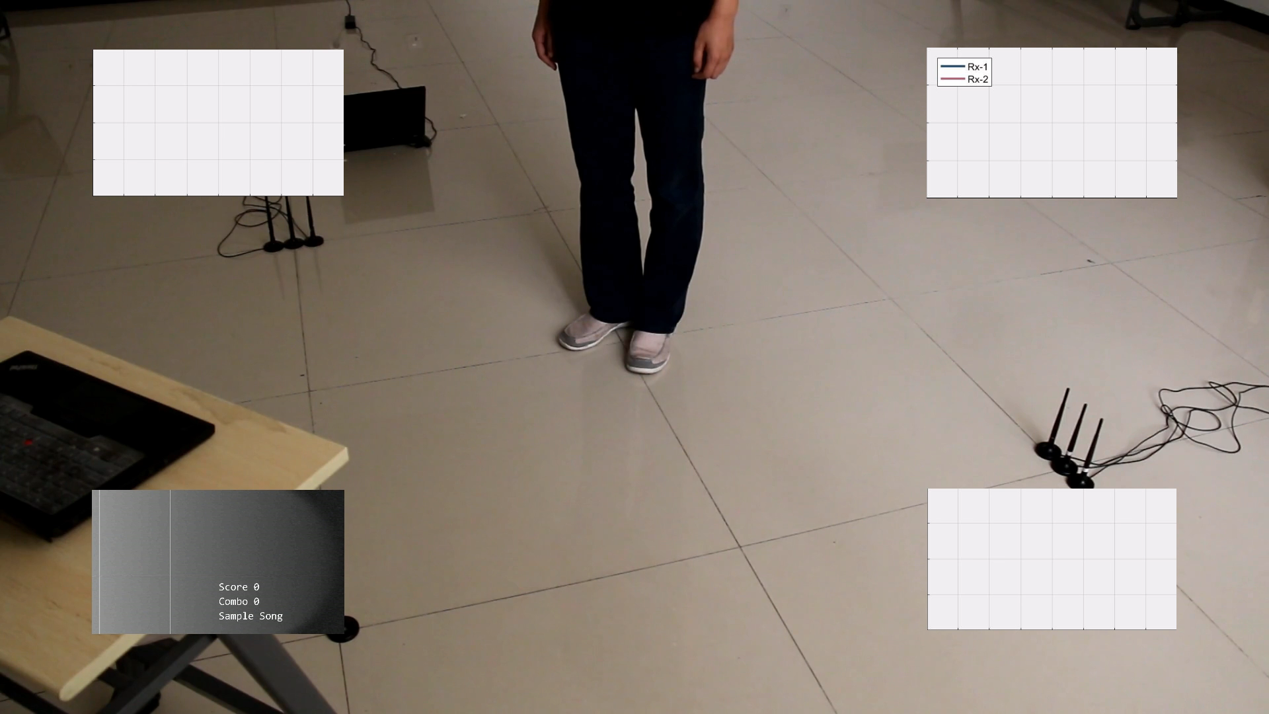
WiDance
A passively interactive dancing pad-like exergame using OFF-THE-SHELF WiFi devices WITHOUT training
  Accurately deriving motion-induced Doppler shifts
  Extracting motion directions for exergame designs
Notes:
[Start] In this paper, we propose and design WiDance, a passively interactive dancing pad-like exergame using off-the-shelf WiFi devices. We derive two key techniques to enable WiDance:
We accurately deriving motion-induced Doppler shifts
We extract motion directions based on Doppler shifts for exergame designs
[Click] As a proof-of-concept system, we recognize eight direction inputs for interaction. Here is an illustration of the exergame.

Slide 8
WiDance Design
C1
C2
Two key challenges
Derive full information of Doppler shifts from imperfect Wi-Fi.
Recognize motion direction from Doppler effect for game.
Notes:
[Start] Here is the working flow of WiDance. WiDance process Wi-Fi signals that are altered by user actions. To achieve it, two challenges have to be solved.
[Click] The first challenge is deriving full information Doppler frequency shifts from imperfect commodity Wi-Fi signals that contain significant phase noises.
[Click] And the second challenge is recognizing motion directions from the Doppler frequency shifts.
In this talk, I will mainly introduce how we address the two challenges and only sketch the other processing steps.

Slide 9
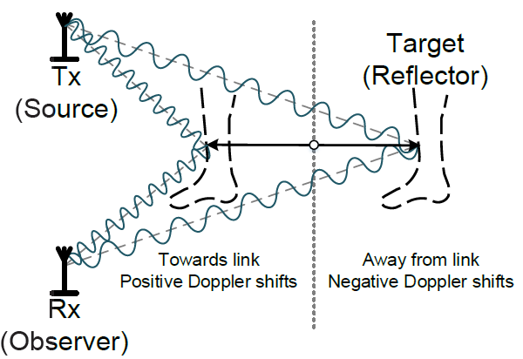
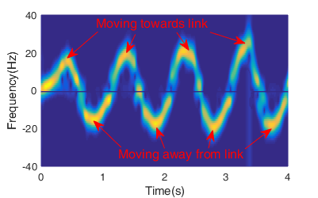
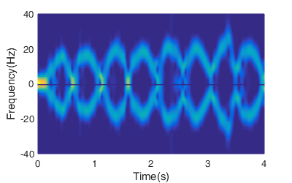
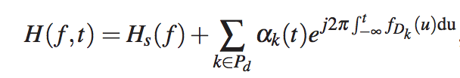
Doppler Effects
Human motions induce Doppler shifts in signals
However, due to uncertain phase noise, only absolute values are available by using CSI power ^{[1]}
USRP Radios
COTS WiFi Devices
Channel State Information
Doppler Freq. Shifts
[1] CARM, Mobicom ’15
Notes:
[Start] In principle, human motions will induce Doppler shifts and alter the radio signals.
[Click] For example, when a user sways his leg back and forth, it causes Doppler frequency shift in the reflected signal, which can be clearly measured using USRP software-defined radios.
[Click] Such frequency shifts can also be extracted from Channel State Information which is currently measurable on commodity WiFi.
[Click] However, unlike USRP, since commodity devices are not well synchronized, the signal phase contains random offsets and cannot be directly used. Without reliable signal phase, previous works can only obtain absolute value, but lose the sign of Doppler frequency shift.

Slide 10
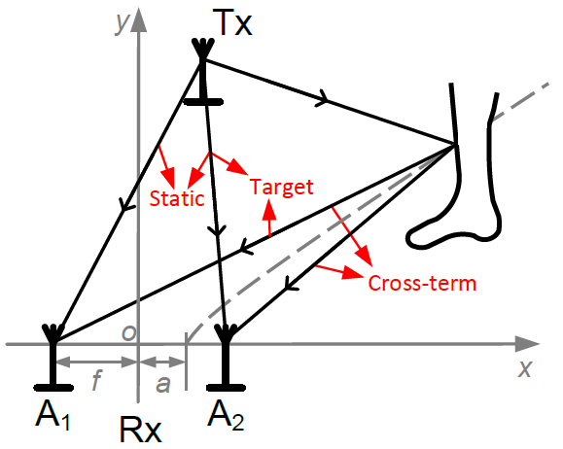


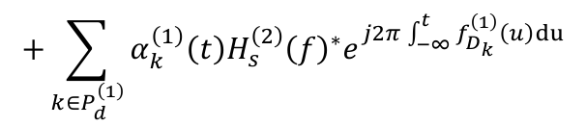
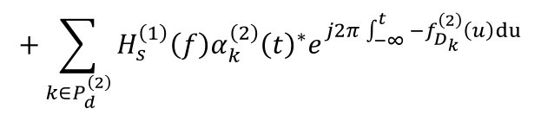
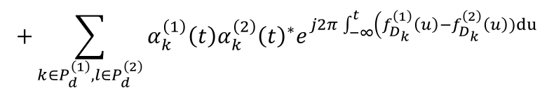
Doppler Extraction
Remove unknown phases with multiple antennas
Conjugate multiplication of signal of TWO antennas
$$H^{\left(1\right)}\left(f,t\right){H^{\left(2\right)}\left(f,t\right)}^{∗}$$
$$≈H_{s}^{\left(1\right)}\left(f\right){H_{s}^{\left(2\right)}\left(f\right)}^{∗}$$
Static term
$$+\sum_{k∈P_{d}^{\left(1\right)},l∈P_{d}^{\left(2\right)}}{α_{k}^{\left(1\right)}\left(t\right){α_{k}^{\left(2\right)}\left(t\right)}^{∗}e^{j2π\int_{−∞}^{t}{\left(f_{D_{k}}^{\left(1\right)}\left(u\right)−f_{D_{k}}^{\left(2\right)}\left(u\right))du\right.}}}$$
Cross term
$$+\sum_{k∈P_{d}^{\left(1\right)}}{α_{k}^{\left(1\right)}\left(t\right){H_{s}^{\left(2\right)}\left(f\right)}^{∗}e^{j2π\int_{−∞}^{t}{f_{D_{k}}^{\left(1\right)}\left(u\right)du}}}$$
Target term
$$+\sum_{k∈P_{d}^{\left(2\right)}}{H_{s}^{\left(1\right)}\left(f\right){α_{k}^{\left(2\right)}\left(t\right)}^{∗}e^{j2π\int_{−∞}^{t}{{−f}_{D_{k}}^{\left(2\right)}\left(u\right)du}}}$$
Target term
Yet Target terms contain both $f_{D_{k}}^{(1)}$ and $−f_{D_{k}}^{\left(2\right)}$!
Notes:
[Start] Our solution is to leverage multiple antennas that are pretty common on modern WiFi devices. The key insight is different antennas on the same device experience the same phase offset caused by unsynchronization. So we can remove the unknown phases by calculating conjugate multiplication of signals received by two antennas.
[Click] In a typical indoor multipath environment, the result contain three types of terms.
[Click] Firstly, the static term is the product of static signals of two antennas. It is constant and can be omitted.
[Click] Secondly, the cross terms are the product of dynamic signals of two antennas. They contain the difference of Doppler frequency shifts and are not of our interest.
[Click] Finally, the target terms are the product of static signal of one antenna and dynamic signal of the other antenna. They contain useful Doppler frequency shifts.
[Click] However, as you may see, there are two target terms that both contain Doppler shifts but in opposite signs.
So to extract the true shifts, we require the upper target term with true shifts to be larger than the lower term with opposite sign.

Slide 11



Doppler Extraction
A sufficient condition is the term with true Doppler frequency shift has higher power
$$\left|\frac{H_{s}^{\left(1\right)}\left(f\right)}{α_{k}^{\left(1\right)}\left(t\right)}\right|<\left|\frac{H_{s}^{\left(2\right)}\left(f\right)}{α_{k}^{\left(2\right)}\left(t\right)}\right|$$
$$\left|α_{k}^{\left(1\right)}\left(t\right){H_{s}^{\left(2\right)}\left(f\right)}^{∗}e^{j2π\int_{−∞}^{t}{f_{D_{k}}^{\left(1\right)}\left(u\right)du}}\right|>\left|H_{s}^{\left(1\right)}\left(f\right){α_{k}^{\left(2\right)}\left(t\right)}^{∗}e^{−j2π\int_{−∞}^{t}{f_{D_{k}}^{\left(2\right)}\left(u\right)du}}\right|$$
Static component #1
$$<$$
Static component #2
≈
Dynamic component #1
Dynamic component #2
Mean of power #1
$$<$$
Mean of power #2
Std of power #1
Std of power #2
Notes:
[Start] With simple mathematic derivation, this sufficient condition for selecting true Doppler shift, transforms like this formula.
This is a pretty nice result because it intuitively means that the ratio of static signal power and dynamic signal power of the first antenna is smaller than that of the second antenna.
[Click] While we cannot directly split static components and dynamic components from superimposed received signal, the condition can be easily approximated by using the mean signal power as the static component, while the standard deviation of signal power as the dynamic component.
This is based on the observations that 1) Signal with higher amplitude is likely to possess larger static responses. 2)Signal with higher variance is likely to possess larger dynamic responses.

Slide 12
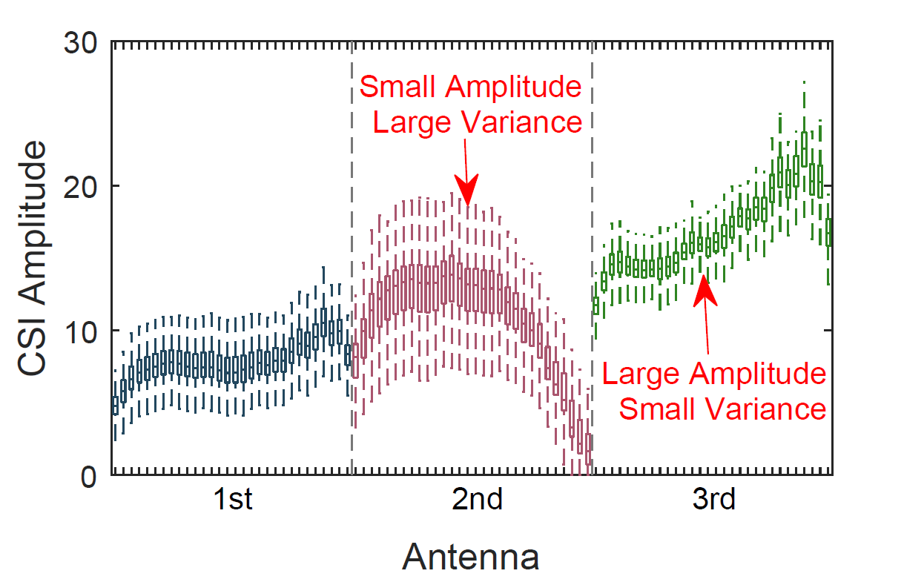
Antenna Selection
Select two antennas out of the typical three.
  Antenna #1: Small Amplitude, Large Variance.
  Antenna #2: Large Amplitude, Small Variance
Notes:
[Start] Here is an example of antenna selection. The NIC we use has three antennas. Clearly we are going to select the second antenna for its small average amplitude and large variance, and then select the third antenna for its large amplitude and small variance.

Slide 13
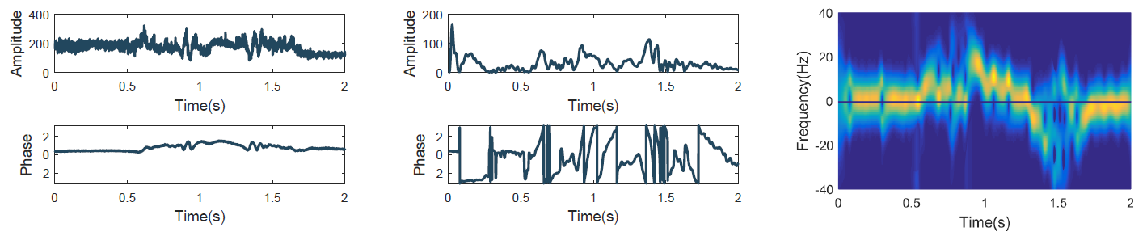
Signal Processing Procedure
Passband filtering
  Remove static terms, low-frequency interferences and burst noises.
Time-Frequency Analysis (PCA + STFT)
  Spectrogram of Doppler frequency shifts.
Raw signal
Passband Filtering
Spectrogram
Notes:
[Start] After antenna selection and calculation of conjugate multiplication, we pass the product to a passband filter to remove irrelevant static terms and cross terms. And then conduct short-term-fourier-transform to generate spectrogram of Doppler shifts. Note that the sign of Doppler shift is correctly reserved.

Slide 14

Problem Statement
C1
C2
Challenges
  Derive motion-induced Doppler frequency shifts from Wi-Fi.
  Recognize motion direction from Doppler effect for game.
Notes:
[Start] With the signed Doppler shifts, the next step is to recognize motion directions from the Doppler frequency shifts.

Slide 15









Motion Recognition
One link is insufficient for direction recognition.
Infinite possible solutions of v
Tx
$$v$$
$$v_{t}$$
  The symmetric distribution of radial velocity
  Users perform reactions at unknown speed
$$v′′$$
$$v$$
VS.
$$v′$$
$$v_{r}$$
Target
Rx
$$v′$$
$$v$$
VS.
$$v′′$$
Notes:
[Start] First of all, we study the least number of wireless links required for motion recognition.
[Click] Suppose a user stands on some ellipse whose two foci are the transmitter and receiver.
[Click] The motion velocity can be decomposed into radial velocity and tangential velocity.
[Click] Among which, the tangential velocity is not related to Doppler shifts.
[Click] With the signs of Doppler shifts, we know the direction of radial velocity (towards left but not right). However, in such situation, there will still be infinite solutions of the true velocity.
[Click] First, given a fixed radial velocity v_r, there will be a symmetric version of v shown in the figure.
[Click] Second, as we don’t know the true value of motion velocity, there could be multiple velocities.
%As the user stands on some ellipse whose two foci are the transmitter and receiver, and moves

Slide 16

Motion Recognition
Solve ambiguity with minimum cost of two orthogonal links.
V₂
Tx
Rx₂
Determine the motion direction by:
Direction of radial velocity.
Ratio of radial velocity.
+
$$v$$
-
V₁
Rx₁
Notes:
[Start] So how to solve the ambiguity? Our solution is to use minimum costs by adding an additional orthogonal link.
[Click] To recognize motion direction, we first calculate the signs of radial velocities. It helps determine which quadrant the motion direction is in.
[Click] Then, we calculate the ratio of radial velocities (which are approximated by ratio of Doppler shifts). This helps determine the accurate motion direction.

Slide 17
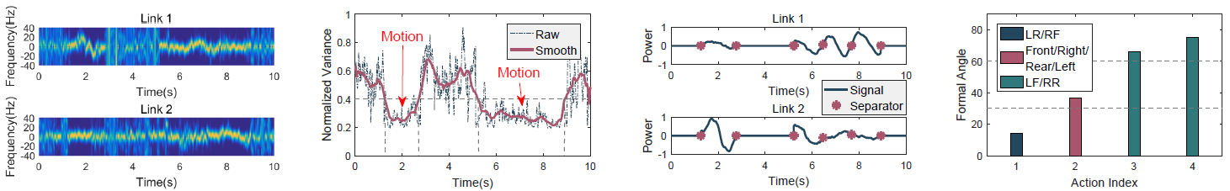
Motion Recognition
Movement Detection
  Distribution of signal power in frequency domain.
Trace Segmentation
  Detection of pair of prominent peaks
Motion Classification
  Direction of radial velocity.
  Ratio of radial velocity.
Spectrogram
Detection
Segmentation
Classification
Notes:
[Start] Based on the model, we propose a light-weight non-learning recognition process, including movement detection, trace segmentation and motion classification.
To detect user movement, we monitor the distribution of signal power in frequency domain. When user moves, the power concentrates on the Doppler frequency shift and the variance is statistically lower that when no user moves.
To segment motions, we detect prominent peaks of Doppler frequency shifts and pair them as one leg stride action.
And finally, we leverage the proposed model to recognize motion directions.

Slide 18
Experiment & Evaluation
Overall performance
Performance of recognition scheme
Performance of extraction scheme
Performance of compound gestures
Performance comparison
Impact of user diversity
Impact of action range
Impact of note interval
Impact of area size
Impact of transmission rates
Notes:
Now let me present the experimental results. We have extensive evaluation in our paper. Due to time limit, I only emphasize some more interesting parts. Please refer to the paper for more details.

Slide 19
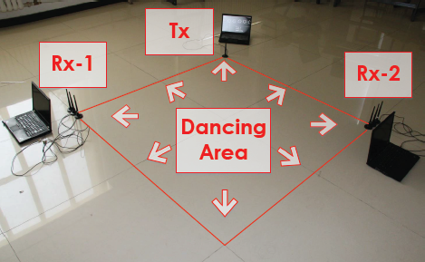
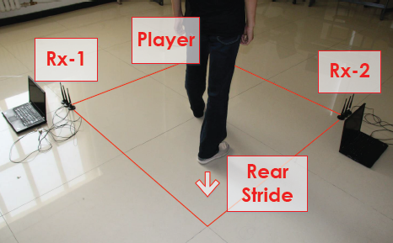
Experiment
Setup
  3 laptops with Intel 5300 NICs.
  2 links on Channel 165 (5.825GHz).
  Packet rate: 1024Hz.
  Tx power: 15dBm.
Recruitment
  30 participants.
  Over 10, 000 actions.
Baselines
  HMM-WiDance
  CARM (ACM MobiCom’15)
Dancing Area
User Action
Notes:
[Start]. To evaluate WiDance, we build the system with 3 laptops equipped with Intel 5300 NIC. One is transmitter and others are receiver, forming two links. We use Wi-Fi channel 165, and set transmission rate to 1000 packets per second. The transmission power is set to 15 dBm.
[Click]. 30 people are recruited for the test, and over 10000 actions are performed during the test.
[Click]. We implement two baselines for comparison. One is the learning-enhanced version of WiDance and the second is a previous activity recognition scheme.
To evaluate the two core modules of WiDance, i.e. Doppler Extraction and Motion Recognition. We compare WiDance with two methods, HMM-WiDance and CARM. HMM-WiDance use Doppler frequency shifts obtained by WiDance, yet train HMM model with it for motion direction recognition. CARM use signal power to obtain absolute value of Doppler frequency shifts and train HMM model with it.

Slide 20
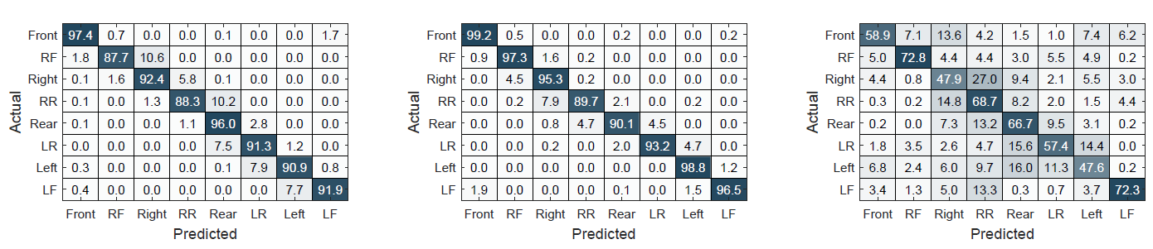
Overall Performance
WiDance vs. HMM-WiDance
  Non-learning recognition scheme achieves comparable accuracy with the unfavorable learning method.
WiDance vs. CARM
  Only with both amplitude and sign of Doppler frequency shifts can motion directions be effectively recognized.
WiDance (Overall 92%)
HMM-WiDance (Overall 95%)
CARM (Overall 60%)
Notes:
[Start] Three methods achieve overall accuracy of 92%, 95% and 60% respectively.
[Click] By comparing WiDance with HMM-WiDance, we find that the non-learning recognition scheme can still achieve high accuracy comparable with the unfavorable learning method.
[Click] By comparing WiDance with CARM, we find that only with both amplitude and sign of Doppler frequency shifts can motion directions be effectively recognized.

Slide 21
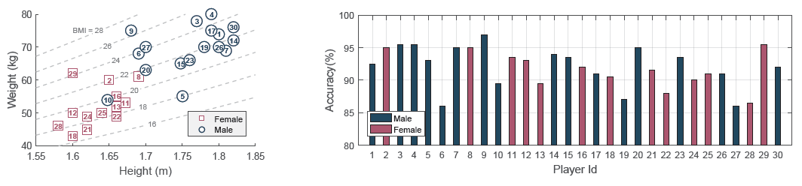
Impact of User Diversity
Participants status
Impact of user diversity
Participants have various weights and heights
And different levels of body coordination and familiarity with dancing games
WiDance recognizes actions of all participants with accuracy higher than 85%
Notes:
[Start] We further study impacts of major factors. The first is user diversity.
As shown in left figure, participants have various weights and height……
For all the users, WiDance shows robust performance of consistently higher than 85%.

Slide 22
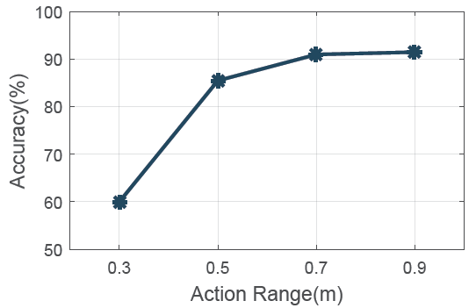
Impact of Action Range
Smaller action ranges leads to
  shorter action time
  smaller action speed
>90% when the action range is larger than 0.6m
Notes:
[Start] The performance of WiDance is also impacted by action ranges. As actions with smaller range have shorter time durations and speeds, it is harder for WiDance to recognize from spectrogram.
As a result, WiDance only maintains high accuracy of 90% when the action range is larger than 0.6m.

Slide 23
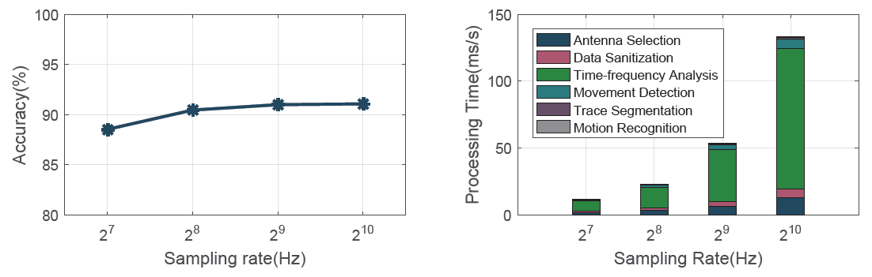
Impact of Packet Rate
Impact of packet rate
Computation Overhead
With decreasing of transmission rate,
  Accuracy of WiDance slightly degrades.
  Processing time of WiDance exponentially reduced.
Tradeoff processing time and accuracy
Notes:
[Start] Transmission rate is also evaluated. A lower transmission rate means less communication and calculation overhead.
The left figure shows that performance of WiDance slightly degrades with decreasing of transmission rate, while the right figure shows that processing time of WiDance exponentially reduced.
So with a moderate transmission rate, WiDance achieves real-time processing and reaction.

Slide 24
Discussion
Multiple moving objects.
  Doppler shift of the dancer might be obfuscated by the similar shift of the intruder.
Limited detection range.
  Currently 4m X 4m, easily deployed at different location
  Deploying more systems in the area of interest.
Potential applications.
  Smart home controller.
  Indoor localization.
Notes:
[Start] Here is some thinking for the limitations and potential applications of WiDance.
[Click] Firstly, WiDance is currently infeasible for simultaneous multiple users, and this is a general problem for wireless sensing using commodity devices.
[Click] Secondly, WiDance is limited in detection range due to attenuation of signal power of reflecting signal. So one may have to deploy more systems in a large area of interest, or target actions with larger Doppler frequency shifts, such as walk.
[Click] Thirdly, in addition to exergame interface, WiDance can be used for smart home controller and assisting indoor localization.

Slide 25
Conclusion
Extracting complete Doppler frequency shifts from COTS Wi-Fi.
  Doppler effect of multiple antennas.
  Antenna selection strategy.
Recognizing motion directions with Doppler effect.
  Orthogonal links model.
  Light-weight non-learning recognition scheme.
A proof-of-concept interactive exergame WiDance.
  an overall recognition accuracy of 92% in typical indoor environments without training.
Notes:
[Start] As a conclusion, we design novel algorithms to extract motion-induced Doppler shifts from commodity Wi-Fi devices.
And we model the relation between Doppler shifts and motion directions.
Finally, we prototype WiDance system with an overall recognition accuracy of 92%.

Slide 26
Thanks!
Q&A
Chenshu Wu
Tsinghua University
wucs32@gmail.com
https://www.cs.princeton.edu/~chenshuw
Notes:
[Start]. That‘s all of my talk. Thanks for listening. I’m glad to take questions.

Slide 27
Thanks!
Q&A
Chenshu Wu
Tsinghua University
wucs32@gmail.com
https://www.cs.princeton.edu/~chenshuw
Notes:
[Start]. That‘s all of my talk. Thanks for listening. I’m glad to take questions.

Slide 28
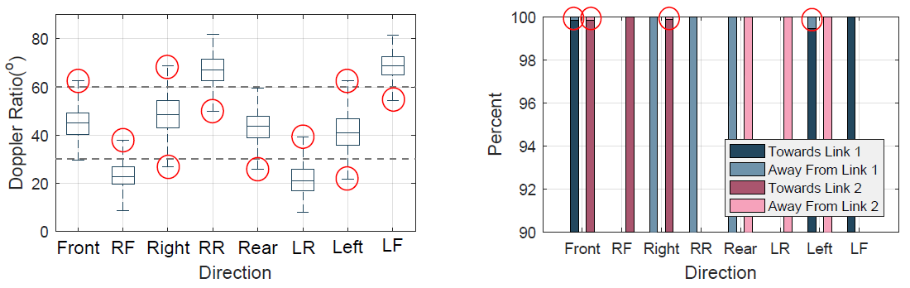
Analysis of Error Sources
Adjacent errors (Major)
  Ratio of radial velocity.
Non-adjacent errors(Minor)
  Direction of radial velocity.
Adjacent errors
Non-adjacent errors
Notes:
[Start] Next, we analyze the sources of recognition errors.
The left figure shows the distribution of ratio of radial velocities. Note that we adopt 30 and 60 degrees as thresholds to separate adjacent motion directions. From the figure, we can find that inaccurate estimation of ratio causes major recognition errors.
The right figure shows the distribution of direction of radial velocity. As can be seen, there are little wrong estimation of direction, causing minor recognition errors.

Slide 29
Discussion
Dependency on particular hardware cards.
  Requirement of specific NICs (e.g Intel 5300)
  We have developed smaller devices at $10 costs
Notes:
[Start] Here is some thinking for the limitations and potential applications of WiDance.
[Click] Firstly, WiDance is currently infeasible for simultaneous multiple objects, and this is a general problem for wireless sensing using commodity devices.
[Click] Secondly, WiDance requires particular NIC that portrays channel state information of Wi-Fi signals.
[Click] Thirdly, WiDance is limited in detection range due to attenuation of signal power of reflecting signal. So you have to deploy more systems in a large area of interest, or target actions with larger Doppler frequency shifts, such as walk.
[Click] As for application, in addition to exergame interface, WiDance can be used for smart home controller and assisting indoor localization.

Slide 30
Motion Recognition
One link is insufficient for motion direction recognition.
  The symmetric distribution of radial velocity causes ambiguity of moving directions.
  Users cannot perform reactions at constant speed to consistently mapping the level of radial velocity to moving direction.
Notes:
[Start] Next, we recognize motion direction from Doppler effect. First, we study the least number of wireless links required for motion recognition.
[Click] As the user stands on some ellipse whose two foci are transmitter and receiver, the motion velocity can be decomposed into radial velocity and tangential velocity, and Doppler frequency shift is only related to radial velocity.
[Click] So we conclude that only one link is insufficient for motion direction recognition.
[Click] The first reason is that radial velocity is symmetrically distributed about the norm and has ambiguity.
[Click] The second reason is that radial velocity are changing with motion velocity, which are not constant due to diversity of user motions.

Slide 31
Motion Recognition
Deploy two orthogonal links.
The motion direction is judged by.
  Direction of radial velocity.
  Ratio of radial velocity.
Notes:
[Start] So we propose to deploy two orthogonal links to solve the problem.
[Click] To recognize motion direction, we first calculate the signs of radial velocities (which are equivalent to the signs of Doppler frequency shifts). It helps determine which quadrant the motion direction is in. Then, we calculate the ratio of radial velocities (which are approximated by ratio of Doppler frequency shifts). It helps determine the accurate motion direction.

