Slide 1



Satori: In-band Analog Backscatter for Audio Transmission
ACM MobiSys 2025
Yang Zou, Xin Na, Yimiao Sun, Yande Chen, Yuan He*
School of Software & BNRist, Tsinghua University
Notes:
Hello everyone. I am Yang Zou, a second-year PhD student from Tsinghua University.
It’s a great honor to be here to share our work:
Satori: In-band analog backscatter for audio transmission.

Slide 2




Background: Audio sensing
Machine failure detection
Security surveillance
Command recognition
Audio sensing supports various industrial applications.
Notes:
Audio sensing supports various industrial applications, such as machine-failure detection, security surveillance, and speech-command recognition.
To support these applications, we must first capture high-quality audio signals.

Slide 3



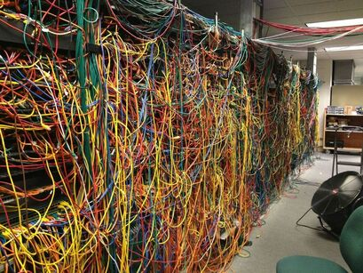
Audio Transmission in Industrial Scenarios
Audio data 0101110010 →
Server
The sensors are deployed close to the audio source and transmit audio data via networks.
Extensive cabling is usually costly and impractical in industrial settings.
Notes:
Since audio signals attenuate fast and are prone to noise, a common solution is to deploy sensing nodes close to the audio source and transmit data to the server via wired networks.
[Click]
However, extensive cabling is usually costly and impractical in industrial settings.

Slide 4




Audio Transmission in Industrial Scenarios
Server
Traditional wireless nodes bring battery waste and maintenance costs.
These nodes are expected to transmit audio with ultra-low power consumption.
Notes:
Thus, wireless transmission is preferred.
[Click]
However, traditional wireless nodes usually results in excessive battery waste and high maintenance costs.
[Click]
And we hope that the sensing nodes can deliver high-quality audio while minimizing power consumption.

Slide 5




Backscatter Technology
Backscatter for audio transmission
Audio data 010110
Transmitter
Receiver
Tag
Mic.
Ambient energy
A backscatter tag harvests ambient energy and modulates the audio
data onto the backscattered signals.
Notes:
Backscatter is a low-power wireless transmission technology.
Ideally, a backscatter tag can directly harvest energy from the environment, such as the solar energy or RF energy, and then modulates audio data onto the backscattered RF signal.
This approach is promising to enable battery-free audio transmission.

Slide 6
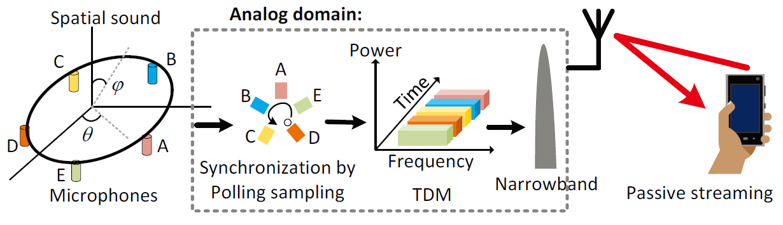
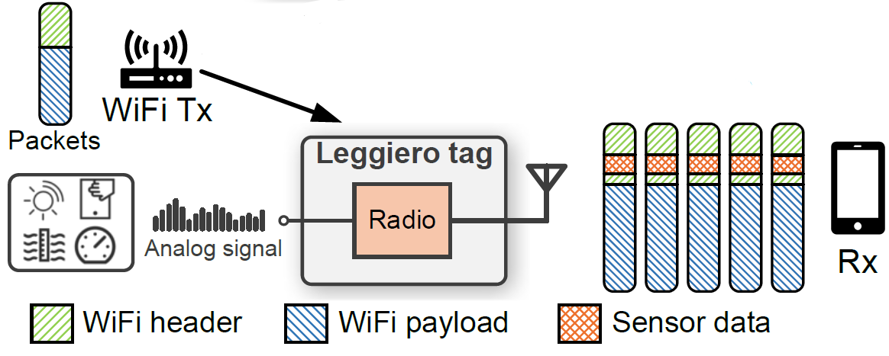
Existing Works
Digital backscatter
Analog backscatter
Single tone
excitation
Passive WiFi NSDI’16
RF Transformer MobiCom’22
Microphone Array Backscatter
WiFi excitation
Pulse Position Modulation
Mobicom’21
HitchHike Sensys’16 | FreeRider CoNext’17 | MOXcatter Mobisys’18
RapidRider INFOCOM’21 | Tscatter Mobisys’23 | WiTAG SIGCOMM’20
CAB Mobisys’22 | SyncScatter NSDI’21 | Orthcatter NSDI’24
 | ……
Leggiero
WiFi Excitation + Phase Modulation
Mobisys’23
They can achieve throughput of 100 kbps or even Mbps with ultra-low power consumption.
They directly embed the analog signals into reflected RF signals.
Notes:
In recent years, researchers have proposed many backscatter techniques.
Based on how sensor data is embedded, the backscatter can be classified into digital and analog types.
Digital backscatter first converts analog sensing data into digital signals and embeds them into single-tone or ambient excitation. These methods can achieve throughput of hundreds of kbps or even several Mbps, sufficient for audio transmission, while consuming minimal energy.
[Click]
In contrast, analog backscatter directly embeds analog sensing data into backscattered signals.
For example, the microphone array backscatter uses analog pulse modulation to embed audio into single tone excitation, and Leggiero embeds analog signals into the CSI phase of WiFi.

Slide 7

Obstacles
Backscatter tag
Tx
Complexity and power consumption from the high-speed processing.
Analog audio
signal
Digital
processing
OR
Radio
Challenges in achieving accurate and reliable analog embedding.
Mic.
Analog audio
embedding
Frequency shifting
clock
Rx
Notes:
Despite significant progress in backscatter, current implementations still face some obstacles in the audio transmission task.
[Click]
First, in audio embedding, digital backscatter can reliably process and embed audio signals, but brings complexity and high power consumption.
The analog backscatter, on the other hand, struggles to embed high-quality audio signals accurately.

Slide 8
Obstacles
Backscatter tag
Tx
Analog audio
signal
Digital
processing
2.45GHz
Energy and bandwidth overhead from frequency shifting.
OR
Radio
Mic.
2.46GHz
Analog audio
embedding
Frequency shifting
clock
Rx
Notes:
Second, since in-band self-interference significantly degrades audio quality, most designs choose to shift the reflected signal to a vacant frequency band.
[Click]
However, this introduces additional energy and bandwidth overhead, which is often unacceptable in industrial scenarios.

Slide 9

Satori Overview
Satori explores the in-band analog backscatter for audio transmission.
Satori tag
Analog phase modulation
Analog audio
Achieve accurate and low-power analog audio embedding.
Rx
Mic.
Amp
Excitation signal
Tackle the in-band self-interference.
Reduce the energy and bandwidth overhead.
WiFi
symbols
Backscattered
signal
Freq
Tx
In-band backscatter
transmission
Notes:
To address these problems, we propose Satori, the first in-band analog backscatter for audio transmission.
[Click]
The Satori tag is excited by common WiFi signals.
[Click]
It first uses analog phase modulation to embed audio signals into the phase of each WiFi symbol, achieving fast, accurate, and low-power analog audio embedding.
[Click]
Furthermore, it tackles the self-interference and transmits backscattered signals within the frequency of the excitation, reducing the energy and bandwidth overhead.

Slide 10
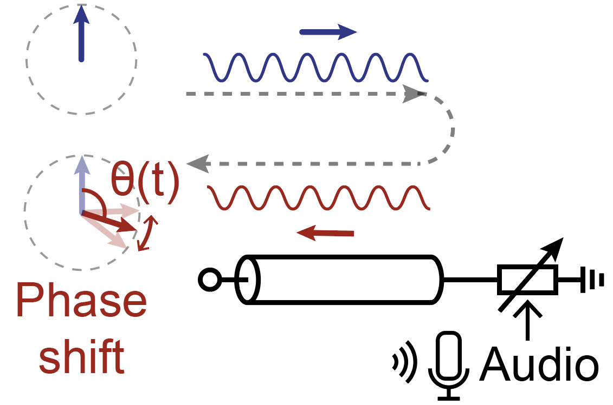
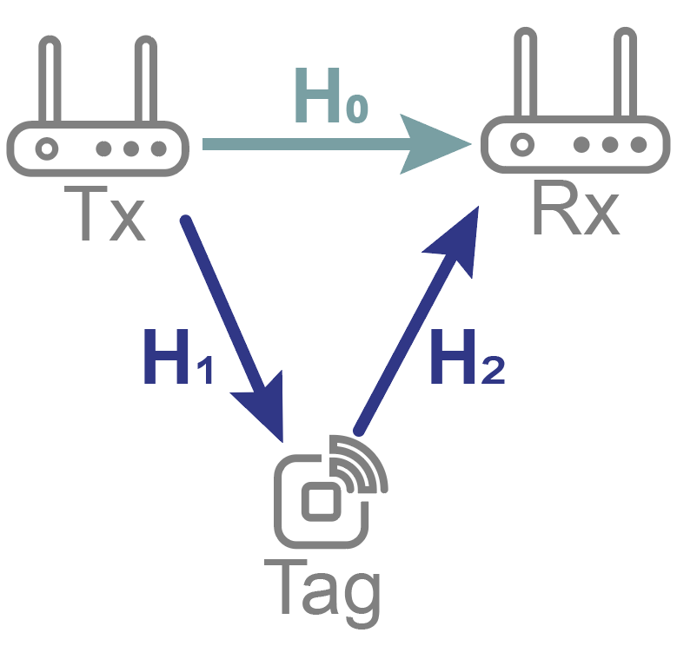
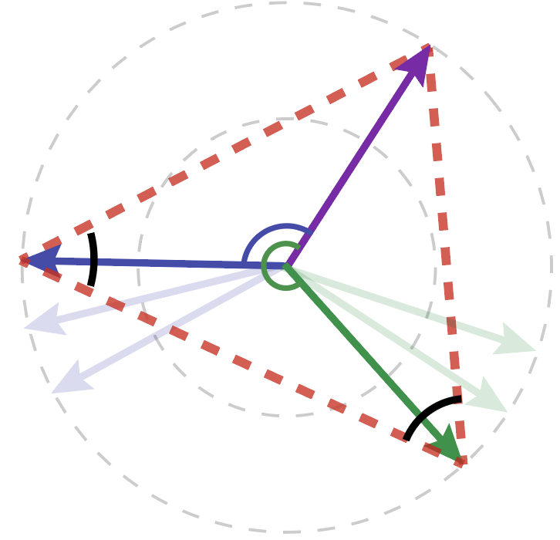
Tag Design
In-band analog backscatter
Analog modulation
In-band transmission
A phase shifter for analog phase modulation.
Explore the in-band backscatter channel
Design the modulation scheme to tackle the interference
Notes:
Next, I will introduce how the Satori tag achieves analog modulation and in-band transmission.

Slide 11
Tag Design
In-band analog backscatter
Analog backscatter
In-band backscatter
A phase shifter for analog phase modulation.
Explore the in-band backscatter channel
Design the modulation scheme to tackle the interference
Notes:
First, we design a phase shifter for accurate and low-power analog modulation.

Slide 12
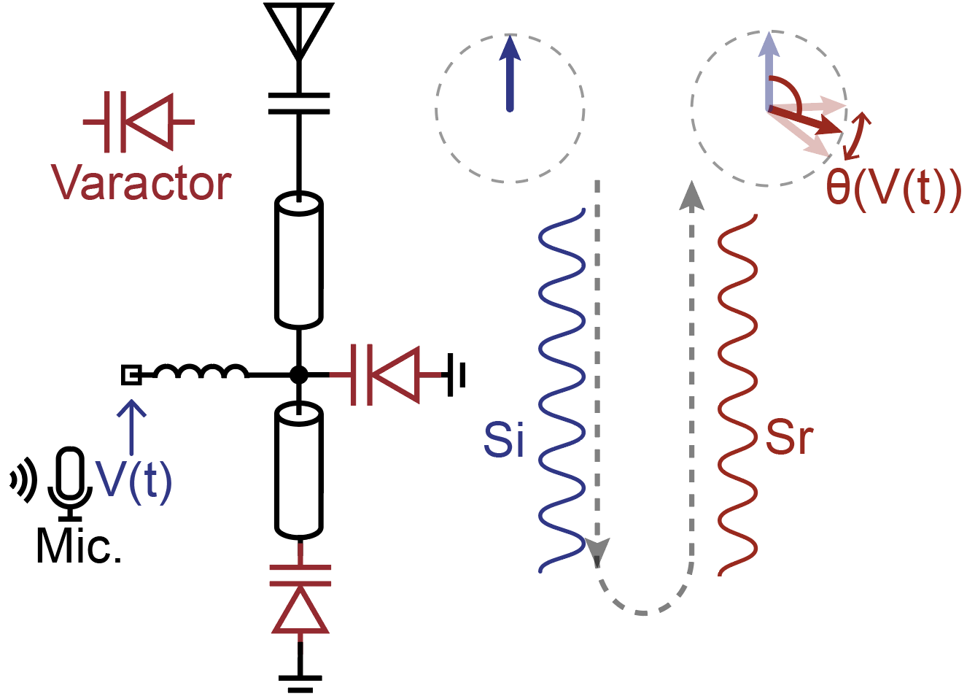
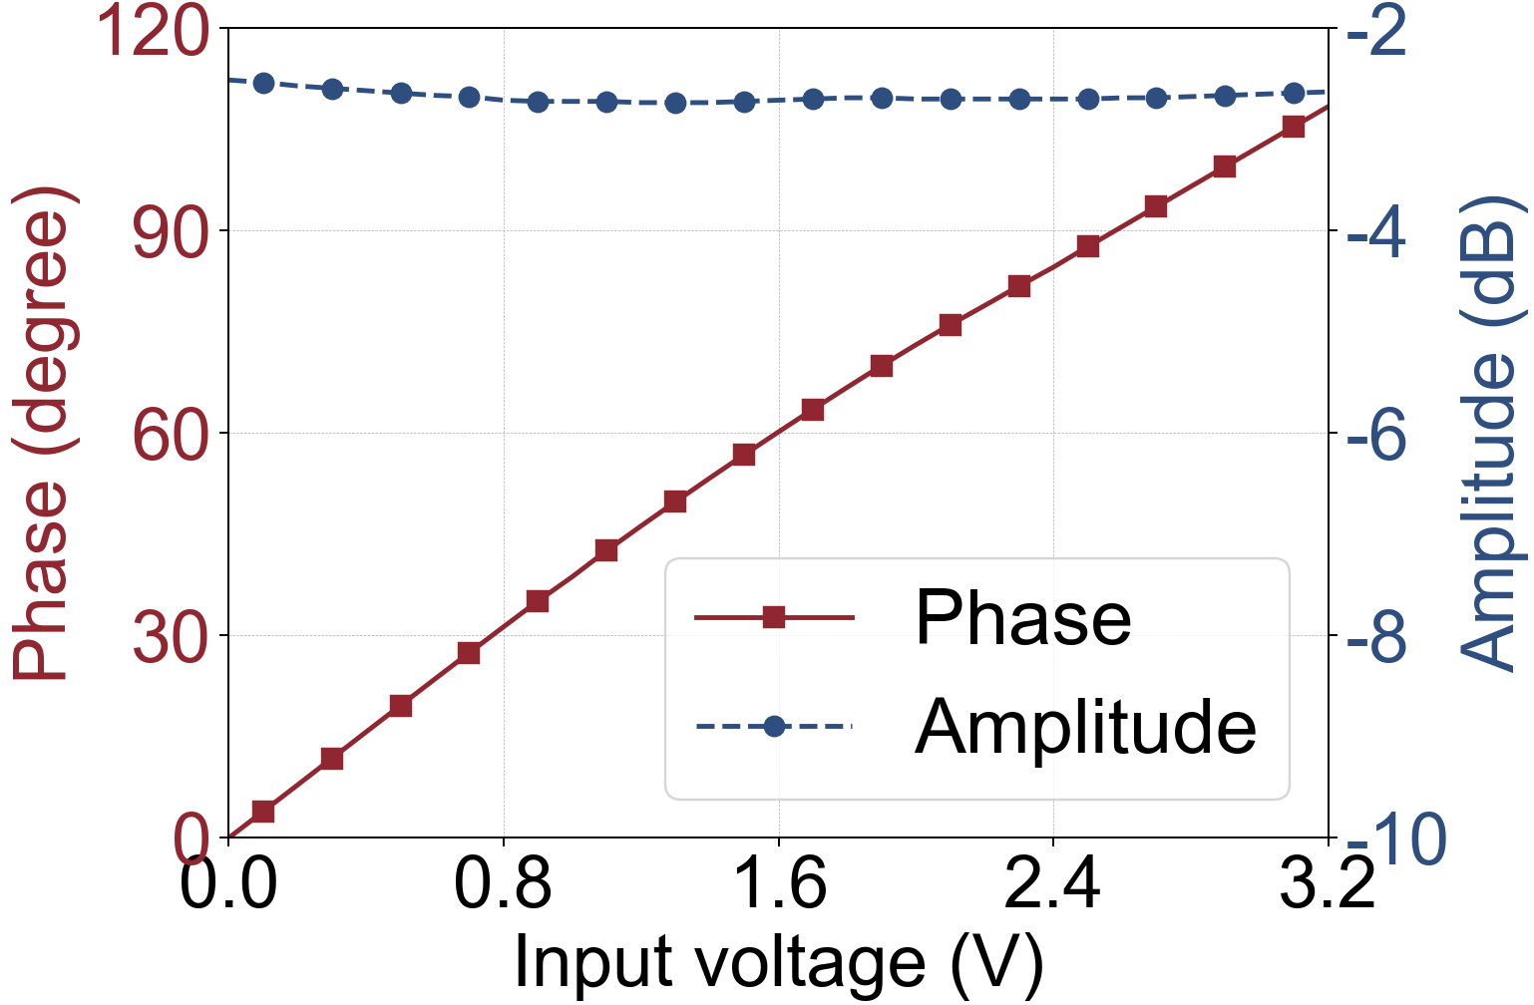
Phase Shifter
Structure of the phase shifter
Accurate audio embedding
θ(V(t))=aV(t)+b
The reflected phase is nearly linear with the voltage.
Satori leverages the phase shifter to achieve accurate analog audio embedding while minimizing power consumption.
Notes:
The structure of the analog phase shifter is shown in the left figure.
The microphone converts the audio into the varactor’s bias voltage. As the voltage varies with the audio, the varactor’s impedance changes and result in reflected phase shifting.
Since the varactors are reversely biased, the power consumption is negligible.
[Click]
The figure on the right shows the phase shifter’s performance: the reflected phase changes linearly with the input voltage.
[Click]
And Satori leverages the phase shifter to achieve accurate analog audio embedding.

Slide 13
Tag Design
In-band analog backscatter
Analog backscatter
In-band backscatter
A Phase shifter for analog phase modulation.
Explore the in-band backscatter channel
Design the modulation scheme to tackle the interference
Notes:
Next, we introduce how to achieve in-band transmission with self-interference. Before detailing the scheme, let us first discuss the channel model.

Slide 14


Modeling the Channel
Channel model of the backscattered signal
Q
V(t)
Tx
Rx
Channel
Measurement
I
H1
H2
Tag
Phase shift
Tuning circle
V(t)
The tuning circle represents the backscatter tag’s phase shift effect on the wireless channel.
Notes:
Let us first consider a backscatter channel, as illustrated in the figure on the left.
The signals pass through the channel, is phase-shifted by the tag, and then reflected to the receiver.
The receiver performs channel measurement, and the measured channel vector traces a circle, which we call [Click] “tuning circle”.
[Click]
The tuning circle represents the backscatter tag’s phase shift effect on the wireless channel.

Slide 15
In-band Backscatter Channel
Channel model of in-band backscatter
Q
H0
V(t)
Tx
Rx
Rx Channel
Measurement
H1
H2
H0
Self interference
Tag
I
Phase shift
Measured channel
V(t)
One channel measurement alone can’t extract the tag’s phase modulation.
The tag should provide at least three points with distinct phases.
Notes:
Next, we consider the in-band backscatter channel model. Here, the Rx receives the direct excitation and the backscattered signals.
And the channel vectors still traces the tuning circle.
However, [Click] due to the self-interference, [Click] it is impossible to accurately extract the phase modulation, or the tuning triangle, with a single channel measurement.
[Click]
To determining this circle, the tag should provide at least three points with distinct phases. This is the basic idea of the in-band modulation scheme.

Slide 16
Tag Design
In-band analog backscatter
Analog backscatter
In-band backscatter
A Phase shifter for analog phase modulation.
Explore the in-band backscatter channel
Design the modulation scheme to tackle the interference
Notes:
Now, l introduce the design of in-band analog modulation.

Slide 17
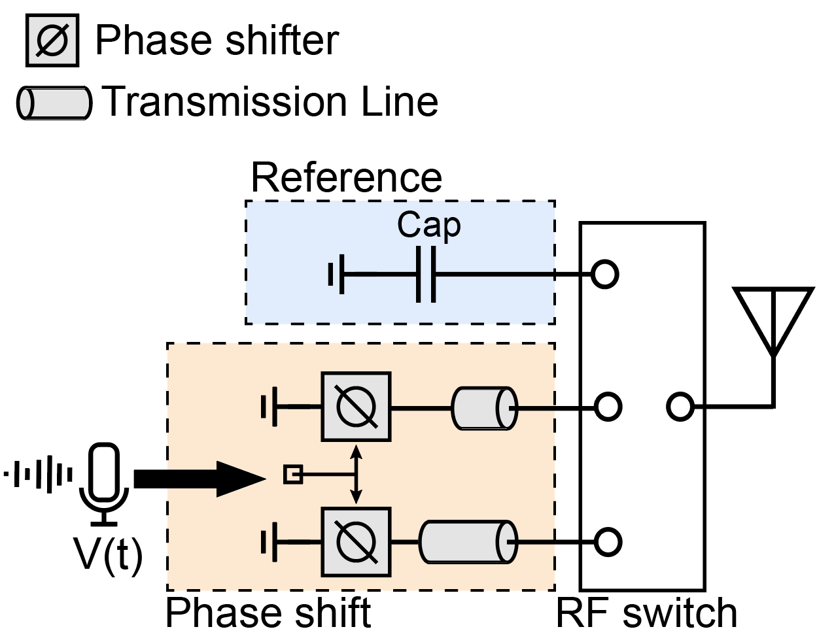
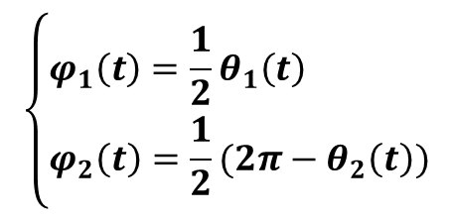
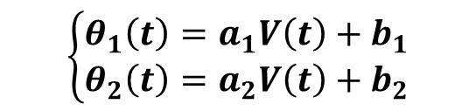
In-band Analog Modulation
REF
PM1
PM2
Satori tag
WiFi symbol
Switch toggle
Q
Embedding rate
41.67 kHz
Tuning triangle
θ1(t)
$$\left\{\begin{aligned}θ_{1}\left(t\right)=a_{1}V\left(t\right)+b_{1} \\ θ_{2}\left(t\right)=a_{2}V\left(t\right)+b_{2}\end{aligned}\right.$$
φ2(t)
θ2(t)
I
$$\left\{\begin{aligned}φ_{1}\left(t\right)=\frac{1}{2}θ_{1}\left(t\right) \\ φ_{2}\left(t\right)=\frac{1}{2}(2π−θ_{2}\left(t\right))\end{aligned}\right.$$
φ1(t)
The analog audio signal is carried in the internal angles of the tuning triangle formed by the three symbols.
Notes:
When a WiFi symbol comes, the tag first embeds a fixed reference phase in the first WiFi symbol.
Then, the tag sequentially embeds the phases, [Click] theta one and [Click] theta two, into other two WiFi symbols.
These three WiFi symbols form a triangle, which we call the tuning triangle [Click]. According to geometry, its internal angles [Click] are functions of audio signal. [Click]
[Click] Therefore, the analog audio signal is carried in the shape of the tuning triangle.
[Click] Besides, since Satori uses three out of six symbols to embed one audio sample, the embedding rate is about 42 kHz and sufficient for audio transmission.

Slide 18
In-band Analog Modulation
Consider the in-band transmission
Q
Tuning triangle is unchanged.
Q
θ1(t)
θ2(t)
I
Add self-interference
Self interference
I
The tuning triangle can reliably carry the audio signal in the in-band backscatter transmission with self-interference.
Notes:
We now consider in-band backscatter transmission with self-interference.
[Click] We can observe that the shape of the tuning remains unchanged.
[Click] This observation confirms that the tuning triangle can reliably carry the audio signal in the in-band backscatter transmission with self-interference.

Slide 19
Satori Receiver Design
Notes:
Next, we discuss how to extract the embedded audio.

Slide 20
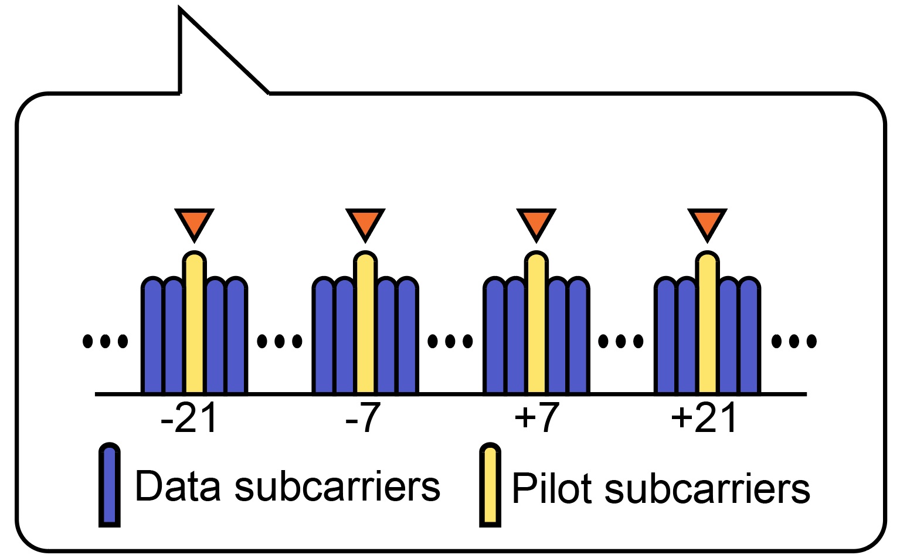
Receiving process
Received WiFi symbols
Estimated channel:
Q
Tuning triangle
Symbol structure
Internal angles
Audio signal
I
Leverage four pilot subcarriers for per-symbol channel estimation.
Extract the tuning triangle from the estimated channel and recover the audio signal.
Notes:
Since the tag modifies the phase of each symbol to embed audio signals, the receiver needs to perform per-symbol channel estimation to extract the embedded audio.
[Click] Specifically, we leverage the pilot subcarriers for the symbol level channel estimation, as they are fixed and known in every WiFi symbol.
[Click] For each pilot subcarrier, the receiver extracts the tuning, computes the internal angles, and recovers the embedded audio signal.

Slide 21
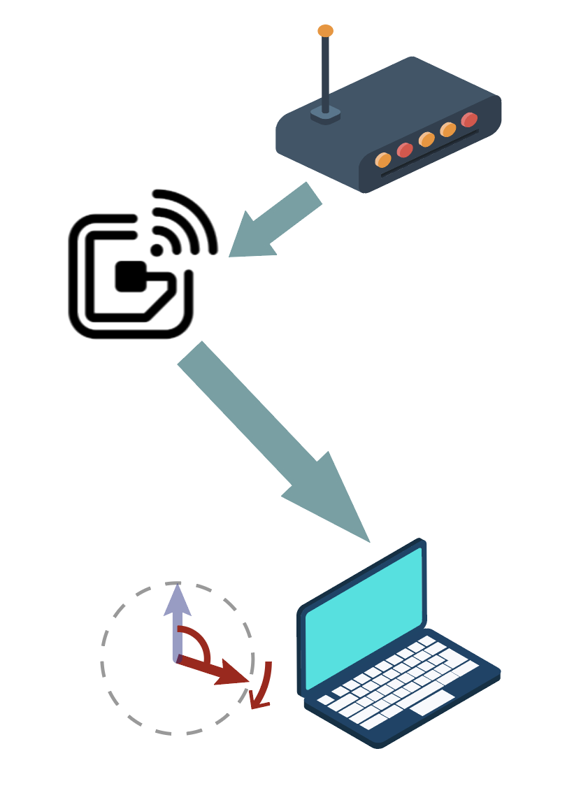
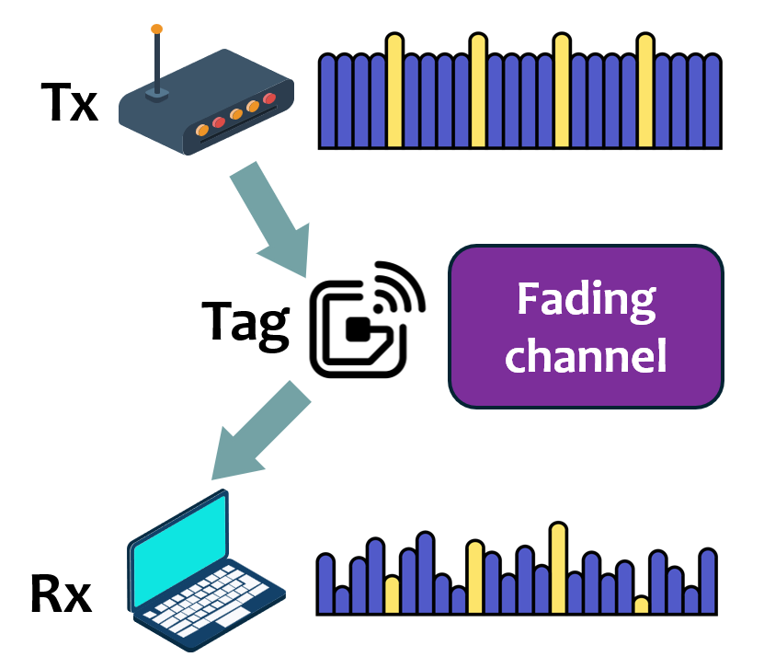
Problems
Carrier frequency offset
Deep fading
Tx: 2.45GHz
Tag
CFO
Rx: 2.45GHz+100kHz
Phase Error!
Carrier frequency offset causes continuous phase rotation.
Deep channel fading severely attenuates the backscattered signals.
Notes:
The receiving process may seem straightforward. However, the carrier frequency offset causes continuous phase rotation, which distorts the recovered audio signal.
And the deep channel fading can significantly attenuate the backscattered signals, leading to failure in audio recovery.

Slide 22

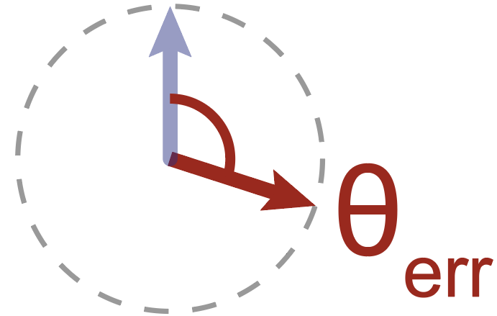


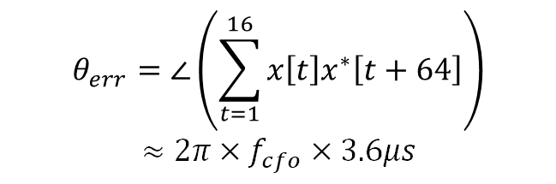
2-steps CFO Calibration
Average CFO calibration
Fluctuating CFO calibration
Q
REF3
OFDM symbol
CFO
CP
REF2
16 samples
16 samples
CFO
θ3
REF1
θ2
θ1
Relationship between $θ_{err}$ and CFO:
$$θ_{err}=∠\left(\sum_{t=1}^{16}{x\left[t\right]x^{∗}\left[t+64\right]}\right)$$
$≈2π×f_{cfo}×3.6μs$
I
$θ_{i}≈2π×f_{cfo}×i×T+θ_{0}$
Use the linear fitting method to estimate the average CFO.
Use the cyclic prefix (CP) to estimate the fluctuating CFO symbol by symbol.
Notes:
We first focus on the CFO problem. Since CFO typically fluctuates around an average value, we propose a two-step CFO calibration method.
[Click] First, we remove the average CFO by leveraging the fixed reference symbols. The CFO introduces time-varying phase to the fixed symbols, [Click] and we can estimate the average CFO using a linear fitting method.
[Click] Then, we eliminate fluctuating CFO by leveraging the cyclic prefix. Since the CP duplicates the last 16 samples of each OFDM symbol, [Click] we can extract the phase difference between these samples, and correct the CFO symbol-by-symbol.

Slide 23
Problems
Carrier frequency offset
Deep fading
Tx: 2.45GHz
Tag
CFO
Rx: 2.45GHz+100kHz
Phase Error!
Carrier frequency offset introduces phase error.
Deep fading severely weaken the backscattered signals.
Notes:
After CFO calibration, the receiver can extract the tuning triangle from each pilot subcarrier to recover the tag’s analog voltage.
However, deep fading may severely weaken some pilot subcarriers, leading to failure in audio recovery.

Slide 24
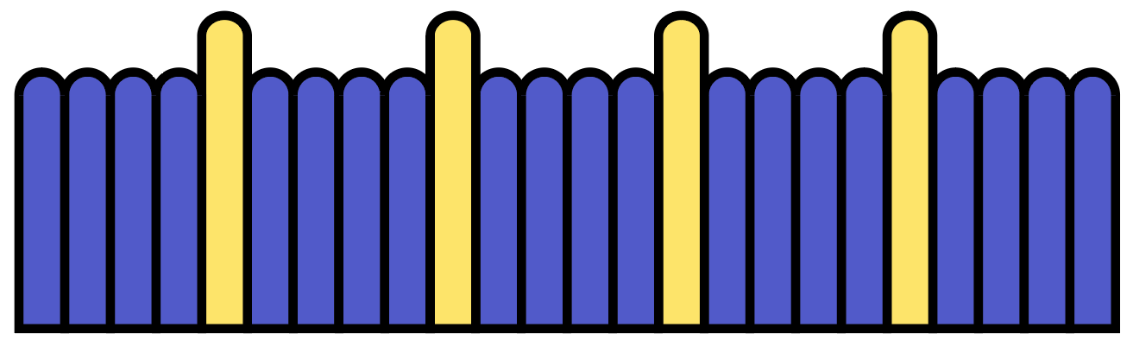
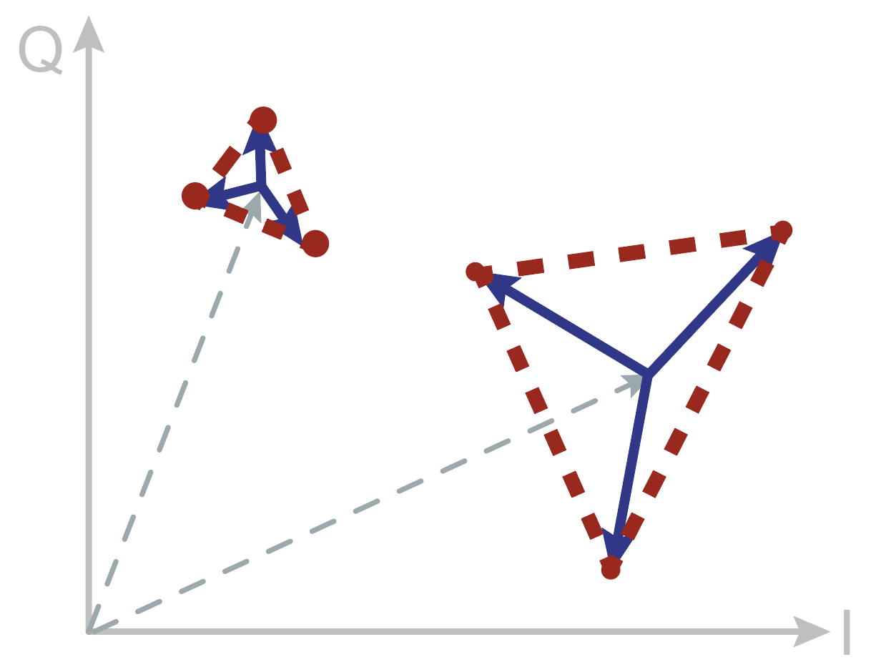


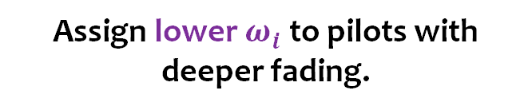

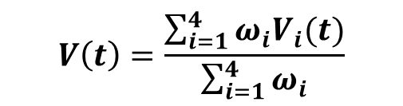


Fading-adaptive Audio Recovery
How to determine $ω_{i}$ ?
Extract audio
Severe fading
$$V_{1}(t)$$
$$V_{2}(t)$$
$$V_{3}(t)$$
$$V_{4}(t)$$
$$V\left(t\right)=\frac{\sum_{i=1}^{4}{ω_{i}V_{i}(t)}}{\sum_{i=1}^{4}{ω_{i}}}$$
Weak fading
Assign lower $ω_{i}$ to pilots with deeper fading.
Severe fading leads to smaller tuning triangles.
Notes:
To prevent this, we consider to extract audio signals from all pilot subcarriers and apply weighted averaging.
We assign lower wito pilots with deeper fading.
[Click] But how do we assign these weights? We observe that deep fading reduces signal amplitude, which makes the tuning triangle smaller.

Slide 25




Fading-adaptive Audio Recovery
How to determine $ω_{i}$ ?
Extract audio
$$V_{1}(t)$$
$$V_{2}(t)$$
$$V_{3}(t)$$
$$V_{4}(t)$$
$$D_{i1}$$
Extracted tuning triangle
Centric point
$$D_{i3}$$
$$V\left(t\right)=\frac{\sum_{i=1}^{4}{ω_{i}V_{i}(t)}}{\sum_{i=1}^{4}{ω_{i}}}$$
$$D_{i2}$$
Weight assignment:
Assign lower $ω_{i}$ to pilots with deeper fading.
$$ω_{i}=D_{i1}+D_{i2}+D_{i3}$$
The fading-adaptive audio recovery improves robustness against deep fading.
Notes:
We calculate the sum of distances from the triangle's centroid to its three endpoints. This value reflects the triangle’s size and is used as the weight.
[Click] This method improves audio recovery’s robustness against deep fading.

Slide 26
Implementation & Evaluation
Notes:
Then, I will introduce the implementation and evaluation result.

Slide 27
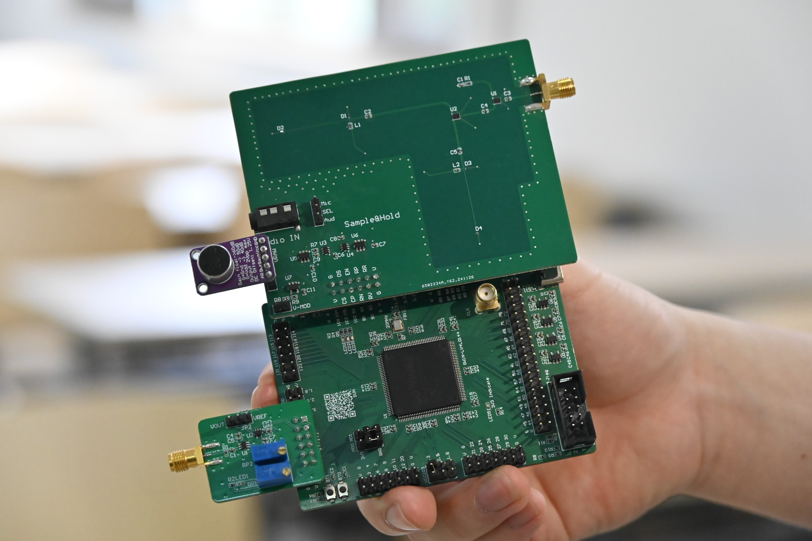
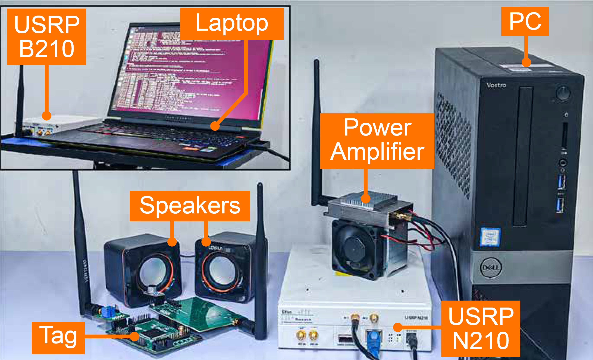
Implementation
Satori Tag Prototype
The prototype is implemented on a 4-layer printed circuit board (PCB) with commercial components.
2 simple RF switches and 4 varactors for in-band analog modulation consume uW-level power.
The transceivers are implemented with USRP B210/N210 SDR.
The transmitter sends 802.11n signals generated by MATLAB Wireless Waveform Generator.
Notes:
We implemented a prototype on a PCB.
For the in-band analog modulation part, we only used two simple RF switches and four varactors, keeping the power consumption in several microwatts.
And we used the USRPs as the transceivers. And the transmitter sends WiFi signals generated by MATLAB Wireless Wave

Slide 28
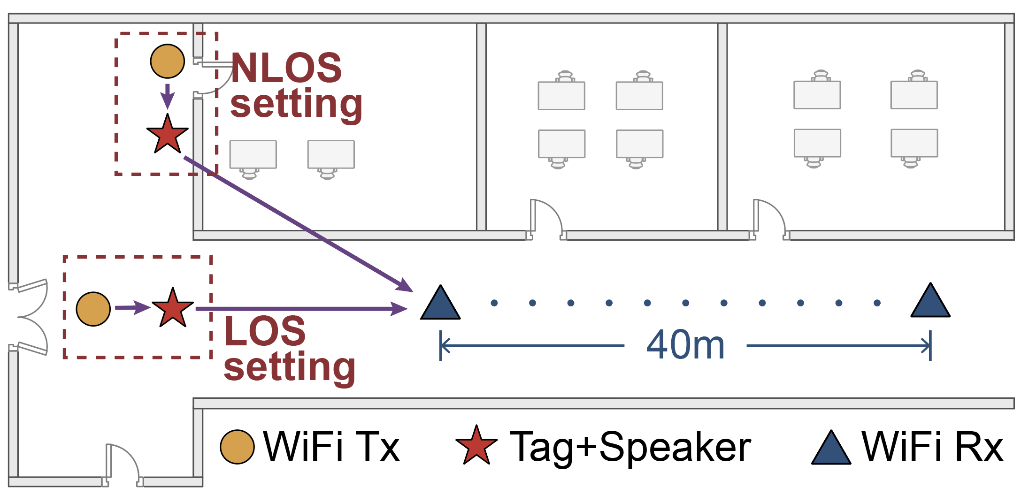
Evaluation Setup
Transceiver
Implemented with USRP
Transmission power: 20 dBm
Antenna: 6 dBi gain
Signal: IEEE 802.11n packets
Tag
Antenna: 6 dBi gain
Tx-to-Tag distance: 0.5m (default)
Varying Tag-to-Rx distance.
Floorplan of the experiment environment.
Audio
Key Metric: SNR of the received audio
Two speakers generate audio signals
Audio frequency: 200~3600 Hz
Audio data rate: 320 kbps
Notes:
We used the following evaluation setup. The Tx transmits WiFi packets at 20 dBm. The tag was placed at a default distance of 0.5 m from the Tx. The Tx, Rx, and tag were all equipped with 6 dBi antennas.
Two speakers adjacent to the tag generated audio signals ranging from 200 to 3600 Hz.
To evaluate the audio transmission quality, we recorded the tag microphone output at 320 kbps as the original audio signal, and we measure the SNR of the recovered audio signal relative to the original signal.

Slide 29
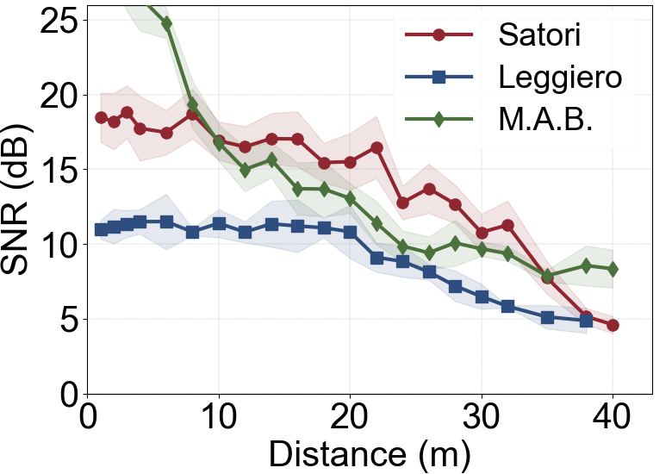
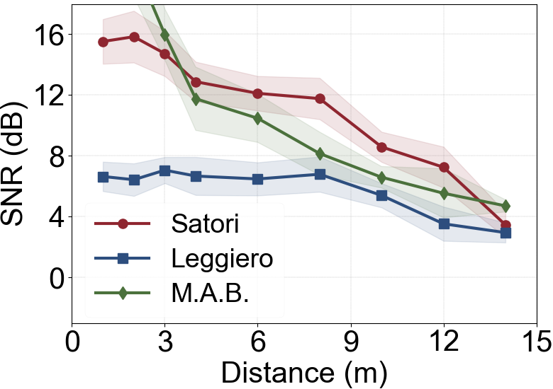
Evaluation: SNR
SNR in LOS scenarios
SNR in NLOS scenarios
Satori supports transmission range of 35 m and achieves an SNR exceeding 18 dB.
[Leggiero]: Xin Na, Xiuzhen Guo, Zihao Yu, Jia Zhang, Yuan He, and Yunhao Liu. Leggiero: Analog WiFi Backscatter with Payload Transparency. ACM Mobisys 2023.
[M.A.B.]: Jia Zhao, Wei Gong, and Jiangchuan Liu. 2021. Microphone array backscatter: An application-driven design for lightweight spatial sound recording over the air. ACM MobiCom 2021
Notes:
In indoor environments, we evaluated the audio SNR transmitted by Satori at varying Tag-to-Rx distances, in both line-of-sight and none-line of sight scenarios.
The result shows that Satori supports transmission range of 35 m and achieves an SNR exceeding 18 dB.

Slide 30
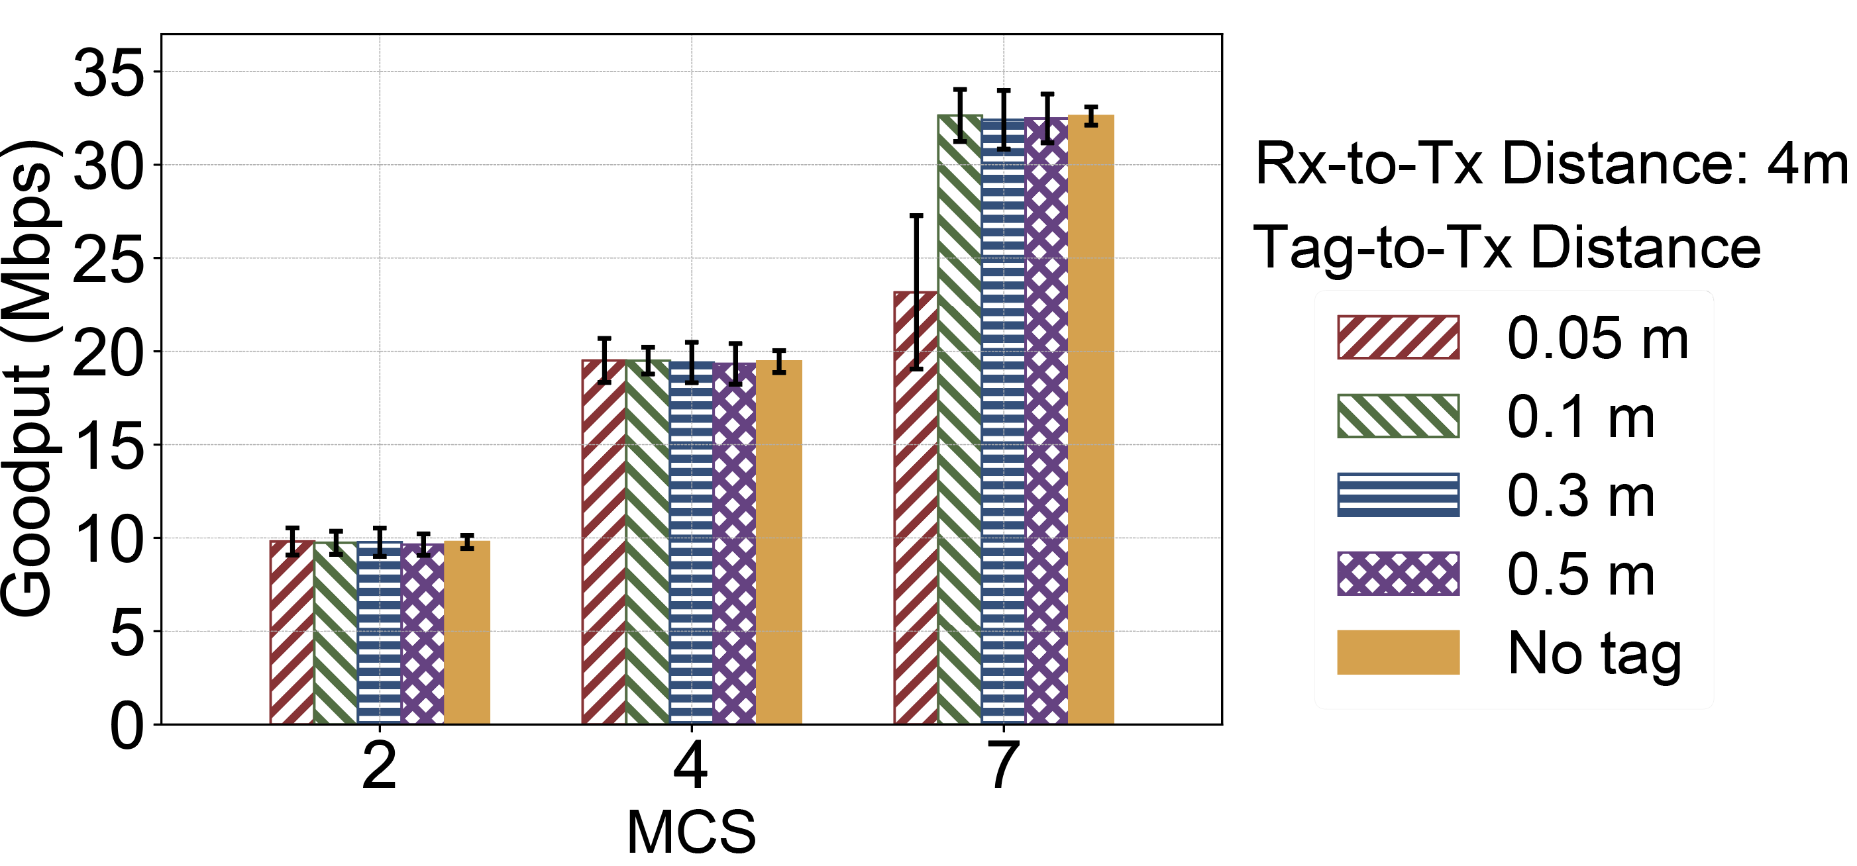
Evaluation: Impact on WiFi Traffic
Goodput fluctuation is less than 1% when Tag-to-Tx > 0.1m.
Goodput decreases only when the tag is very close to Tx and MCS is high.
Satori does not significantly impact WiFi traffic across most distance and MCS settings.
Notes:
We also evaluated how Satori’s in-band transmission affects WiFi traffic.
Because the backscattered signal is much weaker than the original signal, Satori does not significantly impact WiFi traffic in most scenarios.
Notable goodput degradation occurs only when the tag is positioned very close to the Tx.
However, such extreme conditions are rare in real deployments. Therefore, Satori doesn’t significantly impact WiFi traffic.

Slide 31
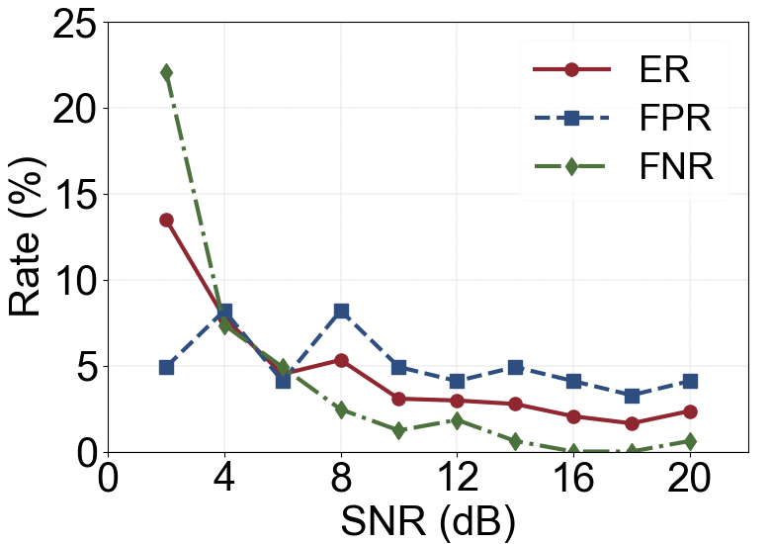
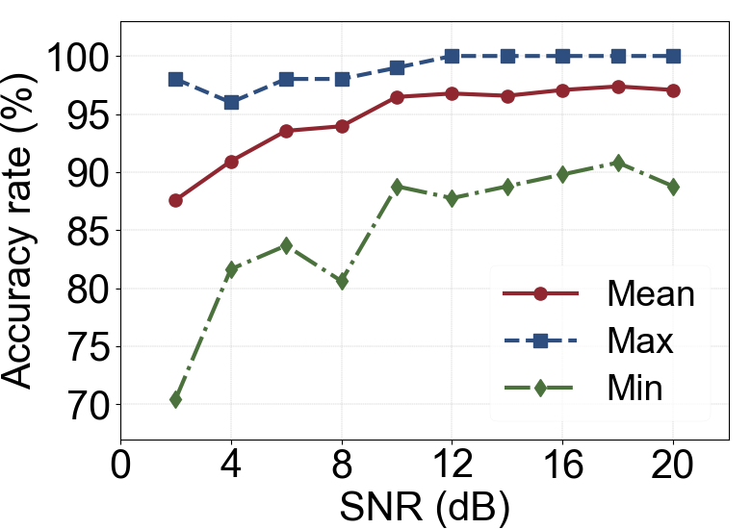
Proof-of-concept Application
Machine Failure Detection
Speech Command Recognition
The audio transmitted by Satori can be accurately recognized.
Satori effectively supports downstream audio sensing tasks.
Datasets:
[Machine Failure Detection]: Purohit Harsh, Tanabe Ryo, Ichige Kenji, Endo Takashi, Nikaido Yuki, Suefusa Kaori, and Kawaguchi Yohei. MIMII Dataset: Sound Dataset for Malfunctioning Industrial Machine Investigation and Inspection. DCASE 2019.
[Speech Command Recognition]: Pete Warden. Speech commands: A dataset for limited-vocabulary speech recognition. arXiv preprint 2018.
Notes:
We implemented several proof-of-concept applications.
We transmitted mechanical sounds and human speech, then performed machine failure detection and speech recognition on the received audio.
The results shows that received audio can be accurately recognized.
For example, at an SNR of 6 dB, machine failure detection achieves 95 percent accuracy, indicating that abnormal mechanical noises can be identified at a distance of 35 meters.
Thus, Satori effectively supports the audio sensing tasks.

Slide 32





Conclusion
We propose Satori, an in-band analog backscatter that enables ultra-low-power audio transmission.
Satori transmits audio at a 41.67 kHz embedding rate, achieve an SNR exceeding 18 dB , and supports transmission distances more than 35 m.
Satori follows the paradigm of RF computing, offering a direct manipulation from analog audio to the phase of RF signals.
Yang Zou
Xin Na
Yimiao Sun
Yande Chen
Yuan He
Please find more details in:
http://tns.thss.tsinghua.edu.cn/sun/
https://ling-yanghui.github.io/
Notes:
We propose Satori, an in-band analog backscatter that enables ultra-low-power audio transmission.
Satori transmits audio at about 42kHz sampling rate, achieve an SNR exceeding 18 dB , and supports transmission distances more than 35 m.
Satori follows the paradigm of RF computing, offering a direct manipulation from analog audio to the phase of RF signals.
This enables efficient, low-power audio transmission and opens new possibilities for IoT audio-sensing applications.

Slide 33
Embedding Rate
REF
PM1
PM2
REF
PM1
WiFi symbol
Switch toggle
4 us
WiFi symbol duration
24 us
Embedding period
Satori takes 6 WiFi symbols to embed one audio signal sample.
It achieves a sampling rate of 41.67 kHz, sufficient for audio signal of 20Hz~20kHz.
Notes:
Let’s focus on the tag’s embedding rate.
Satori uses three out of six WiFi symbols to embed one audio sample. Given that each WiFi symbol lasts 4 microseconds, its embedding period is 24 microseconds.
This corresponds to a sampling rate of 41.67 kHz, which is sufficient to transmit audible audio signals in the 20 hertz–20 kilohertz range.

Slide 34
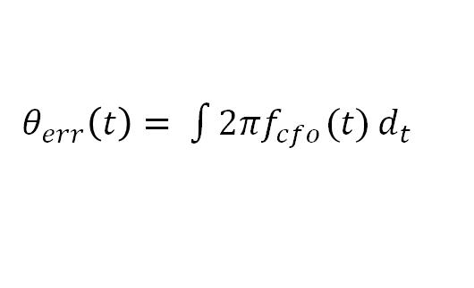
CFO Problems
Carrier frequency offset (CFO) introduces phase error:
$θ_{err}\left(t\right)= \int{2πf_{cfo}(t)}d_{t}$
Q
Original triangle
Extracted triangle
CFO
Triangle deformation!
Audio error
I
Estimated channel
The phase error caused by the CFO causes the deformation of the extracted tuning triangles, leading to audio recovery failure.

Slide 35
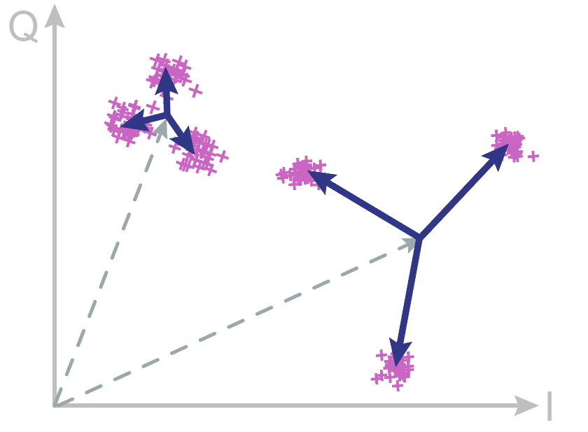

Deep Fading
Estimated channel on two pilot subcarriers
Tx
Severe fading
Fading
channel
Tag
Weak fading
Rx
The channel fading significantly weakens some pilot subcarriers, making the tuning triangle severely affected by the noise.
Notes:
Specifically, channel fading can significantly weaken some pilot subcarriers of the backscattered WiFi signal. This makes the tuning triangle highly susceptible to noise interference.

